Slide 1

SDM COLLEGE OF ENGINEERING AND TECHNOLOGY, DHARWAD
DEPARTMENT OF INFORMATION SCIENCE AND ENGINEERING
PNEUMONIA DETECTION USING DEEP LEARNING
FOR THE ACADEMIC YEAR 2019-2020
PRESENTED BY:
NAGENDRA T. P. – 2SD16IS029
CHINMAY.R.DIXIT – 2SD17IS404
PRASHANTH.R.R – 2SD16IS038
AMRUTH .M. – 2SD16IS003
UNDER THE GUIDANCE OF:
Dr. VANDANA S. BHAT

Slide 2
Content:
Introduction
Literature Survey
Abstract
Problem Definition
About Project
Objectives
Features
Tools and Technologies
Software Requirements Specifications
Screenshots/Algorithms
Conclusion
Future Scope
References

Slide 3
Introduction
The World Health Organization estimates that more than 160 million children around the world develop pneumonia each year, 20 million of whom are hospitalized and 2 million of whom die.
This is a personalized medical diagnosis that uses deep learning and machine learning to help doctors and patients. The diseases that we will be detecting are Bacterial Pneumonia and Viral Pneumonia.
[Source: http://www.pkids.org/diseases/pneumonia.html]

Slide 4
Literature survey
Authors | Title | DOP | Remarks
Kartik Thakral , Rahul Nijhawan, Ankush Mittal | Pneumonia Detection Using CNN based Feature Extraction | 02 DEC 2018 | The Paper Presents study on image processing techniques used to identify and classify the Pneumonia diseased
Bhaiyya.D.Ghanmode , P.L.Paikrao | MobileNet Architecture | 15 FEB 2019 | The Paper Presents the study on Importance of MobileNet Architecture
Yachika Gupta ; Prateek Kumar | Neural Network for Medical Image Processing | 25 MAR 2019 | This Paper Presents the study of Neural Network for Medical Image Processing

Slide 5
Abstract
A chest x-ray exam will allow your doctor to see your lungs, heart and blood vessels to help determine if you have pneumonia.
When interpreting the x-ray, the radiologist will look for white spots in the lungs (called infiltrates) that identify an infection.
  RadiologyInfo Web site at http://www.radiologyinfo.org by Radiological Society of North America (RSNA)

Slide 6
Problem statement
In developed countries, access to antibiotics and vaccines has mostly controlled incidents of pneumonia. However, in developing countries, pneumonia takes the lives of more children than any other single cause each year, including any other single disease, war, or famine.
There are so many medical facilities in the US and EU. Therefore, we target India by finding out the resolutions here. We laser focus on one kind of medical image, i.e., the lung images to detect Pneumonia.

Slide 7
About Project
Over the recent years, Computer Aided Algorithms have become the major research domain in machine learning.
The ML algorithms have already been proved to facilitate the medical area primarily in detection of breast cancer, mammograms, lung nodules.

Slide 8
Existing System
Doctors and Radiologists spend years studying how to classify the images and we try to automate that. There is a shortage of Doctors and Radiologists out there in the rural areas. They are also expensive.
Thus, we are coming up with this Novel solution that is able to solve the above problems.

Slide 9
Proposed System
This is a personalized medical diagnosis that uses deep learning and machine learning to help doctors and patients.
This project aims to the development of algorithm that is capable of detecting Pneumonia from chest radiographs to aid in delivery of health care services to areas where access to expert radiologists is still limited.

Slide 10
Objective
The main objectives of this project are :
To detect at a very low cost
To give accurate results
To save time
To give no chance of human error since it is an automated system

Slide 11
Features
Simple , interactive and user-friendly GUI for the end users
Faster processing of the images
Gives more accurate results (98%)
Economical

Slide 12
TYPES OF PNEUMONIA INFECTIONS
Bacterial
Fungal
Viral
A cough that brings up mucus Fever Fever
Fast breathing Cough Chills
Fatigue Dry cough

Slide 13
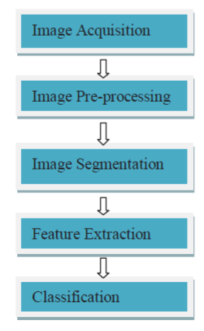
Steps for disease identification:

Slide 14
Tools And Technology
  Software Requirements
Platform : VS Code , Spyder
Libraries : Pandas, numpy , tensorflow, keras
matplotlib.
.
Data : X-ray Scanned Image
OS : Windows
  Hardware Requirements
System : Computer or laptop with a minimum of 8 GB RAM
Input Device : Mouse, Keyboard
Output Device : Monitor

Slide 15
Software Requirement Specification
  Functional Requirements
Input :
1)Pneumonia effected X-ray Image
        2) Normal Chest X-ray
Behaviour : Uses the trained model to produce output.
Output : Displays whether the person has Pneumonia or not on GUI.

Slide 16
  Non-Functional Requirements
Performance : More reliable and accurate since there is no scope for human errors
Data Integrity : Data is stored accurately
Accessibility : Easily accessible system
Reliability : More reliable proposed system

Slide 17
STRUCTURED DESIGN
Input Image
Noise Removal by Gaussian Filter
Pre-processing : Smoothing filter, RGB to gray color conversion
Feature Extraction
Prediction
Image Classification

Slide 18
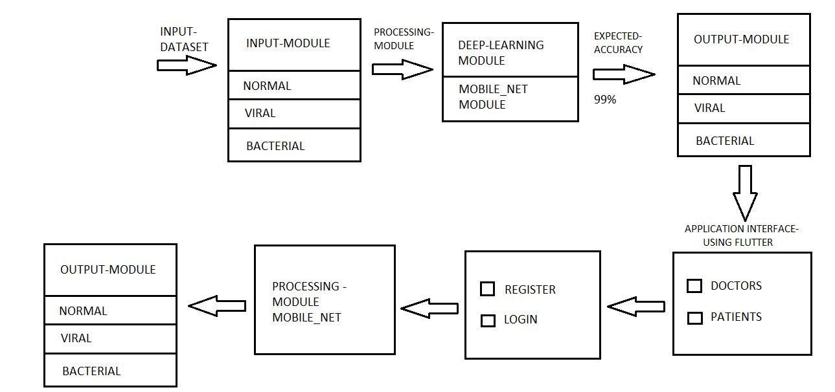
Architecture Of Proposed System for Pneumonia Detection

Slide 19
Algorithms Used
Convolutional Neural Network :-
    In deep learning, a convolutional neural network (CNN, or ConvNet) is a class of deep neural networks, most commonly applied to analyzing visual imagery. Convolutional networks were inspired by biological processes in that the connectivity pattern between neurons resembles the organization of the animal visual cortex.
    A convolutional neural network consists of an input and an output layer, as well as multiple hidden layers. The hidden layers of a CNN typically consist of a series of convolutional layers that convolve with a multiplication or other dot product.

Slide 20
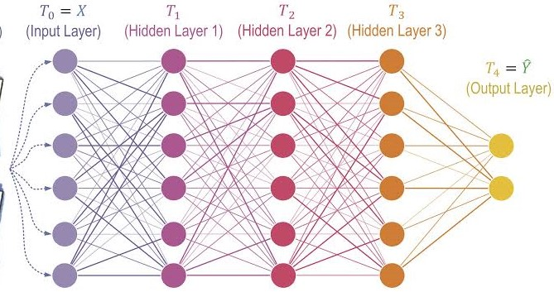
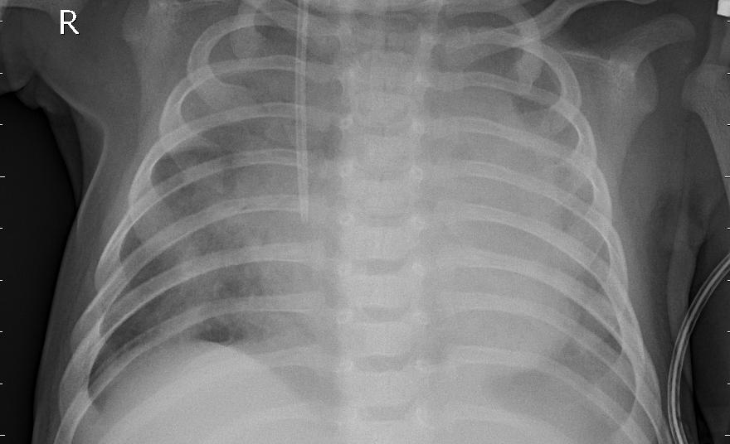
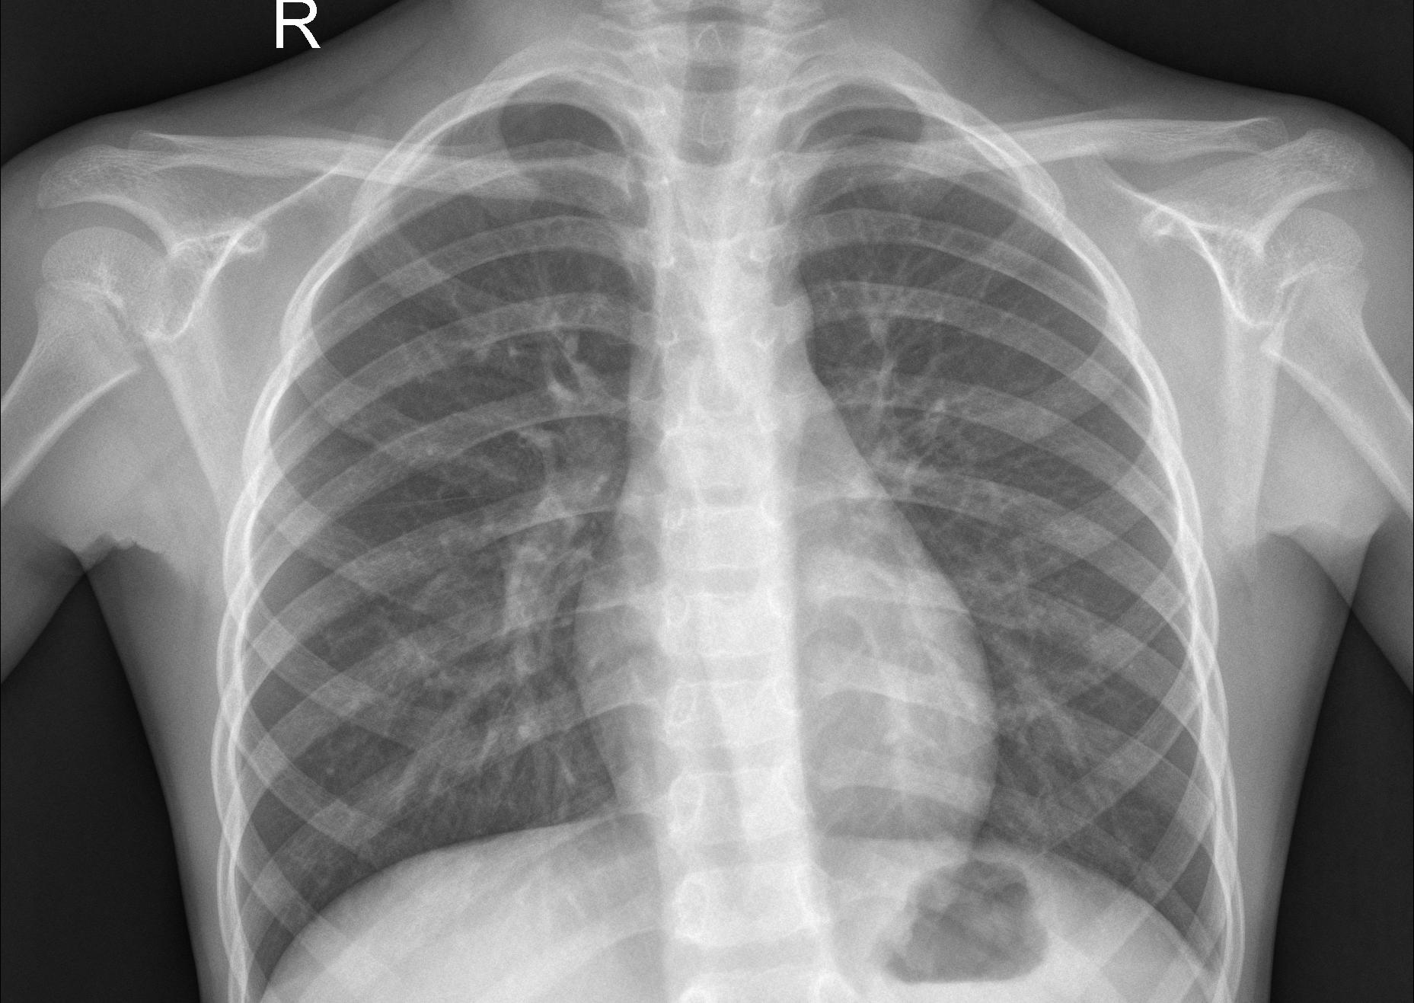
Deep Neural Network
Y
(Label)
X
(Image)
Normal
Pneumonia
affected
A feedforward deep neural network
Source: Estimating Information Flow in Deep Neural Networks

Slide 21
Neural Network Models for Medical Image Processing
MobileNet – 24
GoogleNet
VGG 16
UNet
AlexNet
Classification
Stage
1024 * 1024
224 * 224
Feature Extraction Stage
Pre-Processing Stage

Slide 22
Results
Model | ImageNet Accuracy | Million Parameters
MobileNet-24 | 70.6% | 4.2
GoogleNet | 69.8% | 6.8
VGG 16 | 71.5% | 138
SqueezeNet | 57.5% | 1.25
AlexNet | 57.2% | 60
Source: MobileNets: Efficient Convolutional Neural Networks for Mobile Vision Applications

Slide 23
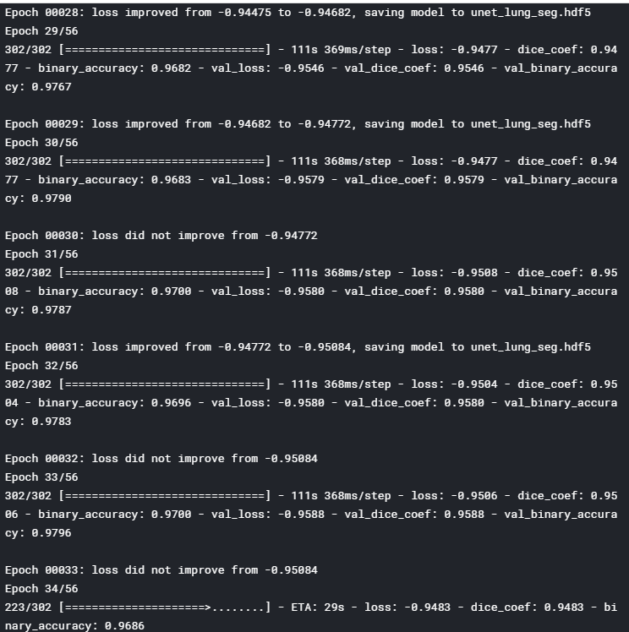
Pneumonia Detection Accuracy

Slide 24
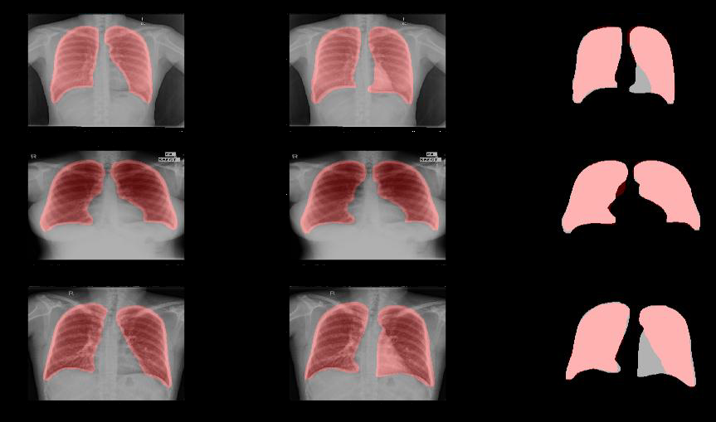
Sample X-ray Image Modeling

Slide 25
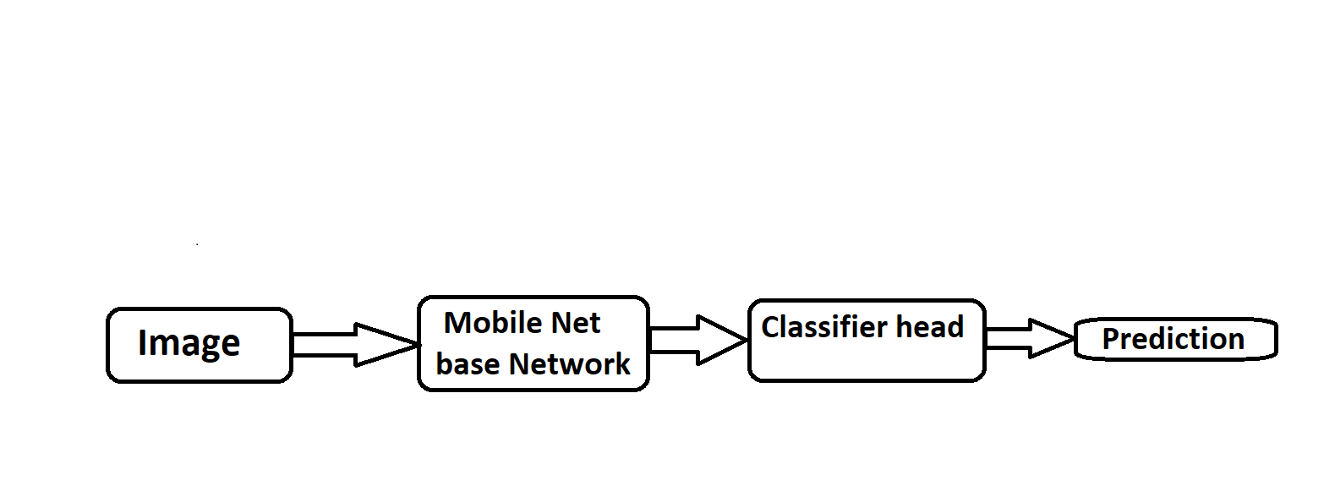
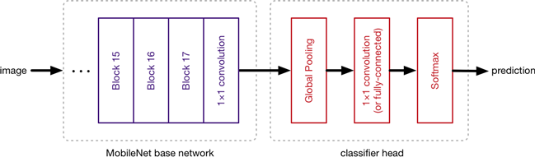
Structured Design
BLOCK DIAGRAM
  Image Classification with MobileNet

Slide 26
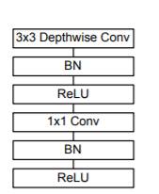
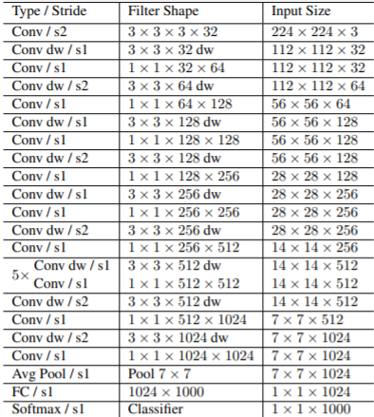
MobileNet Architecture
Depthwise Separable convolutions with
Depthwise and Pointwise layers followed by
BatchNorm and ReLU.
For MobileNets the Depthwise convolution applies a single filter to each input channel. The Pointwise convolution then applies a 1×1 convolution to combine the outputs of the Depthwise convolution (a separate layer for filtering and a separate layer for combining). This factorization has the effect of drastically reducing computation and model size.
MobileNet Body Architecture
Source: MobileNets: Efficient Convolutional Neural Networks for Mobile Vision Applications

Slide 27
SUMMARY
Our study facilitates the early diagnosis of Pneumonia to prevent adverse consequences (including death).
We have proposed a model architecture for detecting Pneumonia from frontal chest X-ray images with the utilization of Densenet as feature-extractors and soft max as classifier. We observed the performance of various pre-trained CNN models along with distinct classifiers and then on the basis of statistical results selected MobileNet-224 for the feature extraction stage.

Slide 28
Future Scope
Deployment of the model on cloud so that anyone can use it.
Using chest X-ray to detect the covid-19.
It can be further expanded to detect 14 diseases from chest x-ray
Working on CT scans

Slide 29
References
Context: https://www.kaggle.com/paultimothymooney/chest-xray-pneumonia
Citation: http://www.cell.com/cell/fulltext/S0092-8674(18)30154-5
Data: https://data.mendeley.com/datasets/rscbjbr9sj/2
License: CC BY 4.0
“RadiologyInfo Web site at http://www.radiologyinfo.org by Radiological Society of North America (RSNA)”
“Diagnosis of Pneumonia from Chest X-Ray Images Using Deep Learning”
“MobileNets: Efficient Convolutional Neural Networks for Mobile Vision Applications”

Slide 30
THANK YOU

