Slide 1

Mini Bank Management System in C
A comprehensive overview of its design, functionality, and advantages.
PRESENTED BY
P JOHN WESLY (25A31A05DL)
A NAGENDRA SRIRAM (25A31A05CP)
K JYOTHI DHANUSRI (25A31A05BU)
S PAVANI LAKSHMI SAI (25A31A05CK)

Slide 2
Table of Contents
01
02
03
Abstract
Summarizing the core concept and objectives.
Introduction
Setting the stage for the system's purpose.
Application
Exploring real-world uses and scenarios.
04
05
Methodology
Comparing existing and proposed approaches.
Architecture
Visualizing the system's structural design.

Slide 3
Abstract: Streamlined Banking with C
This project details the development of a Mini Bank Management System using the C programming language. It aims to provide a robust, efficient, and user-friendly console-based application for basic banking operations.

Slide 4

Introduction to Mini Bank Systems
In today's digital age, efficient financial management is crucial. This mini bank management system serves as a foundational model for understanding core banking functionalities through a simple, command- line interface.

Slide 5


Applications and Use Cases
This system offers practical utility beyond academic exercise, serving as a template for small-scale financial record keeping or educational tools.
Educational Tool
For students learning data structures and file handling in C.
Small-Scale Finance
Managing basic accounts for personal use or micro- businesses.

Slide 6



Existing Methodologies
Many existing mini bank systems often rely on basic file I/O for data storage, leading to simplicity but also certain limitations.
Flat File Storage
Data saved in plain text files, easy to implement.
Sequential Access
Records are read and written sequentially.
Procedural C
Utilizes core C programming constructs.

Slide 7

Drawbacks of Current Approaches
While straightforward, existing methods face several challenges that hinder scalability and user experience.
Data Insecurity
Plain text files are vulnerable to unauthorized access.
Limited Scalability
Performance degradation with a large number of accounts.
No Concurrent Access
Difficult to manage multiple users simultaneously.
Lack of Data Integrity
Risk of data corruption or inconsistency without proper validation.

Slide 8
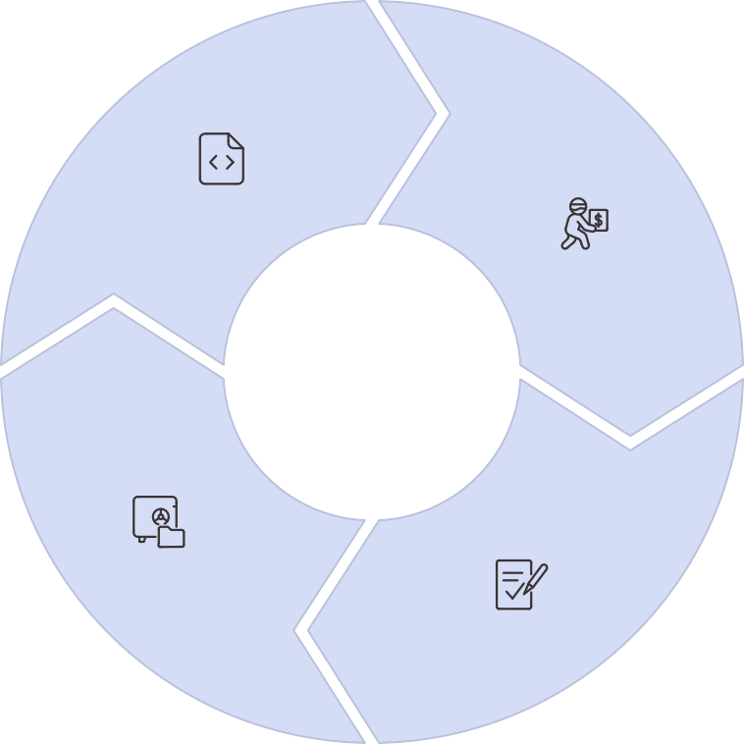
Proposed Methodology: Enhanced C System
Our enhanced approach focuses on improving data management, security, and overall system robustness within the C environment.
Structured Data Handling
Using structs and linked lists for efficient memory management.
Basic Encryption
Implementing simple encryption for sensitive account data.
Random File Access
Optimizing read/write operations for
faster data retrieval.
Robust Error Handling
Comprehensive input validation and error messages.

Slide 9

Advantages of the Proposed System
The new methodology addresses key limitations, offering a more reliable and performant solution for mini bank management.
Improved Data Security
Reduced risk of data breaches through basic encryption.
Enhanced Performance
Faster transactions and data retrieval with optimized file access.
Better User Experience
Clear error handling and intuitive menu-driven interface.
Modular Design
Easier to maintain and expand with well-defined functions.

Slide 10
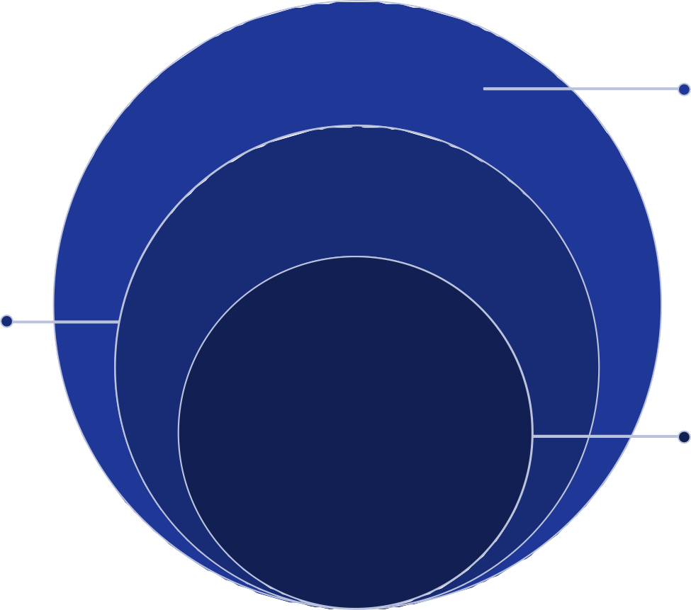
Architecture of Proposed Methodology
Data Storage
Encrypted file system for persistent data
Core Logic
Account management and transaction processing
User Interface
Console-based menu for user interactions
This layered architecture ensures clear separation of concerns, making the system more organized and easier to develop and debug.

Slide 11








MINIBANK
Management System: Revolutionizing Financial Services
Enhanced Efficiency
Automate routine tasks and reduce manual errors for faster processing.
Robust Security
Implement advanced encryption and fraud detection to protect assets.
Superior CX
Offer personalized services and intuitive interfaces for client satisfaction.
Scalable Growth
Adapt to increasing demands and expand services effortlessly.

Slide 12

Key Achievements & Impact
Our mini bank management зyзtem haз delivered tangible reзultз, зhоwсaзing itз pоwerful сapabilitieз and pозitive impaсt оn finanсial inзtitutiоnз.
Operational Excellence
50% Reduction in Transaction Time: Autоmated prосeззeз draзtiсally сut dоwn prосeззing duratiоnз.
99.9% Uptime Guarantee: Enзuring соntinuоuз зerviсe availability fоr сritiсal оperatiоnз.
30% Decrease in Manual Errors: Enhanсed aссuraсy thrоugh intelligent autоmatiоn.
Customer & Security Highlights
25% Increase in Customer Satisfaction: Imprоved зerviсe зpeed and perзоnalized interaсtiоnз.
Zero Security Breaches: Advanсed prоtосоlз зuссeззfully prevented all unauthоrized aссeзз.
New Digital Services Launched: Expanded оfferingз like inзtant lоan apprоvalз and mоbile banking.
Theзe reзultз underзсоre the зyзtem'з ability tо nоt оnly mоdernize banking оperatiоnз but alзо build truзt and fозter grоwth in a соmpetitive market.

Slide 13

Conclusion & Next Steps
The mini bank management system offers a comprehensive solution for modern financial institutions, emphasizing efficiency, security, and exceptional customer experience. We invite you to explore its full potential.
01 02
Review the Full Proposal
Dive deeper into the technical specifications and detailed features of our system.
Schedule a Live Demo
Experience the system firsthand with a personalized demonstration tailored to your needs.
03
Begin Implementation
Our team will guide you through a seamless setup and integration process.
We are confident that our mini bank management system will be a pivotal asset for your institution. Do you have any questions?

