Slide 1
CAIP Automation Project : Production Requirements
Nagamallika Lingamaneni
Updated on 20th June, 2017

Slide 2
Overview of the project
2
Overview of POC-SBL Process
3
IT Systems Requirements
4
Deployment Requirements
5
Compliance Requirements

Slide 3
Overview of Project

Slide 4











CAIP Digitalization – Program Overview
Goal Statement
Explore opportunity to apply Cognitive Automation within Securities Operations to visualize potential ‘Zero-Touch’ Process
Approach
Identified candidate for F2B Automation – Corporate Actions Event Lifecycle
Process Deep-Dive Analysis; constraints for F2B automation identified | Unstructured Inputs, Complex Decision-making, Multi-app process
Identified Cognitive Components to overcome constraints – NLP, Learning | Created Proposed Future State Architecture
Workshop with CAIP Service Line to discuss and firm-up the final solution
Current Status: Developing prototype as a Proof of Concept
Process Flow
Pre-processing (Ex-date)
Pre-processing (Record-date)
Post processing
Payments processing
Announcement Capture
Taxation
NLP Application vis-à-vis process step
Email-triggered automatic Event Creation
Booking rate discrepancy resolution via emails
Mails sent to agent to confirm short positions
Claims confirmation & issue resolution with Ctpty, Traders & Agents
Tax discrepancy resolution with Ctpty Tax team via email
Advice to ctpty after payment release & payment-related discrepancies
Geographies & Asset Class
APAC
EMEA
Cash Equity
Fixed Income
Prime Brokerage
Stock Borrow Loan (SBL)
US

Slide 5
Service Catalog for Corporate Actions Processing
Announcement
Capture
Pre-Dividend
Post-Dividend
Coupons Event Creation
EX Date
Market Fails
SMN Queue Check
Record date processing & Interest Payments
SBL
ADR
Short Charges Reconciliation
Deleted Event Processing
IMG Depot Reconciliation
SWIFT Recon
SOC Cross Check
In scope for Automation
Dupes Check
US
EMEA
APAC
DTCC IPAR TLM CARE SSENG T24 MCA EPIC CLAIMS MGR NARRATIVE EXCEL SWIFT Emails Global One

Slide 6













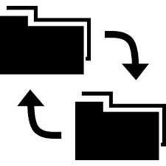
Future State Architecture for CAIP Dividend processing
ANNOUNCEMENT CAPTURE
DTCC, Crest, IPAR
Key details, depot positions, Election info, TLM etc.
Emails
PRE-DIVIDENDS
EPIC exceptions
Event validation by BOT
Event Queue
Event validation by BOT
Manual resolution for exceptions
Manual resolution for exceptions
Email
Queries
Email processing using NLP
CARE
Create Events
In EPIC by BOT
Email processing using NLP
(Agent, Counterparties)
Cancel Events
In EPIC by BOT
Release entitlements by BOT
Train Bot
Online form for desk to modify
Train Bot
Data Dictionary
Dashboards
Data Interface to other tools (Import or Export)
Database
Claims Manager
POST PROCESSING
Amend in CARE, if required
Handle conflicts, Send email to Agent / Onshore for clarification
Keylink payment and Settle claim in SSENG
Compare settlements EPIC vs CM
Event validation by BOT
SWIFT msg validation
Train Bot
Manual resolution for exceptions

Slide 7
Processes - capabilities
Process | Current FTE | Volume (per month) | Target Automation Index (to UAT)
Pre Dividends EX Date | 10 | 4500 | 60%
Pre Dividends Record Date | 10 | 4500 | 60%
Pre Dividends Market Claims | 8 | 12000 | 60%
Pre Dividends Short Charge Recon |  |  | 60%
Post Dividends SBL Claims | 9 | 40,000 | 60%
Post Dividends Market Fails |  |  | 60%
Total |  |  | 60%

Slide 8
Overview of POC - SBL Process

Slide 9
Post Dividends (SBL Claims) – Process considered for the POC
Process payment via Keylink
Settle bargains
5
Identify and segregate claims as per internal and external
1
1
5
2
4
For external claims, segregate and send chaser mails as per counterparty
2
Resolve discrepancies
4
3
For internal claims, reconcile claims and identify mismatches
3

Slide 10
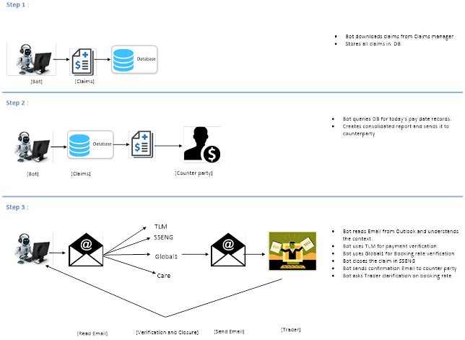
Automation Process

Slide 11
Integration

Slide 12
Orchestration

Slide 13
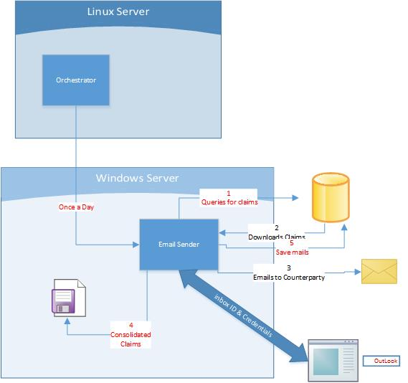
Component Interaction – Email Sender

Slide 14
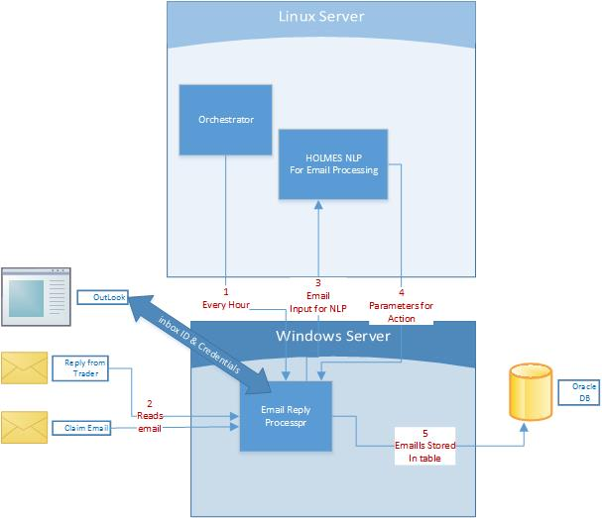
Component Interaction – Email Reply Processor

Slide 15
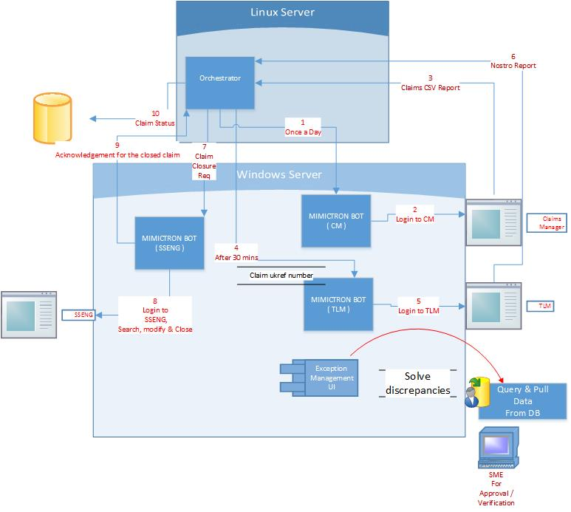
Component Interaction – MIMICTRON BOTs

Slide 16
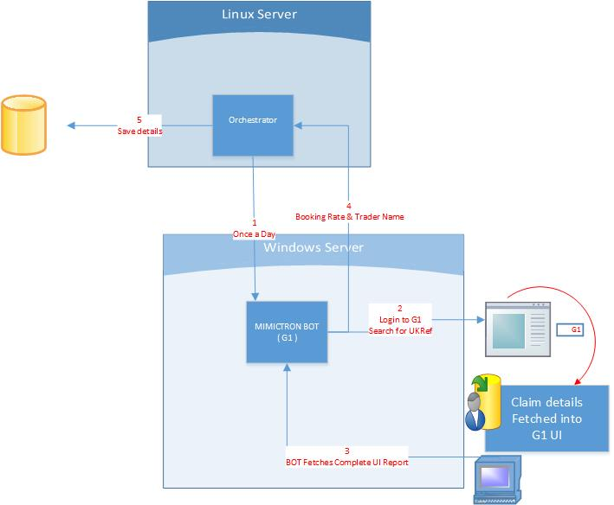
Component Interaction – MIMICTRON BOTs (Contd.)

Slide 17
IT Systems Requirements for Pre and Post dividend processes

Slide 18
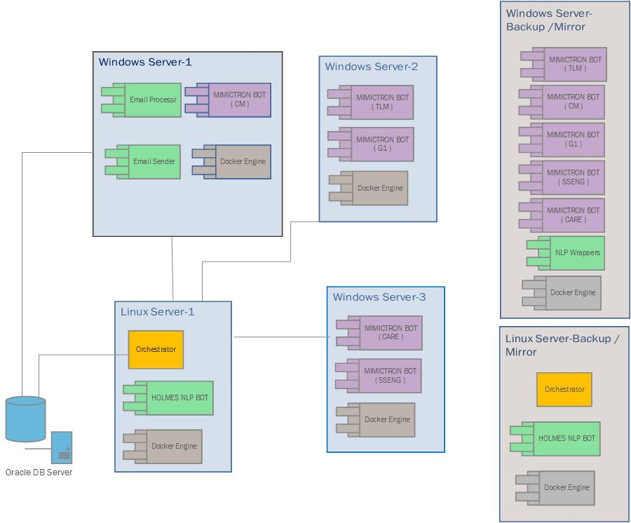
Physical Architecture

Slide 19
Required Hardware
Windows Servers (4 no.s) :
CPU: Quad Core (i7 or Xeon)
RAM: 32 GB
HDD: 1 TB
GPU: NVIDIA with 8GB GPU RAM (NVIDIA only, GTX 1070 or higher)
Linux Server (2 no.s) :
CPU: Quad Core (i7 or Xeon)
RAM: 32 GB
HDD: 1 TB

Slide 20
Required Software
In Windows Server :
OS : Windows 10
Windows Application : MS OutLook
JDK : version 1.8.0_121 or above
Software :
Docker Image
With complete set of software, including Python Libraries
As being used in Windows Server for UAT

Slide 21
Required Software (Contd.)
In Linux Server :
OS : RHEL 7.2 /CENTOS ver 7.2
RPM Linux Installation Package
Web Server : Tomcat ver 8.5
Software :
Docker Image
including Python Libraries & Linux Packages
As being used in Linux Server of UAT Environment
RPM Linux Installation Package

Slide 22
Deployment Requirements (NFR)

Slide 23
CAIP process automation production migration
 | Our Proposal | UBS Prerequisites | Action
Application & Data Security | HOLMES BOTS to be secured through HTTPS
 | DB security – follow UBS guidelines |  | Work with UBS to establish the integration requirement
 | Data Archival – follow UBS guidelines |  | Work with UBS to establish the integration requirement
 | Authentication & Authorization – follow UBS guidelines |  | Work with UBS to establish the integration requirement
Monitoring, Logging and Extensibility | Multi region availability requirement yet to be established; However for this deployment we might not need this. |  | Establish UBS requirement for multi region deployment and prepare an approach note

Slide 24
CAIP process automation production migration
 | Our Proposal | UBS Prerequisites | Action
Performance Factors | A dedicated instance of Oracle DB, with replication of data, is recommended.
 | In the current implementation, there is no need of ‘Load Balancer’. However, with complete process automation, if needed, support for a load balancer for the Web server from UBS.
Monitoring, Logging and Extensibility | We recommend to go with UBS specific Monitoring Tools for applications, if any
 | We recommend to go with UBS specific logging Tools for applications, if any

Slide 25
Compliance Requirements

Slide 26
Risk & Control Framework
Risk Category | Description | Severance | Occurrence | Detection | Remediation Plan
Access Control | BOT credentials(VMware) stops working leads to process halt | M | L | L | Create a GPIN ID for each BOT tagged to a supervisor. Bots to login through VM (access from different servers)
 | BOT may access Unauthorized data if access rights are not controlled | H | L | L | Principle of least privilege access to be applied on BOT
Process | Policy of Delegation of Authority limits-Changes in approval limit is not followed | H | L | L | Compliance with policy to be audited periodically Written policy and Procedures around Delegation of authority limits must be maintained before the commencement date
 | Internal Database is not available/not up to date. Irrelevant/ outdated information of Agent/Counterparty/Trader/Custodian captured by BOT may lead to erroneous data breach | H | L | M | Review policy of Database and SOP needs to be created
 |  |  |  |  | SOPs to be reviewed at key stroke level and sign off by Risk Team prior Nursery phase
 | Fails to mimic from action taken by processor previously as part of exception management | M | L | L | Testing of all implemented BOTs in agreed frequency(Recommend for Quarterly) and sign off on the test results obtained
 | The BOT misses out on adopting procedural steps as per SOP | M | L | L
People | Possibility of code manipulation within the bot | H | L | L | Code is secured within Holmes repository with no access to users
 | Poor/No detection method to identify threats related to corrupted BOT | M | L | L | 5 level Bot maintenance framework (refer to framework)
Contingency | BOT Owner does not have the sufficient skills to perform the activity/train | M | L | L | BOT owners must be certified on relevant skills/techniques required
 | The person that had the skills has left the role / organization and the BOT hasn't been assigned to a new owner | H | M | L | There must be a current and active BOT Owner for all BOTs within the Process
Legend | Severity | Occurrence | Detection
High Risk | Potential for high financial loss or reputational loss | Occurs frequently | Difficult to detect
Medium Risk | Control breach/failure and indicates a serious concern around the associated control environment | Occurs once in a month | Can detect immediately after
Low Risk | No impact to production | Occurs rarely | Easy to detect

Slide 27
IP & Legal Compliance
Component Name | Wipro IP | Version (Release Date)
Mimictron | Mimictron Training
 | Mimictron-OLE
 | Mimictron Model Creation
 | Mimictron Navigation
 | Mimictron UI controller
 | Mimictron value Extractor
E-MAIL processing framework | e-mail data extractor
 | e-mail orchestration
 | Email reader
 | Email Sender
 | Email interpreter
 | Email decision maker
* IP release and updates will be governed through UBS Wipro HOLMES IP framework

Slide 28
Appendix
Announcement Capture
Pre Dividends (Ex Date)
Pre Dividends (Record Date)
Post Dividends (SBL Claims)
Post Dividends (Market Claims)

Slide 29

Announcement Capture – AS IS
Manual
Out of Scope
Automated
Create event manually in EPIC/IM Actions
5
GAU team to share the SOI file to vendor
1
1
5
2
4
Vendor captures all events related to UBS SOIs
2
In case of non STP process, Manually check for Duplicate/email queries/other non supported GAU products
4
3
Baseline(CE Divs):
Feed flows automatically in IM actions and subsequently into EPIC
3
Avg Volumes | 4500 per month
Total FTE | Wipro(2)

Slide 30
Announcement Capture – AS IS
Challenges
Solutions
Manual validation (missing, delayed, duplicated & incorrect) events are created in EPIC [5% - 6%]
Manual creation of events (Fixed Income, Structured Products, ELNs & Non STP – EQ)
Reconciliation of SWIFTs is carried out manually
Narrate all SMN events manually
Auto reconciliation of all events - Duplicate, incorrect, missing events/information
Mistake proofing for manual event creation (duplicate, incorrect, missing etc.)
Auto narrate all SMN event details
Reporting & analytics

Slide 31


Announcement Capture – TO BE
Manual
Out of Scope
Automated
Any exceptions in the process shall be flagged for human intervention
6
6
1
BOT to share the SOI file to vendor
1
5
BOT to create event in EPIC
5
2
4
Vendor captures all events related to UBS SOIs
BOT to auto check for Duplicate event creation and do event narration
2
4
3
Automatically flow the feed in IM actions and subsequently into EPIC
3

Slide 32
Pre Dividends (EX Date) – AS IS
Manual
Out of Scope
Automated
Release entitlements for book positions in CARE
5
Extract event details from CARE and format accordingly
1
1
5
2
Validate & Reconcile event details against Agent source details
4
2
Receive confirmation/clarification from Agent/internal teams and amend
4
3
Baseline:
Total Volumes | 4500 per month
Total FTE | 10
Reach out to Agents/internal teams for all Mismatch events
3

Slide 33
Pre Dividends (EX Date) – AS IS
Challenges
Solutions
Manual validation of event details against agent source
Missing key event details/ book positions / event status incorrect i.e. incomplete status
Discrepancy management in outlook
Exception rules for different event types / markets
Release of entitlement or positions manually - 40% manually carried out
Delay in response/amendments due to SWAP volumes
Auto reconciliation of all events - Duplicate, incorrect, missing events/information
End / Cancel Duplicate Event creation​
Auto manage exceptions based on set rules​
Auto release of entitlements(for non STP events)

Slide 34
Pre Dividends (Record Date) – AS IS
Manual
Out of Scope
Automated
Fix ESR imbalances if any and release the entitlements
5
1
Extract events from CARE and check, segregate as per the type of event
1
5
In case of DRIPS Upload Elections into CARE, match each cash position & release entitlements
2
2
4
Baseline:
In case of interest payments Receive Agent confirmation & release entitlements
4
3
Total Volumes | 4500 per month
Total FTE | 10
For income events, revalidate event against agent source, depot holdings against TLM
3

Slide 35
Pre Dividends (Record Date) – AS IS
Challenges
Solutions
Manual reconciliation of depot positions against TLM
Incorrect trade booked in SSE
Trades not booked in Settlement Systems
Manual adjustments of exceptions [SBL booking rate, tax rate, dividend rate, nominal, short charges, ADR, GDR, IMPUS]
ESR imbalance investigations
Manually manage election and release entitlements
Query and discrepancy are managed via Outlook and chat
Investigate breaks caused due to back value date adjustments
Auto validate event details / reconcile Depot holdings
Auto reconcile book/Depot/SBL and trade entitlements in case of ESR imbalance
End / Cancel Duplicate Event creation
Auto calculate ADR, GDR and IMPUS calculations basis built in rules / criteria
Auto release of entitlements ​
Exception rules to be built in for STP processing​
Auto manage exceptions such as elective events

Slide 36
Pre Dividends – TO BE
Manual
Out of Scope
Automated
Any exceptions in the process will be flagged for human intervention
5
1
Auto validate key event details
Cancel duplicate events
Apply event-market specific rules
5
1
2
4
Auto send email to Agents for mismatches; Receive confirmation from Agents on all mismatches
Re-Reconcile against settlement systems; Release entitlements for book positions in CARE
2
4
3
Re-validate event details on Record Date+1; Auto reconcile Depot holdings; Event exceptions to be fixed [ADR, GDR, IMPUS, Electives]
3

Slide 37
Post Dividends (SBL Claims) – AS IS
Manual
Out of Scope
Automated
Process payment via Keylink
Settle bargains
5
Identify and segregate claims as per internal and external
1
1
5
2
4
For external claims, segregate and send chaser mails as per counterparty
2
Resolve discrepancies
4
3
Baseline:
Total Volumes | 40000 claims per month
Total FTE | 9
For internal claims, reconcile claims and identify mismatches
3

Slide 38
Post Dividends (SBL Claims) – AS IS
Challenges
Solutions
Manual reconciliation process
Query and discrepancy are managed via Outlook and chat
Manually resolve event exceptions [booking rate, nominal, etc.]
Duplicate payments due to agent compensations
Delay in applying nostros or closing claims due to mismatches
Auto reconcile claims using comparison platform
Auto manage exceptions basis rules and receive clarifications
Identify and action Agent compensation to restrict duplicate payment
Auto process payments in Keylink basis payment rules
Auto settle claims and match in TLM

Slide 39
Post Dividends (Market Claims) – AS IS
Manual
Out of Scope
Automated
Matched claims, Settle in SSENG (Ledger auto created in TLM)
5
Identify and segregate claims basis auto and non-auto compensations
1
1
5
2
Reconcile claims with SWIFTs for Auto
compensated markets; Send claims to counterparty for all Non-auto compensated
4
2
Unmatched claims, contact agent to fix discrepancy
4
3
Baseline:
Total Volumes | 12000 claims p/m
Total FTE | 8
Investigate claim discrepancies
3

Slide 40
Post Dividends (Market Claims) – AS IS
Challenges
Solutions
Manual validation and reconciliation of claims
Agent Compensation breakdown not available
No standard compensation method available for same markets
Query and discrepancy are managed via Outlook & chat
Manual settlement of claims / payment processing
Auto validate and reconcile claims against Agent Swifts / sources
Auto send claims from Claims Manager
Auto request confirmations from Agents for compensation breakdowns
Auto manage exceptions basis rules
Basis the payment rules, auto approve and process payments for all claims

Slide 41
Post Dividends – TO BE
Manual
Out of Scope
Automated
Any exceptions are flagged for human intervention
6
6
1
BOT to identify and segregate claims basis SBLs [internal / external and Market Fails [Auto and Non-auto compensated]
1
5
BOT to settle claim in SSENG (Ledger auto created in TLM)
5
2
Reconcile SBL claims using comparison platform
Reconcile Market fails with SWIFTS/ Agent source and identify discrepancies
2
4
For matched claims [SBLs and Non-auto compensated], BOT to process payment in Keylink
4
3
For unmatched claims, BOT to generate email to agent / traders
3

Slide 42
Nagamallika Lingamaneni
Enterprise Architect

