Slide 1
Realtime application
Art
C++ (generated and hand-written)
Art compiler
C++
TargetRTS
Target OS Target hardware

Slide 2





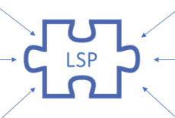

Code RealTime
RealTime Application
Art
C++ (generated and hand-written)
Art compiler
C++
TargetRTS
Common Trace Format
Trace Analysis (with AI)
Trace Visualization
Target OS Target hardware
Art Debugger
Trace configuration

Slide 3
Realtime application
UML-RT
C++ (generated and hand-written)
Model compiler
C++
TargetRTS
Target OS Target hardware

Slide 4
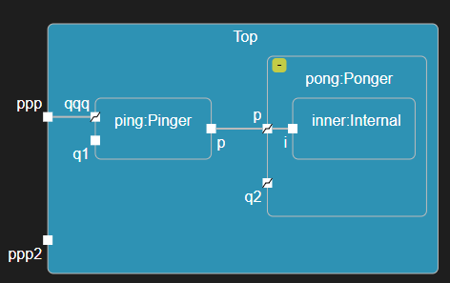
Notes:
protocol PROTO {
/* In Events */
in pong();
/* Out Events */
out ping();
};
capsule Top {
/* Ports */
/* Parts */
part ping : Pinger, pong : Ponger;
/* Connectors */
connect ping.p with pong.p;
/* State Machine */
statemachine {
state t21 {
mytrans: initial -> XT;
t2: XT -> XT;
state XT;
entry
`
// YourCodeHere
`;
exit
`
// YourCodeHere
`;
};
initial -> t21;
};
};
capsule Internal {
service behavior port i~ : PROTO;
statemachine {
state State;
initial -> State;
};
};
capsule Pinger {
/* Ports */
behavior port log : Log;
behavior port timing : Timing;
service behavior port p : PROTO;
service behavior unwired port q1 : PROTO;
/* Parts */
/* Connectors */
/* State Machine */
statemachine {
state State1 {
pong: on p.pong
`
timing.informIn(RTTimespec(1,0));
`;
timeout: on timing.timeout
`
log.show(getName());
log.log(" sends ping");
log.commit();
p.ping().send();
`;
};
initial -> State1
`
log.show(getName());
log.log(" sends ping");
log.commit();
p.ping().send();
`;
};
};
capsule Ponger {
/* Ports */
behavior port log : Log;
service port p~ : PROTO;
service behavior unwired port q2~ : PROTO;
/* Parts */
part inner : Internal;
/* Connectors */
connect p with inner.i;
/* State Machine */
statemachine {
state State1 {
ping: on p.ping
`
log.show(getName());
log.log(" sends pong");
log.commit();
p.pong().send();
`;
};
initial -> State1;
};
};

Slide 5
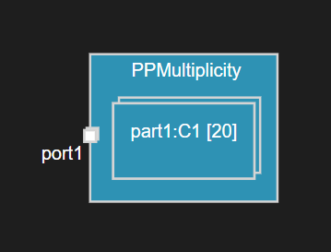
capsule PPMultiplicity {
/* Ports */
service port port1 : P1[10];
/* Parts */
part part1 : C1[20];
/* Connectors */
/* State Machine */
statemachine {
state S1;
initial -> S1;
};
};
capsule C1 {
/* Ports */
/* Parts */
/* Connectors */
/* State Machine */
statemachine {
state State;
initial -> State;
};
};
protocol P1 {
/* In Events */
/* Out Events */
};

Slide 6
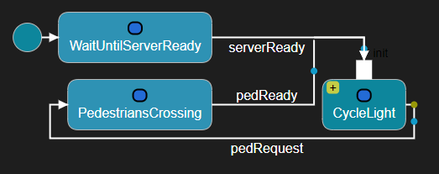
protocol TrafficLightSignals {
/* In Events */
/* Out Events */
out red(), green(), yellow();
};
protocol TrafficLightControl {
/* In Events */
in pedestrian();
/* Out Events */
};
protocol PedLightControl {
/* In Events */
in stop();
in walk();
/* Out Events */
};
capsule TrafficLight {
[[rt::decl]]
`
private: RTTimerId cycleTimer;
`
/* Ports */
service behavior port server : TrafficLightSignals;
service behavior port control : TrafficLightControl;
service behavior port pedLightControl~ : PedLightControl;
behavior port timer : Timing;
behavior port pedTimer : Timing;
/* Parts */
/* Connectors */
/* State Machine */
statemachine {
state WaitUntilServerReady;
state CycleLight {
entrypoint init;
state Red;
state Green;
state Yellow;
init -> Red;
red_to_green: Red -> Green on timer.timeout
`
log.log("Red -> Green");
log.commit();
`;
green_to_yellow: Green -> Yellow on timer.timeout
`
log.log("Green -> Yellow");
log.commit();
`;
yellow_to_red: Yellow -> Red on timer.timeout
`
log.log("Yellow -> Red");
log.commit();
`;
};
state PedestriansCrossing {
updatePedLight: on pedTimer.timeout
`
if (*((bool*) rtdata) == true) {
pedLightControl.walk().send();
bool waitForWalk = false;
pedTimer.informIn(RTTimespec(4,0), &waitForWalk, &RTType_bool);
// Time for pedestrians to cross
}
else {
pedLightControl.stop().send();
timer.informIn(RTTimespec(2,0));
}
`;
pedRequest_ignored: on control.pedestrian
`
// Ignore additional requests from pedestrians since we already are in the PedestriansCrossing state.
`;
};
initial -> WaitUntilServerReady;
serverReady: WaitUntilServerReady -> CycleLight.init on server.rtBound
`
log.log("TrafficLight starts up");
log.commit();
cycleTimer = timer.informEvery(RTTimespec(2,0));
`;
pedRequest: CycleLight -> PedestriansCrossing on control.pedestrian when
`
return true;
`
`
log.log("Pedestrian requests to cross");
log.commit();
timer.cancelTimer(cycleTimer);
`;
pedReady: PedestriansCrossing -> CycleLight.init on timer.timeout
`
log.log("Pedestrians ready");
log.commit();
cycleTimer = timer.informEvery(RTTimespec(2,0));
`;
};
};
capsule PedLight {
/* Ports */
service behavior port pedControl : PedLightControl;
service behavior notify port server~ : PedLightControl;
/* Parts */
/* Connectors */
/* State Machine */
statemachine {
state WaitUntiServerReady;
state DoNotWalk {
entry
`
server.stop().send();
`;
};
state Walk {
entry
`
server.walk().send();
`;
};
initial -> WaitUntiServerReady;
serverReady: WaitUntiServerReady -> DoNotWalk on server.rtBound;
walk: DoNotWalk -> Walk;
stop: Walk -> DoNotWalk;
};
};
capsule TLSystem {
/* Ports */
/* Parts */
part trafficLight : TrafficLight;
part pedLight : PedLight;
/* Connectors */
connect pedLight.pedControl with trafficLight.pedLightControl;
/* State Machine */
statemachine {
state State;
initial -> State;
};
};

Slide 7
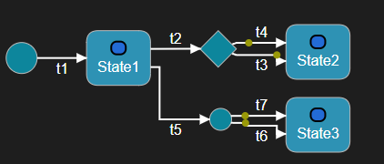
// ART_0007_choiceWithTooManyElseTransitions
capsule ChoiceSample {
/* Ports */
/* Parts */
/* Connectors */
/* State Machine */
statemachine {
state State1, State2, State3;
t1: initial -> State1;
choice X;
junction Y;
t2: State1 -> X;
t3: X -> State2 when
`
return true;
`;
t4: X -> State2 when
`
else
`;
t5: State1 -> Y;
t6: Y -> State3 when
`
else
`;
t7: Y -> State3 when
`
else
`;
};
};

Slide 8
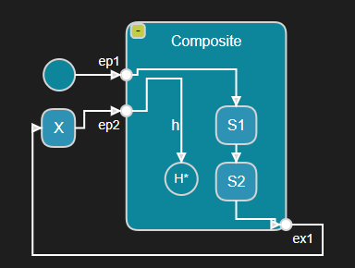
capsule HC {
/* Ports */
/* Parts */
/* Connectors */
/* State Machine */
statemachine {
state Composite {
entrypoint ep1, ep2;
exitpoint ex1;
state S1, S2;
ep1 -> S1;
S1 -> S2;
S2 -> ex1;
h: ep2 -> history*;
};
initial -> Composite.ep1;
state X;
Composite.ex1 -> X;
X -> Composite.ep2;
};
};

Slide 9
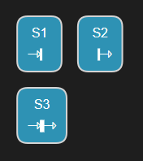
capsule SEE_Action {
/* Ports */
/* Parts */
/* Connectors */
/* State Machine */
statemachine {
state S1 {
entry
`
// YourCodeHere
`;
};
state S2 {
exit
`
// YourCodeHere
`;
};
state S3 {
entry
`
// YourCodeHere
`;
exit
`
// YourCodeHere
`;
};
};
};

Slide 10
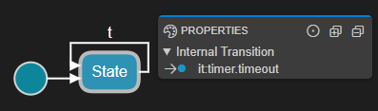
capsule ITC {
/* Ports */
behavior port timer : Timing;
/* Parts */
/* Connectors */
/* State Machine */
statemachine {
state State {
it: on timer.timeout
`
// YourCodeHere
`;
};
initial -> State;
t: State -> State;
};
};

Slide 11
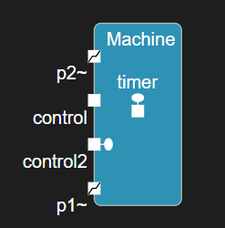
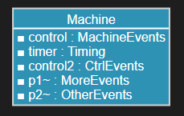
Notes:
capsule Machine {
service port control : MachineEvents;
behavior port timer : Timing; // predefined Timing protocol
service behavior port control2 : CtrlEvents;
service port p1~ : MoreEvents, p2~ : OtherEvents;
// ...
};

Slide 12

Notes:
capsule Server {
service behavior unwired port p~ : Protocol;
service behavior port q~ : Protocol;
service behavior port q2~ : Protocol;
// ...
};

Slide 13
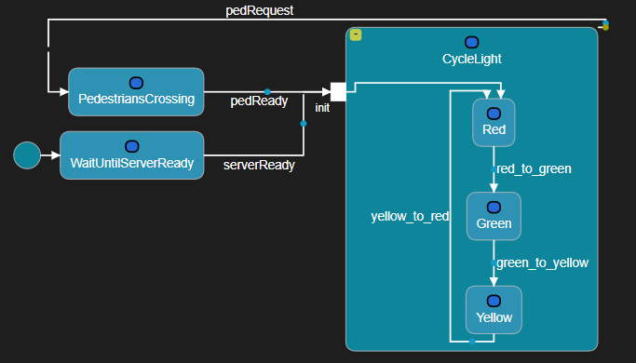
Notes:
capsule TrafficLight {
statemachine {
state WaitUntilServerReady, CycleLight;
state /* pedestrians are crossing the street */ PedestriansCrossing;
initial -> WaitUntilServerReady;
WaitUntilServerReady -> CycleLight;
CycleLight -> PedestriansCrossing;
};
};

Slide 14
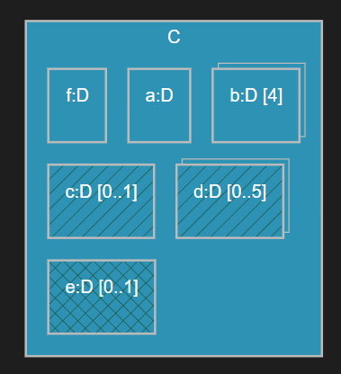
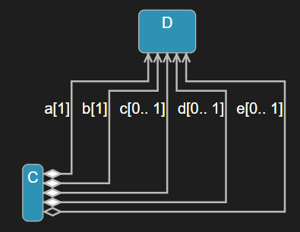
Notes:
capsule C {
part a : D;
fixed part b : D[4];
optional part c : D, d : D[0..5];
plugin part e : D;
// ...
};

Slide 15
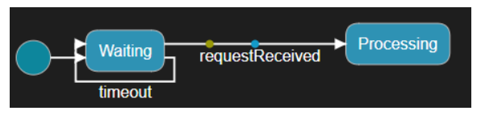
Notes:
capsule MyCap {
statemachine {
state Waiting, Processing;
initial -> Waiting;
requestReceived: Waiting -> Processing on com1.request, com2.request when
`
return canHandleNow();
`
`
log.log("Handling request");
log.commit();
handle(msg);
`;
timeout: Waiting -> Waiting on timer.timeout[`return zCount < 10;`];
};
};

Slide 16
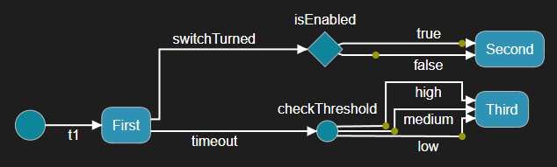
Notes:
capsule ChoiceSample {
statemachine {
state First, Second, Third;
t1: initial -> First;
choice isEnabled;
junction checkThreshold;
switchTurned: First -> isEnabled;
false: isEnabled -> Second when
`
return true;
`;
true: isEnabled -> Second when
`
else
`;
timeout: First -> checkThreshold;
low: checkThreshold -> Third when
`
return t < LIMIT1;
`;
medium: checkThreshold -> Third when
`
return t >= LIMIT1 && t < LIMIT2;
`;
high: checkThreshold -> Third when
`
else
`;
};
};

Slide 17
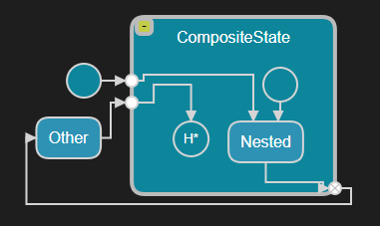
Notes:
capsule CC {
statemachine {
initial -> CompositeState.ep1;
state CompositeState {
state Nested;
entrypoint ep1, ep2;
exitpoint ex1;
initial -> Nested;
ep1 -> Nested;
Nested -> ex1;
ep2 -> history*;
};
state Other;
CompositeState.ex1 -> Other;
Other -> CompositeState.ep2;
};
};

Slide 18
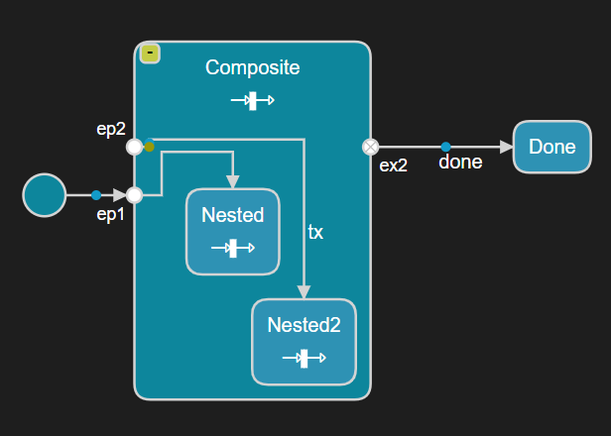
Notes:
capsule Top
{
[[rt::header_preface]]
`
#include <string>
`
[[rt::impl_preface]]
`
#include "testlib.art.h"
`
[[rt::decl]]
`
private: std::string result;
int tCount = 0;
`
behavior port timer : Timing;
statemachine {
state Composite {
entrypoint ep1, ep2;
exitpoint ex2;
entry
`
result += "Enter:Composite ";
`;
exit
`
result += "Exit:Composite ";
`;
state Nested {
entry
`
result += "Enter:Nested ";
`;
exit
`
result += "Exit:Nested ";
`;
};
state Nested2 {
entry
`
result += "Enter:Nested2 ";
`;
exit
`
result += "Exit:Nested2 ";
`;
};
ep1 -> Nested;
tx: ep2 -> Nested2 on timer.timeout when `tCount == 1`
`
result += "Effect:tx ";
timer.informIn(RTTimespec(1,0));
tCount++;
`;
};
initial -> Composite.ep1
`
timer.informIn(RTTimespec(1,0));
tCount++;
`
;
state Done;
done: Composite.ex2 -> Done on timer.timeout
`
std::string msg = "Unexpected result : " + result;
ASSERT(result == "Enter:Composite Enter:Nested Exit:Nested Effect:tx Enter:Nested2 Exit:Nested2 Exit:Composite ", msg.c_str());
PASS();
`;
};
};

Slide 19
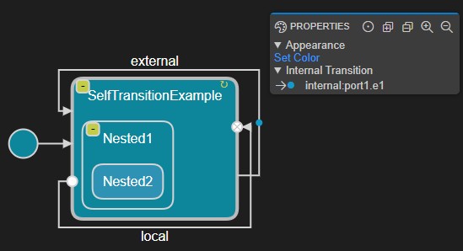
Notes:
capsule ITC {
/* Ports */
behavior port timer : Timing;
/* Parts */
/* Connectors */
/* State Machine */
statemachine {
initial -> SelfTransitionExample;
state SelfTransitionExample {
state Nested1 {
state Nested2;
};
internal: on port1.e1
`
// Internal transition
`;
entrypoint e1;
exitpoint e2;
local: e1 -> e2
`
// Local transition
`;
};
external: SelfTransitionExample -> SelfTransitionExample on port2.e2
`
// External transition
`;
};
};

Slide 20
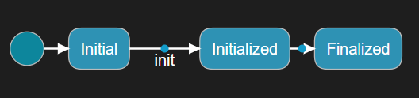
Notes:
class DataObject {
/* Trigger Operations */
trigger initialize(`int` data), finalize();
/* State Machine */
statemachine {
state Initial, Initialized, Finalized;
initial -> Initial;
init: Initial -> Initialized on initialize(`int`)
`
// Initialized
int i = data;
`;
Initialized -> Finalized on finalize()
`
// Finalized
`;
};
};

Slide 21
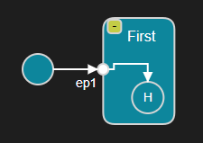
Notes:
class MyClass {
statemachine {
state First {
entrypoint ep1;
ep1 -> history;
};
initial -> First.ep1;
};
};

Slide 22
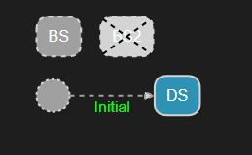
Notes:
capsule B {
statemachine {
state BS, BS2;
Initial: initial -> BS;
};
};
capsule D : B, `IDataManager`, `IController` {
[[rt::decl]]
`
// IDataManager impl
public:
void manageData() override;
// IController impl
public:
void control() override;
`
[[rt::impl]]
`
// impl of manageData() and control()
`
statemachine {
state DS;
state exclude BS2;
redefine Initial: initial -> DS;
};
};

Slide 23
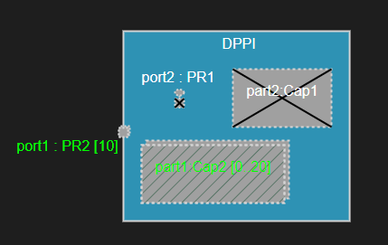
Notes:
capsule BPPI {
service port port1 : PR1;
behavior port port2 : PR1;
part part1 : Cap1;
part part2 : Cap1;
statemachine {
state State;
initial -> State;
};
};
capsule DPPI : BPPI {
service notify port redefine port1 : PR2[10];
optional part redefine part1 : Cap2[0..20];
part exclude part2;
behavior port exclude port2;
statemachine {
state State2;
};
};

Slide 24
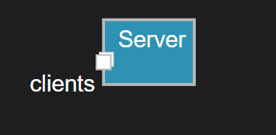
Notes:
protocol ComEvents {
/* In Events */
/* Out Events */
};
capsule Server {
service port clients : ComEvents[100];
// ...
};

Slide 25
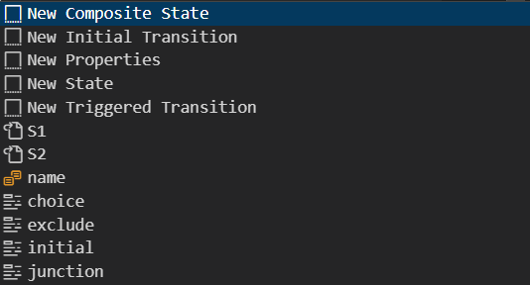
Art Editor
Code Templates
References
Name
Keywords

Slide 26
Threads
C1
cp1 : D
dp1 : X
cp2 : E
ep1 : F
fp1 : X
ep2: G
Logical1
Logical2

Slide 27
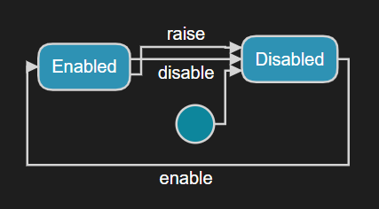
Notes:
capsule ExternalPort {
statemachine {
state Disabled, Enabled;
initial -> Disabled;
enable: Disabled -> Enabled;
disable: Enabled -> Disabled;
raise: Enabled -> Disabled;
};
};

Slide 28

IDE
Art Debugger
control →
realtime
application
← observe
debug
port

Slide 29
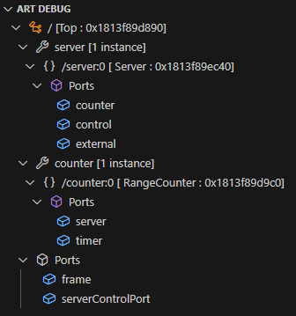
top capsule instance
capsule part
capsule instance contained in part
ports

