Slide 1
Waze User Churn Prediction Binary Classification Problem
By- Nagesh Bashetkar

Slide 2
Problem Statement
Waze is a free navigation application that makes it easier for drivers to get where they need to go safely. This is a fictional data analysis with the purpose of interpreting data to generate insight into preventing user churn for the application
Churn is the business term that describes how many customers stop using a product or service, or stop doing business with a company altogether and at what rate this occurs.
User churn is measured by the number of users who have either uninstalled the app or stopped using the app.

Slide 3
Project Goal & Objective
Project Goal:
To increase the overall growth of Waze by preventing monthly user churn on the Waze application
Objectives:
Developing a churn prediction model will help prevent churn, improve user retention, and grow Waze’s business.
Analyze and interpret data, generate actionable insights, and help leadership make informed business decisions.
Empower the Waze leadership to make data-driven decision making by offering key insights and data-informed recommendations.
Proactively identify factors that will engage high-risk churn users to retain them.

Slide 4
Data Set
14,999 Rows
13 Columns
2 columns with Dtype: object
3 columns with Dtype: float64
8 columns with Dtype: int64
y-variable, "label" has null values
y-variable, "label" is a categorical variable
Another categorical variable is "device"
The rest of the variables are numeric variables

Slide 5
Data Architecture
1
2
3
4
Perform Exploratory Data Analysis (EDA)
Prepare data for modeling
Build a model (base model)
Evaluate the model
5
6
7
8
Validate Models
Evaluate the final model using test data
Experiment with different models
Select the final model

Slide 6
Project Life Cycle
Understand &
Explore
Analyze &
Prepare
Build &
Evaluate
Compare &
Improve
Plan-
Understand problem
Analyse-
Determine appropriate models/algorithms
Construct-
Build a model
Execute-
Understand data
Perform EDA
Identify appropriate evaluation metrics
Prepare data for modeling
Perform Feature Engineering
Configure Hyperparameter Tuning
Evaluate the model results
Experiment with different models
Experiment with different ML techniques
Validate models
Identify the best model
Evaluate the best model using test data
Interpret and translate insights for stakeholders and non-technical audience

Slide 7
Methods & Techniques
Understand &
Explore
Analyze &
Prepare
Build &
Evaluate
Compare &
Improve
Phases
Plan - Analyze - Construct - Execute -
Data Preprocessing: Duplicated data Missing data Outliers Skewness in distribution | Feature Engineering: Feature selection Feature transformation Feature extraction Scaling: Standardization Scaling Encoding | Model Evaluation: Metrics Accuracy Precision Recall F1-score ROC Model Evaluation: Visual Confusion Matrix | Select Best Model Regression model (Binomial Logistic Regression) Naïve Bayes model Tree-based models (Random Forest, XGBoost) Data Split: Training Validation Test
Missing data and skewness affect model performance Outliers affects performance of regression models, but not tree- based models | Separate/Define X-features and y-variable to build models Either scale extreme values or find models that does not require scaling | Measure model performance using the appropriate metrics to achieve business goal | Select the best model based on the model performance and explainability Present overfitting / underfitting the model with data
Identified outliers using Z-score and the 1.5*IQR rules Identified data distribution types using histogram Checked class imbalance by calculating proportion of target variable | Dropped non-predictive features and duplicated feature such as “ID” Transformed categorial variables (“label”, “device”) to numerical variables Created two new features | Evaluate classification models Recall F1-score Confusion matrix Measured baseline via binomial logistic regression model | Compared Navie Bayes model (does not require scaling) and Random Forest, XGBoost (tree- based model that are less sensitive to outliers) Evaluated the final model using test data
Techniques
Rationale
Actions

Slide 8
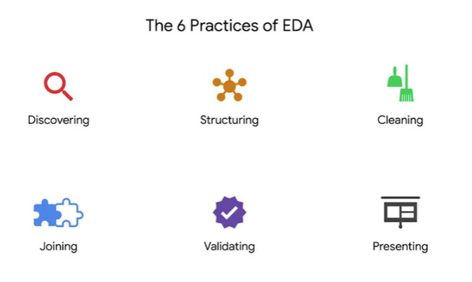
Exploratory Data Analysis
6 Practices of EDA:
1.Discovering
Check the overall shape, size,and content of the dataset using head(), info(), describe(), and shape() functions
2.Structuring
Sorting
Extracting
Filtering
Slicing
Grouping
Merging
3.Cleaning
Identify & handle duplicated data
Identify & handle missing data
Identify & handle outliers
Identify & handle data quality issues
Identify categorical data
Transform categorical data into numerical data using lebel and categorical encoding techniques
4.Joining
Adding more data
5.Validating
Validate data for accuracy and completeness
6.Presenting

Slide 9
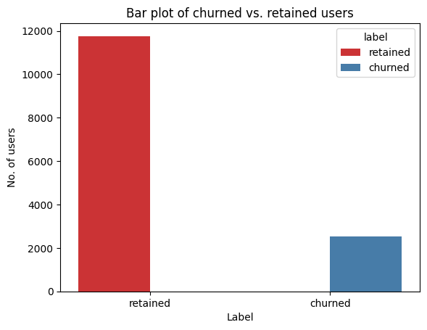
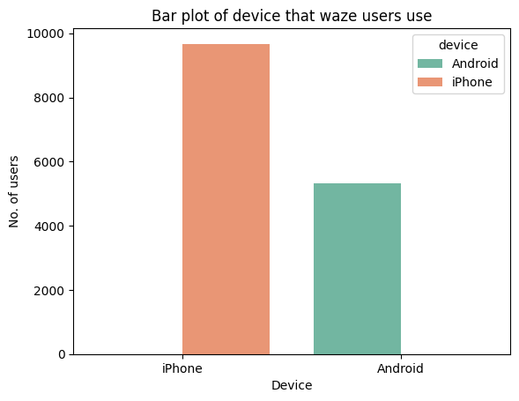
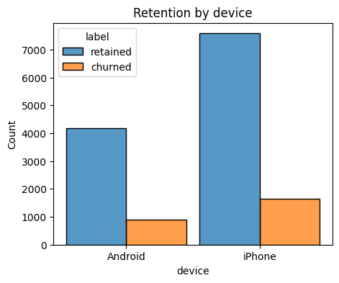
Data Visualization
retained 11763
churned 2536
From the graph it is clearly seen the no of retained users are more than the churned users
The class is balanced; the proportion of retained vs. churned is 82.2% vs. 17.7%
iPhone 9672
Android 5327
From graph it is clearly seen that user uses iPhone over Android device
64.48% user uses iPhone & 35.51% users uses Android device
Churned
iPhone - 0.648659 Android - 0.351341
Retained
iPhone - 0.644393
Android - 0.355607

Slide 10
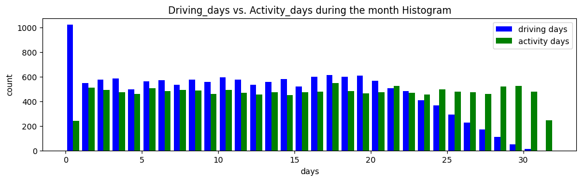
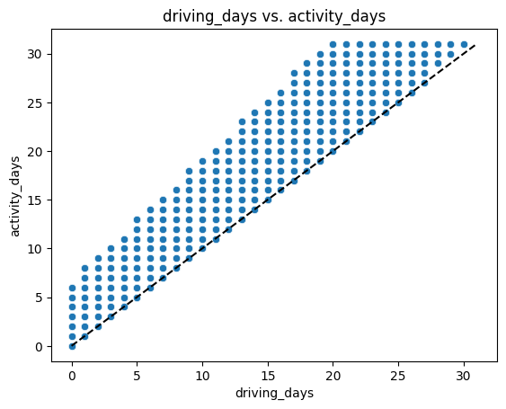
Data Visualization
People are opening the app (activity_days) but not using it during driving (driving_days)
Also, number of activity_days(>30) > number of driving_days for the same month? Some issue with the data?
MAX Driving Days 30
MAX Activity Days 31
Number of driving_days < Number of activity_days.

Slide 11
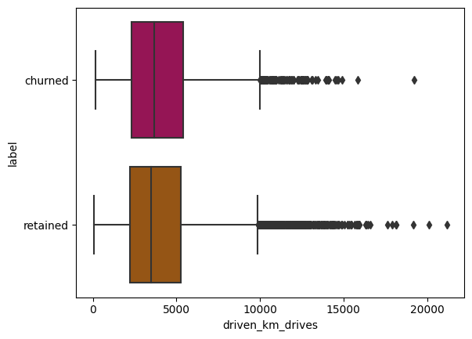
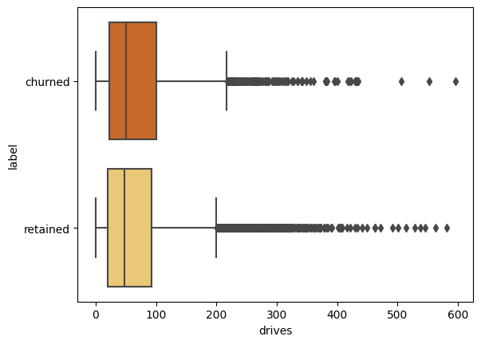
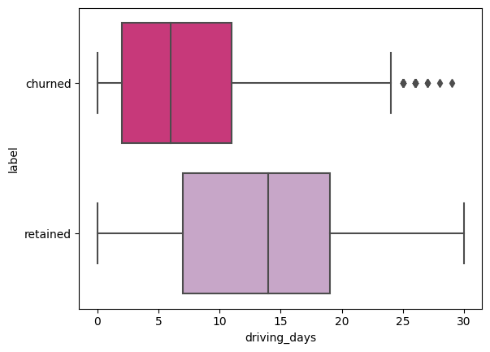
Handling Outliers
There are 440 outliers in "driven_km_drives"
3% of outliers (440/14299 * 100 = 3%) in the dataset
There are 695 outliers in "drives"
4.86% of outliers (695/14299 * 100 = 4.86%) in the dataset
No outliers were identified in "driving_days", but...

Slide 12
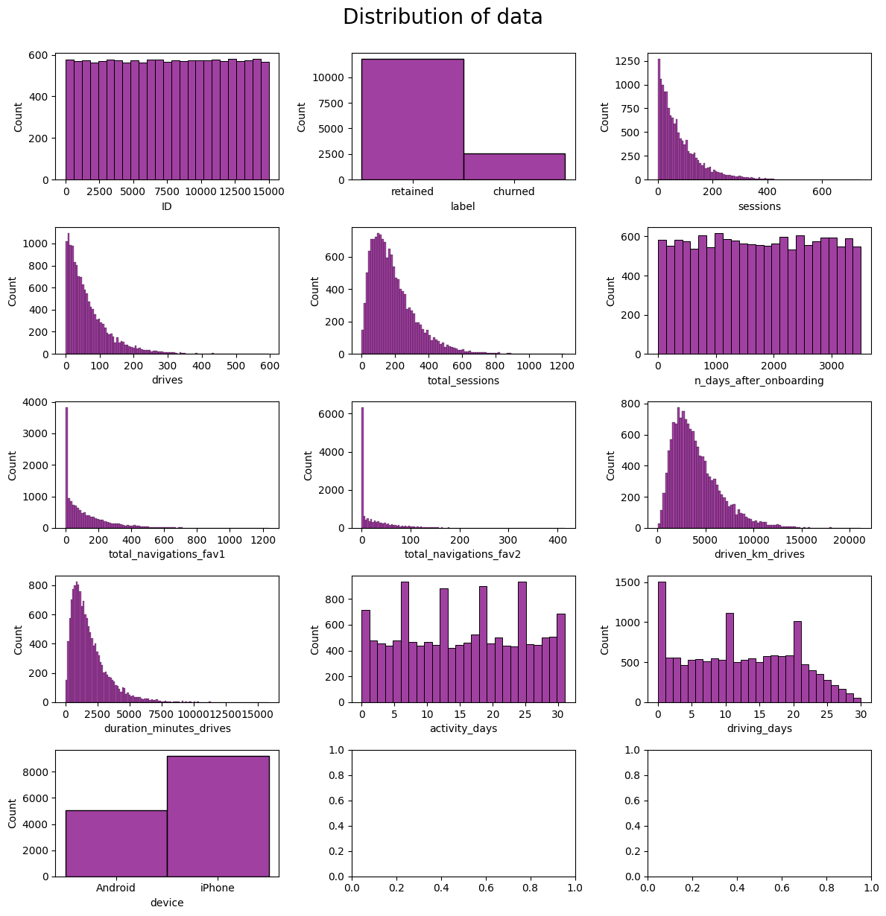
Distribution of data along Feature column
Most of the Feature columns are right skewed distributed
Very few Feature columns are uniformly distributed

Slide 13
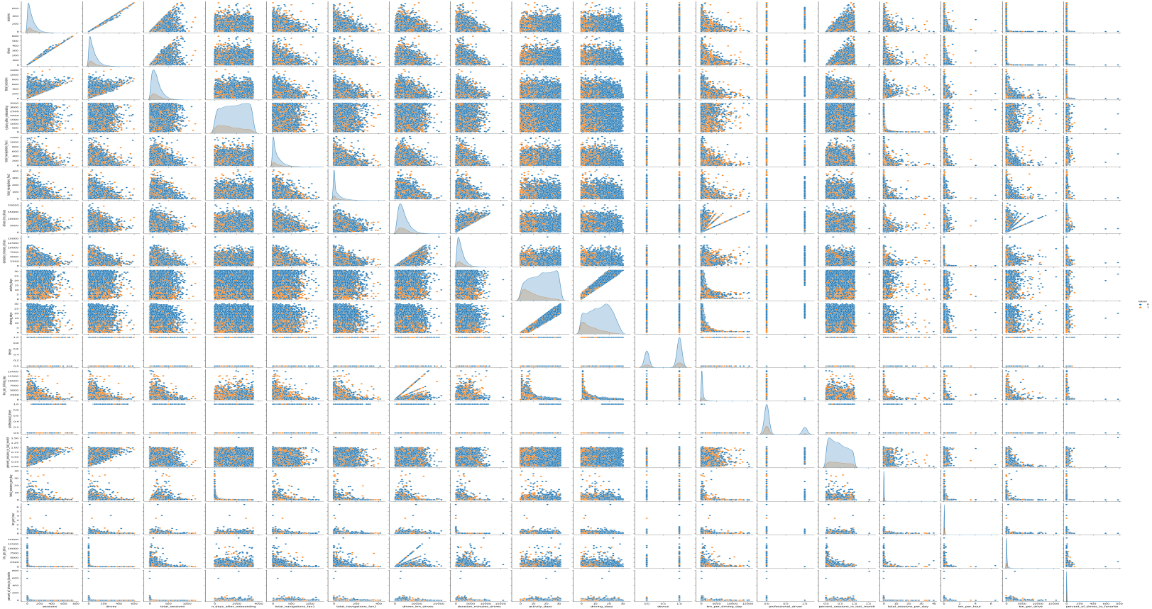
Pair Plot

Slide 14
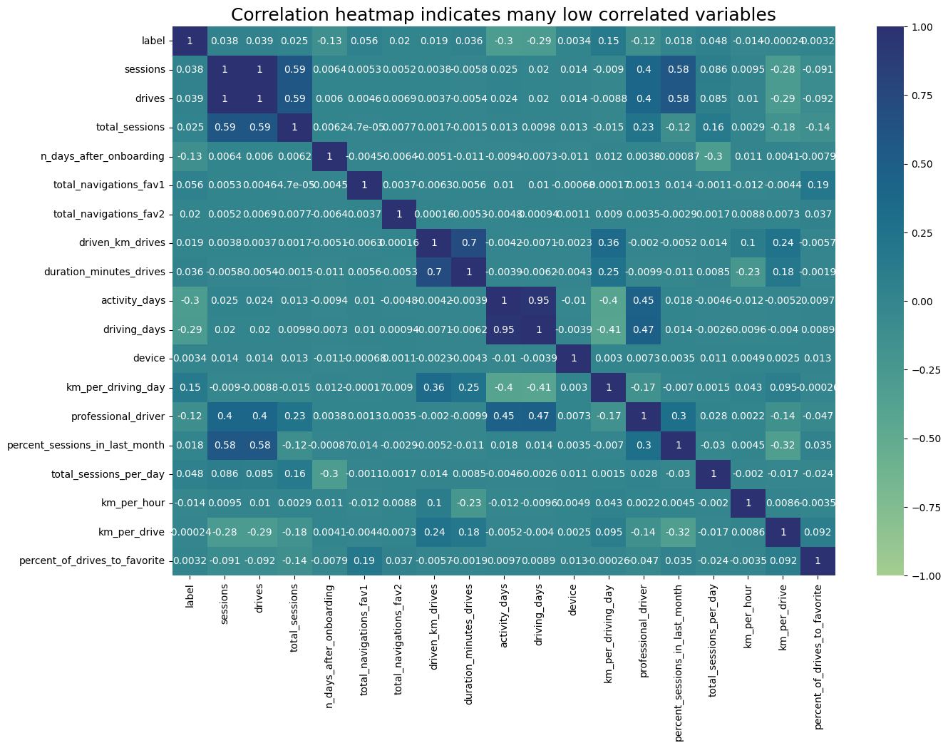
Corelation Heatmap

Slide 15
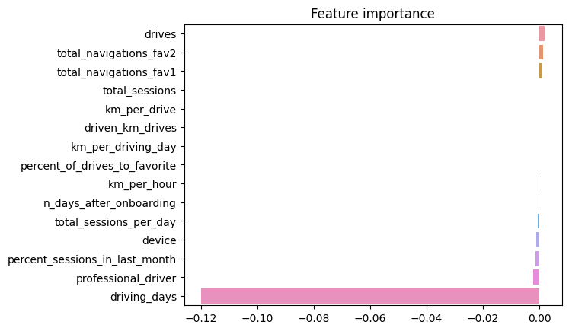
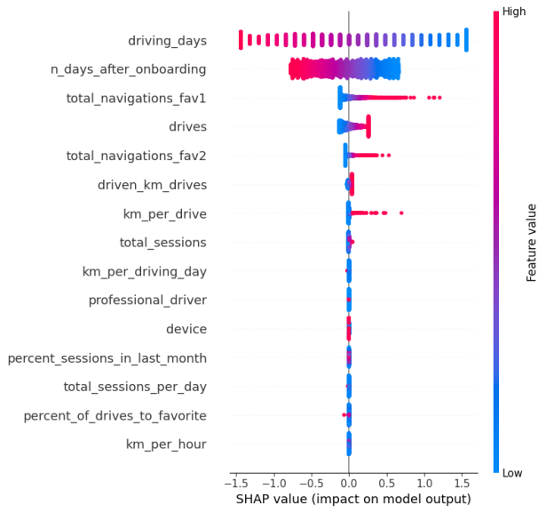
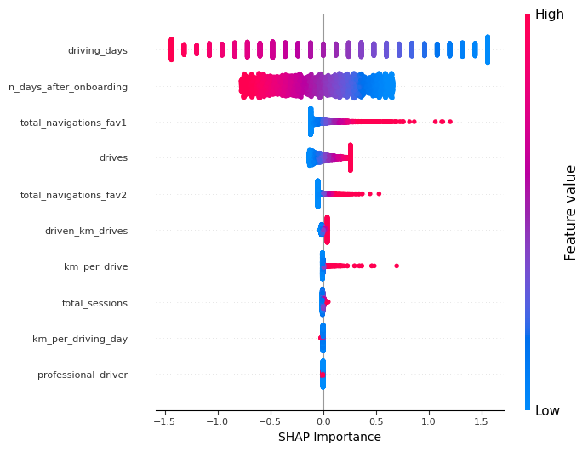
Logistic Regression Model Feature Analysis
* Variables most influenced the model's prediction are:
The most influencial variable: "driving_days" has negative correlation with user churn
The second influencial variable: "drives" has positive correlation with user churn Variables least * influenced the model's predictions are:
"driven_km_drivers"
"total_sessions"
" km_per_driving_day"

Slide 16
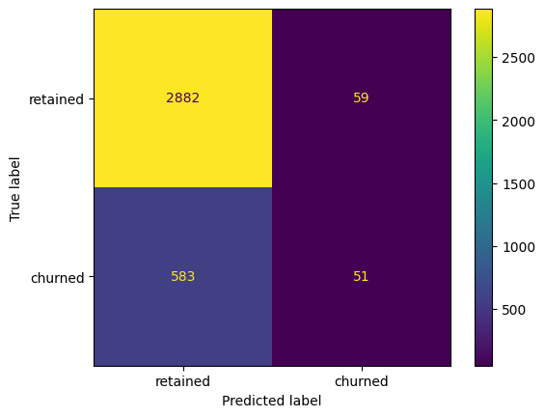
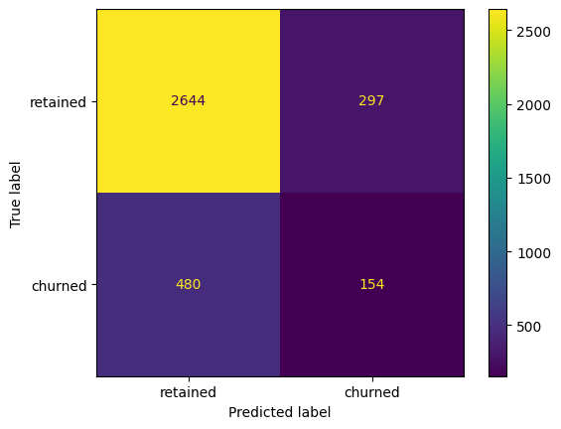




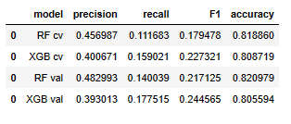
Analysis Results
Binomial Logistic Regression | Naïve Bayes | Random Forest | XGBoost
Imputed outliers Skewness has negative impact on model performance; feature transformation (scaling) is needed Used test data to evaluate model performance |  | Imputed outliers Naïve Bayes does not require scaling Used test data to evaluate model performance | Hyperparameter tuning Cross validation Grid search Used cross validation and validation data to evaluate model performance |  |  |  | Hyperparameter tuning Cross validation Grid search Used cross validation and validation data to evaluate model performance

Slide 17
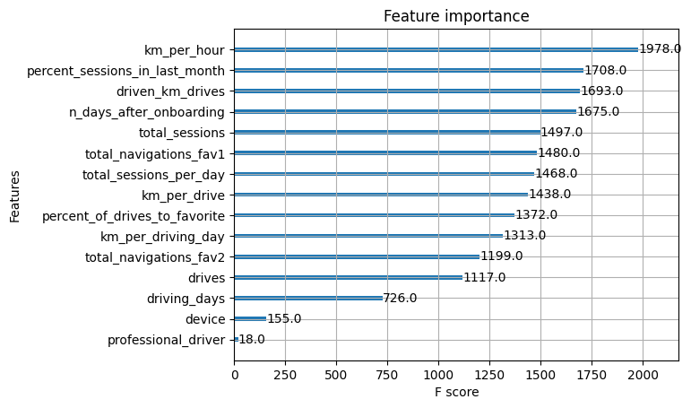
Churn Rate by the Features
Km_per_hour
In general, churned users had high km_per_hour drive
Percentage _sessions_in_last_month:
More churned users had less percentage sessions in last month than the retained users
Driven_km_drives:
One group of churned users drove longer distance than others in a month

Slide 18
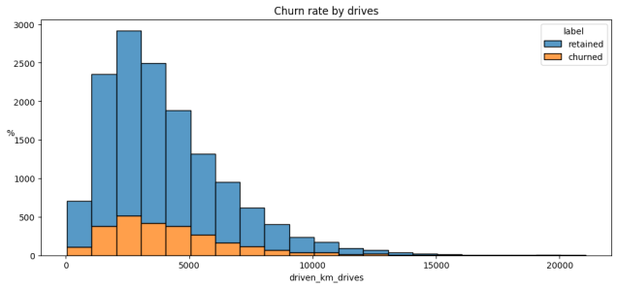
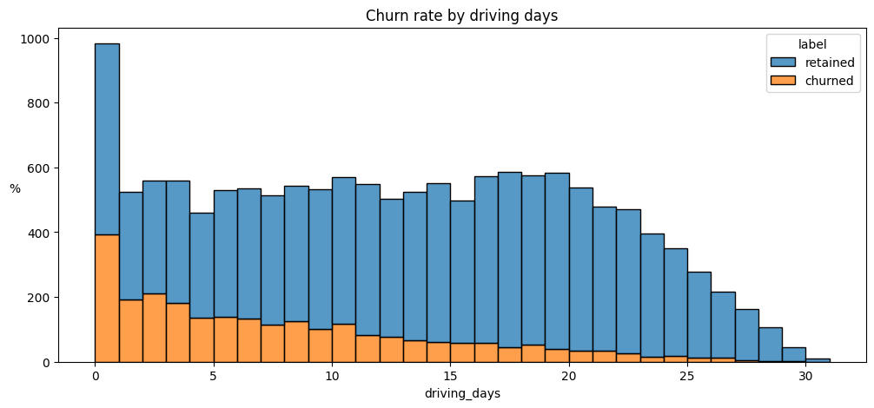
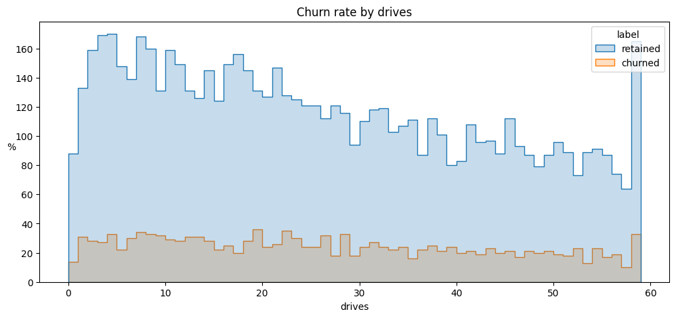
Recommendations based on EDA
Improve the experience of users who
uses the app for long-distance travel
Improve the experience of new users

Slide 19
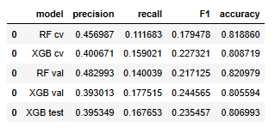
Recommended Next Steps based on Final Model Evaluation using Test Data
FN TP
Model performance is not very good with:
Recall: 16.76%
F1-score: 23.54%
To improve the model performance,
consider trying the following steps:
Experiment with other ML algorithms and/or techniques
Increase the size of data; analyze the entire 12 months of data instead of just 1 month of data

Slide 20
Hypothesis Testing
Hypothesis Testing :
Hypothesis testing is a procedure used to determine if there is enough
Evidence in a sample of data to infer that a certain condition is true for the entire population.
Null Hypothesis : Represents a statement of no effect or no difference and
is what you aim to reject
Alternative Hypothesis : Represents what you want to prove
Steps In Hypothesis Testing :
Set up Hypotheses : Define your H0 and H1
Choose significance Level (α ): commonly set at 0.05, this represents the
probability of rejecting H0 when true.
Select Test & Compute Test Statisctic : Depending on data & distribution,
select appropriate tests like T-test, Chi-square, F-Test, etc.
Make a Decision : If the p-value is less than α, reject the null hypothesis

Slide 21
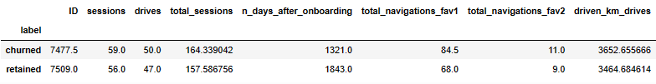
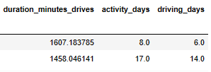
Hypothesis Testing
Test Observations :
Churned users had more no. of drives than retained users in a given month; 50 drives vs. 47 drives
Churned users used the app less no. of times than retained users in a given month; 8 times vs. 17 times
Churned users used the app less no. of days than retained users in a given month; 6 days vs. 14 days
Churned users drove more frequently than retained users in a short-period of time and used the app less number of times

Slide 22
Hypothesis Testing
Question 1: What is the median driving distance per drive?
Answer : The median distance that both churned and retained users
drove per drive is the same (73.1 km per drive vs. 73.7 km per drive)
Question 2: What is the median dirving distance per driving day?
Answer : Churned users drove "longer in distance" than retained users in a given
driving day (608.8 km per driving day vs. 247.5 km per driving day)
Churned users made "longer distance travels in in a driving day" than retained users
Question 3: What is the median number of drives per driving day?
Answer : 64% of iPhone users vs. 36% of Android users
Question 4: What percentage of the users are Android users vs. iPhone users?
Answer : It appears that more iPhone users fall into this category. But before we
jump to any conlcusions, lets see the ratio of iPhone users vs Android users in the overall dataset
Question 5: Can we break down the users by label (i.e. churned vs. retained) and by device (iPhone vs. Android)?
Answer : It seems the ratio of iPhone users and Android users is consistent between the churned group and the retained group

Slide 23
Leasson Learned
Understanding the requirements, strengths and limitations of each algorithm is important; it makes data science professionals more effective. Requirements include business goal, outcome variable and its type)
Model Assumptions need to be part of data analysis when using regression techniques (e.g.,
binomial logistic regression model)
Befoíe building the model
Afteí building the model
Selecting the appropriate model evaluation metrics (e.g., recall, F1, confusion matrix for
Waze user churn prediction model) is important to achieve business goals
A combination of 3 is required; hyperparameter tuning, grid search, and cross-validation
Test data should be reserved to evaluate the final model selected during validation (using validation data / cross-validation)
“Hypothesis Testing” is one of Regression Techniques; other regression techniques include
“Linear Regression” and “Logistic Regression”

Slide 24
Thank You
​

