Slide 1
OOP Concepts
Copyright:
Beta Soft Systems

Slide 2
Abstraction
Abstraction refers to the act of representing essential features without including the background details or explanations.

Slide 3
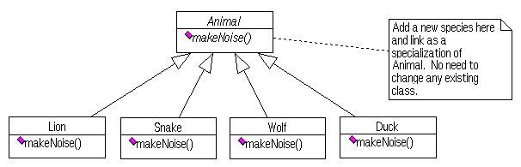
Polymorphism
Polymorphism refers to the process whereby an object invokes a method of another object in a common manner (with the same name) without understanding or caring how it is accomplished

Slide 4
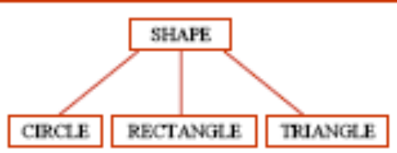
Inheritance
It is a way to form new or derived classes using classes or base classes that have already been defined. It is also known as generalization. Models Is-A relationship.
Multiple inheritance may lead to the Black Diamond Problem.

Slide 5
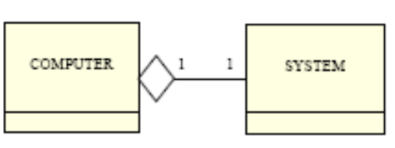
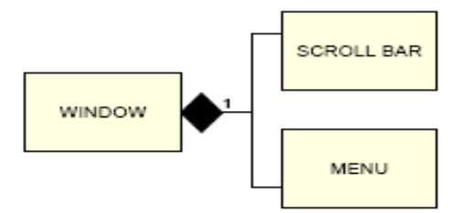
Aggregation and Composition
Association refers to ability to send message between object instances
Aggregation is the typical whole/part relationship
Composition is similar to Aggregation, except lifetime of the part is controlled by whole

Slide 6
Encapsulation
Encapsulation refers to hiding implementation details such as object’s behaviors and attributes
It is also known as Separation of Concerns or Information Hiding
It reduces risk by shifting code’s dependency on well defined interfaces

Slide 7
Modularity
Modularity is closely tied with encapsulation; think of modularity as a way of mapping encapsulated abstractions into real, physical modules
It allows breaking up of something complex into manageable pieces

Slide 8
Association
An association represents an object of one class making use of an object of another class

Slide 9
Coupling
Coupling describes how dependent one object is on another object (that it uses)
Coupling is a measure of the strength of the connection between any two system components. The more any one component knows about another component, the tighter (worse) the coupling is between those two components.
Coupling types are
  Field level
  Method level
  Constructor level
  API level
  Message level
  Protocol level

Slide 10
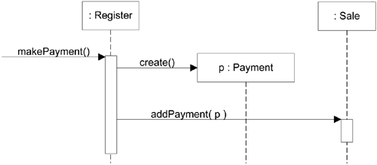
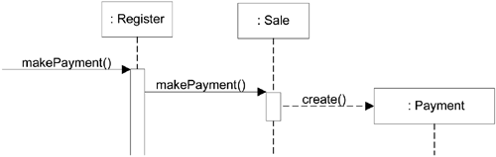
Cohesion
Cohesion defines how narrowly defined an object is. Functional cohesion refers measures how strongly objects are related
Cohesion is a measure of how logically related the parts of an individual component are to each other, and to the overall component. The more logically related the parts of a component are to each other the higher (better) the cohesion of that component.
Low coupling and Tight cohesion is good object oriented design (OOD)

Slide 11
Design Principles
GRASP – General Responsibility Assignment Software Patterns
REP – Release / reuse equivalency principle
OCP – Open closed principle
CQP - Command query separation principle
ISP - Interface segregation principle
DIP - Dependency inversion principle
LSP – Liskov’s substitution principle
CCP – Common closure principle
ADP - Acyclic dependencies principle
SDP - Stable dependencies principle
SAP - Stable abstractions principle
LoD - Law of Demeter

Slide 12
GRASP (General Responsibility Assignment Software patterns)
Information Expert
Creator
High Cohesion
Low Coupling
Controller
Polymorphism
Indirection
Pure Fabrication
Protected Variation

Slide 13
Release/Reuse equivalency principle (REP)
The granule of reuse is the granule of release. Only components that are released through a tracking system can be effectively reused. This granule is the package

Slide 14
Open closed principle (OCP)
Software entities like classes, modules and functions should be open for extension but closed for modifications

Slide 15
Command Query separation principle
Every method should either be a command that performs an action, or a query that returns data to the caller, but not both

Slide 16
Interface Segregation Principle (ISP)
Clients should not be forced to depend on methods that they do not use

Slide 17
Dependency inversion principle (DIP)
High level modules should not depend upon low level modules. Both should depend upon abstractions. Abstractions should not depend upon details. Details should depend upon abstractions

Slide 18
Liskov’s Substitution Principle (LSP)
In class hierarchies, it should be possible to treat a specialized object as if it were a base class object

Slide 19
Common Closure Principle (CCP)
Classes that change together, belong together

Slide 20
Common Reuse Principle
Classes that aren't reused together should not be grouped together

Slide 21
Acyclic Dependencies Principle
The dependency structure for released components must be a directed acyclic graph. There can be no cycles

Slide 22
Stable Dependencies principle
Dependencies between released categories must run in the direction of stability. The dependee must be more stable than the depender

Slide 23
Stable Abstractions Principle
The more stable a class category is, the more it must consist of abstract classes. A completely stable category should consist of nothing but abstract classes

Slide 24
Law of Demeter
An object should avoid invoking methods of a member object returned by another method
It is also known as Principle of Least Knowledge

Slide 25
Design best practices
Pick nouns or noun phrases as classes
Method names should contain a verb
Delegate to helper class
Use declarative configuration, don’t hardcode
Modular design
Divide code into framework and abstraction

Slide 26
Analysis & Design approaches
Nouns and noun sentence analysis : Identify the nouns and verbs in Use Cases. Nouns are classes and verbs are methods
Domain analysis : Identify objects using business domain knowledge
CRC (Class Responsibility Collaborator) : This technique uses cards to identify objects
Robustness analysis : Identify the control, entity and boundary objects

Slide 27
Design tradeoffs
Flexibility vs. Simplicity
Dynamicity vs. Runtime type safety
Time vs. space
Flexibility vs. Efficiency
  Ease of use vs. Normalization

Slide 28
Commonly Used Frameworks
Struts/Tiles, JSF/MyFaces,
Spring
Hibernate
AJAX (GWT, DoJo)
JSON
Webworks/Tapestry/Sitemesh/Turbine (Velocity)
Ruby on Rails
SOAP/Web services
Quartz

Slide 29
Assertions
Pre-conditions
Post-conditions
Invariants

