Slide 1

WebLogic Server Overview
Topology, Configuration and Administration
Oracle WebLogic Server

Slide 2
Agenda
Topology
  Domain
  Server
  Admin Server
  Managed Server
  Cluster
  Node Manager
  Machine
Configuration Files
Administration Tools
Sample Configuration Schemes

Slide 3
Domain
What is it?
  a logically related group of WebLogic Server instances that you manage from a single set of configuration artifacts.
What’s in a domain?
  Servers
  Clusters of servers
Rules:
  All WebLogic Server instances within the same domain must be at the same major and minor version.
  Servers within a domain can be at different Maintenance Pack levels as long as the Administration Server is at the same Maintenance Pack Level or higher than its Managed Servers.
config.xml
Notes:
You can use a variety of criteria for organizing WebLogic Server instances into domains. For instance, you might choose to allocate resources to multiple domains based on logical divisions of the hosted application, geographical considerations, or the number or complexity of the resources under management. For additional information about domains see Understanding Domain Configuration.
Domain Restrictions
In designing your domain configuration, note the following restrictions:
Each domain requires its own Administration Server for performing management activities. When you use the Administration Console to perform management and monitoring tasks, you can switch back and forth between domains, but in doing so, you are connecting to different Administration Servers.
All Managed Servers in a cluster must reside in the same domain; you cannot split a cluster over multiple domains.
All Managed Servers in a domain must run the same version of the WebLogic Server software. The Administration Server may run either the same version as the Managed Servers in the domain, or a later service pack.
If you have created multiple domains, each domain must reference its own database schema. You cannot share a configured resource or subsystem between domains. For example, if you create a JDBC data source in one domain, you cannot use it with a Managed Server or cluster in another domain. Instead, you must create a similar data source in the second domain. Furthermore, two or more system resources cannot have the same name.

Slide 4
Server
What is it?
  A configured instance to host applications and resources
    WebApps, Enterprise Apps, Web Services, …
    JMS, JDBC, Diagnostics, …
What types of servers are there?
  Administration Server
  Managed Server
JNDI
JMS Queue
JDBC Pool
Notes:
All instances of WebLogic Server use a root directory to store their working copy of the domain's configuration files, to store runtime data, and to provide the context for any relative pathnames in the server's configuration. An Administration Server always uses the domain directory as its root directory. A Managed Server can use the domain directory but can also use any other directory that you define.
Applications can use the following resources and services:
Security providers, which are modular components that handle specific aspects of security, such as authentication and authorization.
Resource adapters, which are system libraries specific to Enterprise Information Systems (EIS) and provide connectivity to an EIS.
Diagnostics and monitoring services.
JDBC data sources, which enable applications to connect to databases.
Mail sessions.
XML entity caches and registry of XML parsers and transformer factories
Messaging services such as JMS servers and store-and-forward services
Persistent store, which is a physical repository for storing data, such as persistent JMS messages. It can be either a JDBC-accessible database or a disk-based file.
Startup classes, which are Java programs that you create to provide custom, system-wide services for your applications.
Work Managers, which determine how an application prioritizes the execution of its work based on rules you define and by monitoring actual runtime performance. You can create Work Mangers for entire WebLogic Server domains or for specific application components.
Work Contexts, which enable applications to pass properties to a remote context without including the properties in a remote call.

Slide 5

Administration Server
Managed Servers
What is it?
  Central configuration controller for the entire domain
What else does it do?
  Hosts the Administration Console
  Enables you to start and stop servers from a central location
  Enables you to migrate servers and services within the domain
  Enables you to deploy applications within the domain
Guidelines:
  There must be exactly one* Administration Server in domain
  An Administration Server controls only one domain.
  For production use, we recommend not hosting application logic or resources on the Administration Server
Admin Server
config.xml
Admin Console
*The Administration Server does not need to run at all times, but is required for making configuration and deployment changes to a running domain.
Notes:
Do you need to explicitly configure the admin server?
Administration Server
The Administration Server operates as the central control entity for the configuration of the entire domain. It maintains the domain's configuration documents and distributes changes in the configuration documents to Managed Servers. You can also use the Administration Server as a central location from which to monitor all resources in a domain.
To interact with the Administration Server, you can use the Administration Console, WLST, or create your own JMX client. See Summary of System Administration Tools and APIs in Overview of WebLogic Server System Administration to modify the domain's configuration.
Each WebLogic Server domain must have one server instance that acts as the Administration Server.
In each domain, one WebLogic Server instance acts as the Administration Server—the server instance which configures, manages, and monitors all other server instances and resources in the domain. Each Administration Server manages one domain only. If a domain contains multiple clusters, each cluster in the domain has the same Administration Server.
More Thoughts:
-MSI Mode
-Disabling the Admin Console

Slide 6
Managed Server
What is it?
  A running instance that hosts applications and resources needed by those applications - The real work horses in a WebLogic domain
  Each Managed Server is independent of all other Managed Servers in the domain (unless they are in a cluster, defined later)
  You can have as many Managed Servers in a domain as you need
  Individual Managed Servers are typically added for capacity and application isolation
JNDI
JMS Queue
JDBC Pool
Notes:
Managed Servers host business applications, application components, Web services, and their associated resources. To optimize performance, Managed Servers maintain a read-only copy of the domain's configuration document.
Managed Servers can use the following resources:
Machine definitions that identify a particular, physical piece of hardware. A machine definition is used to associate a computer with the Managed Servers it hosts. This information is used by Node Manager in restarting a failed Managed Server, and by a clustered Managed Server in selecting the best location for storing replicated session data. For more information about Node Manager, see Using Node Manager to Control Servers in Managing Server Startup and Shutdown.
Network channels that define default ports, protocols, and protocol settings that a Managed Server uses to communicate with clients. After creating a network channel, you can assign it to any number of Managed Servers and clusters in the domain. For more information, see Configuring Network Resources in Configuring WebLogic Server Environments.
Virtual hosting, which defines a set of host names to which WebLogic Server instances (servers) or clusters respond. When you use virtual hosting, you use DNS to specify one or more host names that map to the IP address of a server or cluster. You also specify which Web applications are served by each virtual host.

Slide 7
Administration Server to Managed Server Interaction
The Administration Server stores the master copy of the domain configuration, including the configuration for all managed servers in the domain
Each Managed Server stores a local copy of its configuration.
When a Managed Server starts, it connects to the Administration Server to synchronize the configuration
When configuration is changed, the Administration Server sends changed configuration to Managed Servers
Notes:
When a Managed Server starts up, it connects to the domain's Administration Server to synchronize its configuration document with the document that the Administration Server maintains.

Slide 8
Cluster
Cluster 1
A cluster is a group of Managed Servers running simultaneously and working together to provide increased scalability and reliability
  Scalability: through parallelism
  Reliability/Availability: through replication and redundancy
A cluster appears as a single instance to most clients.
Clusters enable some advanced features, such as Whole Server Migration, Service Migration, and clustered JMS destinations.
Admin Svr
Cluster 2
Notes:
What Is a WebLogic Server Cluster?
A WebLogic Server cluster consists of multiple WebLogic Server server instances running simultaneously and working together to provide increased scalability and reliability. A cluster appears to clients to be a single WebLogic Server instance. The server instances that constitute a cluster can run on the same machine, or be located on different machines. You can increase a cluster's capacity by adding additional server instances to the cluster on an existing machine, or you can add machines to the cluster to host the incremental server instances. Each server instance in a cluster must run the same version of WebLogic Server.
How Does a Cluster Relate to a Domain?
A cluster is part of a particular WebLogic Server domain.
A domain is an interrelated set of WebLogic Server resources that are managed as a unit. A domain includes one or more WebLogic Server instances, which can be clustered, non-clustered, or a combination of clustered and non-clustered instances. A domain can include multiple clusters. A domain also contains the application components deployed in the domain, and the resources and services required by those application components and the server instances in the domain. Examples of the resources and services used by applications and server instances include machine definitions, optional network channels, connectors, and startup classes.
You can use a variety of criteria for organizing WebLogic Server instances into domains. For instance, you might choose to allocate resources to multiple domains based on logical divisions of the hosted application, geographical considerations, or the number or complexity of the resources under management. For additional information about domains see Understanding Domain Configuration.
In each domain, one WebLogic Server instance acts as the Administration Server—the server instance which configures, manages, and monitors all other server instances and resources in the domain. Each Administration Server manages one domain only. If a domain contains multiple clusters, each cluster in the domain has the same Administration Server.
All server instances in a cluster must reside in the same domain; you cannot "split" a cluster over multiple domains. Similarly, you cannot share a configured resource or subsystem between domains. For example, if you create a JDBC connection pool in one domain, you cannot use it with a server instance or cluster in another domain. (Instead, you must create a similar connection pool in the second domain.)
Clustered WebLogic Server instances behave similarly to non-clustered instances, except that they provide failover and load balancing. The process and tools used to configure clustered WebLogic Server instances are the same as those used to configure non-clustered instances. However, to achieve the load balancing and failover benefits that clustering enables, you must adhere to certain guidelines for cluster configuration.
To understand how the failover and load balancing mechanisms used in WebLogic Server relate to particular configuration options see Load Balancing in a Cluster, and Failover and Replication in a Cluster.
Detailed configuration recommendations are included throughout the instructions in Setting up WebLogic Clusters.
What Are the Benefits of Clustering?
A WebLogic Server cluster provides these benefits:
Scalability The capacity of an application deployed on a WebLogic Server cluster can be increased dynamically to meet demand. You can add server instances to a cluster without interruption of service—the application continues to run without impact to clients and end users.
High-Availability In a WebLogic Server cluster, application processing can continue when a server instance fails. You "cluster" application components by deploying them on multiple server instances in the cluster—so, if a server instance on which a component is running fails, another server instance on which that component is deployed can continue application processing.
The choice to cluster WebLogic Server instances is transparent to application developers and clients. However, understanding the technical infrastructure that enables clustering will help programmers and administrators maximize the scalability and availability of their applications.
What Are the Key Capabilities of a Cluster?
This section defines, in non-technical terms, the key clustering capabilities that enable scalability and high availability.
Application Failover Simply put, failover means that when an application component (typically referred to as an "object" in the following sections) doing a particular "job"—some set of processing tasks—becomes unavailable for any reason, a copy of the failed object finishes the job.
For the new object to be able to take over for the failed object:
There must be a copy of the failed object available to take over the job.
There must be information, available to other objects and the program that manages failover, defining the location and operational status of all objects—so that it can be determined that the first object failed before finishing its job.
There must be information, available to other objects and the program that manages failover, about the progress of jobs in process—so that an object taking over an interrupted job knows how much of the job was completed before the first object failed, for example, what data has been changed, and what steps in the process were completed. WebLogic Server uses standards-based communication techniques and facilities— including IP sockets and the Java Naming and Directory Interface (JNDI)—to share and maintain information about the availability of objects in a cluster. These techniques allow WebLogic Server to determine that an object stopped before finishing its job, and where there is a copy of the object to complete the job that was interrupted.
Note:For backward compatibility with previous versions, WebLogic Server also allows you to use multicast for communications between clusters.Information about what has been done on a job is called state. WebLogic Server maintains information about state using techniques called session replication and replica-aware stubs. When a particular object unexpectedly stops doing its job, replication techniques enable a copy of the object pick up where the failed object stopped, and finish the job.
WebLogic Server supports automatic and manual migration of a clustered server instance from one machine to another. A Managed Server that can be migrated is referred to as a migratable server. This feature is designed for environments with requirements for high availability. The server migration capability is useful for
Ensuring uninterrupted availability of singleton services—services that must run on only a single server instance at any given time, such as JMS and the JTA transaction recovery system, when the hosting server instance fails. A Managed Server configured for automatic migration will be automatically migrated to another machine in the even of failure.
Easing the process of relocating a Managed Server, and all the services it hosts, as part of a planned system administration process. An administrator can initiate the migration of a Managed Server from the Administration Console or command line. The server migration process relocates a Managed Server in its entirety—including IP addresses and hosted applications—to on of a predefined set of available host machines.
Load Balancing Load balancing is the even distribution of jobs and associated communications across the computing and networking resources in your environment. For load balancing to occur:
There must be multiple copies of an object that can do a particular job.
Information about the location and operational status of all objects must be available. WebLogic Server allows objects to be clustered—deployed on multiple server instances—so that there are alternative objects to do the same job. WebLogic Server shares and maintains the availability and location of deployed objects using unicast, IP sockets, and JNDI.
Note:For backward compatibility with previous versions, WebLogic Server also allows you to use multicast for communications between clusters.
A detailed discussion of how communications and replication techniques are employed by WebLogic Server is provided in Communications In a Cluster.

Slide 9
Cluster Guidelines
All servers in a cluster must also be in the same domain.
All servers within a cluster must be at the same Maintenance Pack level.
Clustered servers can be on the same or different machines.
You can have multiple clusters in a domain.

Slide 10
Load Balancing in a Cluster
For JSPs and Servlets: load balancing is external
  Web server proxy plug-in (round robin)
  HTTP Proxy servlet (i.e., using WLS as a load balancer)
  3rd party hw or sw load balancer
EJBs and RMI Objects: load balancing is done at connection
  Objects are cluster-aware
  Load balancing algorithm is stored in the clustered object’s stub
  Objects are available on all cluster members; remote objects connect/use according the LB algorithm in the stub
  Load balancing algorithms: Round robin, weighted, random, server affinity
Notes:
More details on EJB and RMI load balancing.

Slide 11
Failover in a Cluster
Servlets and JSPs:
  HTTP session state is replicated to a secondary server in the cluster or to a database
EJBs and RMI Objects:
  Replicas available throughout the cluster
  Exceptions caught and retried on another instance
  For Stateful Session Beans, state is replicated on a secondary server
Notes:
Servlets and JSPs
WebLogic Server provides clustering support for servlets and JSPs by replicating the HTTP session state of clients that access clustered servlets and JSPs. WebLogic Server can maintain HTTP session states in memory, a filesystem, or a database.
To enable automatic failover of servlets and JSPs, session state must persist in memory. For information about how failover works for servlets and JSPs, and for related requirements and programming considerations, see HTTP Session State Replication.
You can balance the servlet and JSP load across a cluster using a WebLogic Server proxy plug-in or external load balancing hardware. WebLogic Server proxy plug-ins perform round robin load balancing. External load balancers typically support a variety of session load balancing mechanisms. For more information, see Load Balancing for Servlets and JSPs.
EJBs and RMI Objects
Load balancing and failover for EJBs and RMI objects is handled using replica-aware stubs, which can locate instances of the object throughout the cluster. Replica-aware stubs are created for EJBs and RMI objects as a result of the object compilation process. EJBs and RMI objects are deployed homogeneously—to all the server instances in the cluster.
Failover for EJBs and RMI objects is accomplished using the object's replica-aware stub. When a client makes a call through a replica-aware stub to a service that fails, the stub detects the failure and retries the call on another replica. To understand failover support for different types of objects, see Replication and Failover for EJBs and RMIs.
WebLogic Server clusters support multiple algorithms for load balancing clustered EJBs and RMI objects: round-robin, weight-based, random, round-robin-affinity, weight-based-affinity, and random-affinity. By default, a WebLogic Server cluster will use the round-robin method. You can configure a cluster to use one of the other methods using the Administration Console. The method you select is maintained within the replica-aware stub obtained for clustered objects. For details, see Load Balancing for EJBs and RMI Objects.

Slide 12
Communication in a Cluster
Peer to Peer using Sockets - used for:
  Accessing non-clustered objects deployed to another clustered server instance on a different machine.
  Replicating HTTP session states and stateful session EJB states between a primary and secondary server instance.
  Accessing clustered objects that reside on a remote server instance.
Peer to Peer using Unicast or Multicast - used for:
  Cluster-wide JNDI updates
  Heartbeats
Cluster-wide JNDI tree
  Lists local resources and resources available throughout the cluster
  List is maintained on all servers in the cluster

Slide 13
Node Manager
Utility/process running on a physical server that enables you to start, stop, suspend, and restart WebLogic Server instances remotely
Must run on each physical server that hosts WebLogic Server instances that you want to control with Node Manager
Not associated with a domain. Can start any server instance that resides on the same physical server.
Optional, but required to start/stop servers using the Administration Console
Required for Whole Server Migration and for some configurations of Automatic Service Migration
Admin Server
Managed Server
Node Manager
Notes:
Server instances in a WebLogic Server production environment are often distributed across multiple domains, machines, and geographic locations. Node Manager is a WebLogic Server utility that enables you to start, shut down, and restart Administration Server and Managed Server instances from a remote location. Although Node Manager is optional, it is recommended if your WebLogic Server environment hosts applications with high availability requirements.
A Node Manager process is not associated with a specific WebLogic domain but with a machine. You can use the same Node Manager process to control server instances in any WebLogic Server domain, as long as the server instances reside on the same machine as the Node Manager process. Node Manager must run on each computer that hosts WebLogic Server instances -- whether Administration Server or Managed Server -- that you want to control with Node Manager.

Slide 14
Machine
A definition that identifies a particular, physical piece of hardware.
A machine definition is used to associate a computer with the Managed Servers it hosts.
Used by Node Manager in restarting a failed Managed Server
Used by a clustered Managed Server in selecting the best location for storing replicated session data

Slide 15
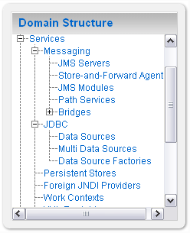
Service Configuration
Besides topology elements, you also configure the services in a domain that applications rely on:
  JMS, JDBC, Diagnostics, etc.
General notion:
  Configure the service in the domain
  Target to specific servers or clusters
  An instance of the resource is created on each server specified

Slide 16
Agenda
Topology
  Domain
  Server
  Admin Server
  Managed Server
  Cluster
  Node Manager
  Machine
Configuration Files
Administration Tools
Sample Configuration Schemes

Slide 17
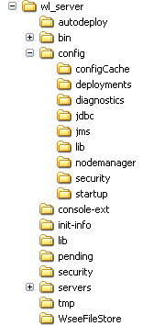
Domain Directory
Domain name
Start and stop scripts
Root configuration for the domain
Configuration files for WLDF, JDBC, JMS, and Security
Pending configuration changes
Subdirectory for each Managed Server in the domain
Notes:
domain-name: The name of this directory is the name of the domain.
Autodeploy: in development mode, apps and files are automatically deployed
Bin: contains scripts that are used in the process of starting and stopping the Administration Server and the Managed Servers in the domain. can optionally contain other scripts of domain-wide interest,
config: contains the current configuration and deployment state of the domain. The central domain configuration file, config.xml, resides in this directory.
config/configCache: Contains data that is used to optimize performance when validating changes in the domain's configuration documents.
config/diagnostics: contains system modules for the WebLogic Diagnostic Framework.
config/jdbc: contains system modules for global JDBC modules that can be configured directly from JMX
config/jms: contains system modules for JMS
config/lib: not used in the current release of WebLogic Server.
config/nodemanager: holds configuration information for connection to the Node Manager.
config/security: contains system modules for the security framework. It contains one security provider configuration extension for each kind of security provider in the domain's current realm.
config/startup: contains system modules that contain startup plans. Startup plans are used to generate shell scripts that can be used as part of server startup.
configArchive: contains a set of JAR files that save the domain's configuration state. Just before pending changes to the configuration are activated, the domain's existing configuration state, consisting of the config.xml file and the other related configuration files, is saved in a versioned JAR file with a name like config.jar#1, config.jar#2, etc.
console-ext: contains extensions to the Administration Console, which enable you to add content to the WebLogic Server Administration Console, replace content, and change the logos, styles and colors without modifying the files that are installed with WebLogic Server.
init-info: contains files used for WebLogic domain provisioning.
lib: Any JAR files you put in this directory are added to the system classpath of each server instance in the domain when the server's Java virtual machine starts.
pending: contains domain configuration files representing configuration changes that have been requested, but not yet activated.
security: holds security-related files that are the same for every WebLogic Server instance in the domain:
SerializedSystemIni.dat
This directory also holds security-related files that are only needed by the domain's Administration Server:
DefaultAuthorizerInit.ldift
DefaultAuthenticatorInit.ldift
DefaultRoleMapperInit.ldift
servers: contains one subdirectory for each WebLogic Server instance in the domain. The subdirectories contain data that is specific to each server instance.
servers/server-name: the server directory for the WebLogic Server instance with the same name as the directory.
servers/server-name/bin: holds executable or shell files that can be or must be different for each server.
servers/server-name/cache: holds directories and files that contain cached data.
servers/server-name/cache/EJBCompilerCache: cache for compiled EJBs.
servers/server-name/data: holds files that maintain persistent per-server state used to run the WebLogic Server instance, other than security state, as opposed to temporary, cached or historical information.
servers/server-name/data/ldap: holds the embedded LDAP database. The runtime security state for the WebLogic Server instance is persisted in this directory.
servers/server-name/data/store: holds WebLogic persistent stores.
servers/server-name/logs: holds logs and diagnostic information.
servers/server-name/logs/diagnostic_images: holds information created by the Server Image Capture component of WLDF
servers/server-name/logs/jmsServers: contains one subdirectory for each JMS server in the WebLogic Server instance. Each such subdirectory contains the logs for that JMS server.
servers/server-name/logs/connector: the default base directory for connector module (JCA ResourceAdapter) logs.
servers/server-name/security: holds security-related files that can be or must be different for each WebLogic Server instance. The file boot.properties is an example of a file that resides here because it can differ from one server to the next. This directory also maintains files related to SSL keys.
servers/server-name/tmp
This directory holds temporary directories and files that are created while a server instance is running. For example, a JMS paging directory is automatically created here unless another location is specified. Files in this directory must be left alone while the server is running, but may be freely deleted when the server instance is shut down.
tmp: stores temporary files used in the change management process.

Slide 18
Configuration Files
config.xml – central configuration file for a domain
includes the configuration of each server instance, cluster, resource, and service in the domain.
references additional XML files that are stored in subdirectories of the domain/config directory: JMS, JDBC, WLDF, and Security
All files are based on schemas
config.xml
<domain (schema locations)>
<name>wl_server</name>
  <security-configuration></security-configuration>
  <jta></jta>
  <server>
    <name>examplesServer</name>
  </server>
  <app-deployment></app-deployment>
  <jms-server></jms-server>
  <jms-system-resource></jms-system-resource>
  <jdbc-system-resource>
    <name>examples-demo</name>
    <target>examplesServer,managedServer-0</target>
    <descriptor-file-name>jdbc/examples-demo-jdbc.xml</descriptor-file-name>
  </jdbc-system-resource>
</domain>
references to other files
examples-demo-jdbc.xml
<jdbc-data-source>
  <name>examples-demo</name>
  <jdbc-driver-params></jdbc-driver-params>
  <jdbc-driver-params></jdbc-driver-params>
  <jdbc-data-source-params></jdbc-data-source-params>
</jdbc-data-source>
Notes:
As a performance optimization, WebLogic Server does not store most of its default values in the domain's configuration files. In some cases, this optimization prevents XML elements from being written to the configuration files. For example, if you never modify the default logging severity level for a domain while the domain is active, the config.xml file does not contain an XML element for the domain's logging configuration.

Slide 19
Two-Phase Configuration Changes
Changes activated in batches:
  Reliability, consistency:
    Make (related) changes as a group
    Validate before making the change
    Activate or Roll back as a single unit( all changes on all servers
General process:
  Get an edit lock
  make changes
    changes are stored in the pending directory
  activate your changes (with implicit validation through the Admin Console or WLST)
    changes are distributed to servers in the domain
    Two phases: prepare and commit
    Prepared on all servers; any failures will cause total rollback

Slide 20
Agenda
Topology
  Domain
  Server
  Admin Server
  Managed Server
  Cluster
  Node Manager
  Machine
Configuration Files
Administration Tools
Sample Configuration Schemes

Slide 21
Administration Tools
Configuration Wizard
  GUI/scriptable tool to create and extend WebLogic domains
  Template based
Administration Console
  Browser-based tool for configuring and monitoring domains, deploying applications, and controlling servers
WebLogic Scripting Tool (WLST)
  Script or command line tool to do the same thing as the Administration Console and Configuration Wizard
  Note that we will cover details on WLST in a separate document
weblogic.Admin
  Deprecated command line tool for configuring a domain
  Recommend using WLST instead
weblogic.Deployer
  Command line tool for deploying applications
Notes:
weblogic.Deployer
Command line tool for deploying and undeploying applications
More info:
http://e-docs.bea.com/wls/docs100/deployment/deploy.html
weblogic.Admin
Command-line interface that you can use to administer, configure, and monitor WebLogic Server
Deprecated. Replaced by WLST Online
More info:
http://e-docs.bea.com/wls/docs100/admin_ref/cli.html

Slide 22
Configuration Wizard
Wizard that walks you through domain creation off line
  Not intended to run against a running domain
Requires a domain template
WLS ships with a default template and templates for samples domains
Customers and layered products can create their own templates
Scriptable (aka “WLST Offline”)
More info:
http://e-docs.bea.com/common/docs100/confgwiz/index.html
http://e-docs.bea.com/common/docs100/interm/config.html
http://e-docs.bea.com/common/docs100/tempbuild/index.html
http://e-docs.bea.com/common/docs100/tempref/index.html

Slide 23
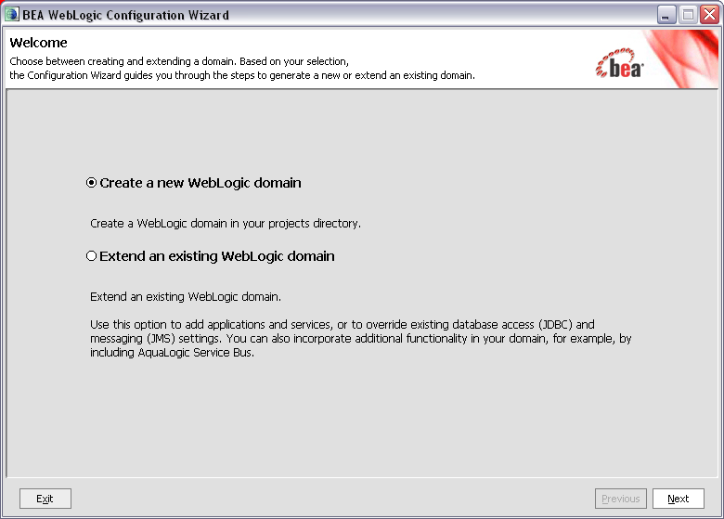
Configuration Wizard

Slide 24
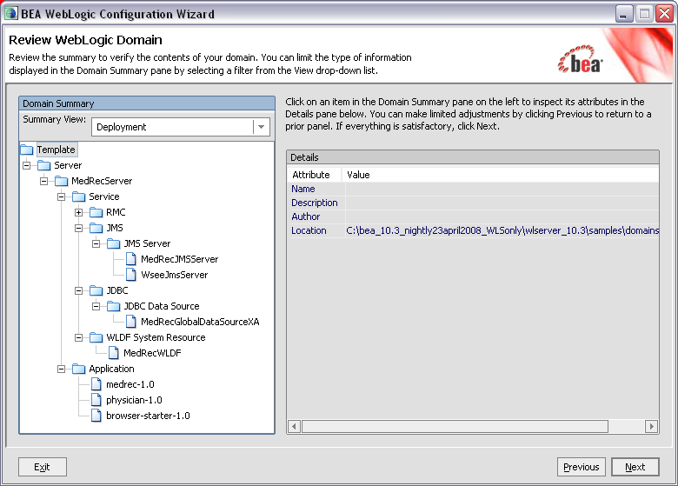
Configuration Wizard

Slide 25
Administration Console
Graphical interface to configure, manage, monitor a domain
One Administration Console for each domain
The Administration Server in the domain hosts the Admin Console application
Open the Admin Console with the following URL:
  http://host:port/console
  Typically in dev: http://localhost:7001/console
  Sample domains use weblogic/weblogic as the user name and password
In WLS 10.3, the Admin Console application deploys lazily – on first use
More info:
http://e-docs.bea.com/wls/docs100/intro/console.html

Slide 26
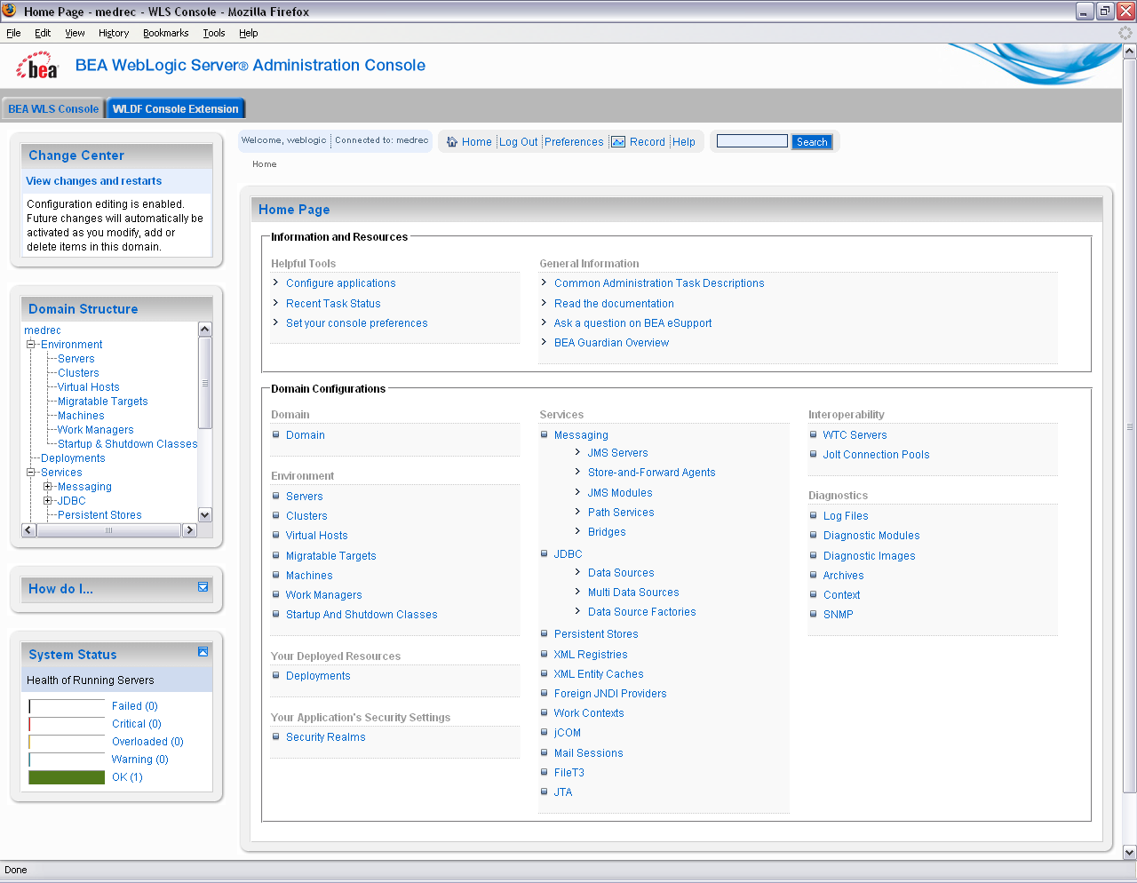

Slide 27
WebLogic Scripting Tool (WLST)
Scripting tool for administering a domain (create, configure, manage, monitor, deploy applications)
Based on Jython, which is a pure Java implementation of Python
Great for automating repetitive tasks
Heavy use by customers and within BEA
“Record” feature in Admin console: record actions to a WLST script
Two modes:
  Offline: analogous to the Configuration Wizard
  Online: analogous to the Administration Console
More info:
http://e-docs.bea.com/wls/docs100/config_scripting/index.html
Notes:
Using WLST Offline
Without connecting to a running WebLogic Server instance, you can use WLST to create domain templates, create a new domain based on existing templates, or extend an existing, inactive domain. You cannot use WLST offline to view performance data about resources in a domain or modify security data (such as adding or removing users).
WLST offline provides read and write access to the configuration data that is persisted in the domain's config directory or in a domain template JAR created using Template Builder. For information about a domain's configuration documents, see Domain Configuration Schema Reference and other schema reference documents listed on the BEA WebLogic 10.0 Reference page.
Note the following restrictions for modifying configuration data with WLST offline:
BEA recommends that you do not use WLST offline to manage the configuration of an active domain. Offline edits are ignored by running servers and can be overwritten by JMX clients such as WLST online or the WebLogic Server Administration Console.
As a performance optimization, WebLogic Server does not store most of its default values in the domain's configuration files. In some cases, this optimization prevents entire management objects from being displayed by WLST offline (because WebLogic Server has never written the corresponding XML elements to the domain's configuration files). For example, if you never modify the default logging severity level for a domain while the domain is active, WLST offline will not display the domain's Log management object. If you want to change the default value of attributes whose management object is not displayed by WLST offline, you must first use the create command to create the management object. Then you can cd to the management object and change the attribute value. See create.
Using WLST Online
You can use WLST to connect to a running Administration Server and manage the configuration of an active domain, view performance data about resources in the domain, or manage security data (such as adding or removing users). You can also use WLST to connect to Managed Servers, but you cannot modify configuration data from Managed Servers.
WLST online is a Java Management Extensions (JMX) client. It interacts with a server's in-memory collection of Managed Beans (MBeans), which are Java objects that provide a management interface for an underlying resource. For information on WebLogic Server MBeans, see " Understanding WebLogic Server MBeans" in Developing Custom Management Utilities with JMX.

Slide 28
Agenda
Topology
  Domain
  Server
  Admin Server
  Managed Server
  Cluster
  Node Manager
  Machine
Configuration Files
Administration Tools
Sample Configuration Schemes

Slide 29
Single Server/Development Configuration
config.xml
Single server acts as the Administration Server and as a host for applications
Not recommended for production, but standard for development
JNDI
JMS Queue
JDBC Pool
Admin Console

Slide 30
Configuring for Application Isolation
Deploy applications to their own servers
Admin server on its own server (highly recommended)
Each managed server on its own physical server
A1
A2
A3
Admin Server
Managed Server
Node Manager

Slide 31
Configuring for Extreme Application Isolation
Domain 1
Each application gets its own domain
Admin server on its own server (highly recommended)
Each managed server on its own physical server
A1
A1
A1
Domain 2
A2
A2
A2

Slide 32
Configuring for High Availability
Clustered servers for HA and scalability
All managed servers in the same cluster are on different machines, although machines are frequently shared
A1
A1
A1
A1
A2
A2
A2
A2
Admin Server
Managed Server
Node Manager

Slide 33
Configuring for Perf and Utilization
Multiple Managed Servers per machine
All Managed Servers in one cluster
Cluster replication scheme considers location in determining secondary Managed Servers
A1
A1
A1
A1
A1
A1
A1
A1

Slide 34
Simplified Administration
Multiple applications deployed to a single cluster
Admin server on its own server (highly recommended)
Single domain to manage
A1
A1
A1
A2
A2
A2
A3
A3
A3

Slide 35
Summary
WebLogic Server configuration is segmented by domain
  Each domain represents a configuration entity and uses one set of configuration artifacts
  Each domain has one Administration Server, and can have multiple managed servers and clusters
Node Manager is a per-machine process used to start and stop WebLogic Server instances
There are a number of administration tools available for configuring and managing a WebLogic domain:
  Config Wizard, Admin Console, WLST, weblogic.Deployer
Managed Servers
Admin Server
config.xml
Admin Console

Slide 36
Q
&
A

