Slide 1
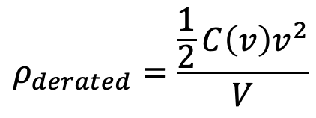
Derated Energy Density
Plotted: All TDK Class II Ceramics
$$ρ_{derated}=\frac{\frac{1}{2}C\left(v\right)v^{2}}{V}$$
Capacitors are better utilized (store more energy per unit mass/volume) when operated near their rated voltage
Metric may be used to directly compare capacitors with different voltage ratings
Logan: “I think the optimal design is to use only 100V and 450V capacitors”

Slide 2
Derated Capacitance Density

