Slide 1


RNS INSTITUTE OF TECHNOLOGY
Channasandra, Dr. Vishnuvardhan Road,Bengaluru – 560 098
2020 – 2021
DEPARTMENT OF INFORMATION SCIENCE
AND ENGINEERING
WEB STORE SYSTEM
WEB TECHNOLOGY MINI PROJECT
Parameshwar Bhat
1RN17IS065
Nagesh Raj T N
1RN17IS060
PROJECT GUIDE:
Dr. Ramya R S
Professor
ISE dept, RNSIT

Slide 2
AGENDA
INTRODUCTION
FRONT END
BACKEND
REQUIREMENTS
FUNCTIONALITIES
SYSTEM DESIGN
ARCHITECTURE DIAGRAM
SNAP SHOTS
CONCLUSION and FUTURE ENHANCEMENTS
REFERENCES

Slide 3
INTRODUCTION
The project entitled Web Store System is developed for the purpose of E-commerce by small businesses.
Online appearance has become the need of the hour for all companies and having a user-friendy, interactive website is utmost important
The Web Store system is a web-based application. It provides a user- friendly, interactive interface based on ReactJS, CSS, and HTML5 elements.
This application makes use of FireBase for hosting and Authentication purposes
The main reason for choosing the ReactJS framework for this application is to render a very interactive and fast website.
Excellent cloud facilities such as FireBase are available which can be easily integrated with out reactJS application.

Slide 4
FRONTEND
The biggest advantage of reactJS is that the front-end and the back-end is coded using the same languages and thus makes it simpler and more efficient.
Frontend has always been an important factor in making people get interested in the content that is to be displayed in the website. This provides a graphical interface to the user.
The layout of our project is achieved using HTML.
The styling for the HTML elements is done using CSS

Slide 5
HTML stands for Hypertext markup language provides a standard markup language for documents that have to be displayed on the browser. HTML can be assisted by CSS, JS for helping in design formats.
Materials-UI is helpful in using the right icons to make the website more appealing and to make the website more user friendly
CSS (Cascading Style Sheets), this helps for designing the basic HTML pages, this can be in the form of background styling, content styling. ReactJS makes it fairly simple to target inner elements.

Slide 6
BACKEND
The Backend for this application is mainly composed of JavaScript for computation and other functions. The Libraries available for ReactJS make it very easy to pull items such as icons directly from the web.
We also make use of FireBase as a tool for authentication while logging in and all the details such as ‘Valid email’, ’User does not exist’ are handled by Firebase.
FireBase also provides the option of hosting our current build for small scale use free of cost.

Slide 7
SYSTEM REQUIREMENTS
System requirements are the configuration that a system must have in order for a hardware or software application to run smoothly and efficiently.
SOFTWARE REQUIREMENTS-
Front end tools: HTML, CSS
Back end tools: FireBase
Browser : Google Chrome
HARDWARE REQUIREMENTS-
PROCESSESOR: i3/i5/amd
RAM: 3GB
500MB Memory
32-bit CPU

Slide 8
FUNCTIONALITIES
Functional Requirements defines the internal working of the software, i.e.,the calculations, technical details, data manipulation and processing and other specific functionality that show how the cases are to be satisfied and how they are supported by non-functional requirements, which impose constraints on the design or the implementation.
The following are the Functional requirements:
* The ability to perform the correct operation when the corresponding functions are called.
* When the function is called, the corresponding actions should be performed.
* The ability to store the data in the database when the input is fed from the front- end.

Slide 9
Non-Functional Requirements
Nonfunctional requirements are requirements which specify criteria that can be used to judge the operation of the system, rather than specific behaviors.
This should be contrasted with functional requirements that specify specific behavior or functions.
Typical nonfunctional requirements are reliability and scalability. Nonfunctional requirements are “constraints”, “quality attributes” and “quality of service requirements”.

Slide 10
SYSTEM DESIGN
Systems design is the process of defining the architecture, modules, interfaces, and data for a system to satisfy specified requirements.
The web-store application has a scope of 3 different levels:
* The User login
* The Home Page
* The Checkout Page

Slide 11
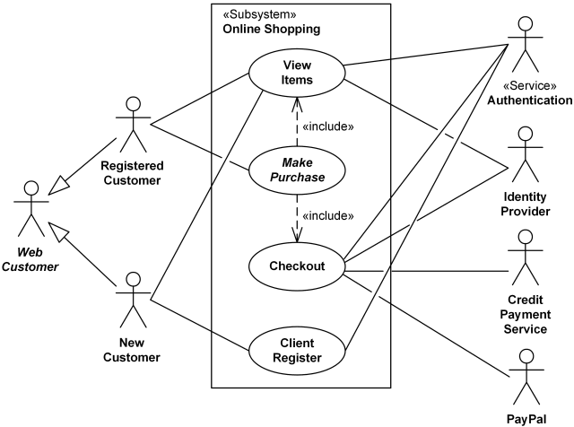
ARCHITECTURE DIAGRAM

Slide 12
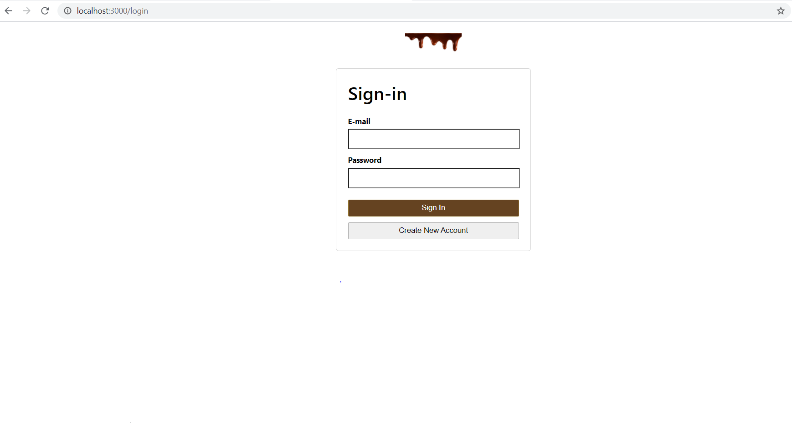
SNAP SHOTS
LOGIN/REGISTER PAGE

Slide 13
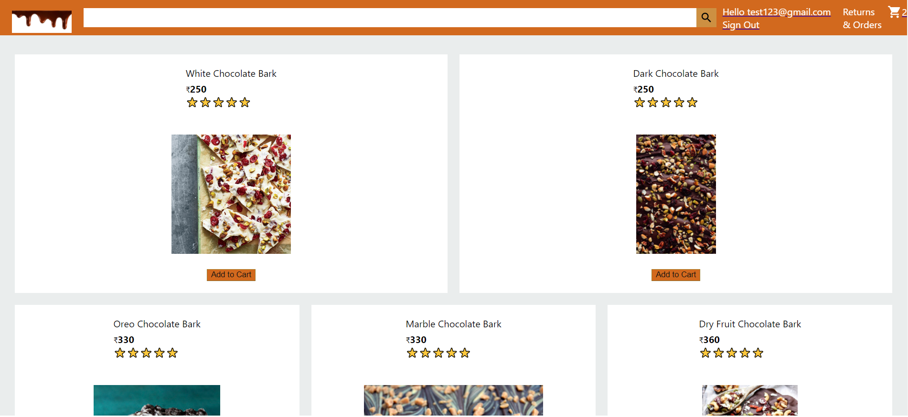
Home Page

Slide 14
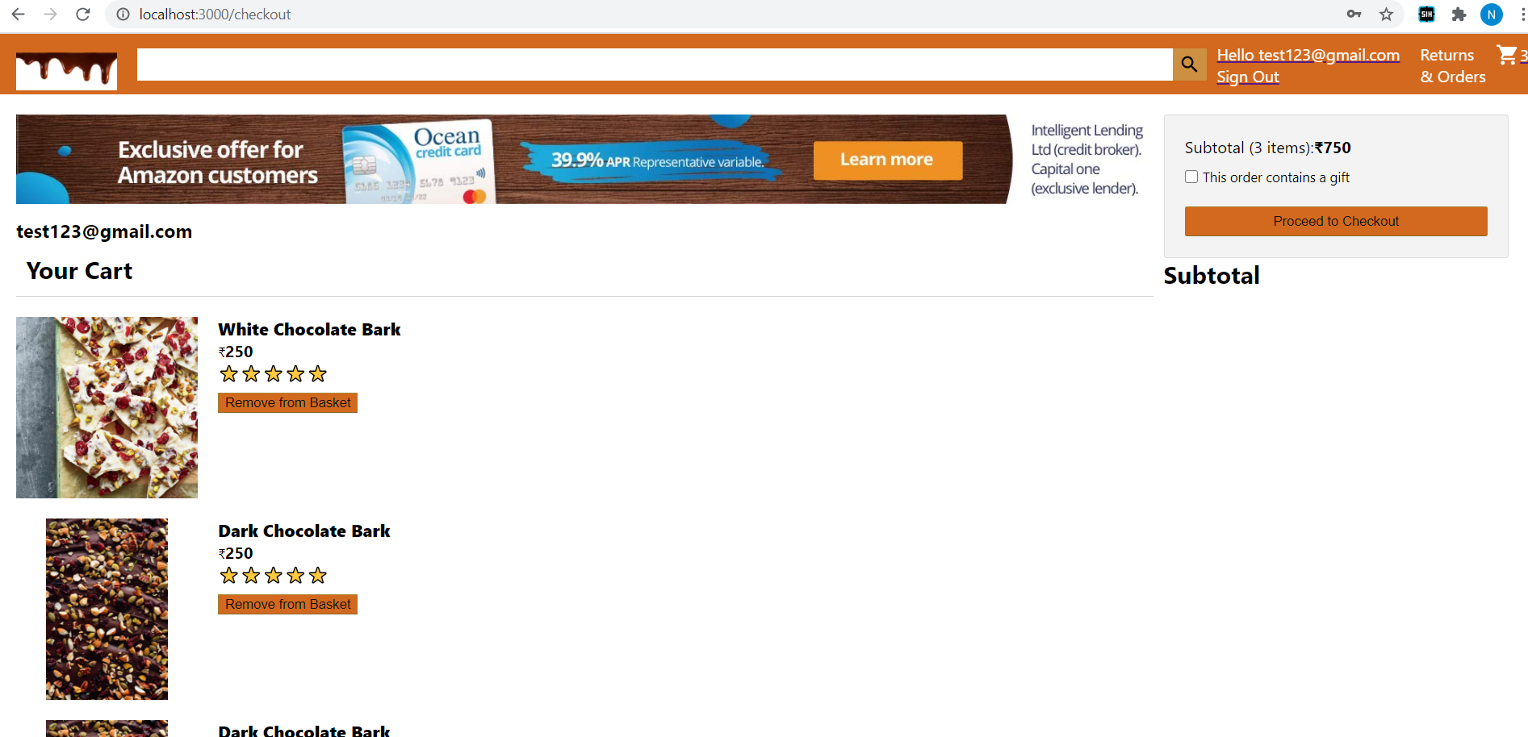
Cart Page

Slide 15
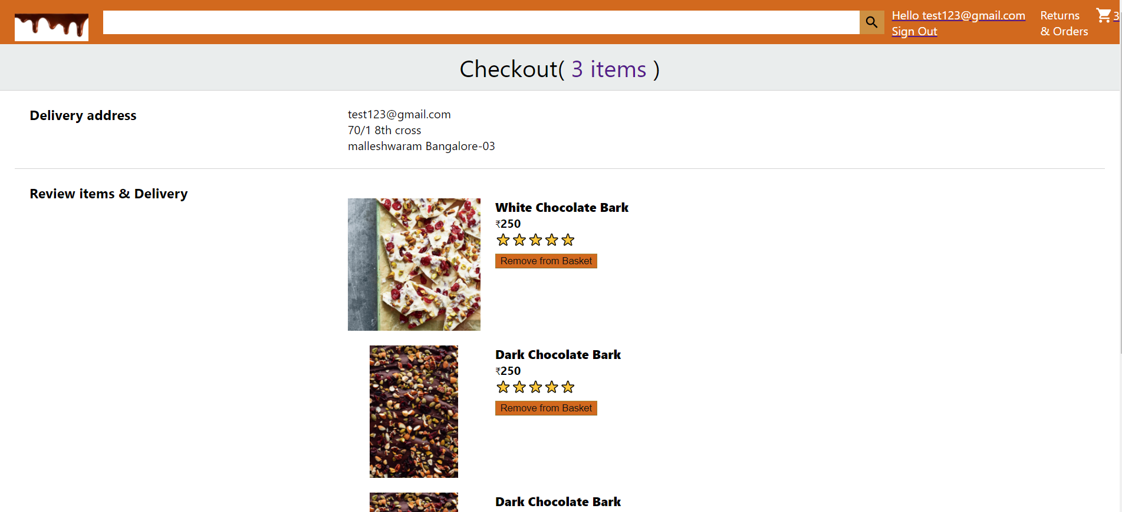
Checkout Page

Slide 16
CONCLUSIONS AND FUTURE ENHANCEMENTS
Conclusion
This Application can be used successfully by a company to make online presence
It helps in additional sales due to larger customer base and reach
This goes hand in hand with regular business as no modification to existing business prospect is required
This project has been deployed using the FireBase tools.
Limitation and Future work
This application has been provided with support for accepting online payments and can be implemented as and when required.
This application can be linked with a stand-alone DataBase like FireStore to fit applications where the number of items are large
The User Interface can be improved further to tailor the needs of the organisation

Slide 17
REFERENCES
www.w3schools.com
www. GeeksForGeeks.com
Fundamentals to web development by Randdy Connolly, 1st edition, Pearson education, India.
www. StackOverflow.com
Learning React: Functional Web Development with React and Redux

Slide 18
THANK YOU !

