Slide 1
Git: Part 1 Overview & Object Model
These slides were largely cut-and-pasted from http://excess.org/article/2008/07/ogre-git-tutorial/ , with some additions from other sources. I have deleted a lot from the cited tutorial, and recommend that you listen to the entire tutorial on line, if you can.

Slide 2
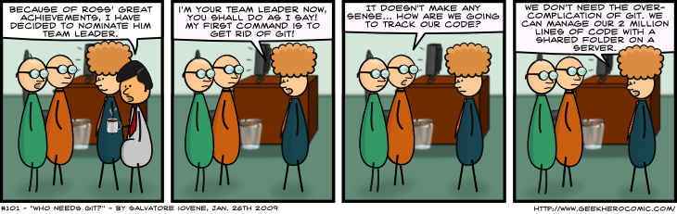
Who needs Git?
http://www.geekherocomic.com/2009/01/26/who-needs-git/

Slide 3
Topics
What is Git?
SCM concepts used in Git
Git object model
Representation of Git objects as files
References

Slide 4
Git
A collection of tools developed by Linux kernel group for SCM
Now used by several other groups, and apparently growing in popularity
Actually implements a replicated versioned file system
Can be used to implement a variety of software configuration management models and workflows

Slide 5
Git Flavor
A collection of many tools
Evolved from scripts
Suited to a C programmer’s mentality
Everything is exposed and accessible
Very flexible
You can do anything the model permits
Including shooting yourself in the foot
Need to understand the underlying model

Slide 6
Git has a lot of commands
Learn a core subset of them
And one of the GUI tools (e.g., gitk)
Then learn the rest as you need them

Slide 7
Groups of Git commands
Setup and branch management
init, checkout, branch
Modify
add, delete, rename, commit
Get information
status, diff, log
Create reference points
tag, branch

Slide 8
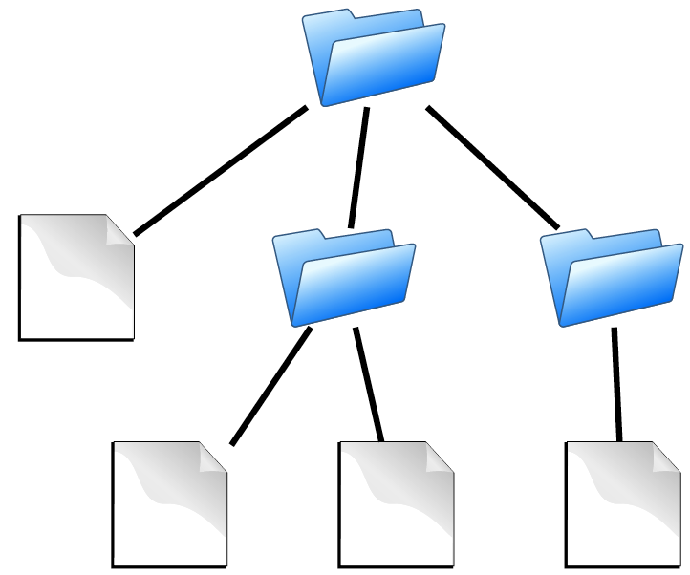
Source code
contains
Directories
Files
is the substance of a software configuration
http://edgyu.excess.org/git-tutorial/2008-07-09/intro-to-git.pdf

Slide 9

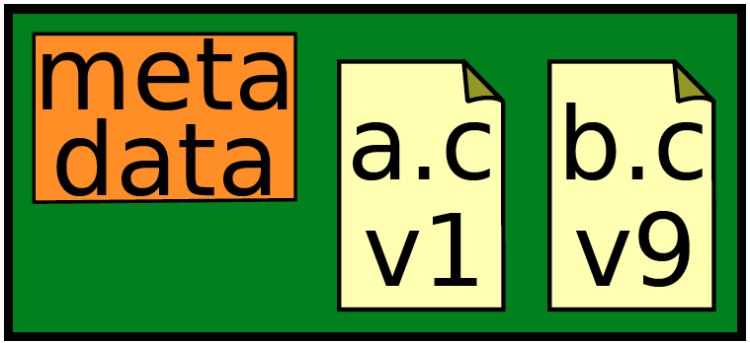
Repository
Contains
files
commits
records history of changes to configuration
http://edgyu.excess.org/git-tutorial/2008-07-09/intro-to-git.pdf

Slide 10
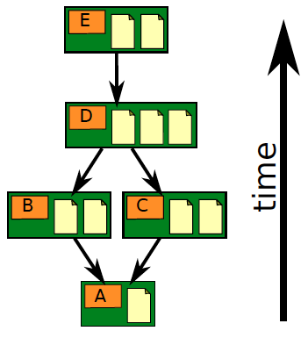
Repository
Contains
files
commits
ancestry relationships
http://edgyu.excess.org/git-tutorial/2008-07-09/intro-to-git.pdf

Slide 11
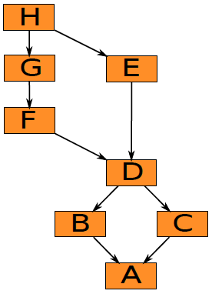
Ancestry relationships
form a directed acyclic graph (DAG)
http://edgyu.excess.org/git-tutorial/2008-07-09/intro-to-git.pdf

Slide 12
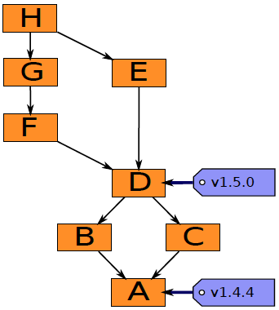
Ancestry graph features
Tags
identify versions of interest
including “releases”
http://edgyu.excess.org/git-tutorial/2008-07-09/intro-to-git.pdf

Slide 13
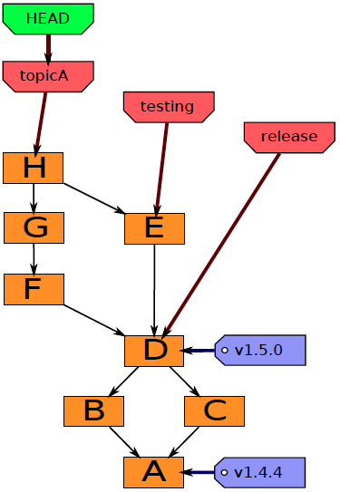
Ancestry graph features
HEAD
is current checkout
usually points to a branch
http://edgyu.excess.org/git-tutorial/2008-07-09/intro-to-git.pdf

Slide 14
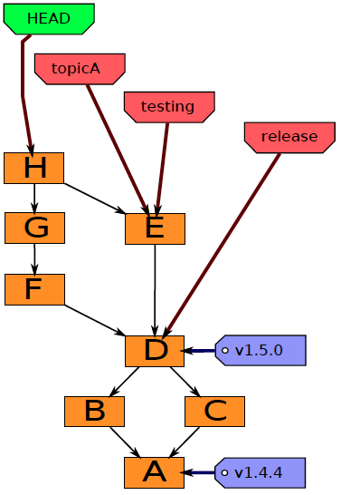
Head may point to any commit
In this case it is said to be detached.
http://edgyu.excess.org/git-tutorial/2008-07-09/intro-to-git.pdf

Slide 15
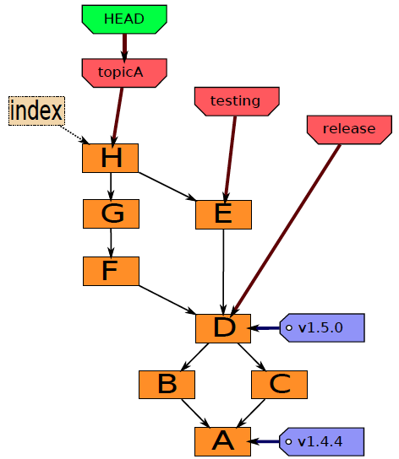
Git components
Index
“staging area”
what is to be committed
http://edgyu.excess.org/git-tutorial/2008-07-09/intro-to-git.pdf

Slide 16
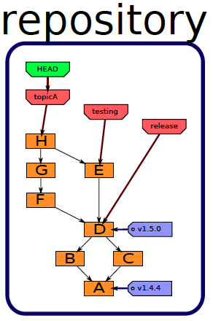
History
A database, stored in directory “.git”.
http://edgyu.excess.org/git-tutorial/2008-07-09/intro-to-git.pdf

Slide 17
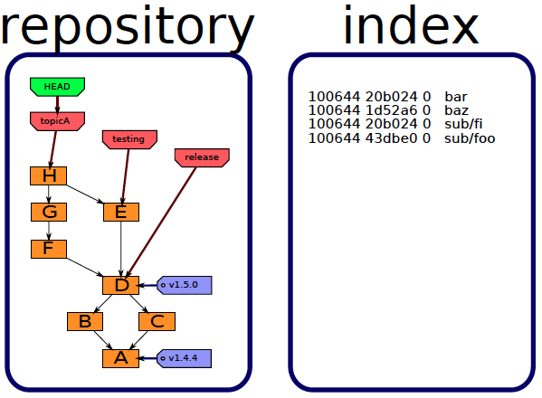
Staging area
Also stored in directory “.git”.
http://edgyu.excess.org/git-tutorial/2008-07-09/intro-to-git.pdf

Slide 18
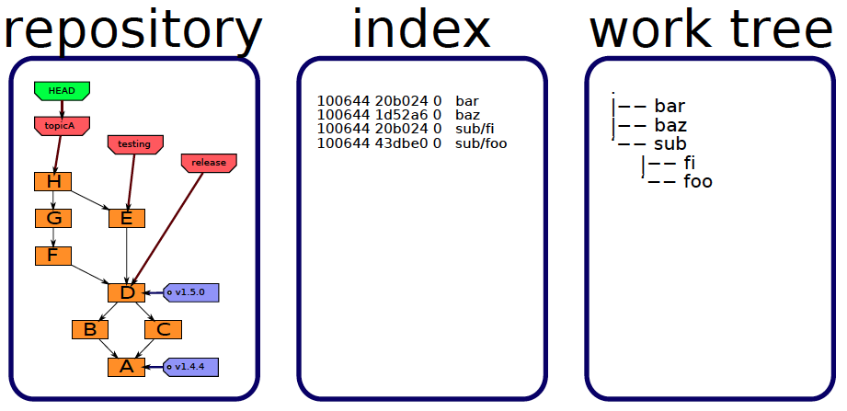
Files you edit
Stored in the directory containing directory “.git”.
http://edgyu.excess.org/git-tutorial/2008-07-09/intro-to-git.pdf

Slide 19
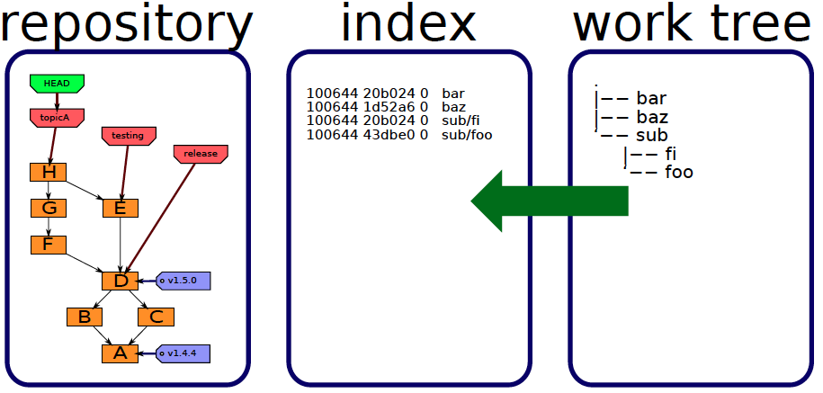
Staging
add
http://edgyu.excess.org/git-tutorial/2008-07-09/intro-to-git.pdf

Slide 20
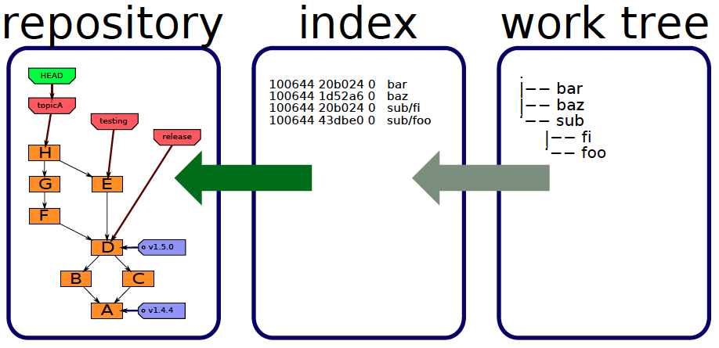
Committing
commit
http://edgyu.excess.org/git-tutorial/2008-07-09/intro-to-git.pdf

Slide 21
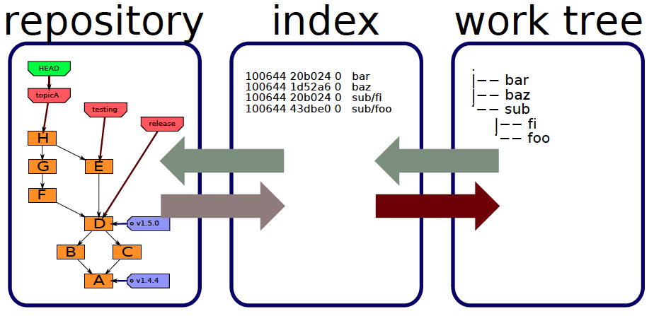
Checking out
checkout
checkout
http://edgyu.excess.org/git-tutorial/2008-07-09/intro-to-git.pdf

Slide 22
Local Operations
Repository (.git directory)
Index (staging area)
Working directory
checkout the project
add (stage) files
commit

Slide 23
Object types
Blobs
Trees
Commits
Tags

Slide 24
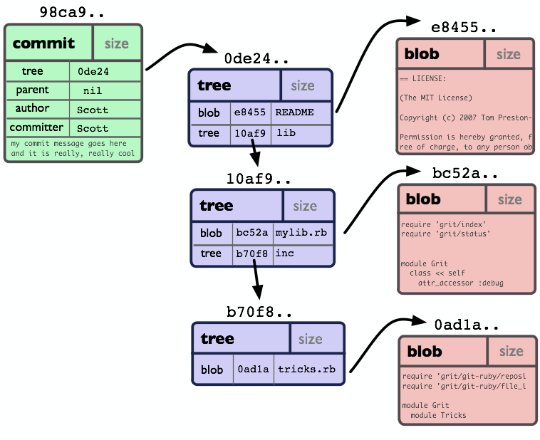
Git Object Model
http://book.git-scm.com/assets/images/figure/objects-example.png

Slide 25
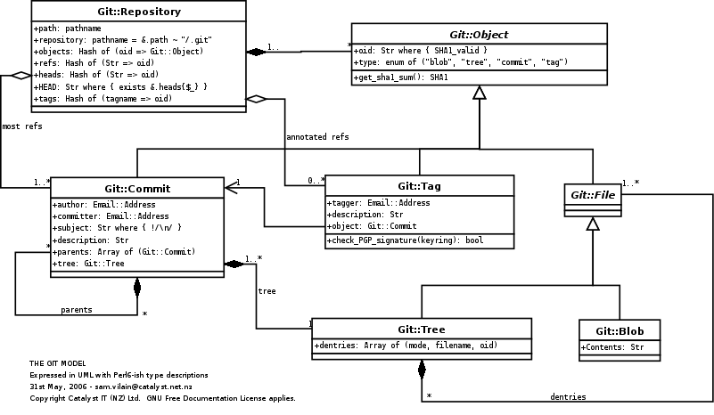
As UML class diagram
http://utsl.gen.nz/talks/git-svn/git-model.png
Notes:
The component clases of the Git object model, as a UML class diagram.

Slide 26
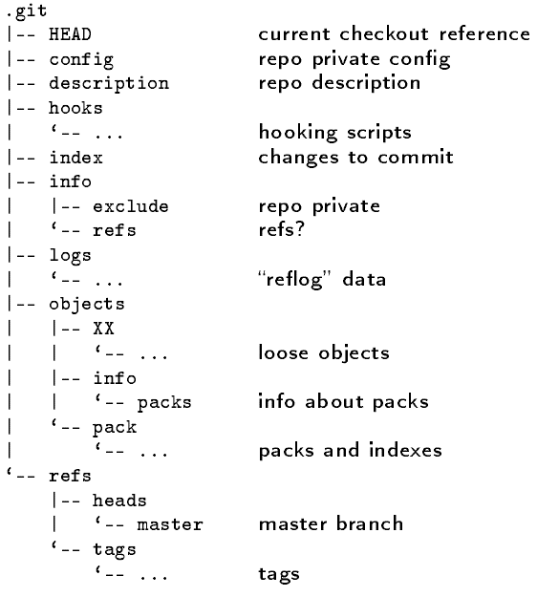
Repository
Notes:
The repository is stored in the subdirectory .git of the working directory.

Slide 27
.git/objects
|-- 23
| ‘-- d4bd826aba9e29aaace9411cc175b784edc399
|-- 76
| ‘-- 49f82d40a98b1ba59057798e47aab2a99a11d3
|-- c4
| ‘-- aaefaa8a48ad4ad379dc1002b78f1a3e4ceabc
|-- e7
| ‘-- 4be61128eef713459ca4e32398d689fe80864e
|-- info
| ‘-- packs
‘-- pack
|-- pack-b7b026b1a0b0f193db9dea0b0d7367d25d3a68cc.idx
‘-- pack-b7b026b1a0b0f193db9dea0b0d7367d25d3a68cc.pack
loose

Slide 28
Some other repository files
.git/config
.git/description – used by gitweb
.git/info/exclude – files to ignore
...

Slide 29
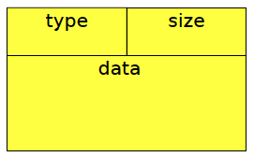
Repository object naming convention
“content addressable” (hashed)
http://edgyu.excess.org/git-tutorial/2008-07-09/intro-to-git.pdf

Slide 30
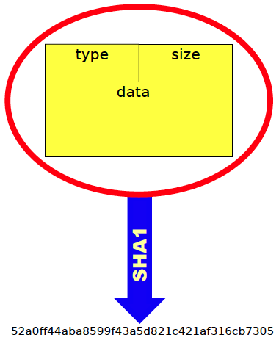
Data values determine hash
http://edgyu.excess.org/git-tutorial/2008-07-09/intro-to-git.pdf

Slide 31
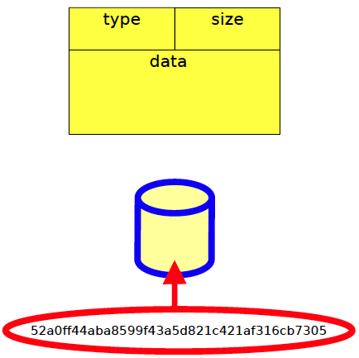
Hash value is filename
http://edgyu.excess.org/git-tutorial/2008-07-09/intro-to-git.pdf

Slide 32
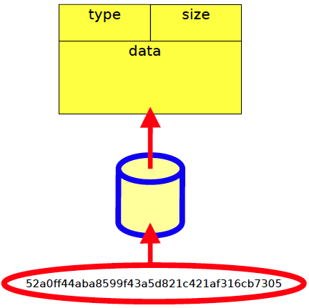
File contains data
http://edgyu.excess.org/git-tutorial/2008-07-09/intro-to-git.pdf

Slide 33
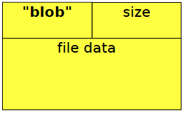
Blobs
http://edgyu.excess.org/git-tutorial/2008-07-09/intro-to-git.pdf

Slide 34
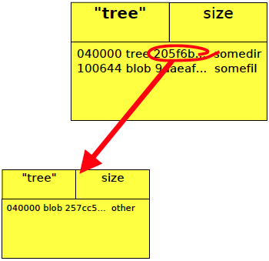
Trees
http://edgyu.excess.org/git-tutorial/2008-07-09/intro-to-git.pdf

Slide 35
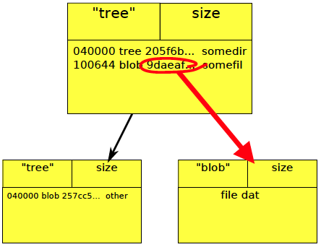
Trees
http://edgyu.excess.org/git-tutorial/2008-07-09/intro-to-git.pdf

Slide 36
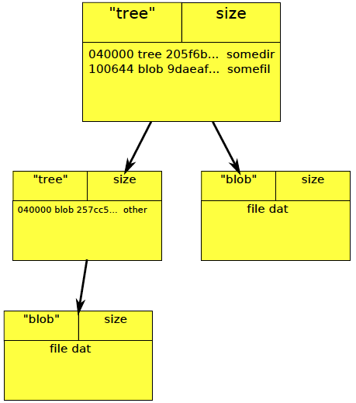
Trees
http://edgyu.excess.org/git-tutorial/2008-07-09/intro-to-git.pdf

Slide 37
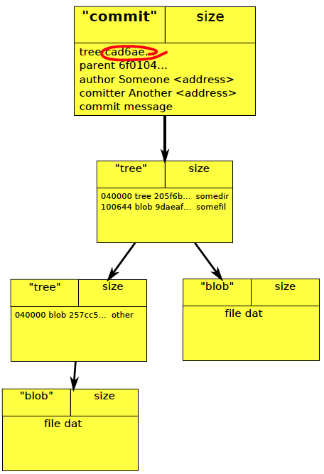
Commits
http://edgyu.excess.org/git-tutorial/2008-07-09/intro-to-git.pdf

Slide 38
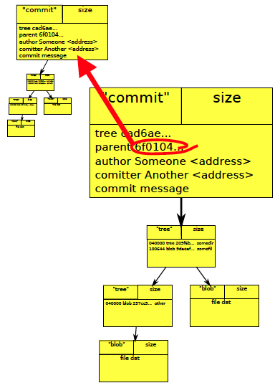
Commits
http://edgyu.excess.org/git-tutorial/2008-07-09/intro-to-git.pdf

Slide 39
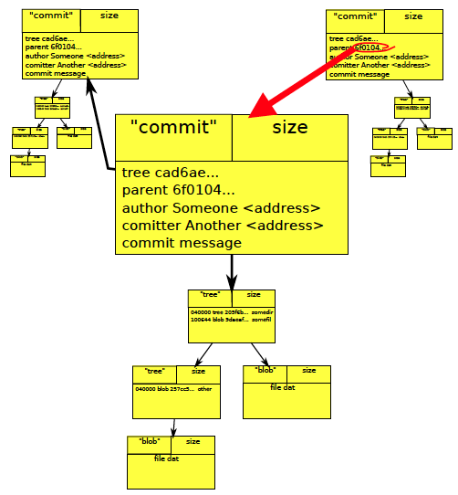
Commits
http://edgyu.excess.org/git-tutorial/2008-07-09/intro-to-git.pdf

Slide 40
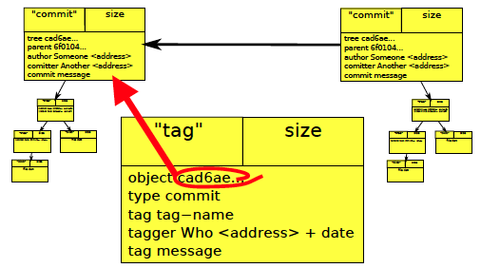
Commits
http://edgyu.excess.org/git-tutorial/2008-07-09/intro-to-git.pdf

Slide 41
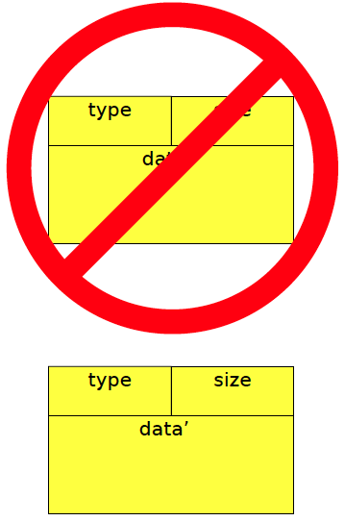
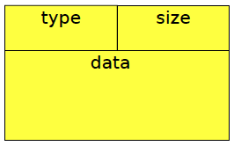
Objects are immutable
http://edgyu.excess.org/git-tutorial/2008-07-09/intro-to-git.pdf

Slide 42
References
http://book.git-scm.com/index.html
http://excess.org/article/2008/07/ogre-git-tutorial/
http://www-cs-students.stanford.edu/~blynn/gitmagic/
http://progit.org/book/
http://www.geekherocomic.com/2009/01/26/who-needs-git/

