Slide 1
VERSION CONTROL SYSTEM (VCS)
HELP YOU TRACK/MANAGE/DISTRIBUTE REVISIONS
STANDARD IN MODERN DEVELOPMENT
EXAMPLES:
  CONCURRENT VERSIONS SYSTEM (CVS)
  SUBVERSION (SVN)
  GIT

Slide 2
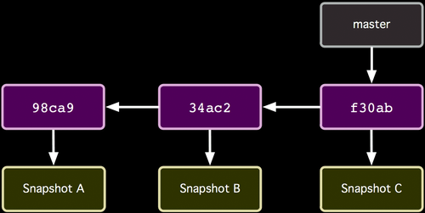
HOW REPOSITORIES ARE ORGANIZED
http://git-scm.com/book/

Slide 3
HOW REPOSITORIES ARE ORGANIZED
Commits (from oldest to newest; hashes as commit IDs)
Snapshot of all files at each commit
http://git-scm.com/book/

Slide 4
HOW COMMIT WORKS
Master at < 34ac2 > commit ID
http://git-scm.com/book/

Slide 5
HOW REPOSITORIES ARE ORGANIZED
Master at < f30ab > commit Id
http://git-scm.com/book/

Slide 6
HOW REPOSITORIES ARE ORGANIZED
Head commit is <f30ab>
http://git-scm.com/book/

Slide 7
COMMON WORKFLOW
CREATE TEMP LOCAL BRANCH
CHECKOUT TEMP BRANCH (PULL)
EDIT/ADD/COMMIT/PUSH ON TEMP BRANCH
CHECKOUT MASTER BRANCH
PULL TO UPDATE MASTER BRANCH
MERGE TEMP BRANCH WITH UPDATED MASTER
DELETE TEMP BRANCH
PUSH TO UPDATE SERVER REPOS

Slide 8
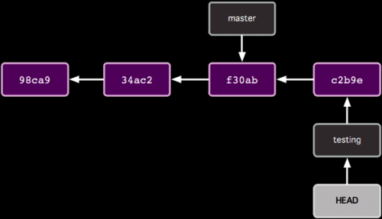
ORGANIZATION WITH TWO BRANCHES

Slide 9
ORGANIZATION WITH TWO BRANCHES
Last commit of each branch

Slide 10
ORGANIZATION WITH TWO BRANCHES
Currently checked out branch

Slide 11
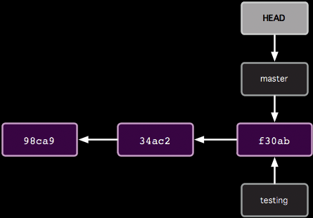
HOW GIT BRANCH WORKS
$ git branch testing
Before

Slide 12
HOW GIT BRANCH WORKS
$ git branch testing
After

Slide 13
COMMON WORKFLOW
CREATE TEMP LOCAL BRANCH
CHECKOUT TEMP BRANCH
EDIT/ADD/COMMIT ON TEMP BRANCH
CHECKOUT MASTER BRANCH
PULL TO UPDATE MASTER BRANCH
MERGE TEMP BRANCH WITH UPDATED MASTER
DELETE TEMP BRANCH
PUSH TO UPDATE SERVER REPOS

Slide 14
HOW GIT CHECKOUT WORKS
$ git checkout testing
Before

Slide 15
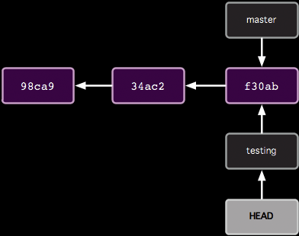
HOW GIT CHECKOUT WORKS
$ git checkout testing
After

Slide 16
COMMON WORKFLOW
CREATE TEMP LOCAL BRANCH
CHECKOUT TEMP BRANCH
EDIT/ADD/COMMIT ON TEMP BRANCH
CHECKOUT MASTER BRANCH
PULL TO UPDATE MASTER BRANCH
MERGE TEMP BRANCH WITH UPDATED MASTER
DELETE TEMP BRANCH
PUSH TO UPDATE SERVER REPOS

Slide 17
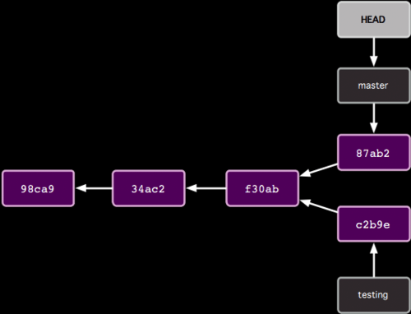
HOW GIT COMMIT WORKS WITH MULTIPLE BRANCHES
Edit some stuff
$ git add -A
$ git commit –m “testing1"
Before

Slide 18
HOW GIT COMMIT WORKS WITH MULTIPLE BRANCHES
Edit some stuff
$ git add -A
$ git commit –m “testing1"
After

Slide 19
COMMON WORKFLOW
CREATE TEMP LOCAL BRANCH
CHECKOUT TEMP BRANCH
EDIT/ADD/COMMIT ON TEMP BRANCH
CHECKOUT MASTER BRANCH
PULL TO UPDATE MASTER BRANCH
MERGE TEMP BRANCH WITH UPDATED MASTER
DELETE TEMP BRANCH
PUSH TO UPDATE SERVER REPOS

Slide 20
HOW GIT CHECKOUT WORKS
$ git checkout master
Before

Slide 21
HOW GIT CHECKOUT WORKS
$ git checkout master
After

Slide 22
COMMON WORKFLOW
CREATE TEMP LOCAL BRANCH
CHECKOUT TEMP BRANCH
EDIT/ADD/COMMIT ON TEMP BRANCH
CHECKOUT MASTER BRANCH
PULL TO UPDATE MASTER BRANCH
MERGE TEMP BRANCH WITH UPDATED MASTER
DELETE TEMP BRANCH
PUSH TO UPDATE SERVER REPOS

Slide 23
HOW GIT CHECKOUT WORKS
$ git checkout master

Slide 24
COMMON WORKFLOW
CREATE TEMP LOCAL BRANCH
CHECKOUT TEMP BRANCH
EDIT/ADD/COMMIT ON TEMP BRANCH
CHECKOUT MASTER BRANCH
PULL TO UPDATE MASTER BRANCH
MERGE TEMP BRANCH WITH UPDATED MASTER
DELETE TEMP BRANCH
PUSH TO UPDATE SERVER REPOS

Slide 25
HOW GIT PULL WORKS
Someone else pushed
$ git pull

Slide 26
COMMON WORKFLOW
CREATE TEMP LOCAL BRANCH
CHECKOUT TEMP BRANCH
EDIT/ADD/COMMIT ON TEMP BRANCH
CHECKOUT MASTER BRANCH
PULL TO UPDATE MASTER BRANCH
MERGE TEMP BRANCH WITH UPDATED MASTER
DELETE TEMP BRANCH
PUSH TO UPDATE SERVER REPOS

Slide 27
HOW GIT MERGE WORKS
$ git merge testing
e2b92

Slide 28
COMMON WORKFLOW
CREATE TEMP LOCAL BRANCH
CHECKOUT TEMP BRANCH
EDIT/ADD/COMMIT ON TEMP BRANCH
CHECKOUT MASTER BRANCH
PULL TO UPDATE MASTER BRANCH
MERGE TEMP BRANCH WITH UPDATED MASTER
DELETE TEMP BRANCH
PUSH TO UPDATE SERVER REPOS

Slide 29
HOW TO DELETE BRANCHES
$ git branch -d testing
e2b92

Slide 30
COMMON WORKFLOW
CREATE TEMP LOCAL BRANCH
CHECKOUT TEMP BRANCH
EDIT/ADD/COMMIT ON TEMP BRANCH
CHECKOUT MASTER BRANCH
PULL TO UPDATE MASTER BRANCH
MERGE TEMP BRANCH WITH UPDATED MASTER
DELETE TEMP BRANCH
PUSH TO UPDATE SERVER REPOS

Slide 31
HOW GIT PUSH WORKS
$ git push
e2b92

Slide 32
COMMANDS
Basic :
git init
git status
git add
git commit –m “message”
git push
git pull
git revert <commitId>
Info:
git log
git diff <commitId1> <commitId2>

Slide 33
BRANCH COMMANDS
To create Branch
git branch <branchname>
To enter into that branch
git checkout <branchname>
To check in which branch you are
git branch
To delete the branch
git branch –D <branchname>

Slide 34
BRANCH MERGE COMMAND
To merge with another branch into current you checkout branch.
git merge testing
Example:
git checkout master (entered in master branch)
git pull (pull master branch)
git merge testing (marched master branch with testing)
Note: now the code from testing branch pushed to master branch.
Notes:
B

Slide 35
BRANCH REBASE COMMAND
Rebase is also just like Merge but we have to do in two steps.
First we have to rebase master into testing.
now testing is updated with master.
Then rebase testing into master
now two branches merged with each other.
git checkout testing
git rebase master

