Slide 1

A
PROJECT
ON
WEATHER PREDICTION
BACHELOR OF TECHNOLOGY
IN
COMPUTER SCIENCE AND ENGINEERING
BY
ADARSH P R 23VE1A05k3
MALOTHU SIDDHU 23VE1A05N0
VALLURI NAGESHWARI 23VE1A05R3
ENJETI DEEPTHI 23VE1A0521
ACADEMIC BATCH: 2023-2027
Under the Guidance of
Mr. M. Hari Prasad

Slide 2
CONTENT ________________________________________________
Abstract
Existing System
Drawbacks of Existing System
Proposed System
Merits of Proposed System
Hardware and Software Requirements
Functional and Non-Functional Requirements
Architecture Diagram

Slide 3
ABSTRACT ________________________________________________
Weather prediction is a crucial scientific process that involves forecasting atmospheric conditions based on the analysis of meteorological data. Advanced techniques, including numerical weather prediction (NWP), machine learning models, and satellite observations, are used to improve accuracy. Traditional forecasting relies on physical models that simulate atmospheric behavior, while modern approaches integrate artificial intelligence (AI) and big data analytics to enhance predictions. The accuracy of weather forecasts is influenced by factors such as data quality, computational power, and the complexity of atmospheric interactions. Improved weather prediction is essential for disaster preparedness, agriculture, aviation, and daily life. Despite advancements, challenges such as sudden weather changes and model uncertainties persist. Future research focuses on enhancing predictive models using deep learning, quantum computing, and real-time data assimilation to achieve more precise and reliable forecasts.

Slide 4
EXISTING SYSTEM ________________________________________________
Numerical Weather Prediction (NWP)
Satellite and Radar-Based Forecasting
Statistical and Historical Data Models
Machine Learning and AI-Based Systems
Challenges in the Existing System

Slide 5
DRAWBACKS ________________________________________________
Limited Accuracy for Long-Term Forecasts
High Dependence on Data Availability
Challenges in Predicting Extreme Weather Events
Dependency on Human Interpretation
Real-Time Data Processing Limitations

Slide 6
PROPOSED SYSTEM ________________________________________________
AI and Machine Learning-Based Prediction Models
Real-Time Data Collection and Processing
Improved Numerical Weather Prediction (NWP) Models
Big Data and Quantum Computing for Faster Processing
User-Friendly Mobile and Web Applications

Slide 7
ADVANTAGES ________________________________________________
Increased Forecast Accuracy
Faster Data Processing and Real-Time Updates
Better Prediction of Extreme Weather Events
Scalability and Cost Efficiency
Climate Change Adaptability

Slide 8
HARDWARE & SOFTWARE REQUIREMENTS ________________________________________________
HARDWARE REQUIREMENTS:
Devices : Laptops , Mobile Devices (Smartphones & Tablets)
Network : High-Speed Internet(5G / Wi-Fi)
Processor : High-Speed SSDs (Solid State Drives) and HDDs (Hard Disk Drives)

Slide 9
HARDWARE & SOFTWARE REQUIREMENTS ________________________________________________
SOFTWARE REQUIREMENTS:
Operating System : Windows, Android/iOS
Programming Language : Python3
Libraries used : TensorFlow, OpenCV, Scikit-learn

Slide 10
FUNCTIONAL AND NON- FUNCTIONAL REQUIREMENTS ________________________________________________
FUNCTIONAL REQUIREMENTS:
Data Collection and Integration.
Weather Forecasting and Analysis
Data Storage and Management
Security and User Authentication

Slide 11
FUNCTIONAL AND NON- FUNCTIONAL REQUIREMENTS ________________________________________________
NON- FUNCTIONAL REQUIREMENTS:
Performance.
Reliability.
Usability.
Maintainability.

Slide 12
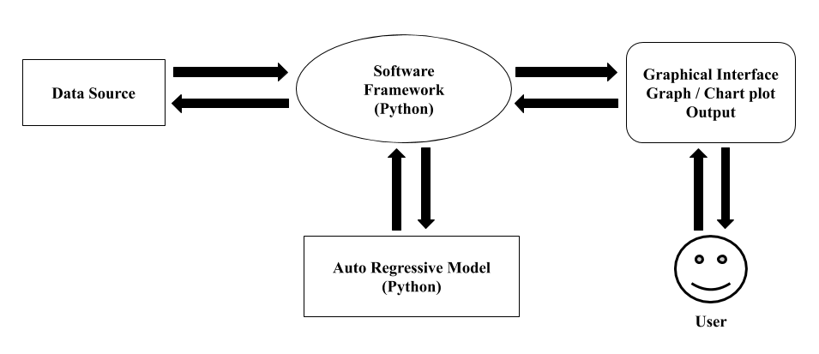
ARCHITECTURE DIAGRAM ________________________________________________

Slide 13
Queries?

