Slide 1
OIC

Slide 2
Ways to connect OIC (115 Adapters)
Oracle SaaS -> Oracle SaaS
Oracle Saas-> Third-party SaaS Apps(SF,SAP,CRM,HRMS…ETC)
Oracle Saas-> On-Prem Apps
Generic social media apps(Li,TW,FAC,OUTLOOK,MS..ETC)
Generic services (SOAP,REST,DB,FILE,FTP)

Slide 3
Basic Building blocks in OIC
Connections
Adapters
Integration
Map
Library
Agent
Lookups
Package
Events

Slide 4
Knowledge on topics
SOAP
REST
DB
SOAPU UI
POSTMEN
BASICS OF Fusion Apps
Bi Reports

Slide 5
OIC Versions
ICS 1.0
OIC 2.0 -> 6
OIC 3.0 -> 3

Slide 6
How many style/patterns in OIC
Application (App driven Orch)
Schedule Applications
Event

Slide 7
Oracle Integration Cloud (OIC) Editions
Feature / Capability | Standard Edition | Enterprise Edition
Integration (App-to-App) | ✅ Supported | ✅ Supported
Prebuilt Adapters (ERP, HCM, Salesforce etc.) | ✅ Yes | ✅ Yes
File-Based Integration | ✅ Yes | ✅ Yes
Process Automation (BPM / Workflow) | ❌ Not available | ✅ Full support
Visual Builder (Web & Mobile App Development) | ❌ Not included | ✅ Included
B2B (EDI, B2B messaging) | ❌ Not included | ✅ Included
Integration Insight (Monitoring business flows) | ❌ Not included | ✅ Included
API Management & Gateway | Limited | ✅ Advanced API Management
Licensing Pricing | 💰 Lower | 💰 Higher (more capabilities)

Slide 8
Key Difference: OIC Standard vs Enterprise
Point | Standard Edition | Enterprise Edition
Scope | Only Integrations (app-to-app) | Integrations + Process Automation + B2B + Insight
Workflow / Process Automation | ❌ Not available | ✅ Fully available
Visual Builder (Web/Mobile Apps) | ❌ Not included | ✅ Included
B2B (EDI transactions) | ❌ No | ✅ Yes
Integration Insight | ❌ No | ✅ Yes
API Platform Capabilities | Basic | Advanced
Cost | Lower | Higher

Slide 9
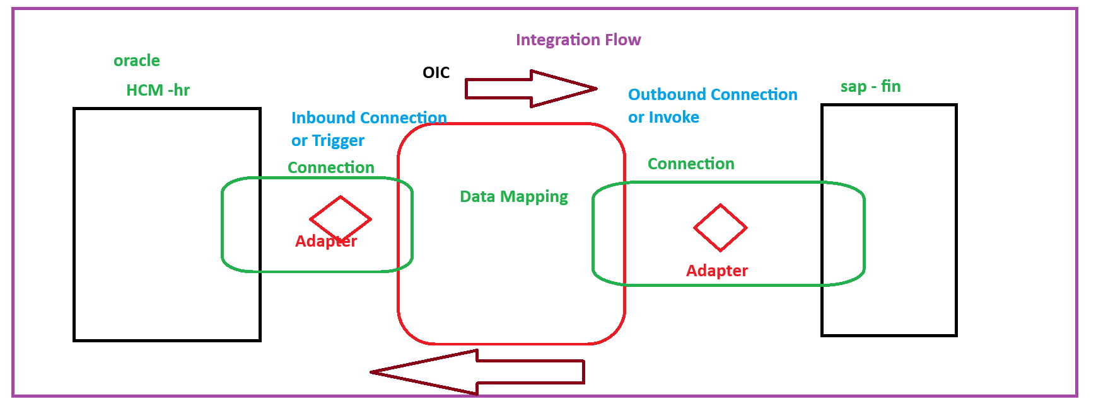
OIC Arch

Slide 10
Steps to Integration Flow
Create Connection
Create Integration ( Draft)
Add connection to Integration ( Trigger , Invoke) and configure
Data Mapping (Validate)
Business Identifier ( Tracking Variables)
Save the Application ( Configure)
Activate Your Application
Run Your application

Slide 11
Case Study
Create Integration application Add Two Numbers

Slide 12
Webservice
Interoperability (Function/Methods/Operation/Procedure)
Two Types ws
SOAP -> Jax-ws (XML)
REST -> Jax-Rs(XML,JSON)

Slide 13
SOAP -> Jax-ws
XML
SOAP
WSDL

Slide 14
JAX-RS- REST Services
http Methods
Get -> Select
Put -> Insert/Crete
Push/Patch -> Update
Delete -> Delete

Slide 15
Status Code
Success (2xx)
Everything is sunshine here. • 200 OK Request succeeded • 201 Created A new resource got created successfully • 202 Accepted Request received but processing still happening • 204 No Content Success but nothing to return in the response body
🧭 Client Errors (4xx)
Client has some issue. Missing data, wrong path, unauthorized access. • 400 Bad Request Invalid input or malformed request • 401 Unauthorized Missing or invalid authentication • 403 Forbidden You are authenticated but not allowed to do this • 404 Not Found The resource does not exist • 405 Method Not Allowed Wrong HTTP method (using POST instead of GET, etc.) • 409 Conflict Resource conflict. Example: duplicate record insert • 415 Unsupported Media Type Body or format not supported • 429 Too Many Requests Hit the rate limit
💥 Server Errors (5xx)
Problem on server side. Client did nothing wrong. • 500 Internal Server Error Generic server crash • 502 Bad Gateway Invalid response from another service • 503 Service Unavailable Server is down or overloaded • 504 Gateway Timeout Server taking too long to respond
🎯 Quick suggestions for when to use what
• Creating an employee → 201 Created • Wrong date format in request → 400 Bad Request • JWT token expired → 401 Unauthorized • Trying to delete payroll when not permitted → 403 Forbidden • Service temporarily down for maintenance → 503 Service Unavailable

Slide 16
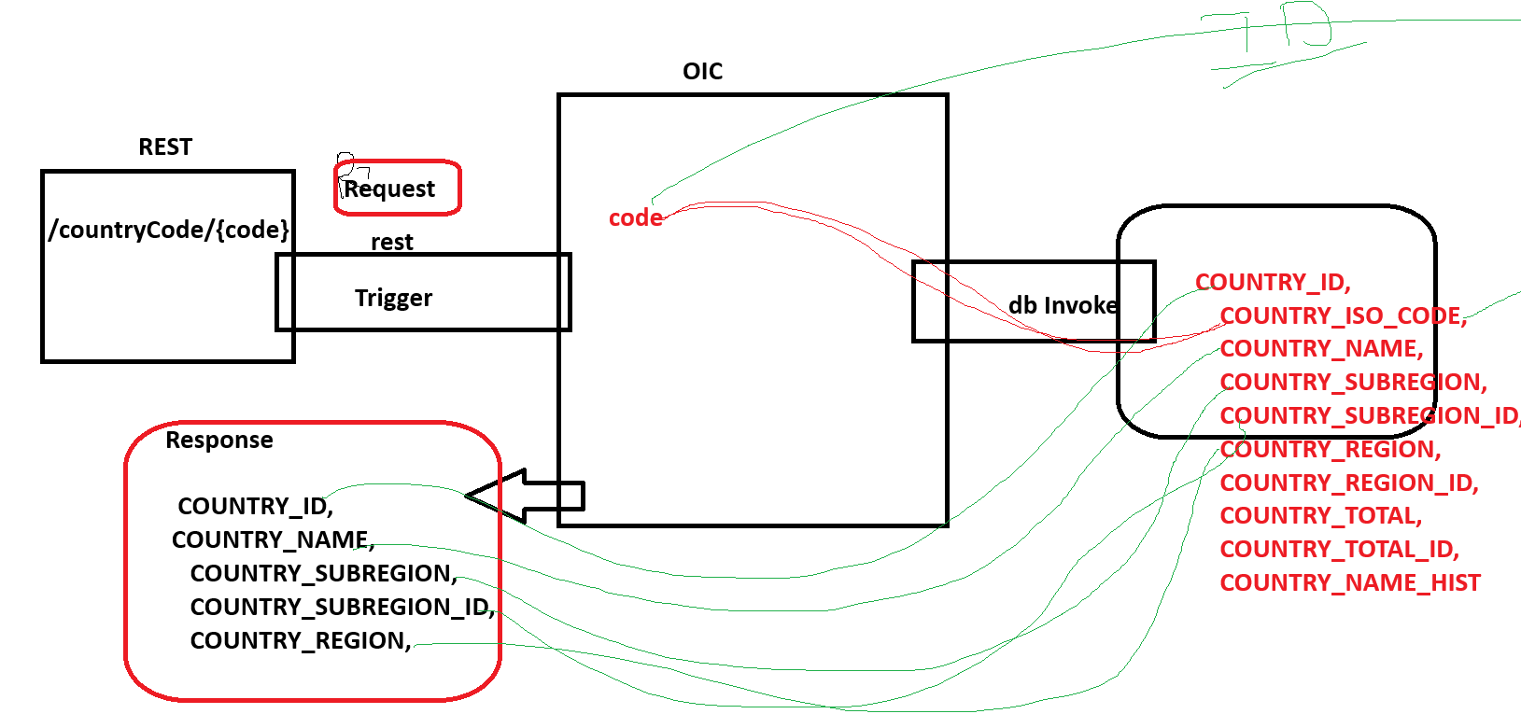
Db connections example

Slide 17
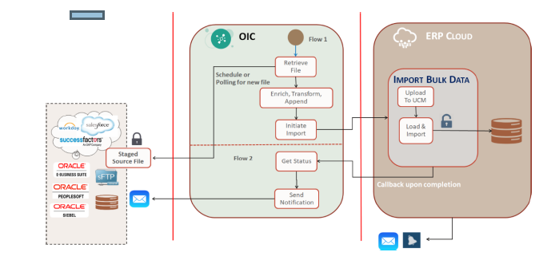
FBDI

Slide 18
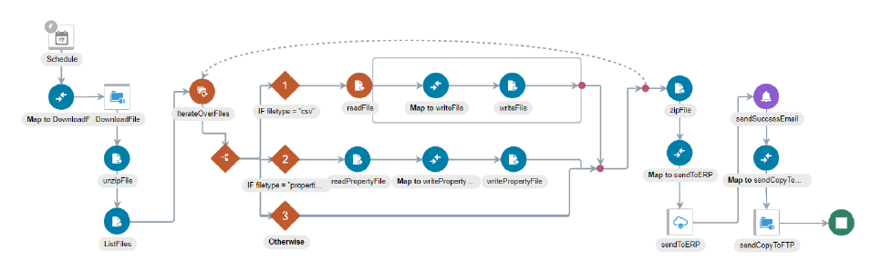
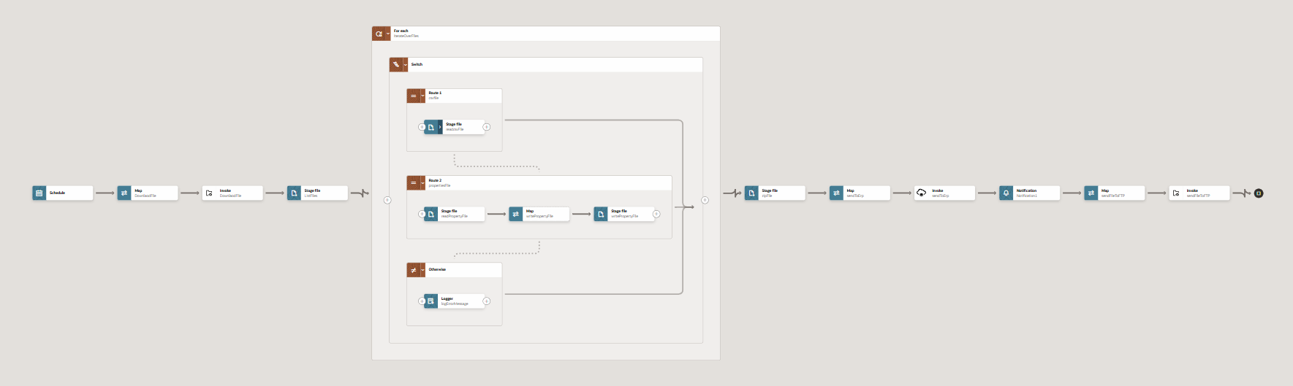
FBDI-> Use Case Import Journal Entries File Based Data Import

Slide 19
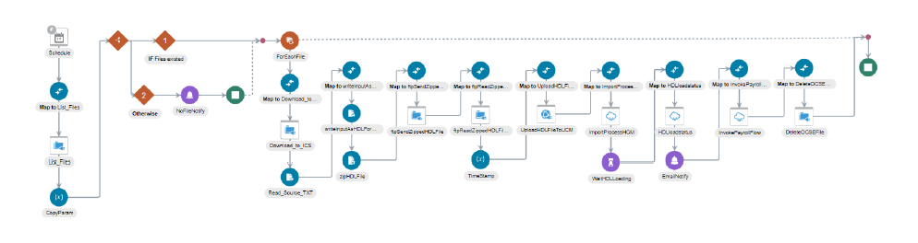
HDL

Slide 20
Connections
REST
SOAP
FTP
ATP
HCM
ERP
CRP
PROJ

Slide 26
Thank You

