Slide 1
Python CSV

Slide 2
What is a CSV ?
CSV (Comma Separated Values) is a simple file format used to store tabular data, such as a spreadsheet or database.
A CSV file stores tabular data (numbers and text) in plain text.
Each line of the file is a data record. Each record consists of one or more fields, separated by commas.
The use of the comma as a field separator is the source of the name for this file format.

Slide 3
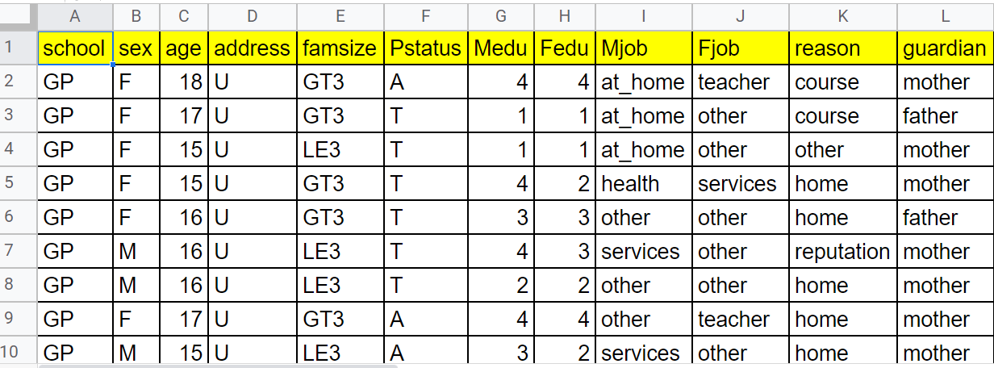
Sample CSV File (student_data.csv)

Slide 4
Working with CSV files in Python
While we could use the built-in open() function to work with CSV files in Python.
There is a dedicated csv module that makes working with CSV files much easier.
Before we can use the methods to the csv module, we need to import the module first using:
import csv

Slide 5
Reading CSV files
The csv.reader() is used to read the file, which returns an iterable reader object.
The reader object is then iterated using a for loop to print the contents of each row.
reader = csv.reader(filehandler)
csv.reader() function in default mode for CSV files having comma delimiter.
However, the function is much more customizable.
If the CSV file was using tab as a delimiter, need to pass optional parameters to the csv.reader() function.
reader = csv.reader(file, delimiter = '\t')

Slide 6
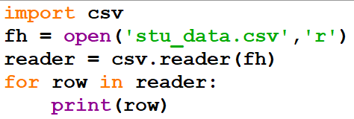
Example: To read a csv file

Slide 7
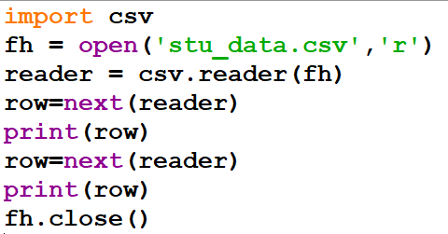
Using next()
next(): Return the next row of the reader’s iterable object as a list.
Example:

Slide 8
Writing CSV files
The csv.writer() function returns a writer object that converts the user's data into a delimited string.
writer = csv.writer(filehandler)
This string can later be used to write into CSV files using the writerow() function.
writer.writerow(list)
If we need to write the contents of the 2-dimensional list to a CSV file, then
writer.writerows(csv_rowlist)

Slide 9
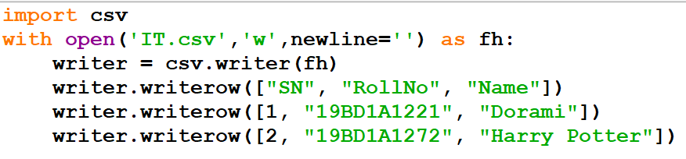
Example: To write student’s information to a csv file

Slide 10
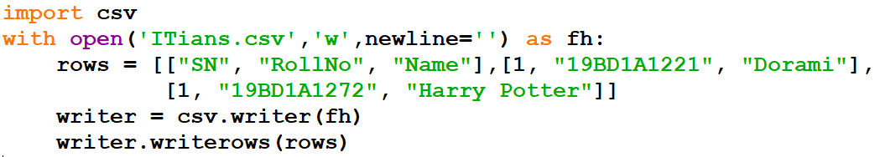
Example: To write all student’s information at once to a csv file

Slide 11
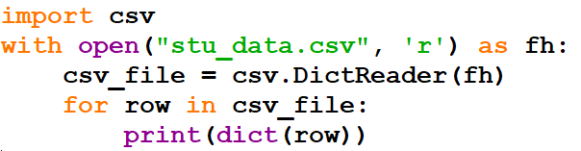
Python csv.DictReader()
The objects of a csv.DictReader() class can be used to read a CSV file as a dictionary.
Example:
Here, csv_file is a csv.DictReader() object. The object can be iterated over using a for loop.
The csv.DictReader() returned an OrderedDict type for each row. That's why we used dict() to convert each row to a dictionary.
Note: Starting from Python 3.8, csv.DictReader() returns a dictionary for each row, and we do not need to use dict() explicitly.

Slide 12
Python csv.DictWriter()
The objects of csv.DictWriter() class can be used to write to a CSV file from a Python dictionary.
csv.DictWriter(file, fieldnames)
file - CSV file where we want to write to
fieldnames - a list object which should contain the column headers specifying the order in which data should be written in the CSV file

Slide 13
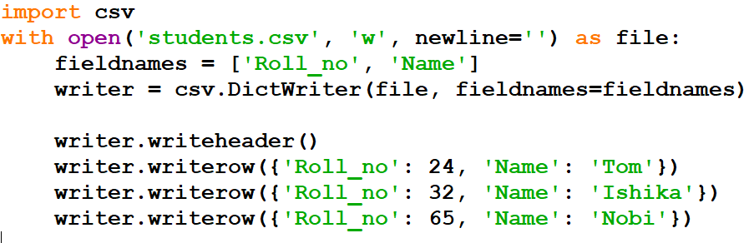
Example: To write dictionary content to csv file

Slide 14
Working in Google Colab

Slide 15
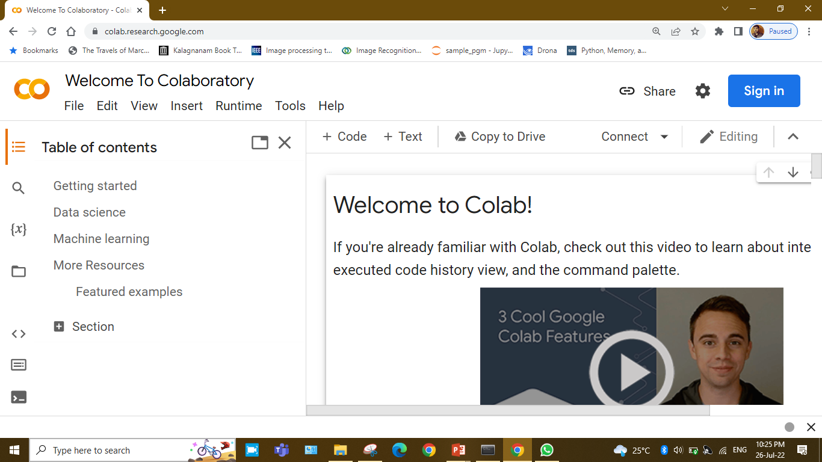
Open link https://colab.research.google.com/

Slide 16
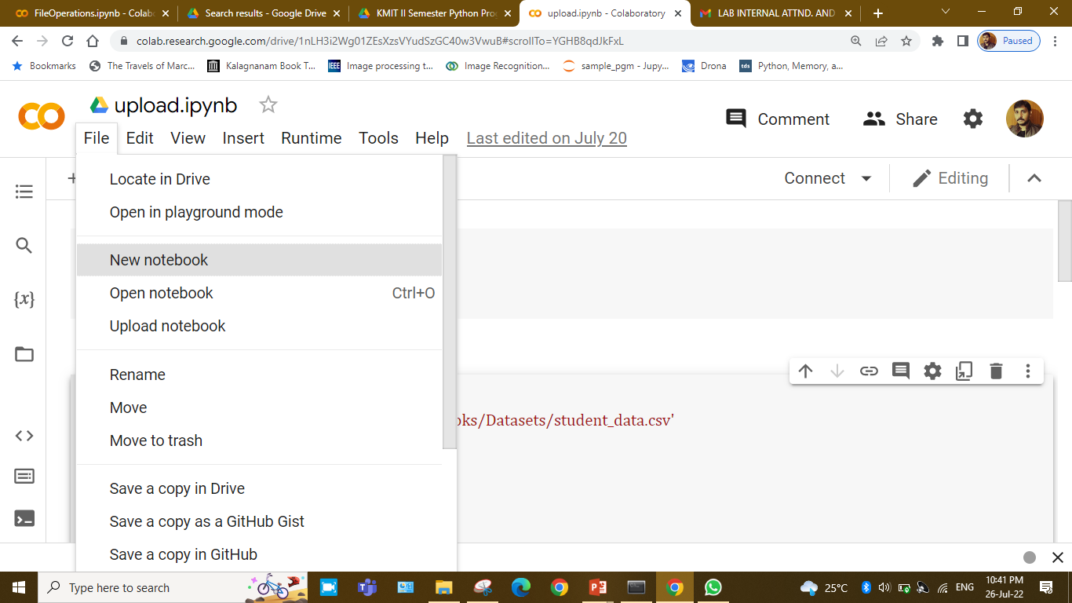
Sign in with Google Account and open new notebook

Slide 17
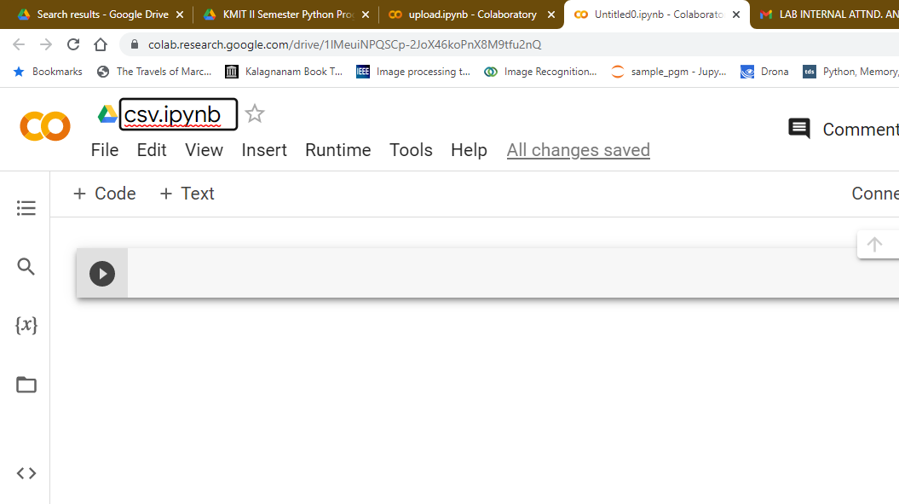
Save notebook with a suitable name.

Slide 18
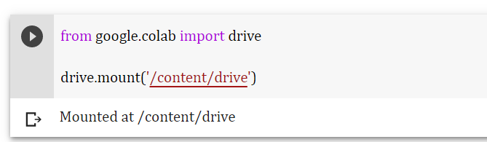
Mount drive using following code segment.

Slide 19
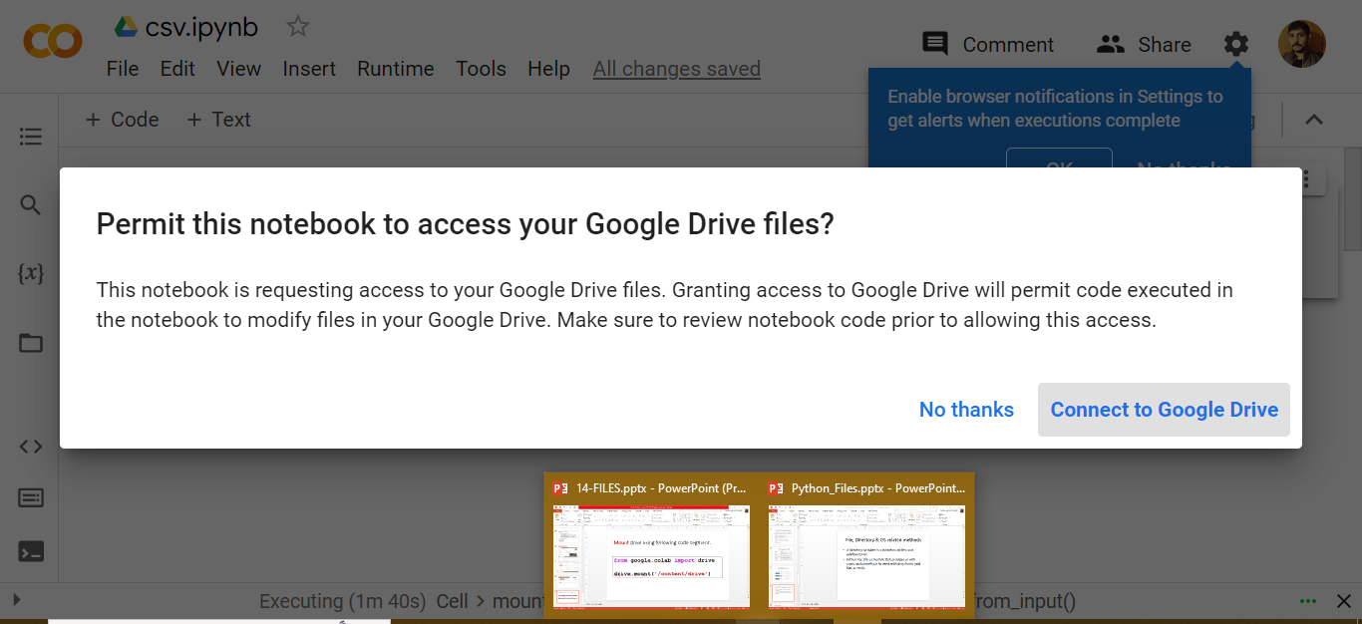
Click on Connect to Google Drive

Slide 20
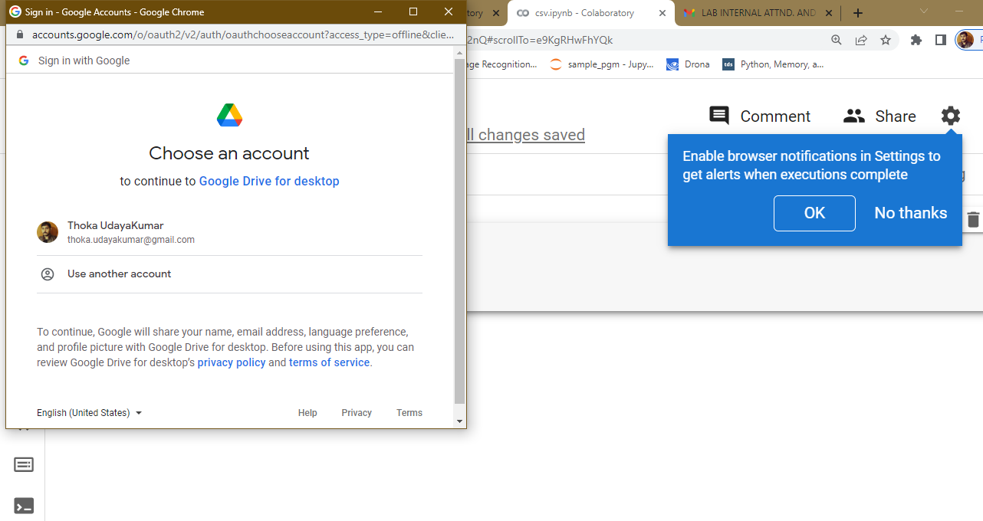
It will ask us for login. Login to same google A/C

Slide 21
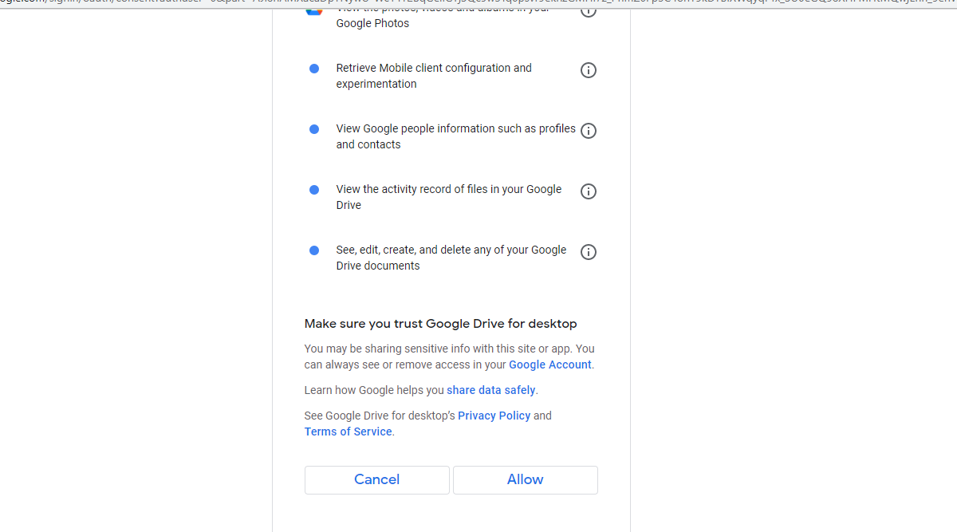
Click on Allow

Slide 22
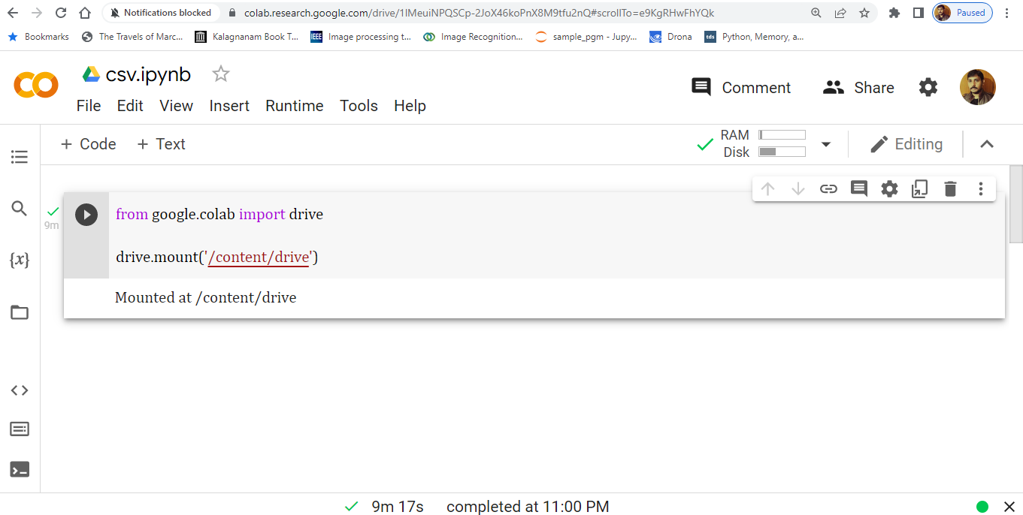
Now Mounted at ‘/content/drive’

Slide 23
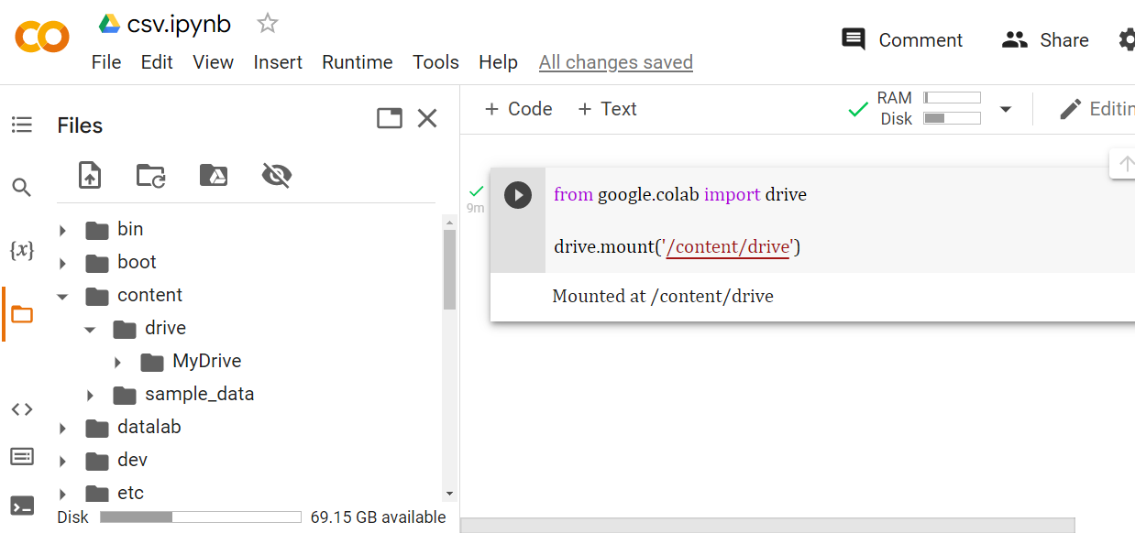
We can see MyDrive at \content\drive

Slide 24
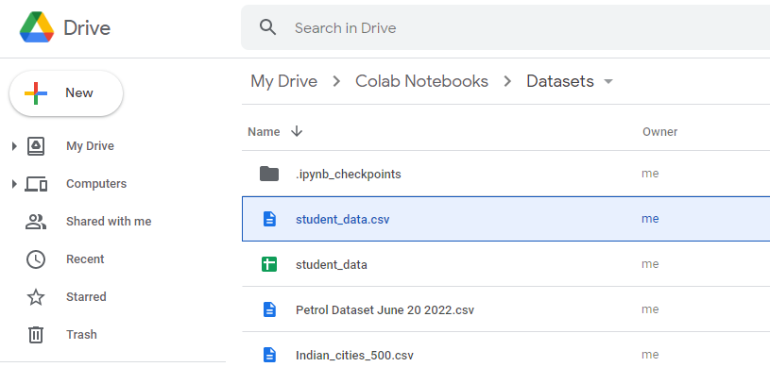
We can access folders from our Drive by using path

Slide 25
Impost csv library
Open the csv file which is available in your Google Drive by specifying exact path.
For Example:
import csv
csv_file = open('/content/drive/MyDrive/Colab Notebooks/Datasets/student_data.csv')

Slide 26
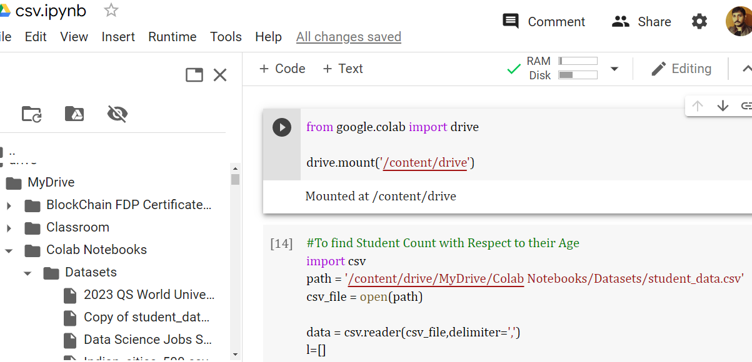

Slide 27
Exercises
Write a program to find Student Count with Respect to their Age
Write a program to find Student Count with Respect to their Gender
Write a program to find Parents Education Status

Slide 28
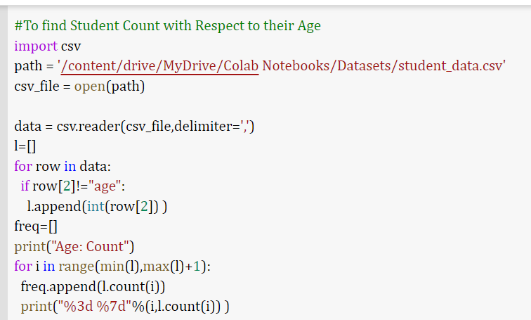
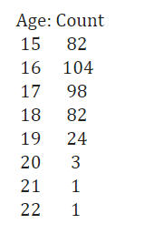

Slide 29
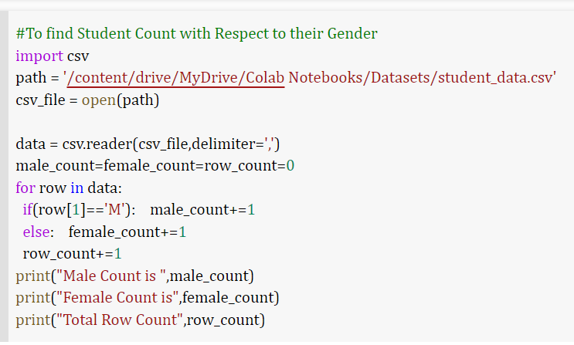


Slide 30
