Slide 1
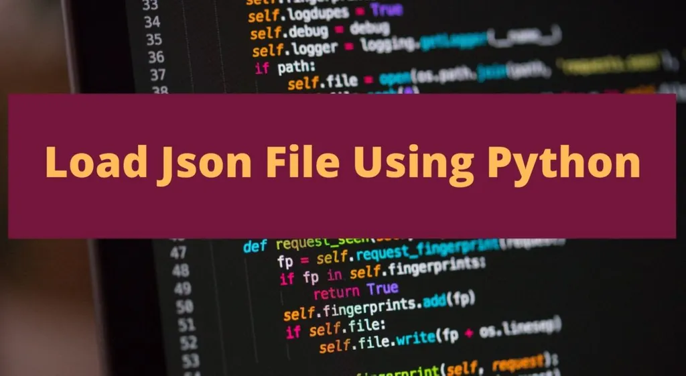

Slide 2
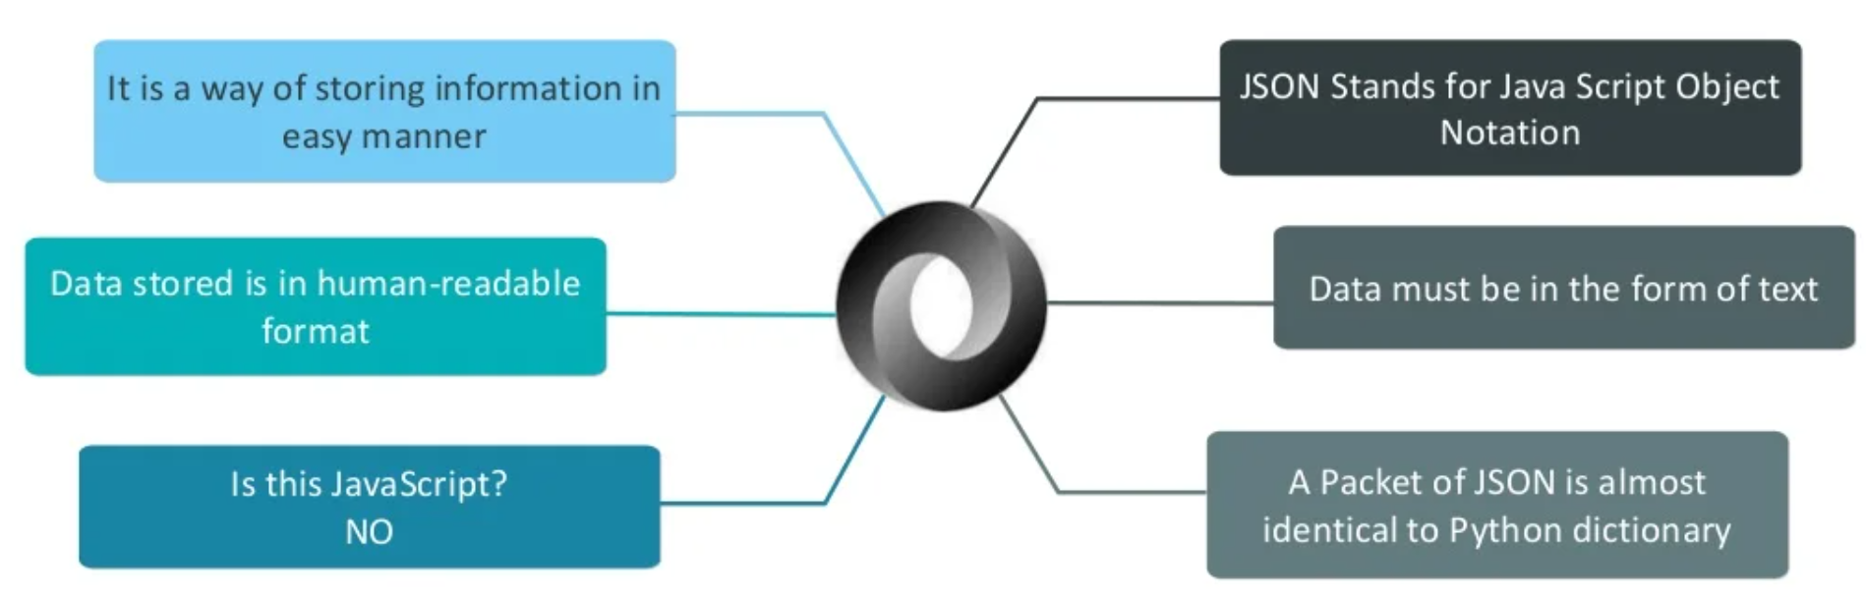
What is JSON ?
JSON (JavaScript Object Notation) is a popular data format used for representing structured data. It's common to transmit and receive data between a server and web application in JSON format.
JSON was inspired by the JavaScript programming language, but it's not tied to only one language.
Most modern programming languages have libraries for parsing and generating JSON data.

Slide 3
Why do we use JSON ?
JSON has a more compact style than XML which was the format of choice years ago. The light-weight approach can make significant improvements.
The XML software parsing process can take a long time. JSON uses less data overall, so you reduce the cost and increase the parsing speed.
The JSON structure is straight forward and often more readable.

Slide 4
Basic JSON syntax
In JSON, data is written in key-value pairs, like so:
"first_name": "Katie"
Data is enclosed in double quotation marks and the key-value pair is separated by a colon.
There can be more than one key-value pair and each one is separated by a comma:
"first_name": "Katie", "last_name": "Rodgers“
The example above showed an object, a collection of multiple key-value pairs.
Objects are inside curly braces:
{
"first_name": "Katie",
"last_name": "Rodgers"
}

Slide 5
Another example of JSON-formatted data is as follows:
{
"name": "Frank",
"age": 39,
"isEmployed": true
}

Slide 6
We can also create arrays, an ordered list of values, with JSON. In that case, arrays are contained inside square brackets:
[
{
"first_name": "Katie",
"last_name": "Rodgers"
},
{
"first_name": "Naomi",
"last_name": "Green"
},
]

Slide 7
// or:
{
"employee": [
{
"first_name": "Katie",
"last_name": "Rodgers"
},
{
"first_name": "Naomi",
"last_name": "Green"
},
]
}
//this created an 'employee' object that has 2 records.
// It defines the first name and last name of an employee

Slide 8
In Python, JSON exists as a string. For example:
p = '{"name": "Bob", "languages": ["Python", "Java"]}'
It's also common to store a JSON object in a file.

Slide 9
Python and JSON
Python makes it simple to work with JSON files.
Python supports JSON through a built-in package called JSON.
To use this feature, we import the JSON package in Python script.
import json
This library mainly parses JSON from files or strings. It also parses JSON into a dictionary or list in Python and vice versa, that is converting a Python dictionary or list into JSON strings.
The text in JSON is done through quoted-string which contains the value in key-value mapping within { }.
It is similar to the dictionary in Python.

Slide 10
JSON to Python (Decoding)
JSON string decoding is done with the help of method json.loads() & json.load() of JSON library in Python..
Reading JSON means converting JSON into a Python value (object). The json library parses JSON into a dictionary or list in Python.

Slide 11
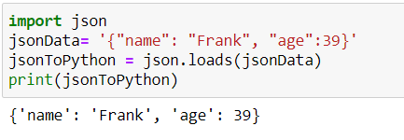
JSON to Python
Example 1: Python JSON to dict
we use the loads() function (load from a string) to parse a JSON string and the method returns a dictionary.
Here, jsonData is a JSON string, and jsonToPython is a dictionary.

Slide 12
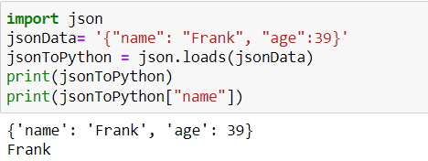
That is, the data is returned as a Python dictionary (JSON object data structure).
So, the statement print jsonToPython[‘name’] returns ‘Frank’
Note: In the above programs, the objects in JSON are converted to dictionaries in Python.

Slide 13
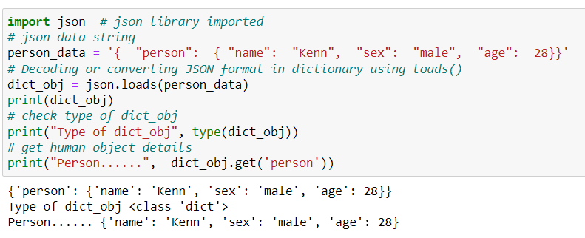
Example 2:

Slide 14
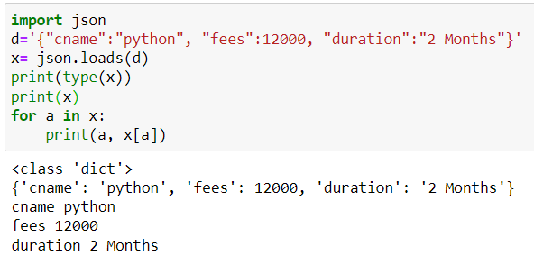
Example 3:

Slide 15
Decoding JSON File or Parsing JSON file in Python(Reading JSON from a file using Python)
Let us see how to read JSON file in Python with Python parse JSON example:
NOTE: Decoding JSON file is File Input /Output (I/O) related operation. The JSON file must exist on your system at specified the location that you mention in your program.
Deserialization is the opposite of Serialization, i.e. conversion of JSON objects into their respective Python objects. The load() method is used for it.
If you have used JSON data from another program or obtained it as a string format of JSON, then it can easily be deserialized with load(), which is usually used to load from a string, otherwise, the root object is in a list or Dict

Slide 16
Example 1 : Python read JSON file
You can use json.load() method to read a file containing JSON object.
Suppose, you have a file named person.json which contains a JSON object.
{"name": "Bob",
"languages": ["English", "French"]
}
Here's how you can parse this file:
import json
with open('path_to_file/person.json', 'r') as f:
data = json.load(f)
print(data)
# Output: {'name': 'Bob', 'languages': ['English', 'French’]}
Here, we have used the open() function to read the json file. Then, the file is parsed using json.load() method which gives us a dictionary named data.

Slide 17
Example 1 : Python read JSON file
import json
#File I/O Open function for read data from JSON File
with open('X:/json_file.json') as file_object:
# store file data in object
data = json.load(file_object)
print(data)
Here data is a dictionary object of Python as shown in the above read JSON file Python example.
Output:
{'person': {'name': 'Kenn', 'sex': 'male', 'age': 28}}

Slide 18
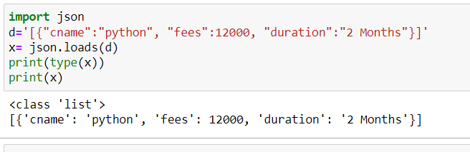
The conversion of JSON data to Python is based on the following conversion table
. Here translation table show example of JSON objects to Python objects which are helpful to perform decoding in Python of JSON string
JSON | Python
object | dict
array | list
string | str
number (int) | int
number (real) | float
true | True
false | False
null | None

Slide 19
Python to JSON (Encoding)
We saw how to convert JSON into a Python value (i.e. Dictionary).
Now, how we can convert (encode) a Python value to JSON?
Converting Python data to JSON is called an Encoding operation.
Encoding is done with the help of JSON library method – dumps()
Serializing JSON refers to the transformation of data into a series of bytes (hence serial) to be stored or transmitted across a network.
To handle the data flow in a file, the JSON library in Python uses dump() or dumps() function to convert the Python objects into their respective JSON object, so it makes it easy to write data to files.

Slide 20
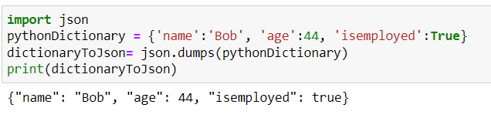
Say that we have the following Dictionary in Python:
So this output is considered the data representation of the object (Dictionary). The method dumps() was the key to such an operation.

Slide 21
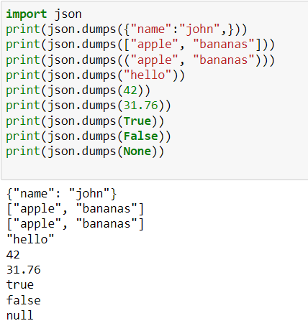
The conversion of Python objects to JSON data is based on the following conversion table.
Python | JSON
dict | object
List, tuple | array
str | string
int | number (int)
float | number (real)
False | false
True | true
None | null

Slide 22
The keys in a Python dictionary have to be converted to a string for them to be used as JSON data.
However, a simple string conversion is only feasible for basic types like str, int, float, and bool. For other types of keys, this can result in a TypeError.
we can avoid that from happening by setting the value of skipkeys argument to True. This will tell Python to skip all keys which cannot be converted to a string.

Slide 23
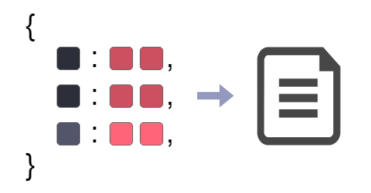
Python Write JSON to File

Slide 24
Method 1: Writing JSON to a file in Python using json.dumps()
We can convert any Python object to a JSON string and write JSON to File using json.dumps() function and file.write() function respectively.
Following is a step by step process to write JSON to file.
Prepare JSON string by converting a Python Object to JSON string using json.dumps() function.
Create a JSON file using open(filename, ‘w’) function. We are opening file in write mode.
simply write JSON string to a file using the “write” function.
Close the JSON file.

Slide 25
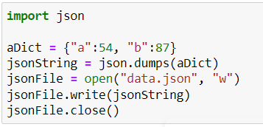
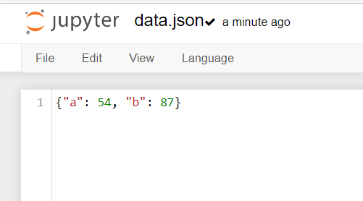
Example 1: Write JSON (Object) to File
In this example, we will convert or dump a Python Dictionary to JSON String, and write this JSON string to a file named data.json.
Python Program
Output
Run the above program, and data.json will be created in the working directory.

Slide 26
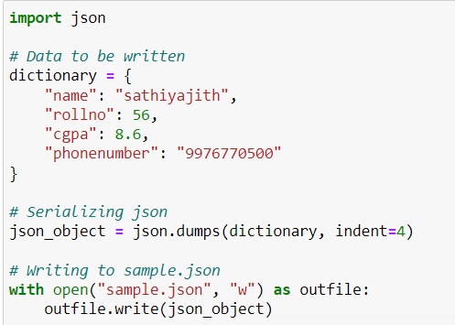
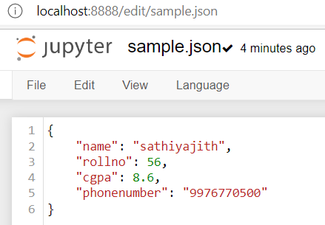
Example2
OUTPUT:

Slide 27
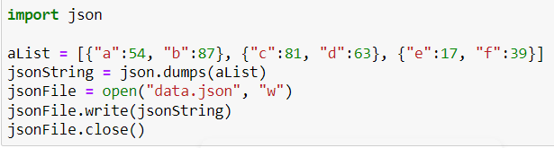
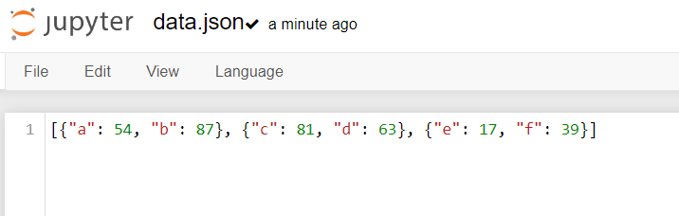
Example 3: Write JSON (List of Object) to File
In this example, we will convert or dump Python List of Dictionaries to JSON string, and write this JSON string to file named data.json.
Python Program
Output
Run the above program, and data.json will be created in the working directory.
data.json

Slide 28
Method 2: Writing JSON to a file in Python using json.dump()
Another way of writing JSON to a file is by using json.dump() method .
The JSON package has the “dump” function which directly writes the dictionary to a file in the form of JSON, without needing to convert it into an actual JSON object.
It takes 2 parameters:
dictionary – the name of a dictionary which should be converted to a JSON object.
file pointer – pointer of the file opened in write or append mode.

Slide 29
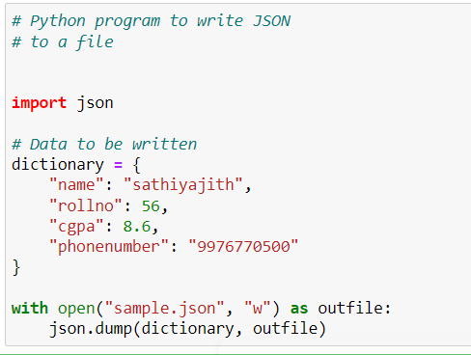
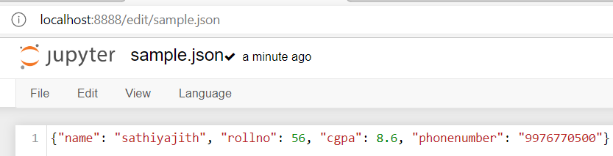
Output:

Slide 30
Format JSON code (Pretty print)
The aim is to write well-formatted code for human understanding.
With the help of pretty printing, anyone can easily understand the code.
To analyze and debug JSON data, we may need to print it in a more readable format.
This can be done by passing additional parameters indent and sort_keys to json.dumps() and json.dump() method.
sort_keys attribute in Python dumps function’s argument will sort the key in JSON in ascending order.
The sort_keys argument is a Boolean attribute. When it’s true sorting is allowed otherwise not.

Slide 31
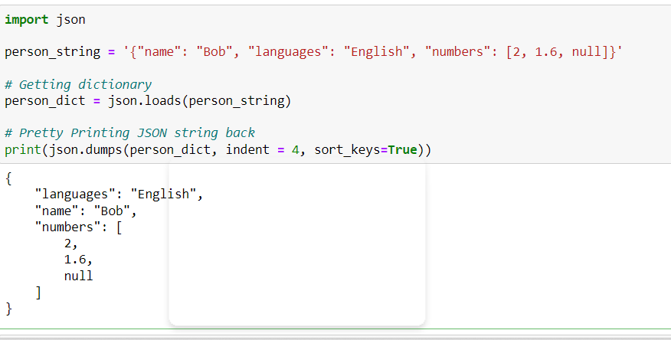
In the above program, have used 4 spaces for indentation. And, the keys are sorted in ascending order.
By the way, the default value of indent is None. And, the default value of sort_keys is False.

Slide 32
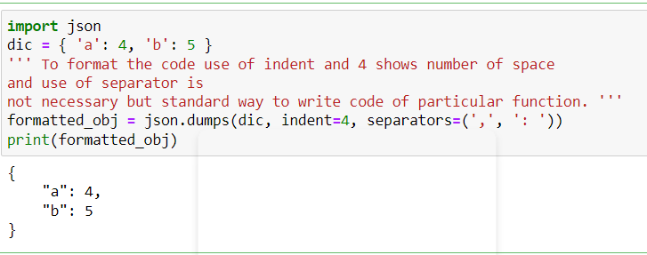

Slide 33
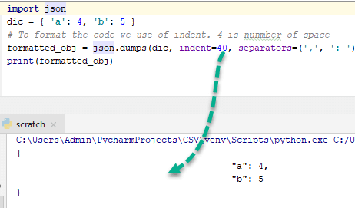
To better understand this, change indent to 40 and observe the output-

Slide 34
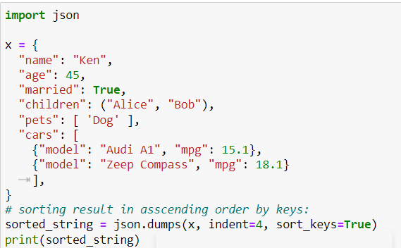

Slide 35
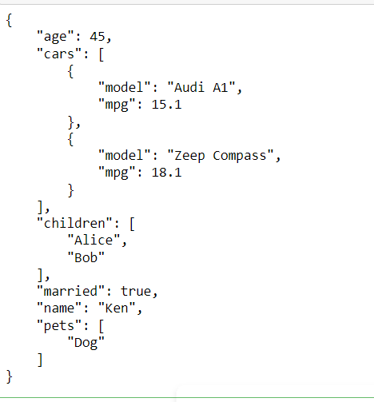
Output:
observe the keys age, cars, children, etc are arranged in ascending order.

Slide 36
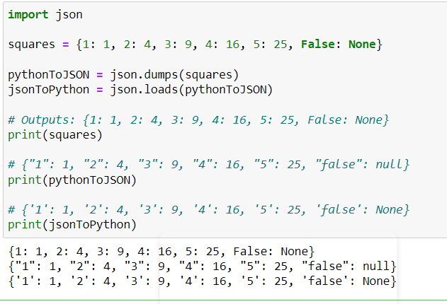
Back and Forth Conversion of Data
The keys for dictionaries in Python can be of different data types like strings, int, or tuples. However, the keys in JSON data can only be strings.
This means that when you convert a dictionary into JSON, all its keys will be cast to strings. Conversion of this JSON back to a dictionary will not get you back the original data type of the keys.

