Slide 1
Error Handling in Python

Slide 2
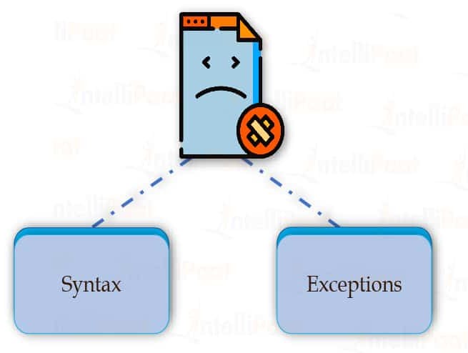
Introduction
We can make certain mistakes while writing a program that lead to errors when we try to run it.
A python program terminates as soon as it encounters an unhandled error.
These errors can be broadly classified into two classes:
Syntax errors
Logical errors (Exceptions)

Slide 3

Python Syntax Errors
Error caused by not following the proper structure (syntax) of the language is called syntax error or parsing error.
Example:
As shown in the example, here a colon : is missing in the if statement.

Slide 4
Python Logical Errors (Exceptions)
Errors that occur at runtime (after passing the syntax test) are called exceptions or logical errors.
For instance, they occur when we
try to open a file(for reading) that does not exist (FileNotFoundError)
try to divide a number by zero (ZeroDivisionError)
try to import a module that does not exist (ImportError).
Whenever these types of runtime errors occur, Python creates an exception object.
If not handled properly, it prints a traceback to that error along with some details about why that error occurred.

Slide 5
Python Built-in Exceptions
Illegal operations can raise exceptions.
There are plenty of built-in exceptions in Python that are raised when corresponding errors occur.
We can view all the built-in exceptions using the built-in local() function.
print(dir(locals()['__builtins__']))

Slide 6
Built-in exceptions
Exception | Cause of Error
ImportError | Raised when the imported module is not found.
IndexError | Raised when the index of a sequence is out of range.
KeyError | Raised when a key is not found in a dictionary.
NameError | Raised when a variable is not found in local or global scope.
RuntimeError | Raised when an error does not fall under any other category.
TypeError | Raised when a function or operation is applied to an object of incorrect type.
ZeroDivisionError | Raised when the second operand of division or modulo operation is zero.

Slide 7
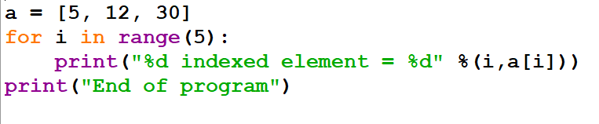
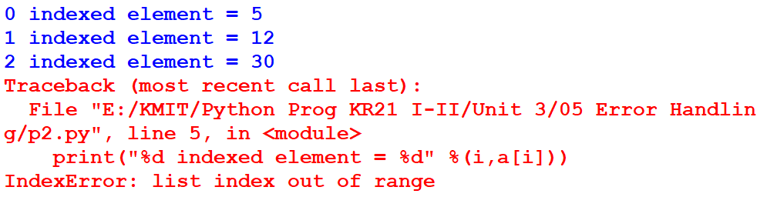
Example: Program when an exception is raised
Output:

Slide 8
Catching Exceptions in Python
try and except statements are used to catch and handle exceptions in Python.
Statements that can raise exceptions are kept inside the try clause and the statements that handle the exception are written inside except clause.

Slide 9
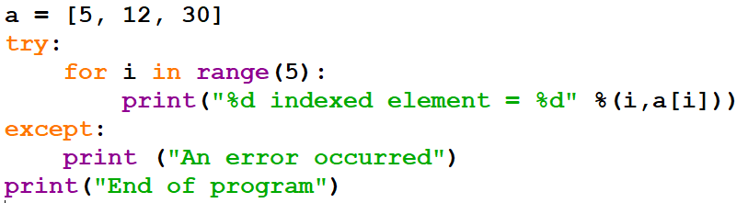
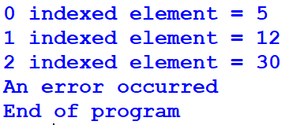
Example: Program to handle exception
Output:

Slide 10
Catching Specific Exception
A try statement can have more than one except clause, to specify handlers for different exceptions.
At most one handler will be executed.
The general syntax for adding specific exceptions:
try:
# statement(s)
except IndexError:
# statement(s)
except ValueError:
# statement(s)

Slide 11
Example: Catching specific exception in Python
def fun(a):
if a < 4:
b = a/(a-3)
print("Value of b = ", b)
try:
fun(3) #fun(5) #fun("hello")
except ZeroDivisionError:
print("ZeroDivisionError Occurred and Handled")
except NameError:
print("NameError Occurred and Handled")
except:
print("Unknown error")

Slide 12
Try with Else Clause
In Python, we can also use the else clause on the try-except block which must be present after all the except clauses.
The code enters the else block only if the try clause does not raise an exception.

Slide 13
Example: Program to depict else clause with try-except
def fun(a , b):
try:
c=((a+b)/(a-b))
except ZeroDivisionError:
print("a/b result in 0")
else:
print(c)
fun(2.0, 3.0)
fun(3.0, 3.0)
Output:
-5.0
a/b result in 0

Slide 14
Finally Keyword in Python
Python provides a keyword finally, which is always executed after the try and except blocks.
The final block always executes after normal termination of try block or after try block terminates due to some exception.

Slide 15
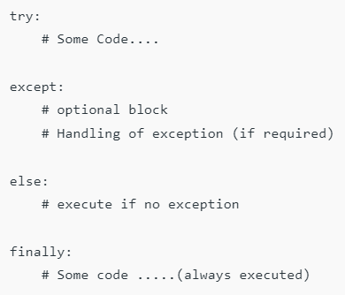
Syntax

Slide 16
Raising Exception
The raise statement allows the programmer to force a specific exception to occur.
The sole argument in raise indicates the exception to be raised.
This must be either an exception instance or an exception class (a class that derives from Exception).

Slide 17
Example: Program to depict Raising Exception
try:
raise NameError("Hi there") # Raise Error
except NameError:
print ("An exception")

Slide 18

Thank You

