Slide 1
Python object-class

Slide 2
Introduction
In Python, object-oriented Programming (OOPs) is a programming paradigm that uses objects and classes in programming.
The main concept of OOPs is to bind the data and the functions that work on that together as a single unit so that no other part of the code can access this data.
Object
Data Members
Member functions
State
Identity id()

Slide 3
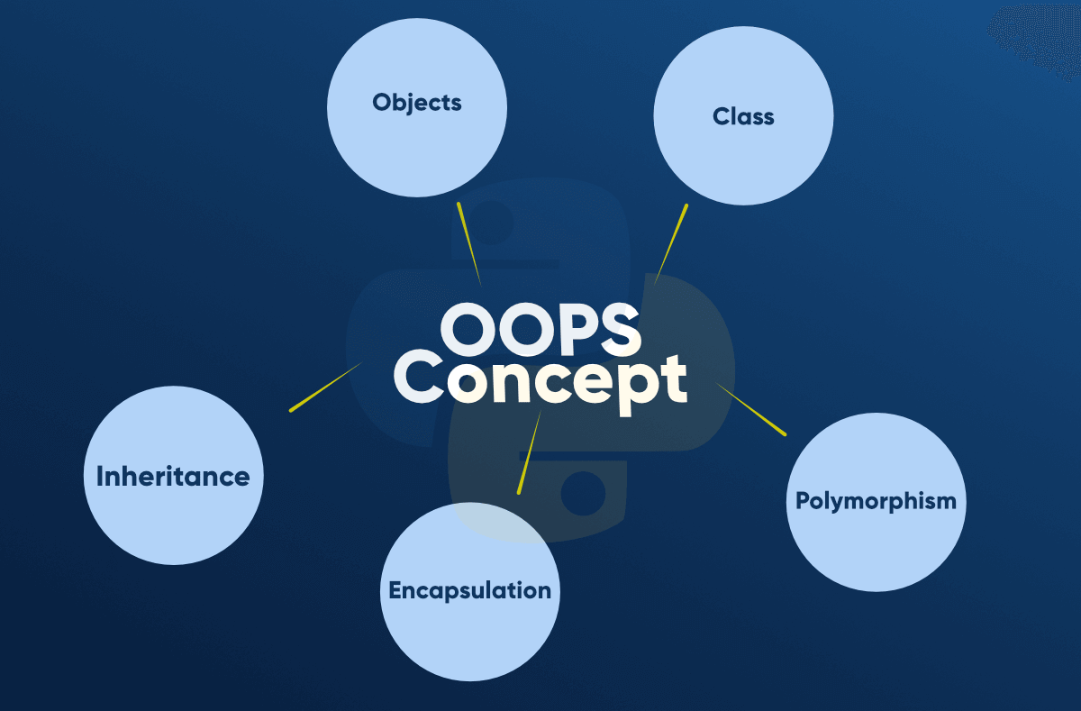
Main Concepts of Object-Oriented Programming (OOPs)

Slide 4
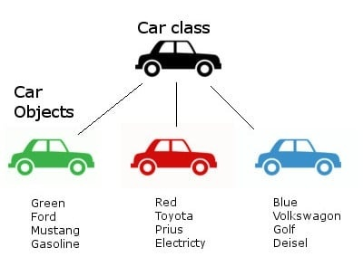
Non-Living Car

Slide 5
Overview of OOPs Terminology
Class: A user-defined prototype for an object that defines a set of attributes that characterize any object of the class. The attributes are data members (class variables and instance variables) and methods, accessed via dot notation.
Object: A unique instance of a data structure that's defined by its class. An object comprises both data members (class variables and instance variables) and methods.
Instance: An individual object of a certain class. An object ‘obj’ that belongs to a class Circle, for example, is an instance of the class Circle.
Instantiation: The creation of an instance of a class.
Method : A special kind of function that is defined in a class definition.

Slide 6
Data member: A class variable or instance variable that holds data associated with a class and its objects
Class variable: A variable that is shared by all instances of a class.
Class variables are defined within a class but outside any of the class's methods.
Class variables are not used as frequently as instance variables are. They are also called attributes of a class or data members.
Instance variable: A variable that is defined inside a method and belongs only to the current instance of a class.
self: self represents the instance of the class.
By using the "self" which is instance of current class we can access the attributes and methods of the class in python.
self doesn’t have to be called self as it is not a keyword. But this is a very strongly followed convention.

Slide 7
Creating an empty Class in Python
class Dog:
pass
obj = Dog()
In the above example, we have created a class named Dog using the class keyword.
An object named obj is created of the class Dog defined above

Slide 8
The self
Class methods must have an extra first parameter in the method definition. We do not give a value for this parameter when we call the method, Python provides it
If we have a method that takes no arguments, then we still have to have one argument.
This is similar to this pointer in C++ and this reference in Java.
When we call a method as
myobject.method(arg1, arg2)
This is automatically converted by Python into
MyClass.method(myobject, arg1, arg2)

Slide 9
The self
self represents the instance of the class. By using the “self” keyword we can access the attributes and methods of the class in python. It binds the attributes with the given arguments.
Characteristics of self
Self is always pointing to Current Object.
Self is the first argument to be passed in Constructor and Instance Method.
Self is a convention and not a Python keyword .

Slide 10
The __init__ method
The __init__ method is similar to constructors in C++ and Java.
Constructors are generally used for instantiating an object.
The task of constructors is to initialize(assign values) to the data members of the class when an object of the class is created.
It is run as soon as an object of a class is instantiated.
The method is useful to do any initialization you want to do with your object.
Syntax of constructor declaration :
def __init__(self):
# body of the constructor

Slide 11
Types of constructors
default constructor: The default constructor is a simple constructor which doesn’t accept any arguments. Its definition has only one argument which is a reference to the instance being constructed.
parameterized constructor: constructor with parameters is known as parameterized constructor. The parameterized constructor takes its first argument as a reference to the instance being constructed known as self and the rest of the arguments are provided by the programmer.

Slide 12
Creating a class and object with class and instance attributes
class Dog:
# class attribute
attr1 = "mammal"
# Instance attribute
def __init__(self, name):
self.name = name
# Object instantiation
Rodger = Dog("Rodger")
Tommy = Dog("Tommy")
# Accessing class attributes
print("Rodger is a",Rodger.__class__.attr1)
print("Tommy is also a", Tommy.__class__.attr1)
# Accessing instance attributes
print("My name is",Rodger.name)
print("My name is",Tommy.name)
Output:
Rodger is a mammal
Tommy is also a mammal
My name is Rodger
My name is Tommy

Slide 13
Creating Class and objects with methods
class Dog:
# class attribute
attr1 = "mammal"
# Instance attribute
def __init__(self, name):
self.name = name
def speak(self):
print("I am ",self.name)
# Object instantiation
Rodger = Dog("Rodger")
Tommy = Dog("Tommy")
# Accessing class attributes
print("Rodger is a",Rodger.__class__.attr1)
print("Tommy is also a", Tommy.__class__.attr1)
# Accessing instance attributes
print("My name is",Rodger.name)
print("My name is",Tommy.name)
# Accessing class methods
Rodger.speak()
Tommy.speak()
Output:
Rodger is a mammal
Tommy is also a mammal
My name is Rodger
My name is Tommy
I am Rodger
I am Tommy

Slide 14
Destructors in Python
Destructors are called when an object gets destroyed.
In Python, destructors are not needed as much needed in C++ because Python has a garbage collector that handles memory management automatically.
The __del__() method is a known as a destructor method in Python.
It is called when all references to the object have been deleted i.e when an object is garbage collected.
Syntax of destructor declaration :
def __del__(self):
# body of destructor

Slide 15
Example
class Dog:
# class attribute
attr1 = "mammal"
# Instance attribute
def __init__(self, name):
self.name = name
def speak(self):
print("I am ",self.name)
# Destructor
def __del__(self):
print(self.name,'Destructor called')
# Object instantiation
Rodger = Dog("Rodger")
Tommy = Dog("Tommy")
# Accessing class methods
Rodger.speak()
Tommy.speak()
del Rodger
del Tommy
Output:
I am Rodger
I am Tommy
Rodger Destructor called
Tommy Destructor called

Slide 16
Destructors in Python
Note : The destructor was called after the program ended or when all the references to object are deleted i.e when the reference count becomes zero, not when object went out of scope.
Notes:
https://www.geeksforgeeks.org/destructors-in-python/

Slide 17

Example
# class Animals is declared
class Animals:
def __init__(self):
self.lion = 'carnivore'
self.dog = 'omnivore'
self.giraffe = 'herbivore'
# object animal of class Animals
obj1 = Animals()
print("Dictionary from the object fields belonging to the class Animals:")
# calling __dict__ on animal object
print(obj1.__dict__)
obj2 = Animals()
obj2.age = 10
# calling vars method on obj object
print(vars(obj2))

Slide 18
Exercise
Write a program to
Create a Student class with student roll number, name and 3 subject marks list
Add a constructor which initializes all student roll number and name.
Add a method in this class giveMarks(). This method should facilitate to enter student marks.
Add a method display () which when called should display output as:
201 Ram 50 60 40
Add a method avgMarks() which when called should return average of all marks

Slide 19
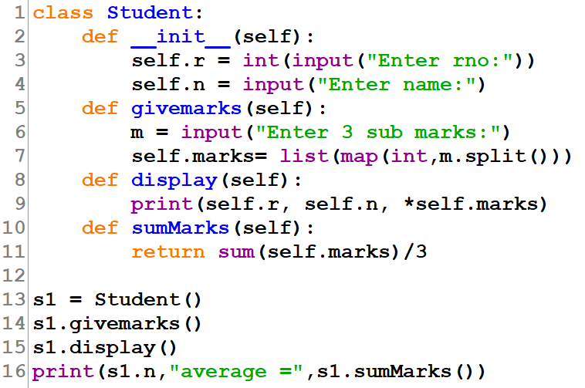
Solution

Slide 20
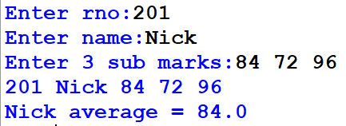
Output

