Slide 1
OptiTraffic AI – TRAFFIC SIGNAL PREDICTION SYSTEM
Shiven Keshav(2024H1120268P)
Naggender Singh(2024H1120216P)
Abhishek Bhosale(2024H1120217P)
Kuldeep Chaudhary(2024H1120184P)

Slide 2
Introduction
Dual-Architecture Approach for Urban Mobility Optimization Urban traffic congestion remains a critical challenge for modern cities, costing economies billions annually in lost productivity, fuel waste, and environmental damage.
This project addresses this challenge through an innovative dual architecture intelligent traffic control system, implementing both modern microservices and traditional SOAP-based Service-Oriented Architecture (SOA) patterns.
The system dynamically optimizes traffic signals using real-time simulation data, machine learning, and secure inter-service communication, while supporting high-concurrency access through advanced authentication mechanisms.

Slide 3
Introduction to Microservices Architecture
Microservices Architecture is an approach to software design where an application is composed of small, independent, and loosely coupled services.
Each service represents a single business capability and can be developed, deployed, and scaled independently. It contrasts with traditional monolithic architectures by promoting modularity, agility, and continuous delivery enabling teams to build scalable and fault-tolerant systems.
Containerization & Deployment with Docker
Each runs in its own isolated container.
Ensures consistent environments across development and production.
Key Characteristics:
Small, focused services
Independent deployment
Lightweight communication (e.g., HTTP/REST, Kafka)
Decentralized data management
High scalability and fault isolation

Slide 4
Introduction to SOAP/XML Architecture
SOAP (Simple Object Access Protocol) is a messaging protocol specification based on XML that allows structured information exchange between systems over a network. It is a foundational technology for building web services, particularly in enterprise systems.
SOAP services are typically defined using WSDL (Web Services Description Language) and rely on standard protocols like HTTP and SMTP for communication.
Key Characteristics:
XML-based message formatting
Platform- and language-independent
Strongly typed with WSDL contracts
Built-in support for security (WS-Security), transactions, and reliability
Transport protocol agnostic (HTTP, SMTP, etc.)

Slide 5
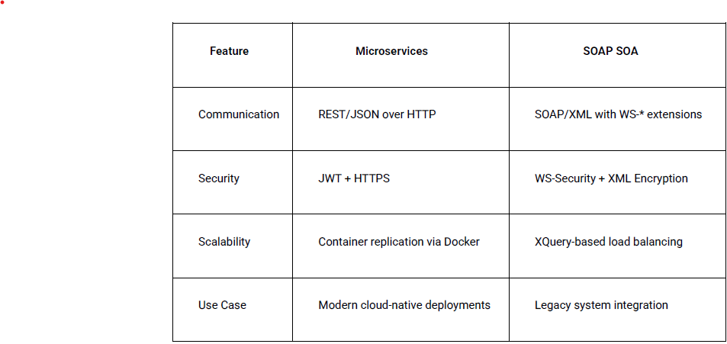
Architectural Comparison

Slide 6
Microservice Architecture Pattern Diagram

Slide 7
SOAP XML Architecture Pattern Diagram

Slide 8
Technical Highlights For Microservices
NGINX + JWT + Rate Limiting
NGINX acts as a reverse proxy and load balancer, sitting in front of the microservices.
JSON Web Tokens (JWT) are used for stateless user authentication.
Built-in rate limiter (configured at 20 requests/second) protects services from abuse and DoS attacks
2. ThreadPoolExecutor for Concurrency
Login microservice uses ThreadPoolExecutor to support concurrent login requests.
Enables the system to handle bursts of authentication requests efficiently (tested up to 10 users per second).
3. Kafka-based Asynchronous Communication
Kafka acts as the message broker between loosely coupled services.
Improves reliability by allowing services to publish/subscribe without direct calls.
Enables real-time streaming of simulation data and prediction.
.

Slide 9
Technical Highlights For SOAP SOA
WSDL 1.1 + XSD (Schema) Validation
Web Services Description Language (WSDL) defines SOAP operations and XML message formats..
XML Schema Definitions (XSD) validate all input/output data structures to prevent schema mismatches.
Ensures contract-first development and backward compatibility.
2. WS-Security (Message-Level Security
UsernameToken authentication: Validates identity with secure password digest (SHA-1 + Nonce + Timestamp).
Encryption of SOAP Body: Sensitive payloads (e.g., login, prediction) are encrypted using AES-256.
Transport secured via TLS (https) and optional digital signatures for integrity.
.

Slide 10
Architectural Views
Module View

Slide 11
Architectural Views
Module View

Slide 12
Architectural Views
Module View

Slide 13
Architectural Views
C & C View

Slide 14
Architectural Views
Allocation View

Slide 15
Benefits of Microservice Architecture
Modularity & Scalability: Each service can be developed, scaled, and deployed independently.
Fault Isolation: Service failures are contained; the API Gateway can route around unhealthy instances.
Technology Heterogeneity: Teams may choose the most appropriate stack per service (e.g., different languages or databases).
Maintainability & Testability: Clear service boundaries and well-defined APIs simplify testing, versioning, and rolling upgrades.
Resilience & Performance: Asynchronous messaging decouples producer/consumer lifecycles and smooths traffic spikes

Slide 16
Benefits of SOAP Architecture
Platform & Language Neutral ○ XML-based messaging works across any OS or language runtime. • Formal Contract (WSDL) ○ Precise service definitions enable tool-driven stub generation and early validation.
Extensibility ○ SOAP headers allow adding features (security, transactions, routing) without altering payload.
Built-in Error Handling ○ Standardized <Fault> element conveys rich error codes and diagnostics. ○ WS-Security Compliance ○ Integrates with WS-Security for message integrity, confidentiality and authentication.
Reliability & Transactions ○ Works with WS-ReliableMessaging and WS-AtomicTransaction for guaranteed delivery and coordinated commits.
Firewall & Proxy Friendliness ○ Uses HTTP/HTTPS as transport, easing traversal through existing infrastructure.

