Slide 1

Voluntech
Nagham Al-Hamad

Slide 2

Introduction
Voluntech is a website that connects fresh graduates, how want to improve their technical skill levels with NGOs which have technical work to do. This help volunteers to gain experience without having to be hired by companies.

Slide 3

Pain Points
The gap between educational outcomes and the requirement in the labor market.
Lack of experience and the weakness of fresh graduates skills .
Competition among workers very high.

Slide 4
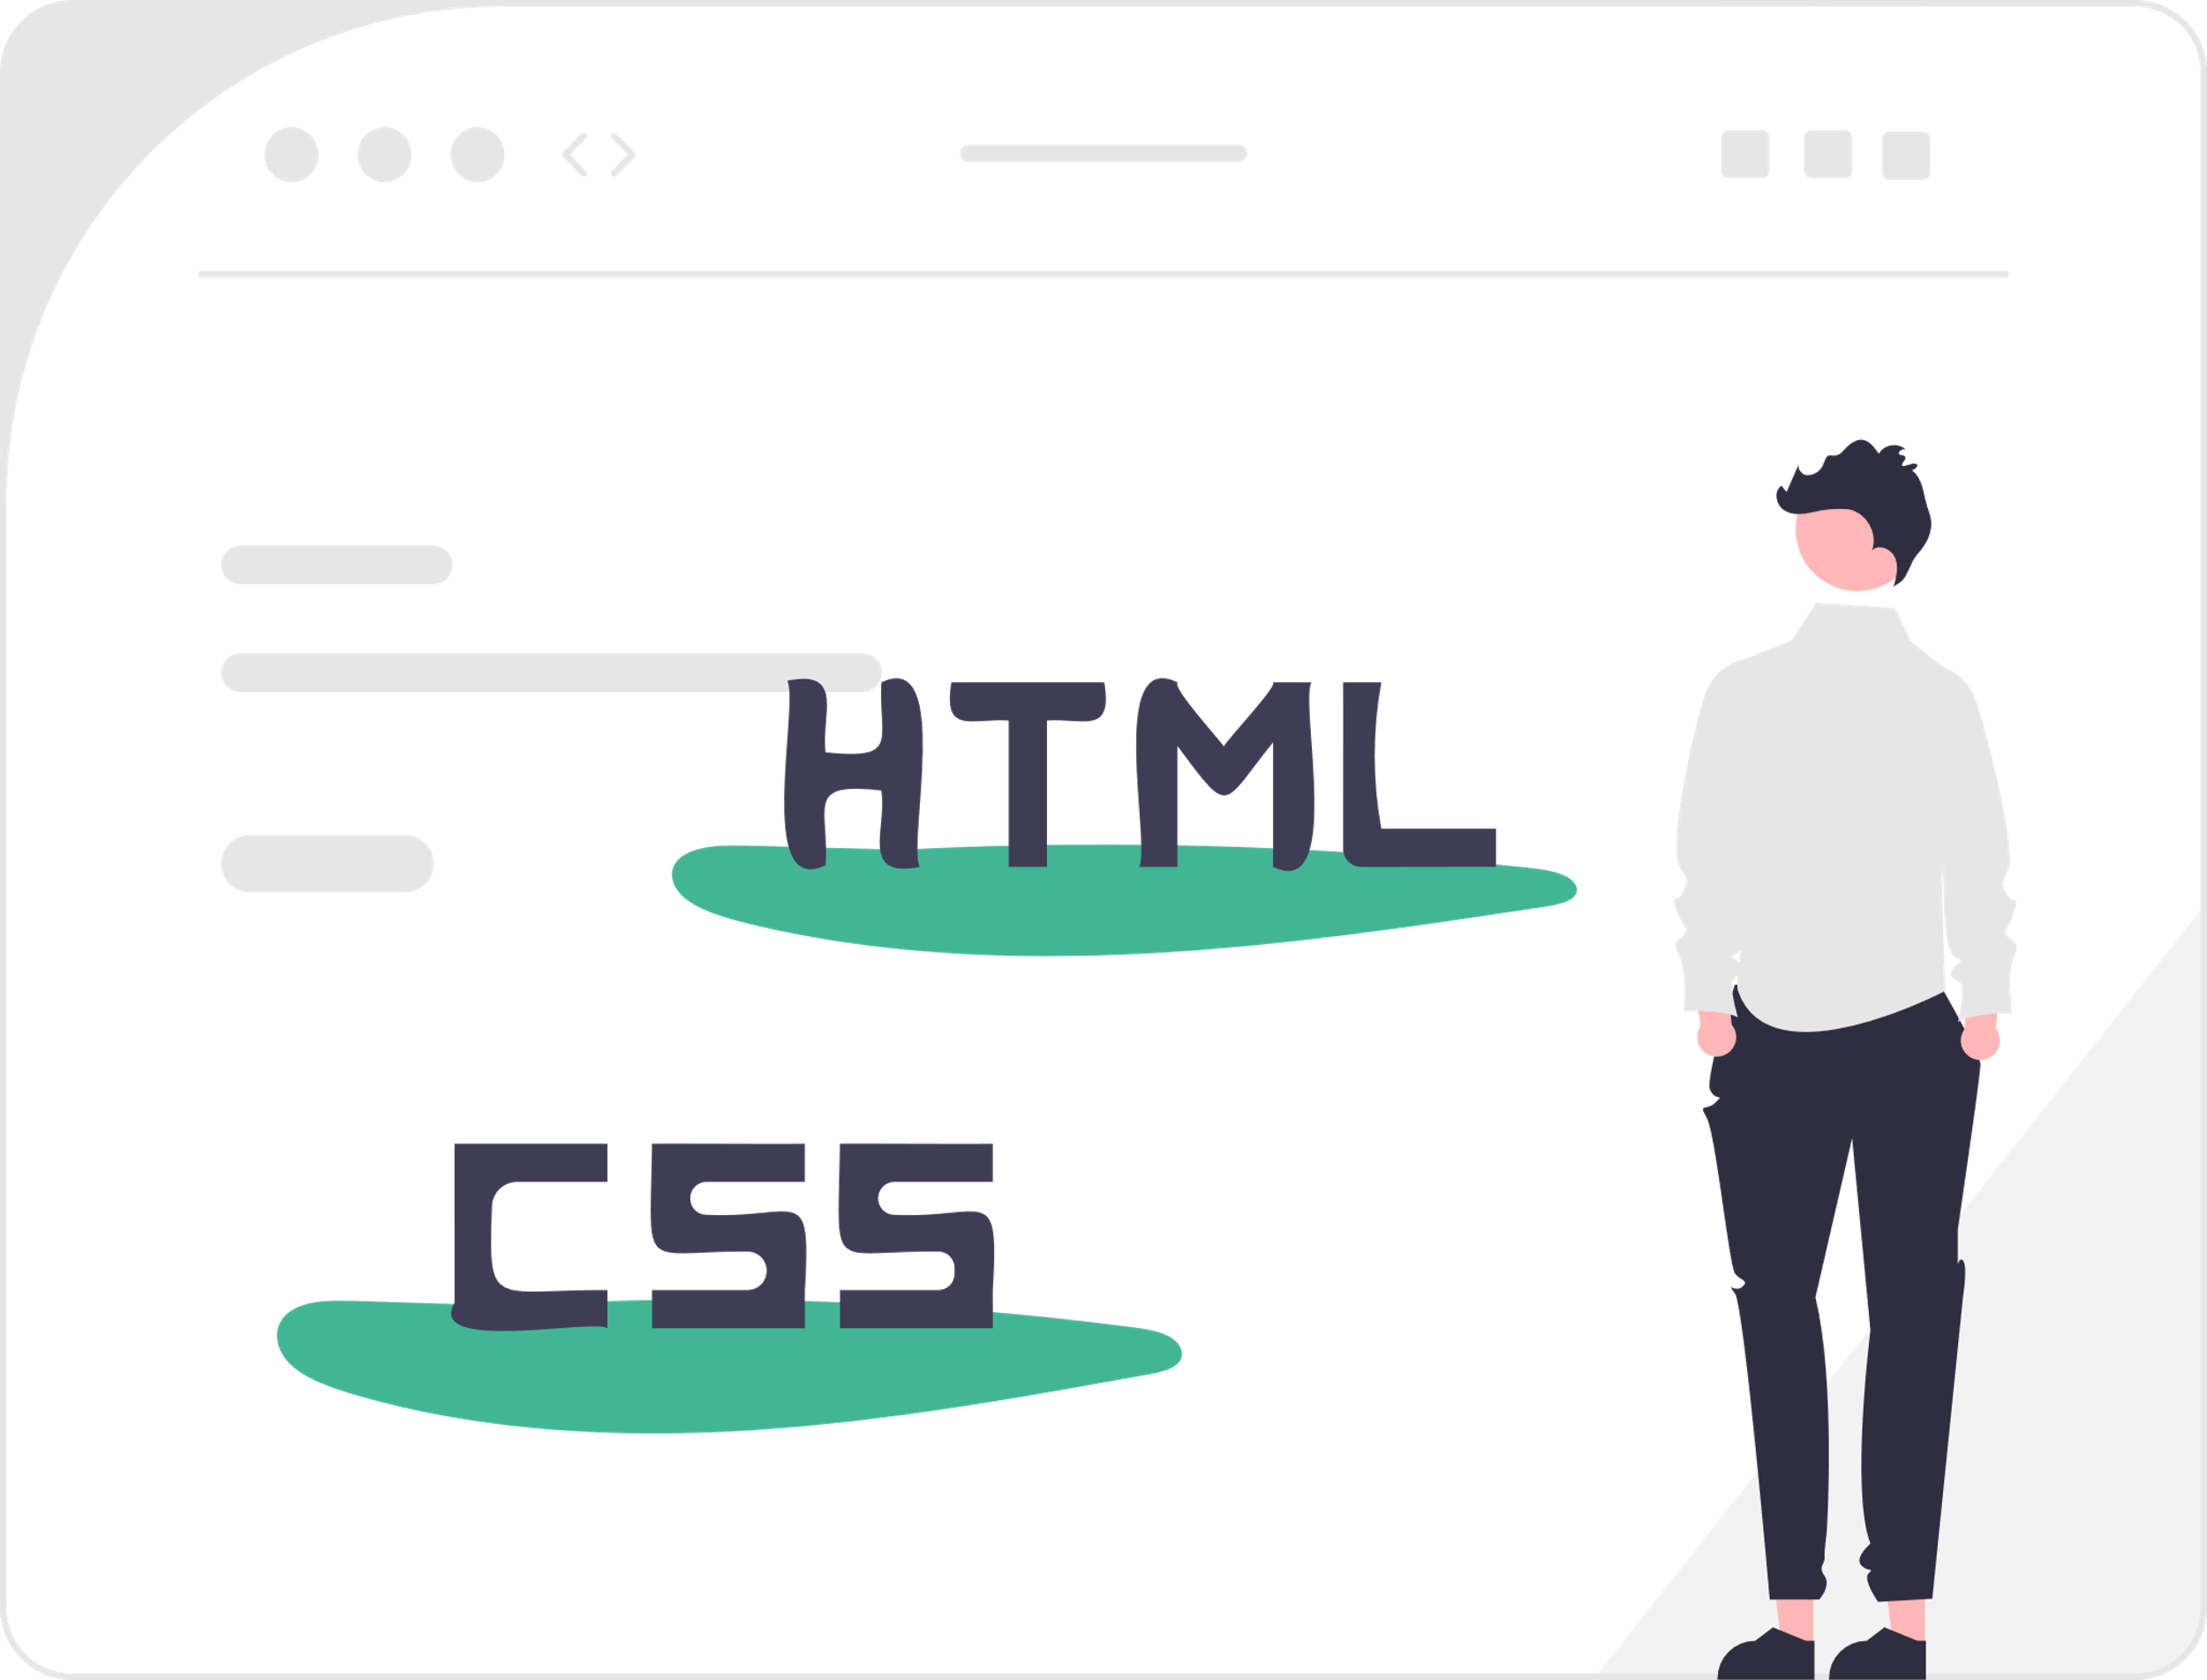
Methodology
There are many steps and processes we have been through to reach the end product. Starting with drawing, sketching, and wireframing, to structure the blocks and design, and give the website the ability to function and control its behavior.

Slide 5
Build the site map to list all the pages that are included on the website. To build this map, we used the Gloomaps tool.
Used Figma to draw the wireframe, which helped us sketch the outline of layouts and basic design.
Structure the pages with HTML. and adding texts, paragraphs, images, and links between pages.
Sketching
Structure

Slide 6
Design
design and add the layouts, colors, backgrounds, and shapes. For this step we use CSS. cascading style sheet language.
To add functions we used Typescript which is an extension of JavaScript. And using angular JavaScript framework.
Behavior

Slide 7
conclusion
Finally, we have been through an exciting journey of designing and developing a website for fresh graduates, which will help them to level up their technical skills. And collaborated with NGOs.
As the project did not finish in a certain way, some user stories and future works remain to be done hereafter.

Slide 8

Questions

Slide 9
Thank you.

