Slide 1
GLOBAL Awards and Accolades

Slide 2









iProspect Client awards & accolades- U.S.
2010 and 2009 Adrian Award for Best Search Marketing
for Motel 6 and Perfect Escapes
eTail’s 2011 Best of the Best in Search for Gap.
2011 & 2010 ClickZ Award for Best Use of Search Engine Marketing for Sears and Reebok
2010 OMMA Award for Google Site Links & SEO for Gap & 2009 OMMA Award for Online Advertising Creativity for Cole Haan
2009 & 2008 SES Award for Best Use of Local Search and Best Use of SEO for Reliant Energy and Nike
2009 Search Engine Watch Award for Best Social Media Marketing for Endless Vacation Rentals
First runner-up for 2010 DMA Award for Best Search Marketing for RadioShack
2011 DFWIMA Award for Most Innovation Use of Search for the GAP Product Feed

Slide 3





iProspect Company Awards- U.S.
Represents more retail clients on the Internet Retailer Top 500 than any other agency for the last 3 consecutive years (2009, 2010, 2011)
CEO Rob Murray named Who’s Who in BtoB Marketing in 2010, 2009, 2008
Our Fort Worth office ranked in the top 100 Workplaces in TX by Texas Monthly Magazine
Named 2011 & 2010 Best Companies To Work For In Marketing & Media
2011 Forrester Waver Report proclaimed iProspect to be “hands down the most global agency in the study.”

Slide 4


iProspect brazil awards
ABEMD- Brazilian Association of Direct Marketing
6th ABANET/IAB – Interactive Adverstising Bureau
2007 Bronze:: PPC :: Abril Publisher Subscriptions
2010 :: Gold :: SEO :: Abril Publisher E-commerce
2008 :: Bronze :: PPC :: Abril Publisher Subscriptions
2007 :: Gold :: PPC :: Abril Publisher Subscriptions

Slide 5



iProspect brazil awards AND REFERENCES
ABEMD- Brazilian Association of Direct Marketing
6th ABANET/IAB – Interactive Adverstising Bureau
2010 :: Gold :: SEO :: Abril E-commerce
2008 :: Bronze :: PPC :: Abril Subscriptions
2007 :: Gold :: PPC :: Abril Subscriptions
2007 Bronze:: PPC :: Abril Subscriptions
iPropect Brazil is the main SEM consulting for the most important marketing specialized publishers
Pioneering development of local search study with Forrester and Google

Slide 6

iProspect Spain awards
“The Best Mobile Performance Campaign During 2011” - Nokia

Slide 7
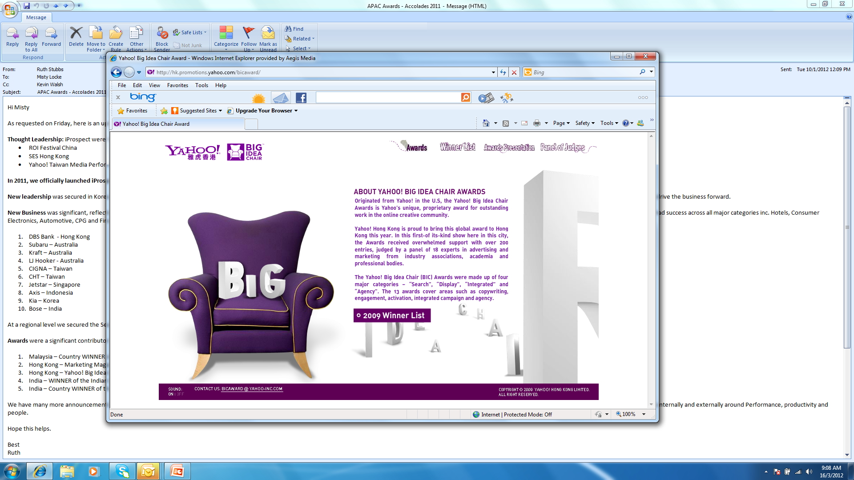

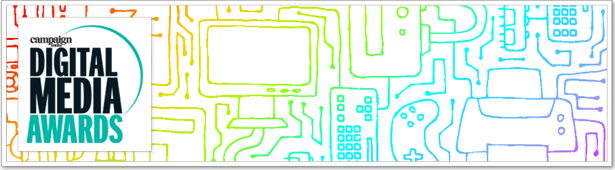


Awards & Accolades : Asia Pacific Highlights
2011 Yahoo! Big Idea Chair Award WINNER
Hong Kong Best Use of Search Solutions
for Ovi Store - Nokia
2011 Yahoo! Big Idea Chair
Country WINNER
India
2011 Marketing Magazine’s
MARKIES Award
WINNER Hong Kong
Best use of Search
Peninsula
2011 India Digital Media Awards
Country WINNER
2011 Microsoft DIGITAL ZENSES Championship
Country WINNER
Malaysia

Slide 8












2011 Client Wins : Asia Pacific Highlights
LJ Hooker - Australia
Axis – Indonesia
DBS – Hong Kong
Chunghwa Telecom
Taiwan
Subaru - Australia
Bose – India
Jetstar – Singapore
Kraft - Australia
Cigna - Taiwan
Kia – Korea
Raffles Hotels – Asia Pacific
Clarins – North Asia

Slide 9

Apac awards
Silver for Best Use of Search for MINI, Malaysian Media Awards

Slide 10
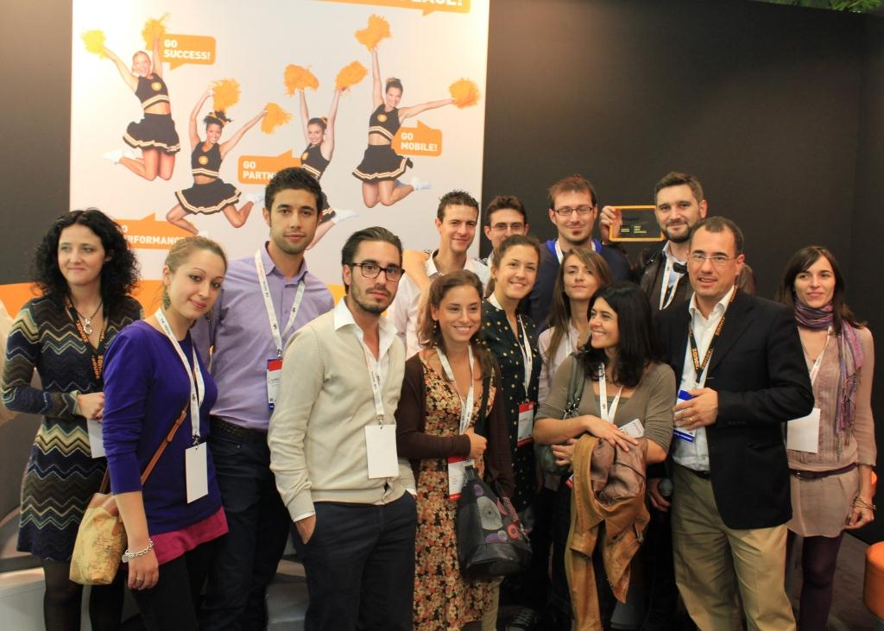
Italy Awards
Zanox Award Winners 2012

