Slide 1

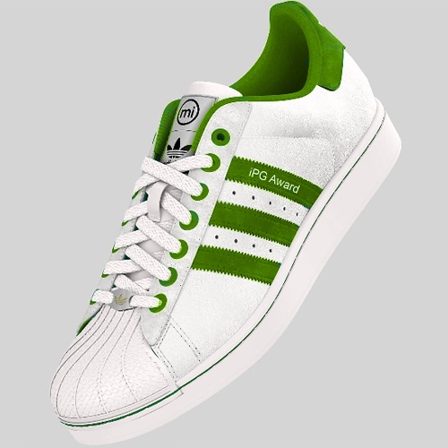

#represent
iProspect Germany - iPG Awards 2012
Ambitiously Driving the Aegis Operating Model

Slide 2
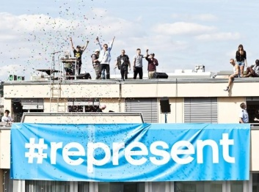


#BACKROUND
#1st goal: raise brand awareness for adidas Originals
#2nd goal: encourage adidas Originals customers to take part in a global campaign
#strategy
drive participation by artists with distinct styles („anchor crews“)
→ promote „anchor crews“ (bought media)
→ give them a stage to represent their originality (owned media)
→ generate digital awareness for adidas Orginals (earned & bought media)
campaign setup in 3 phases
1st phase: the anchor crews promote the campaign buzzword #represent within the target group
2nd phase: public call for crew entries on adidas.com/represent
3rd phase: crew voting phase
anchor crews

Slide 3


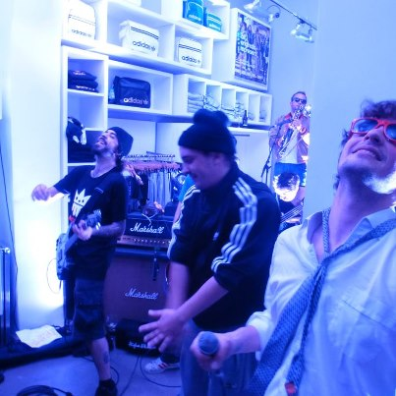
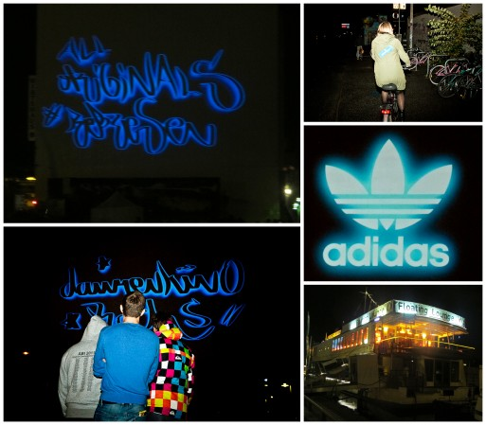
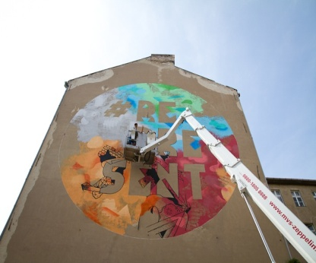
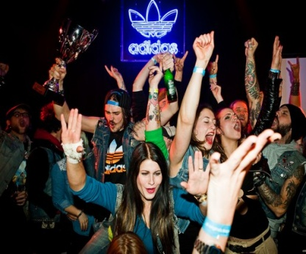
#IMPLEMENTATION OFFLINE
#local events
launch party (Munich)
live concert in Originals retail store (Hamburg)
final event (Berlin)
and many more…
#out of home
„laser graffiti“ event in several German cities
posters
wall painting
#print media
#cinema
instore live act
laser graffiti
painting
Final party
Notes:
5, 6

Slide 4
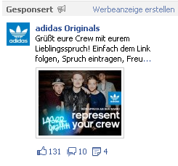
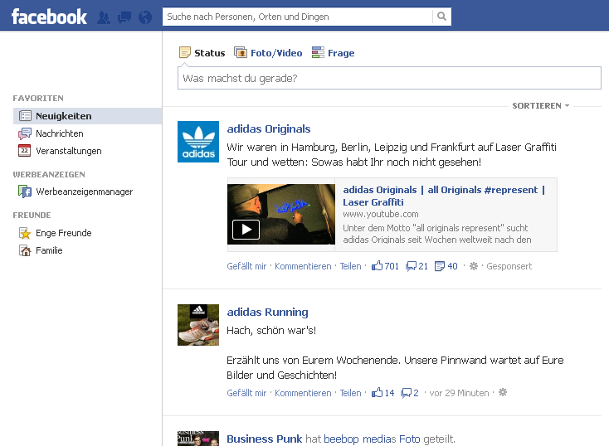
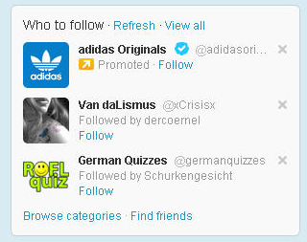
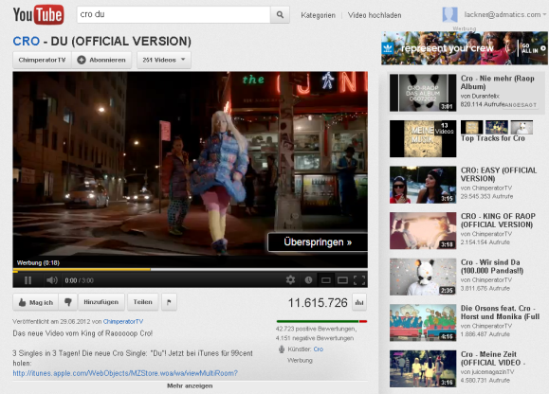
#IMPLEMENTATION ONLINE
#youtube
trueview instream
trueview insearch
trueview indisplay
trueview inslate
#facebook
sponsored posts
like ads
sponsored stories
#twitter
promoted trend
promoted account
promoted tweets
#search
sponsored posts
Facebook newsfeed
twitter promoted account
youtube instream
Notes:
5, 6

Slide 5
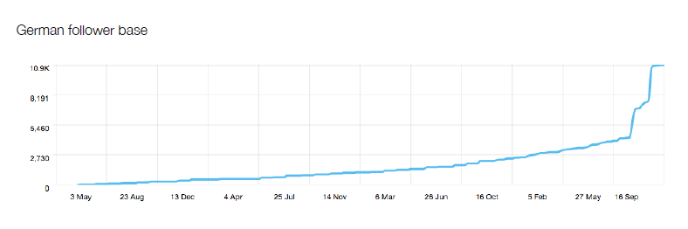
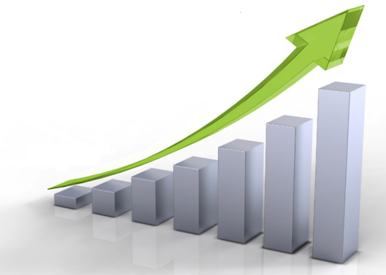
#RESULTS WITHIN 2 MONTHS
#youtube
more than 1.200.000 million views for OBC event videos with an average cost per view of 0,07 €
#facebook
nearly 100.000 generated fans and on facebook over
420.000 actions overall at an average CPF of 0,63 €
#twitter
6.500 new German followers within 10 days.
#website
more than 100.000 clicks generated for adidas.com/represent
#eCom
sales uplift + 40% on Originals products during
campaign duration
+ 150%
twitter follower base DE
+ 40%
Sales Uplift 40%

Slide 6
#performance
lackner@admatics.com
neuner@admatics.com

