Slide 1
Global PPC Award Template
Updated Q4 2012

Slide 2


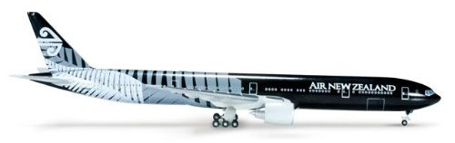


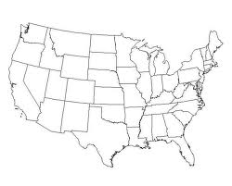
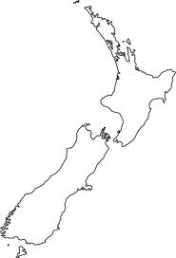
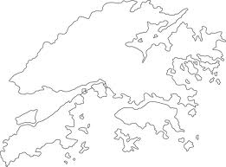
Background/Brief
Air New Zealand Account Setup
New Client
Having won the pitch for Air New Zealand’s PPC account, we took over the account on the 1st September 2012. We would be providing PPC strategy for the 4 markets that they operated in Europe – UK, Germany, France and Netherlands – as well as implementation in all markets, bar Germany, which would be run locally.
Product Offering
Air New Zealand’s main destination was New Zealand, but they were attempting to gain a larger share of the market in flights to Los Angeles and Hong Kong, which formed the first leg of their flights to New Zealand. Los Angeles, especially, was a priority for Air New Zealand to achieve a strong share of voice and drive sales to this destination.
New
Zealand
Los Angeles
Hong Kong

Slide 3



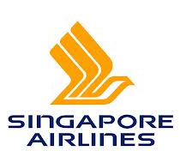

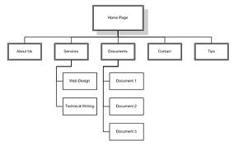

Challenge
A Competitive Market and Account Rebuild
Low Brand Recognition
Air New Zealand are known primarily for serving their namesake destination, New Zealand, and not LA or Hong Kong. We would therefore be competing with better known transatlantic and Asian airlines, as well as the travel aggregators that are better able to draw users and generate conversions.
vs.
Integration Difficulties
As we took over the accounts part way through Air New Zealand’s sale, we opted to continue with the accounts of the incumbent agency. As a result, though, the structure was not ideal for optimisation and broken links meant that the Marin blackout period during integration lasted a week, during which we were unable to optimise.

Slide 4





Strategy
Careful Optimisation and Ad Copy Changes
Bid Optimisation
Using Marin, we implemented the position override facility to ensure that our brand keywords were appearing in position 1.
We then identified the generic keywords that were most likely to convert and implemented regular keyword-specific bid changes to maximise the conversion potential of the campaigns.
[Flights to New Zealand] £1.20
[New Zealand Flights] £1.35
[New Zealand Holidays] £0.86
[New Zealand Airlines] £1.92
[New Zealand Flight Prices] £1.71
Ad Copy Changes
In order to try and maximise the conversion of users, we modified our ad copy based on the copy performance we’d seen to date. We also trialled highlighting the end date of the sale to try and drive conversions, a new test for Air New Zealand, which could provide useful information for the all-important January sales.
Ends Sep 26th

Slide 5



results
Record Sales in
Record Sales Days
Air New Zealand had achieved its record sales day earlier in the year at the end of its January sale, supposedly the busiest time of the year. Within a month of taking over the account, we helped exceed that record on consecutive days: the first day beating it by 6%, the second day beating it by over 16%.
Incumbent Agency
Previous Record Day – Feb 1st
£279,435
Ad Copy Results
The adjustments made to the sale copy to persuade people to purchase sooner, rather than later, resulted in the conversion rate on the site increasing by 35%. As a consequence of more conversions per click, paid search was responsible for over a third of the revenue generated on the record day.
New Record Day – Sep 25th
iProspect
£295,679
Second Record Day – Sep 26th
£324,297

