Slide 1
Global PPC Award Template
Updated Q4 2012

Slide 2






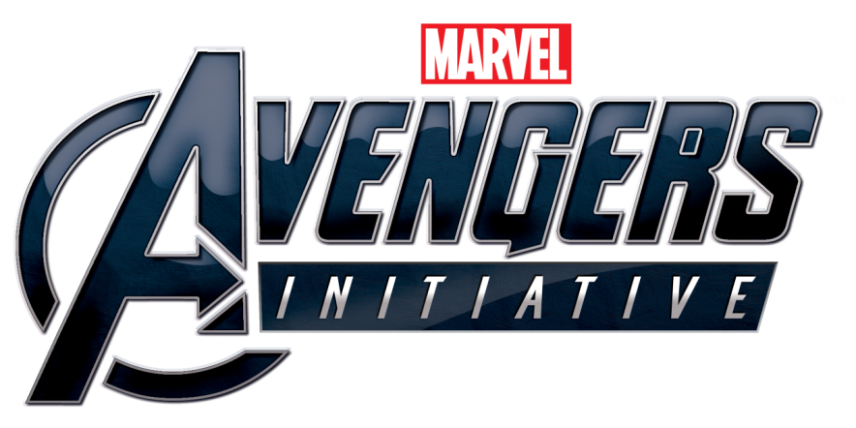

Background/Brief
Avengers Initiative Mobile Game
Avengers Initiative
In line with the DVD and Blu-Ray release of The Avengers, Disney Interactive Studios had created a mobile game where, in its first incarnation, the user took on the role of The Hulk in a first person action adventure.
The app was being released in the UK, Germany and France.
The Role of Search
Disney wanted to promote their app to relevant searches and capitalise on the interest that will be around The Avengers during the launch of the DVD/Blu-Ray.
Users would need to be sent to the iTunes page in order to download the app.

Slide 3

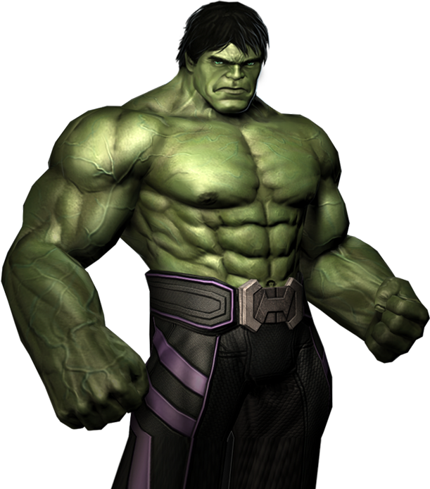
Challenge
An Expensive App and Other Disney PPC
Expensive App on iTunes
Priced at £4.99, it was expensive for an app, although competitively priced amongst similar apps. Furthermore, at the time of the app being launched, there was no way to track iTunes downloads, so we couldn’t optimise to conversions.
Things that make Bruce Banner angry...
1. Tough to convert an expensive app
2. Competing with other Disney ads
Search Campaign Also Running for the DVD
A PPC campaign was also going to be running to try and drive sales of the DVD/Blu-Ray, so we risked competing with another Disney ad, driving up the cost of both campaigns.

Slide 4




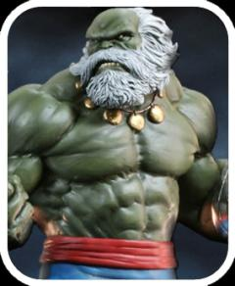
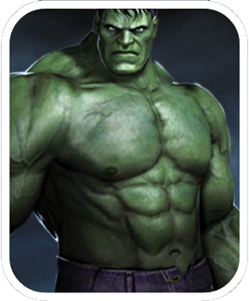



Strategy
Using App- and Mobile-Specific Ad Features
Google’s Fancy Sitelinks
In order to avoid competing with the Disney Home Entertainment ad that would be advertising the DVD & Blu-Ray, we used a new Google feature called “fancy” sitelinks whereby a click-to-download sitelink could be added to the Home Ents ad. We were therefore able to piggyback the Avengers buzz and not increase costs.
Avengers Initiative Mobile Game
Click-To-Download & GDN Ads
To capture search interest, we used click-to-download ads for mobile users to send them straight to the iTunes page to buy the app.
When search traffic was not high enough to spend our budget, we targeted mobile users on the GDN.
Download iPhone App

Slide 5

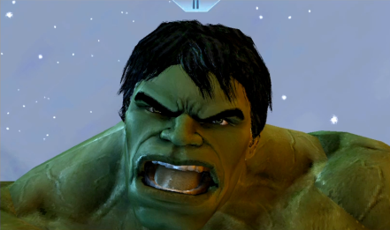
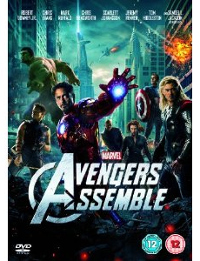
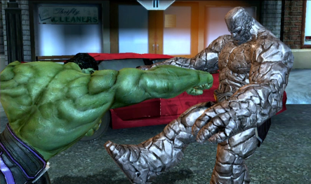
results
Title
“Fancy” Sitelinks
By adding a “fancy” sitelink for the Avengers game onto the Home Entertainment ads, we were able to drive an additional 735 clicks to the iTunes page . There was no competition between Disney ads and we were still able to capitalise on the heightened search interest around the DVD release.
735 highly relevant clicks from the DVD release
Success on the GDN
When standard search ads were failing to drive the necessary volume, GDN text ads were very successful in driving the necessary volume (over 140,000 clicks to date).
Initially targeting both desktop and iOS mobile devices on the GDN, mobile targeting proved so strong that we switched purely to mobile targeting.
The Hulk is a big hit on the GDN with 140,000+ clicks

