Slide 1
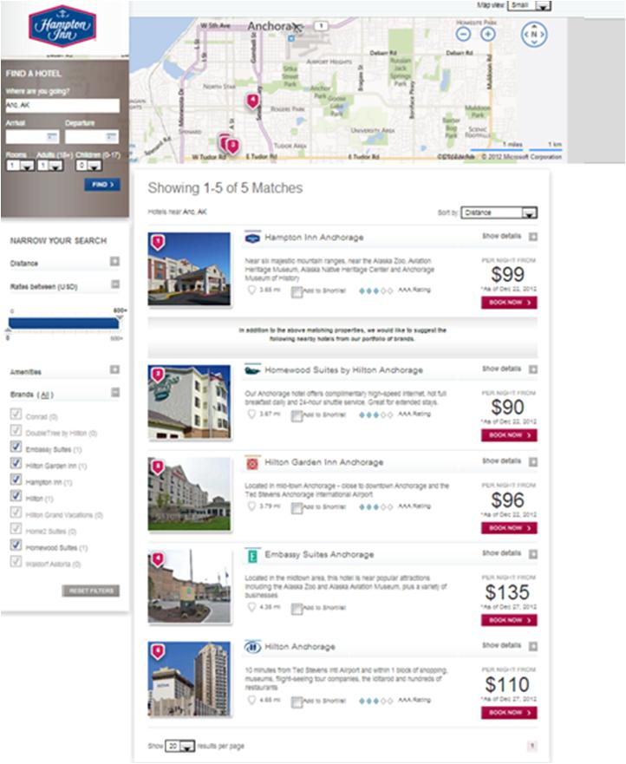
Dynamic landing page
With the help of Isobar, all Hilton brands have paid search driving to DLPs to help users find all relevant hotels within the Hilton family.
This is chosen in almost all cases instead of a local property landing page to encourage bookings.
A radius is set based on the size of the city & surrounding area.
Searches such as “Hilton Hotels near Anchorage” will render a DLP.

Slide 2
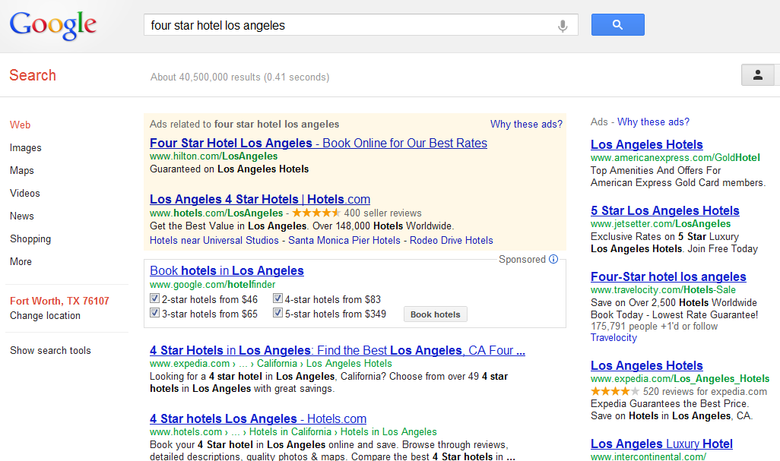
“four star hotel los angeles”
The relevant Hilton Hotel even shows up for a generic search query.

Slide 3
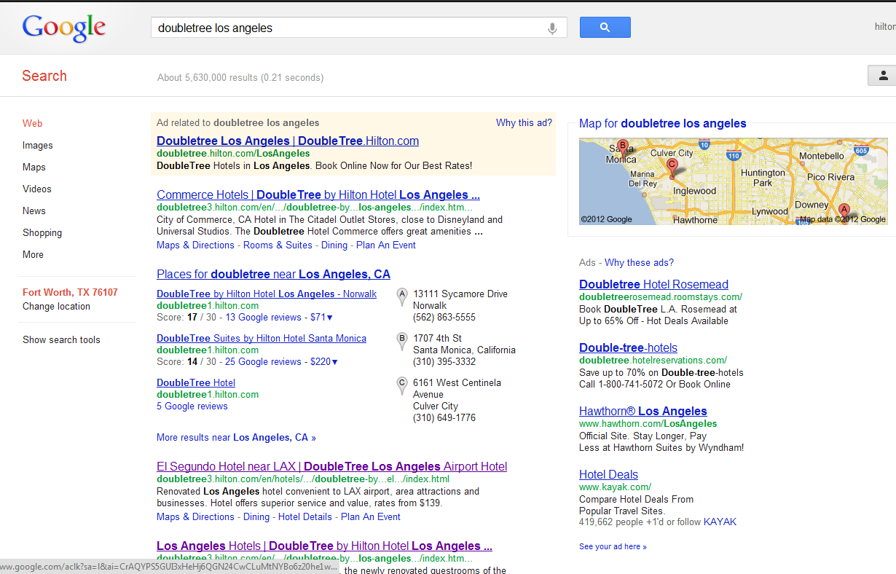
“doubletree los angeles”
Example of a branded search query

Slide 4
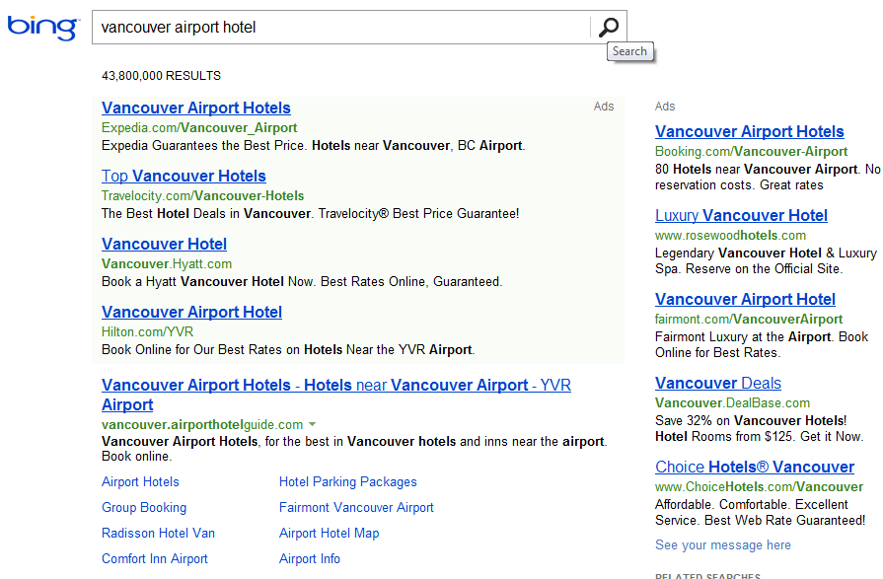
“vancouver airport hotel”
Example of a generic search query for landmarks (airports)

Slide 5
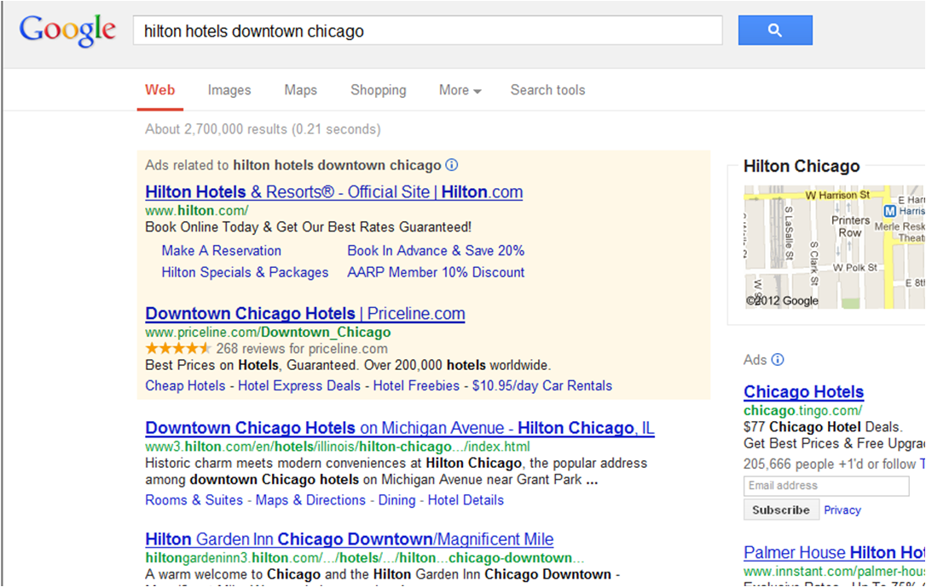
Adding innovations to drive bookings
Sitelinks encourage bookings - our KPI is ROI.
Exploring future opportunities: Google Social Extensions, Click to Call, & Communication Extensions.

