Slide 1
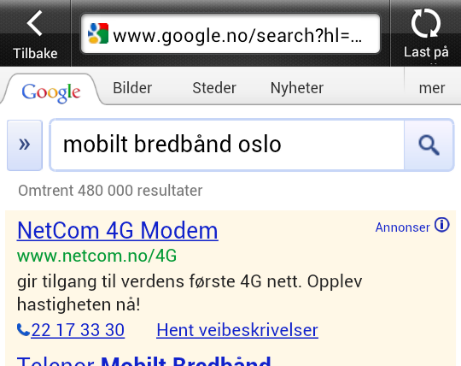




Examples ultra tactical SEM
Geo-targeting in areas where NetCom offers 4G mobile coverage. Different ads shown depending on whether mobile search was performed using NetCom’s own or competitors network.
Ved søk etter mobilt bredbånd via mobilen i områder der NetCom har 4G-dekning, ble det vist ulike annonser avhengig av hvorvidt man bruker NetComs nett eller konkurrentenes nett.
Taktisk bruk av ad extensions
Constant testing of which offers performed the best according to set KPI’s
“Click to call” ads combined with route finder to closest store

Slide 2
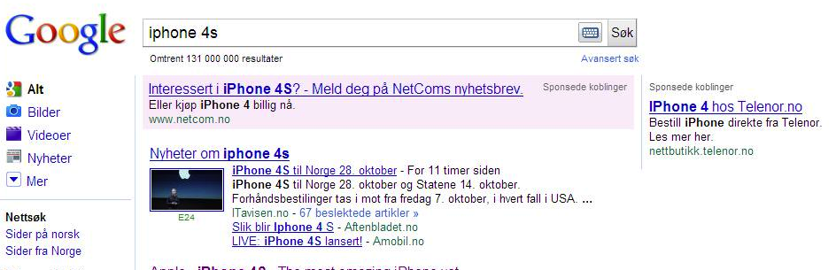
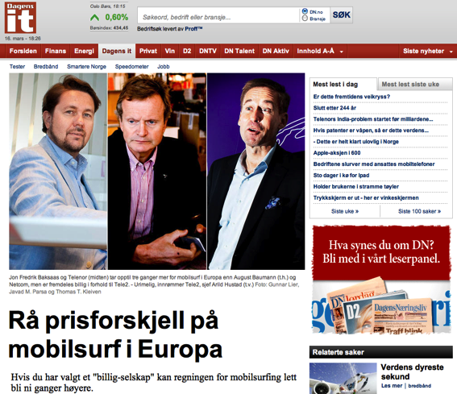


Examples ultra tactical SEM
Only advertiser for iPhone 4S prior to and at launch
Mediedekning rundt NetComs billige mobilsurf i utlandet
Media coverage concerning NetComs cheap mobilesurf offer when abroad

Slide 3
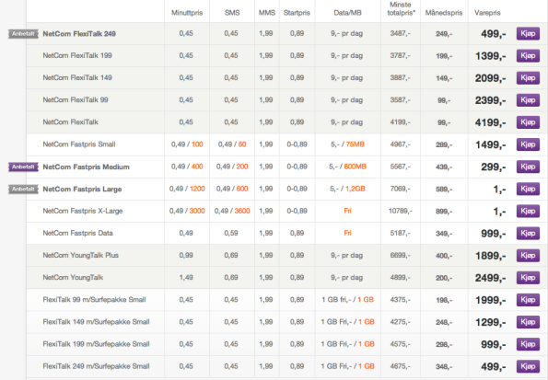
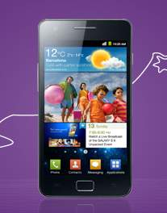




Examples of which offer created highest net earnings

Slide 4
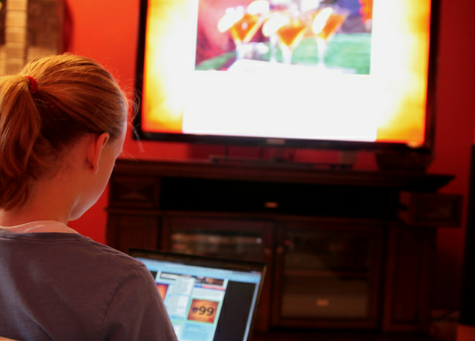
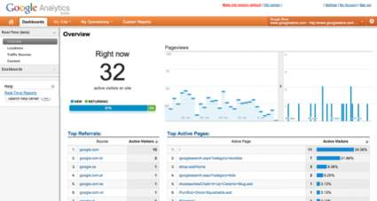
Which TV-spots drives the purchaser to the website?

Slide 5
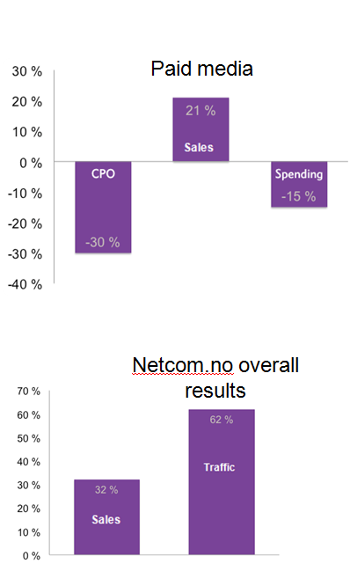
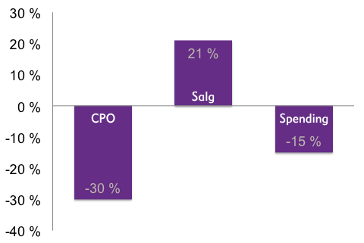
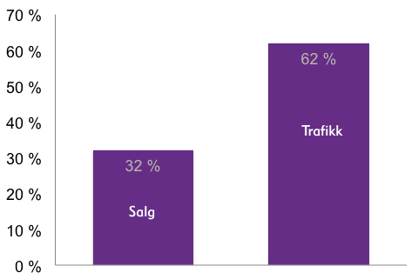

Exceptional results !
Paid media
Cost per unit from Paid media reduced by 30%
Sales from Paid media increased by 21%
Mediaspend reduced by 15%
Owned and Earned media increased site traffic by 62%
Sales from Owned and Earned media increased by 32%
Netcom.no overall results

