Slide 1
Google Adwords
Geo-targeting
Web analytics used for keyword optimization
Negative keywords
’Exact match’ for phrases with highest conversion rate
’Broad match’ for phrases with lower conversion rates

Slide 2
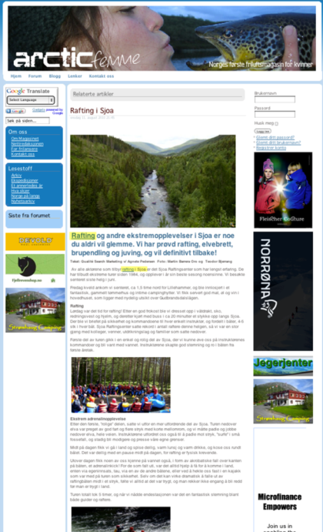
Written and published article on niche sites for Extreme sports and Outdoor lifestyle
SEO – Online PR & linkbuilding

Slide 3
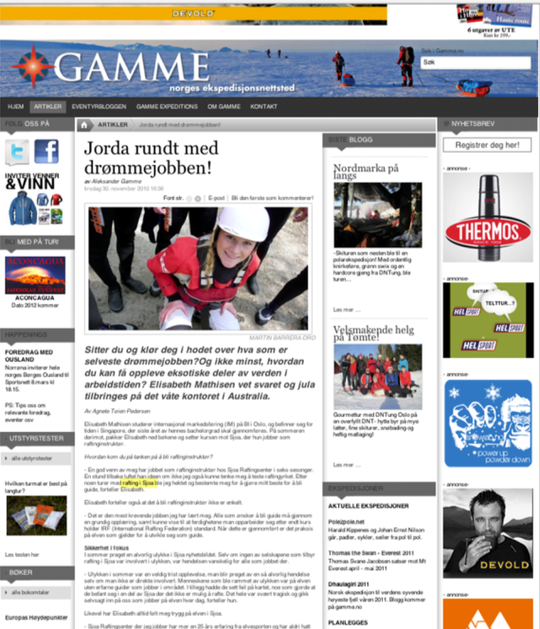
Written and published article on niche sites for Extreme sports and Outdoor lifestyle
SEO – Online PR & linkbuilding

Slide 4
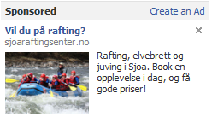
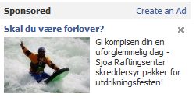
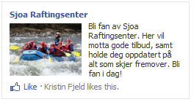
facebook-ads
Lives in Norway
Age 18-64
Likes: extreme sports, rafting, etc.
Lives in Norway
Age 25-40
Men
Lives in Norway
Older than 18
Likes: rafting, kajaking, extreme sports, etc.
Currently not Fan (by Like) of Sjoa Raftingcenter

Slide 5
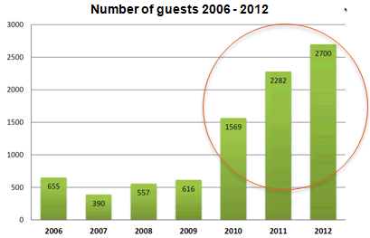
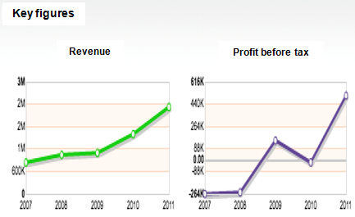
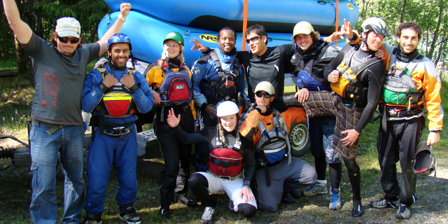
results
Number of guests increased by 155% first season of cooperation, and in total 338% the last 3 seasons!
Economic growth has been outstanding:

