Slide 1


AirAsia Multiple Small Clustered Search, Display Campaigns!

Slide 2
Strategy
MULTIPLE SMALLER DISPLAY CAMPAIGNS
Tier 1: Influence:
Google Display Network
Travel Blogs and Forums (ICM)
Destination & Travel Sites (ICM)
Tier 2: Convert
Paid Search
MULTIPLE SMALLER SEARCH CAMPAIGNS
Category based Search Campaign
Brand Search Campaign
Route Search Campaign
Mobile / Tablet Search campaigns based on Brand/Route/Destination
Destinations Search Campaign
Competition Search Campaign
Interest/Topic/
Category Display Campaign
Notes:
Final One!

Slide 3
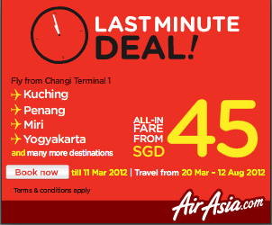

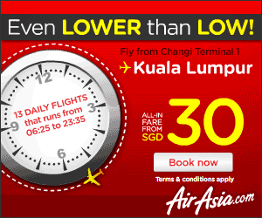
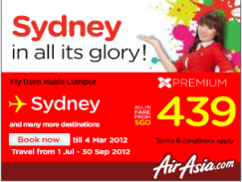

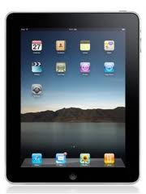
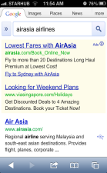
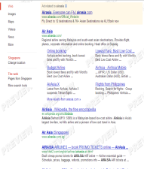
Execution
MULTIPLE SMALLER DISPLAY CAMPAIGNS
Low cost airline
Cheap Tickets
Travel
Air Tickets
Must Visit places
Top Beaches etc
Sites
Tier 1: Influence:
Ads
MULTIPLE SMALLER SEARCH CAMPAIGNS
Fly with Airasia
www.airasia.com/Official_Website
Explore Amazing Destinations with World’s Lowest Fare Airlines!
Fly to Malaysia @ S$40 Fly to Thailand @ S$65
Fly to Indonesia @ S$55 Airasia – Big Sale is back
Tier 2: Convert
Ads
Notes:
Final One!

Slide 4
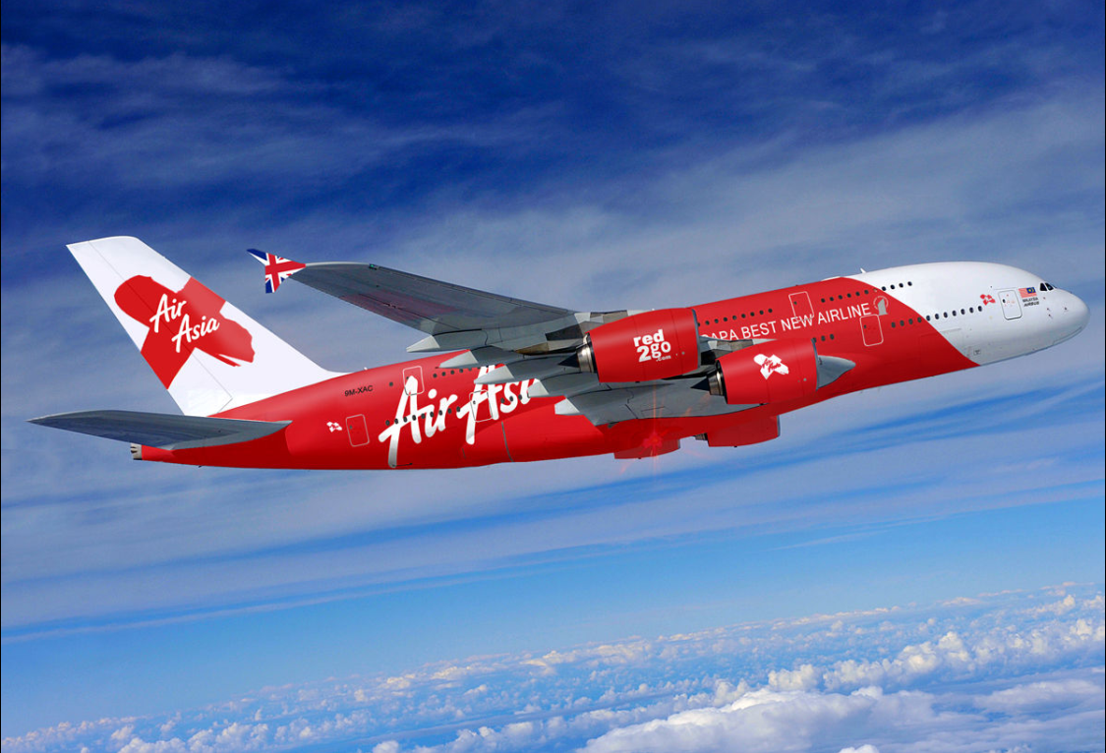
Results
Over 97,480+ additional bookings with 62% decreased CPC
Net Revenue Generated was $24+ Millions
Achieved an ROI of $51x
Introduction
Air Asia is one of the world’s most successful budget airline. Tony Fernandes, its CEO, is the man behind the tremendous success of Air Asia. The reason for the success can be attributed to 2 key pillars:
KEEPING IT SIMPLE & BEING NIMBLE
Results
Notes:
Final One!

