Slide 1
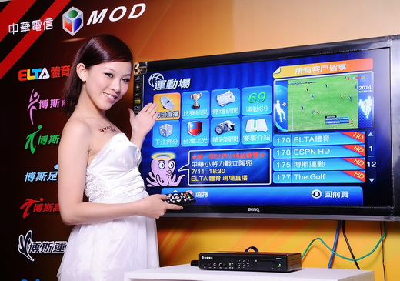

The challenge
Most Taiwanese still used cable TV as their main source of video entertainment consumption…
CHT needed to educate and migrate the highly cemented cable TV attached Taiwanese population into MOD users!!
Notes:
MOD: Kick Starting the Path to Stardom
Throughout the recent years, the MOD service package (Multi Media On-demand) has been one of CHT’s highly focused and promoted products. Via internet bandwidth, MOD provided users with numerous selections of on-demand media content, such as thousands of digital TV channels, TV programs, and movies. In addition, MOD also features interactive services such as gaming, karaoke, information search, online banking, and online shopping.
However, MOD had yet to successfully capture the attention of most Taiwanese. In 2012, iProspect TW was challenged with the task of aiding CHT in the education and migration of the highly cemented cable TV attached Taiwanese population into MOD users. What started as a purely PPC optimization based activity, quickly transcended into a multi-channel SEM strategy which came about with the birth of a new national Taiwanese idol: Jeremy Lin.

Slide 2

Our goal
Then came…
JEREMY LIN!!
We needed to educate consumers on the benefits of MOD, and quickly establish campaign content relevancy with the exploding “Linsanity” phenomenon.
Notes:
Linsanity: Getting in on the Insanity Anytime with MOD!
Prior to 2012, conventional cable TV remained the paradigm source of video media consumption. Like every potential star player, MOD yearned for the right time and opportunity to shine. Luckily, the spotlight showed interest with the rise of another star: Taiwanese-American NBA player Jeremy Lin. Since Lin’s first appearance on court as the sub point guard for the Ney York Knicks against the Utah Jazz (2/4/2012), like all of Taiwan, iProspect TW began closely following this new national icon. As attention and search volume gradually exploded around “Linsanity”, iProspect quickly devise a strategy interlinked with the extraordinary phenomenon, determined to catapult MOD into a new MVP.

Slide 3


Strategy I
Sizing up the Roster
We discovered our original strategy and account structure wasn’t enough to capitalize the attention.
So we setup a brand new ad group containing Lin related keywords, such as “linsanity”, “linvincible”, “knicks”, etc.
We also leveraged keywords related to sports channels, sport news and sports knowledge.
Notes:
Sizing up the Roster
As the Lin buzz skyrocketed, we discovered our original strategy and account structure wasn’t enough to capitalize the attention. We setup a brand new ad group containing Lin related keywords, such as “linsanity”, “linvincible”, “knicks”, etc. We also enlarged the playing field by leveraging keywords related to sports channels, sport news and sports knowledge.

Slide 4


Strategy II & III
Crowd Shouting Ad Copies
We designed a series of ad copies that emphasized Lin’s games could only be completely captured through MOD and exploded user conversion.
24 Hours Prospect Scouting
“Triple-double” stats of 1,499 impression & 32 clicks within 30 minutes of being online, convinced our client to immediately double the budget for 24 hour activity.
Notes:
Crowd Shouting Ad Copies
Blessed with ownership of ELTA Sports, the only TV channel in Taiwan with complete coverage of NBA games, our team designed a series of ad copies that emphasized Lin’s games could only be completely captured through MOD. Rigorous split testing perfected our lineup of ad copies that exploded user conversion.
24 Hours Prospect Scouting
Triple-double stats of 1,499 impression & 32 clicks within 30 minutes of being online, convinced our client that our playbook was solid and enticed them to immediately double the budget for 24 hour activity.

Slide 5

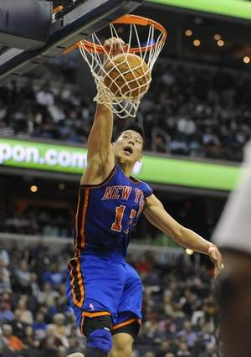

RESULTS
Leading Brand Awareness –The New All Star is Born!
“Earned News” flooded the internet & TV!
Outperforming competitors, revitalizing brand favorability!
Cost Effectiveness – Achieving “Linpossible” with Less!
Burst QI to 5! Over 1% CTR! Avg. CPC of NT$ 5!
Over 160 million impressions & 150 thousand clicks!
Exploding Revenue – Performance is King!
MOD ordering exceeded existing inventory.
New registration surpassed original annual target by 33%.
Notes:
Leading Brand Awareness – The New All Star is Born!
“Earned” news reports surrounding Lin and MOD constantly overflowed the internet and TV. MOD related content SOV massively outperformed industry competitors, revitalizing the public’s favor and attention.
Cost Effectiveness – Achieving “Linpossible” with Less!
Over 160 million impressions & 150 thousand clicks!
We immensely increase CTR and burst QI to a full score of 5! With this, we continuously secured number 1 rankings and over 1% CTR, while paying only an avg. CPC of $5 throughout the season.
Exploding Revenue – Performance is King
MOD becomes hottest out of stock product!
During the campaign, ELTA Sports was able to achieve an impressive TVR of 3.49%. Popular forums such as Mobile01, were reverberating with comments like “For Lin, use MOD!”, which created a MOD ordering frenzy that exceeded existing inventory. New registration surpassed the original annual target by 33%.

