Slide 1
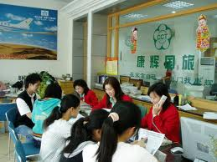
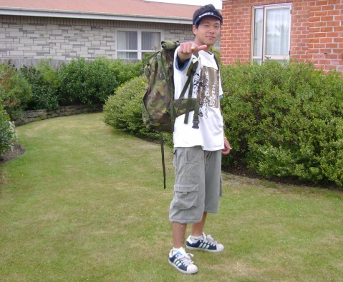
The challenge
Most Taiwanese use travel agencies for travel arraignments….
We needed more people that were willing to try out self-service traveling!!
Notes:
AirAsia is Asia's largest low-fare, no-frills airline and a pioneer of low-cost travel in Asia; however, its brand and services were still relatively less known in Taiwan in early 2012. AirAsia’s business model is based on a mixer of managing consumer demand and ticket inventory to provide the best deals for consumers through their website. Yet, the typical Taiwanese utilizes travel agencies as their main source for travel arrangements; the notion of self-service style travel planning is very distant. Due to this fact, low-cost airlines face strong barriers in expanding their market size.

Slide 2
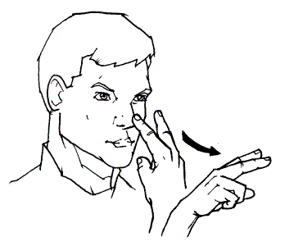
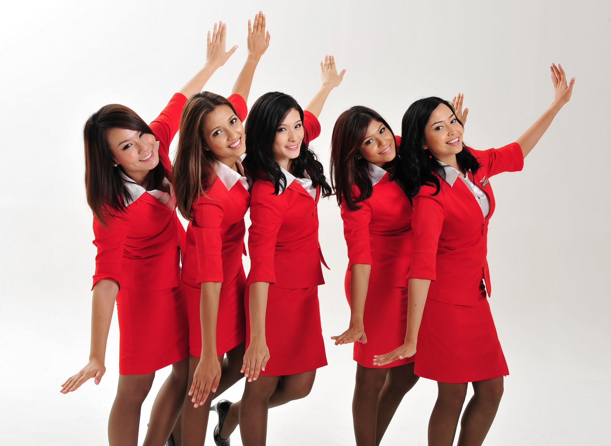
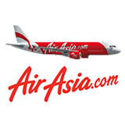
Our goal
We needed to educate consumers on budget airlines benefits, and translate our resource use into increased revenue
Expand the market size for Self-Service travel
Entice strong market demand for AirAsia tickets
I Search
I See
I WANT!!
Notes:
AirAsia wished to leverage SEM in order to simulate sales revenue and increase ROI. Given an account that lacked long-term structure, optimization history data and a limited budget that disabled 24 hour activity, iPropsect TW set out on the difficult mission of reinventing AirAsia’s PPC account performance. To do this, we needed to educate consumers about the benefits of budget airlines offers, but at the same time translate our resource use into increased revenue.
We were tasked with 2 key objectives:
1. Expand the market size for Self- service travel
2. Entice strong market demand for AirAsia tickets

Slide 3

Strategy I - Dual Channel Communication
Long Tail Keywords: Connect with the large, diverse consumer base!
Direct Sales Keywords: Communicate irresistible sales offers!
20% (24h)
Direct Sales Keywords
80% (non-24h)
Long Tail Keywords
Sales!
Notes:
Dual Channel Communication (2012/3-2012/11)
We utilized “Long Tail Keywords“(Non 24 hours online) to connect with the large, diverse consumer base and “Direct Sales Keywords” (24 hours online) to communicate irresistible sales offers, while continuously expanded and optimized both groups to high ROI & low spending categories.

Slide 4

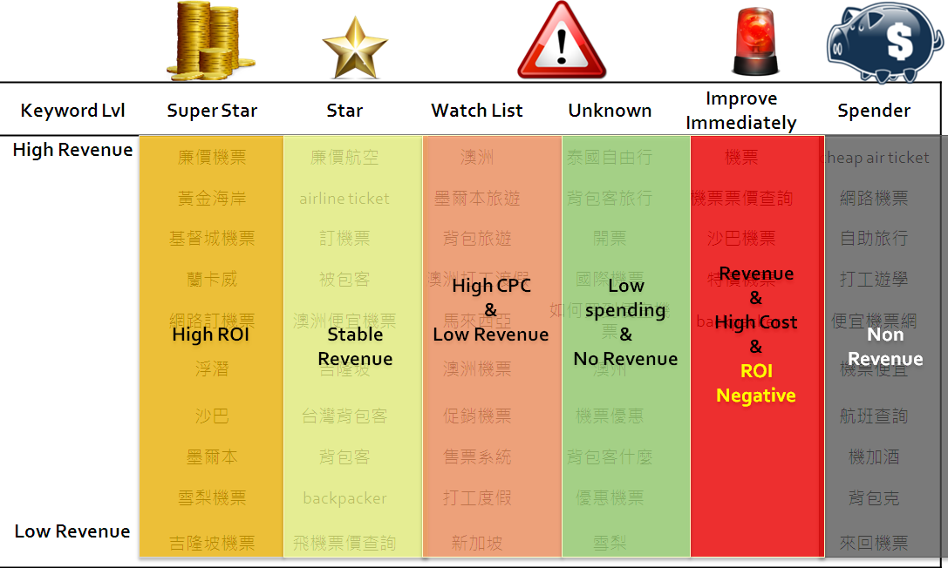




Strategy II & III – restructure & Resource
Increased budget
Conversion optimization
Bidding price &
Ad copy optimization
Placement, matching optimization
Long tail keyword development.
Notes:
Account Restructuring (2012/3-2012/6)
We redesigned the account and redefined ad group constitution to increase organization and operation agility. We quickly increased CTR and quality scores by vigorously split testing ad copies. Leveraging MediaMind, we gained real-time keyword performance data, enabling instantaneous reactions for ad group adjustments and budget reallocation.
Resource Deployment Optimization (2012/7-2012/11)
We then divided keywords into 4 groups according to performance data, and deployed different resources and optimization strategies for each group for maximized cost-benefit return.
Stars: increased budget and conversion optimization
Watch List: bidding price and ad copy optimization
Improve Immediately & Spenders: placement, matching optimization and long tail keyword development.

Slide 5
RESULTS
Account Reconstruction
Resource Deployment Optimization
ROI growth of 629%
Revenue growth of 844%
CTR growth of 54.44%
Decreased avg. monthly CPC by -27%
Notes:
After continuously redesigning and reinventing AirAsia’s PPC accounts’ structure and strategy, within 8 months, we were able to help our client accomplish the following achievements:
Generation of 203,842 clicks
Revenue growth of 844% (March: $860k → November $8.12m)
ROI growth of 629% (March: 377% → November 2747%)
Decreased avg. monthly CPC by -27% (March: $9.12 → November: $6.71)
CTR growth of 54.44% (March: 1.14% → November: 1.77%)

