Slide 1
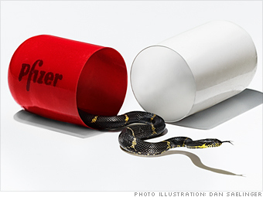

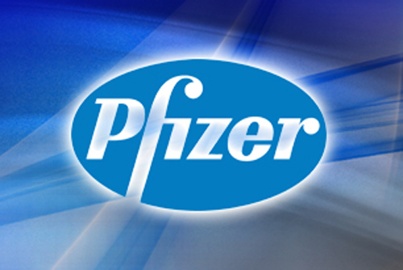
Big Picture & Objective
Among all the rumors about Pfizer on the Internet, iProspect’s goal is to help maximize the exposure of positive content by leveraging SEO, SLPR & PPC.
Balance the
negative image

Slide 2

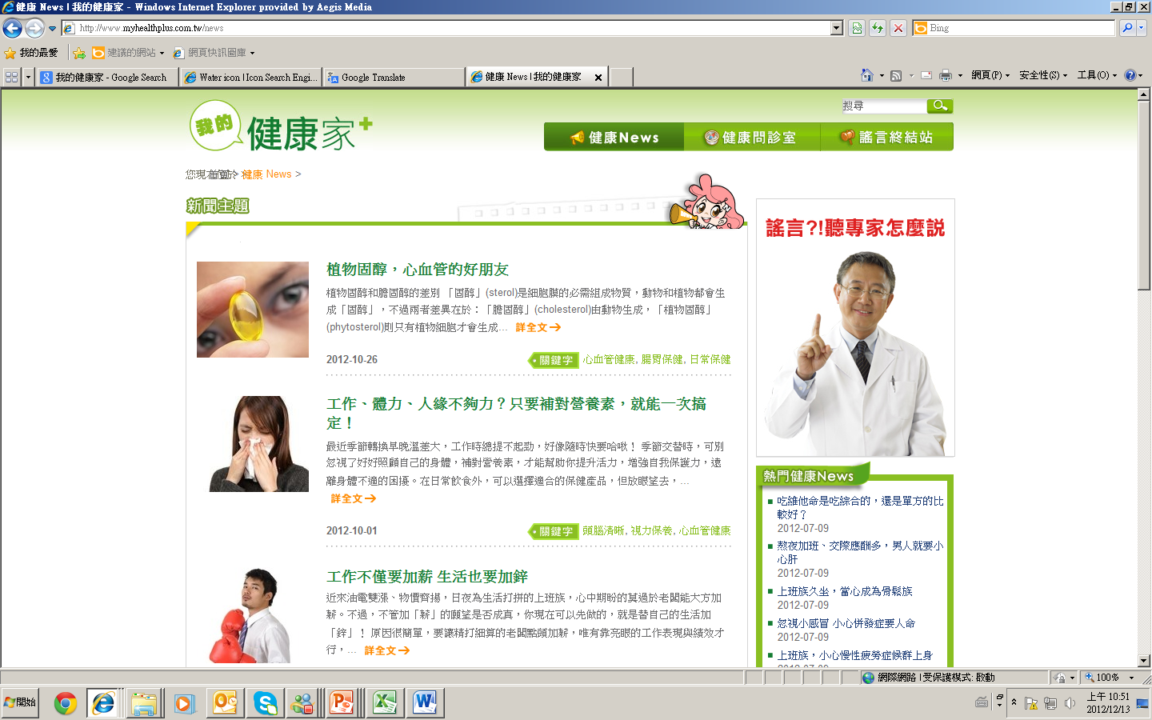
Through iProspect, consumers will be guided
My Health Plus：
The web platform containing positive content.
PPC+SEO+SLPR
When consumers search online..
They will be guided to the
My Health Plus website and other positive sources with user experiences

Slide 3

Strategy Outline
Search
PPC
Health Related content
Deduping PPC content to maximize first screen of SERP on Yahoo
SEO
Synthesize search engine friendliness into the My Health Plus site resulting in higher ranking
SLPR
Depict positive product experiences and accurate information regarding brands and products resulting in high impression
connect
connect
My Health Plus
connect
connect

Slide 4



Performance
iP led consumers to learn the positive truth about Pfizer after 8 weeks optimization of SEO, SLPR & PPC.
70 MIL. Views
60% positive
From 40% negative results on 1st SERP
top 3 PPC
PPC impression reached goal 2.7 times faster than expected, only took 3 weeks.
From none to complete domination
60%
40% MARKET AVG
+42.86%
CPC WAS AS LOW AS ONLY $14.5
(market benchmark: $40)
CTR INCREASE
40%

Slide 5

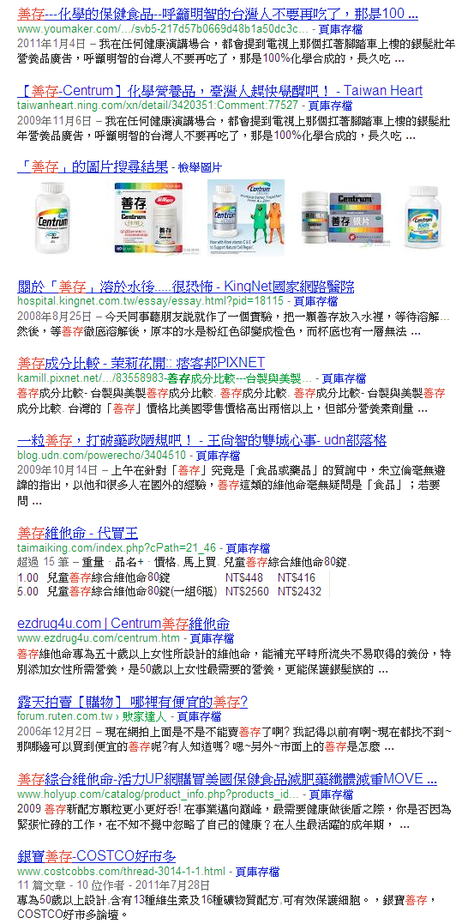
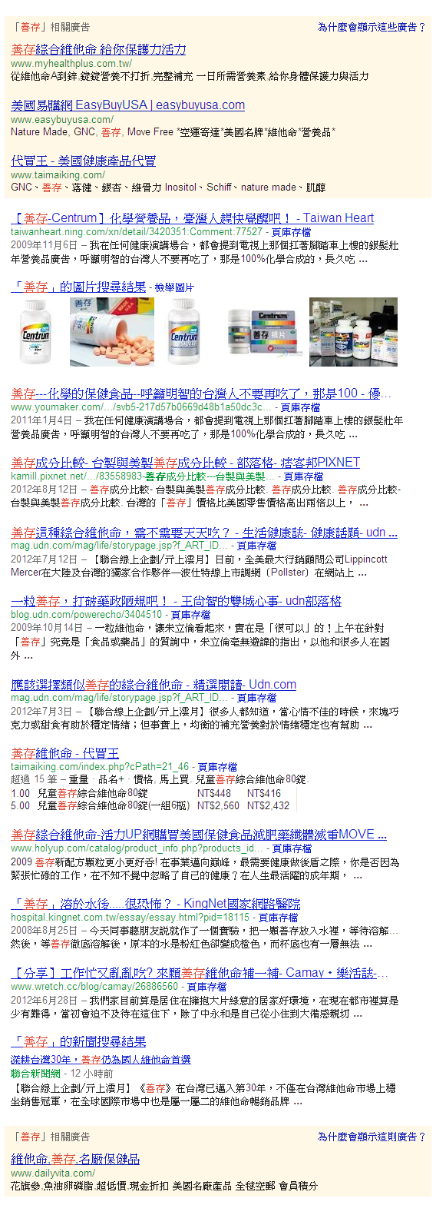



善存 (Centrum)
Before
Negative
After
PPC
Negatvie
Negative
Negative
SLPR
SLPR
SLPR
SLPR
SLPR

