Slide 1
Scorecard 2013 | Eureka Zero
Naming Convention + Reporting System

Slide 2



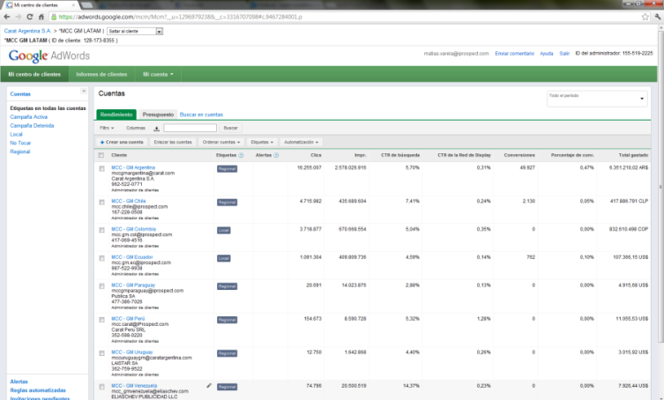
Origin: business core AND PLATFORMS
GM´s Strategies and Objectives
☺
Let´s review GM´s strategies to engage and bond with current and potential car buyers
¿What does GM sell? ¿What do potential buyers actually buy?
¿Can we monitor Standard Metrics in Google AdWords?
¿Why was there a need to define Naming Convention?
Because we wanted to grant the account the ability to best analyze campaigns data and results
☹
¿Monitor and analyze corporate strategies in Google AdWords?
BENEFITS
Data normalization across the region
Granularity: Analyze from format, to channel to market and across markets
Obtain a gradual benefit in costs
CAMARO
NC
EUREKA
RETENTION
CONQUEST
LIFESTYLE
/
AWARENESS
SEGMENT
RETAIL
+
= Better Decisions
¿How was Eureka born?
With passion for innovation and to add value to our work. Obtaining an strategic vision and tailor-made tool and going beyond Adwords platform.
RETENTION
CONQUEST
LIFESTYLE
SEGMENT
RETAIL
BENEFITS
Report and analyze data in a practical manner
Add interactivity to data, graphs and tables
Being able to have a multi angle approach to results
Looking at GM´s business, we decided to include these strategies in each model´s account were it would be logically to include from a PPC POV
Slide1 Finish
Please Press Any Key for Continue…

Slide 3
Integrated Solution
Naming Convention | Modular and Grouped
EXAMPLE
NAMING ACCOUNT
NAME-COUNTRY
EX: SONIC-AR
¿Which type of information can we obtain?
All that has been previously though upon through the naming convention. The modular granularity and the ability cross variables at a channel / model / strategy / format / market enables us a vast amount of options. For this, we only need to brake the naming convention with Eureka´s help…
GM-CHEVROLET-AR-ALL-SONIC-GDN-CONQUEST-HONDA-CITY
NAMING CAMPAIGNS
AR
MOB
GDN
NAMING ADGROUPS
CORVETTE
RETENTION
CLIENT
BRAND
COUNTRY
DEVICES
CAMPAIGN
NETWORK
STRATEGY
ADD1
ADD2
GM
CHEVROLET
CH
ALL
SRCH
CRUZE
CONQUEST
HONDA
GM
CHEVROLET
AR
CH
UY
PY
CO
VE
EC
MOB
DSK
ALL
AVEO
SONIC
CRUZE
CELTA
S10
ACDELCO
SPO
BRAND
NBRAN
GDN
SRCH
YT
RETENTION
CONQUEST
LIFESTYLE
SEGMENT
RETAIL
FORD
WV
AUTOS
CAMIONETAS
OTHERS
UY
DSK
YT
DMAX
LIFESTYLE
FORD
(The nomenclature for the AdGroups starts in the fifth module)
Slide2 Finish
Please Press Any Key for Continue…

Slide 4
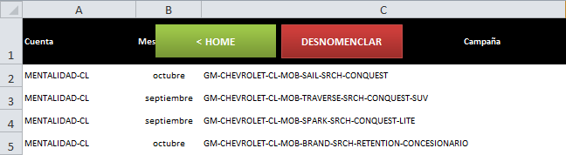
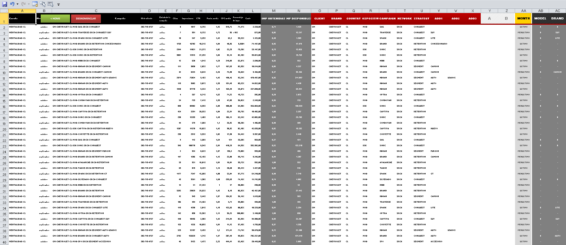
integrated SOLUTION
Reporting System | Loading our Input
Generate a Full Report in just two steps….
PRESS ‘DENOMENCLATE’
2
Paste Adword´s export
1
Slide3 Finish
Please Press Any Key for Continue…

Slide 5
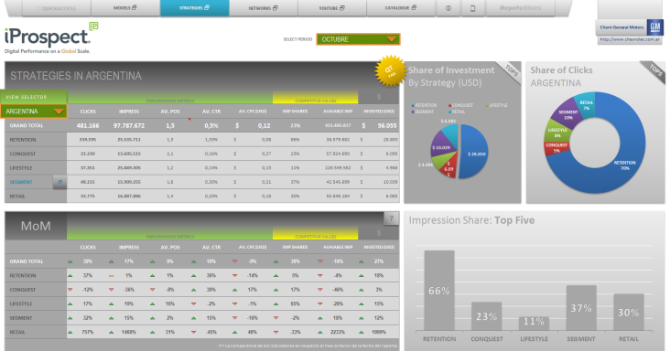
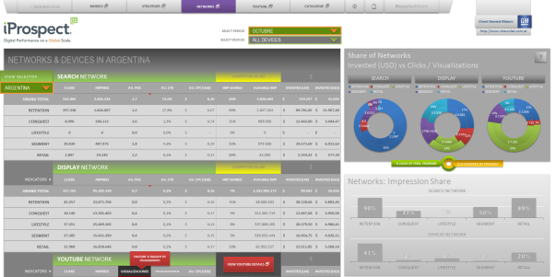
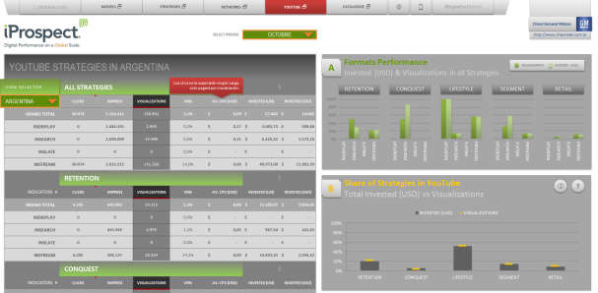
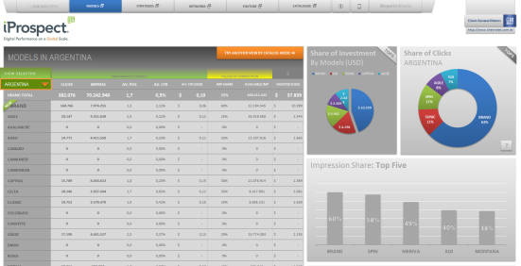
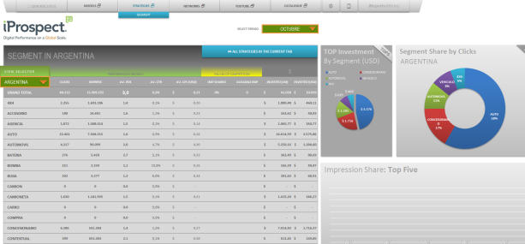
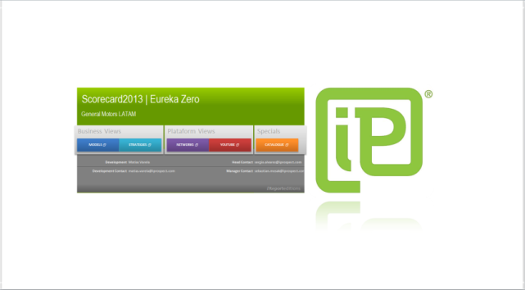
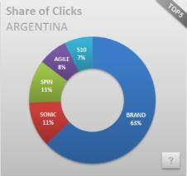




integrated SOLUTION
Reporting System | Scorecard Eureka
AR
SPIN
DSK
One of Eureka´s best features is the ability to modify the entire report through a variable selection: Market or Model. This will re-generate the tables and graph.
A report that provides an easy interpretation of the data thgourh the most relevant indicators and broken down by Market, Models, Strategies and Campaign details with dynamically generated MoM and Conquest tables.
Additionally, users will also be able to view the analysis from a Channel and through a specific view for YouTube broken down by strategies, formats and devices.
RETAIL
Eureka holds 4 Main Sheets (Views) and a Catalogue View
MOB
Enabling 3 Different and complete perspectives for viewing campaigns.
DYNAMIC RANKINGS GRAPHS
And process the information through preset data analysis enabling an easy interpretation of the data.
BUSINESS
PLATFORMS
SPECIALS
SEARCH
ALL SHARE
STRATEGIES
FULL GRAPHS
STRATEGIES
DISTRIBUTION
MODELS
SAIL
DISTRIBUTION
CAMPAIGNS
DISTRIBUTION
DISPLAY
MODELS
STRATEGIES
NETWORKS
YOUTUBE
CATALOGUE
IMP SHARE
SHARE
CH
IMP SHARE
PREMIUM COMPARISSONS (A/B/C)
NETWORKS COMPARISSON
MONTH OVER MONTH MODULE
YOUTUBE
MONTH OVER MONTH
IMP SHARE
IMP SHARE
Slide4 Finish
Please Press Any Key for Continue…

Slide 6
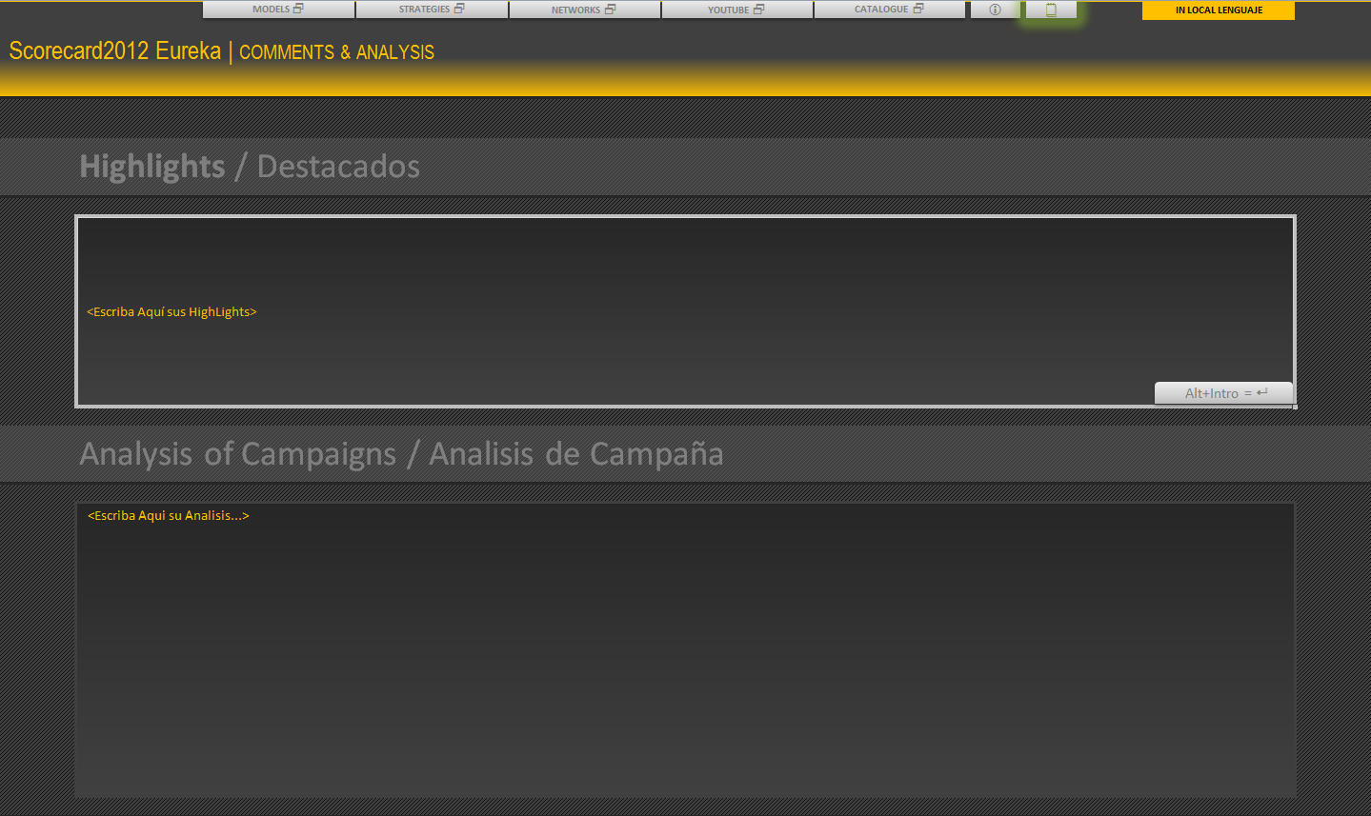
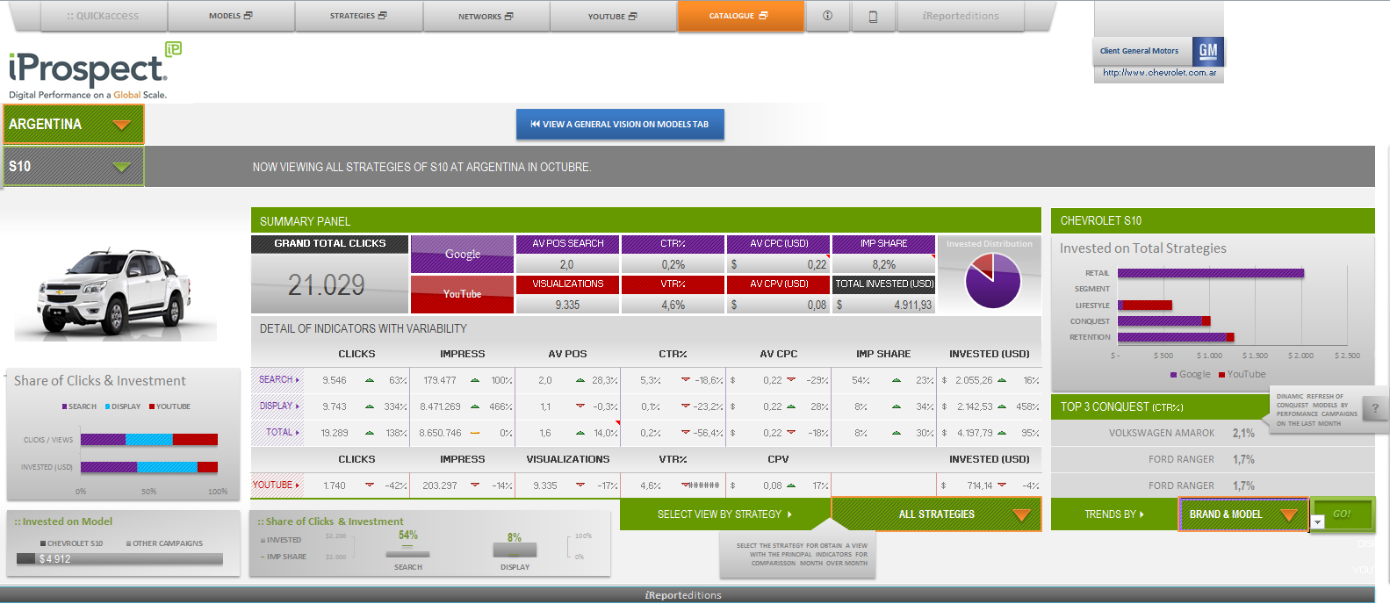
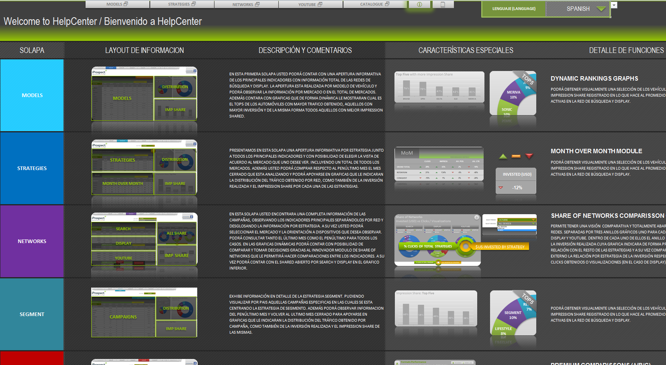
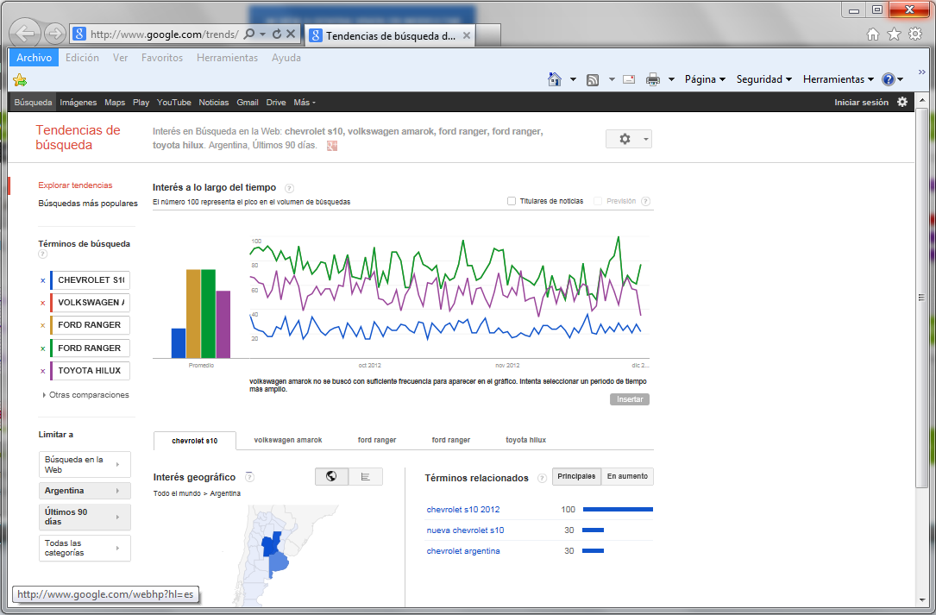
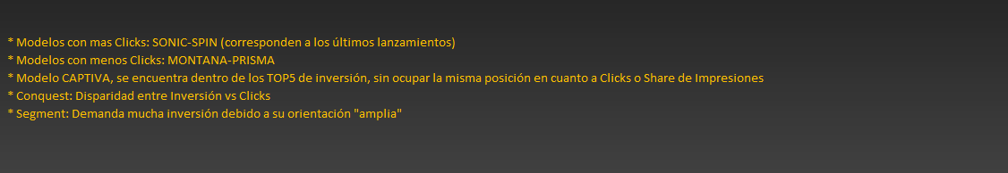
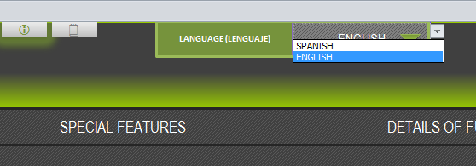
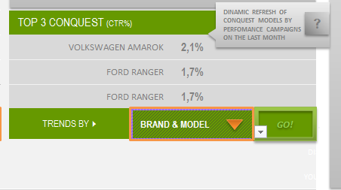
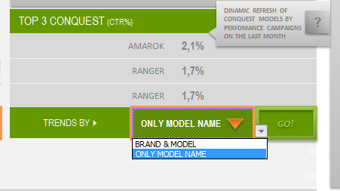
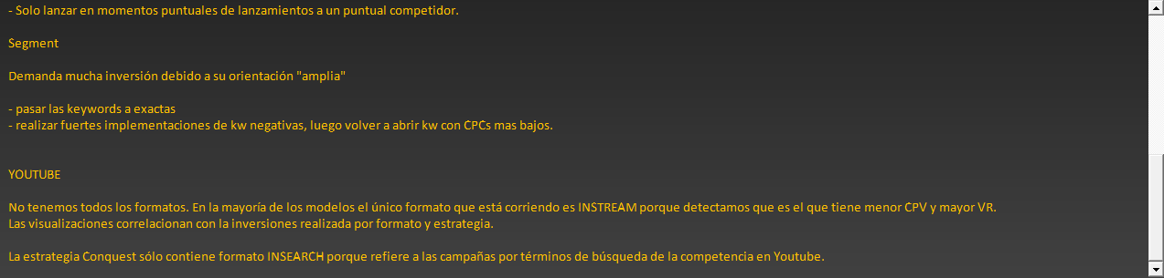
Catalogue View and more
Reporting System | Scorecard Eureka
1
COULD MAKE HIGHLIGHTS
2
LANGUAGE SELECTOR
INVESTED IN ALL STRATEGIES
SUMMARY TOTAL INFO
SEARCH & DISPLAY BY STRATEGIES (+MoM)
SHARE OF NETWORKS
PERFORMANCE
CONQUEST CAMPAIGNS
& REAL TRENDS
REPORTS AND PASTE FROM HIS MS-WORD
WITH SPACIOUSNESS AND SLIDER
YOUTUBE BY STRATEGIES (+MoM)
3
4
MODEL SHARE
IMP SHARE AND INVESTMENT
Panel with 4 selectors
4 Dynamic Graphs
Refreshes dynamically and shows the Top CTR performers for Conquest campaigns
Generates a dynamic link that will hold : Market and Top Brand+Model conquested keywords. Time frame is set to be the previous 3 months
Dynamic and comparative tables
Google Trends customized link
Slide5 Finish
Please Press Any Key for Continue…

Slide 7
Thanks!
For further information please contact
Development: Matias Varela – matias.varela@iprospect.com
Project Lead: Sebastian Mosak – sebastian.mosak@iprospect.com
Regional Lead: Sergio Alvarez – sergio.alvarez@iprospect.com

