Slide 1
Global PPC Award Template
Updated Q4 2012

Slide 2











Background/Brief
Trend Micro Account Setup
New Client
After a recommendation from Carat Enterprise, we were entered into the pitch process for Trend Micro’s PPC account. We won the pitch and then had only 6 weeks in order to complete the transition (including Marin integration) for 10 markets before the incumbent agency would switch off their activity.
Product Offering
We were briefed with promoting Trend Micro’s range of Internet Security products, as well as the additional tools that they offer – password management, online storage, etc. Trend Micro had an evolved range of cross-market PPC-only landing pages that we could use to optimise the paid search.

Slide 3





Challenge
A Competitive Market and Account Rebuild
Competitive Market
Trend Micro were offering a paid product in a market space with free-mium offerings and well known brands. Generic activity was going to struggle against these competitors and previous attempts at running generic campaigns had been expensive and underperformed.
Free-mium Antivirus Products
Poor Existing Structure
The accounts we were inheriting from the incumbent agency were badly structured with match types mixed together and sub-optimal CTRs bringing down quality score across the account. To bring the account to an acceptable standard, we were going to have to start from scratch,
Well Known Antivirus Brands

Slide 4



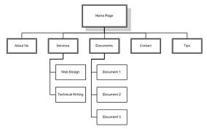
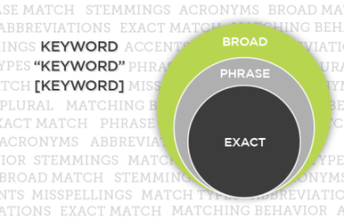
Strategy
Better Keywords and Tighter Matching
Optimised Keyword Selection
We reviewed all of the keywords from the previous agency and through the use of search query reports, identified the keywords that were limiting performance. In addition, we used the search query reports and other keyword tools to expand the keywords used.
Removing the Irrelevant
Expanding the Relevant
Trend
[Trend Micro]
Trends 2012
[Trend Micro 2012]
Fashion Trends
[Trend Micro Products]
Separated Match Types
Match Types were separated into distinct ad groups in order to provide better control over these keywords and allow for more refined optimisation. By introducing Broad Match Modifier, we were able to negate the impact of broad match keywords matching to irrelevant searches.
Structuring by Match Type

Slide 5






results
Across the Board Improvements
Brand Improvements
Despite starting with fresh accounts, so receiving no help from account history, our improvements had an instant impact
Germany: Position rose from 2.5 to 1.2 and average CPC dropped by 18%.
France: Position rose from 1.7 to 1.4 and average CPC dropped by 18%.
UK: Position rose from 2.2 to 1.3 and average CPC dropped by 13%.
Clicks
Avg. CPC
Generic Improvements
Due to the strength of the brand, generics were only being run in Germany, but the effects of our changes were profound. Whilst increasing the number of clicks:
Average CPC dropped from €1.51 to €0.97
Average position rose from 3.8 to 2.1
CTR rose from 0.5% to 2.2%
CTR
Position
Cost

