Slide 1
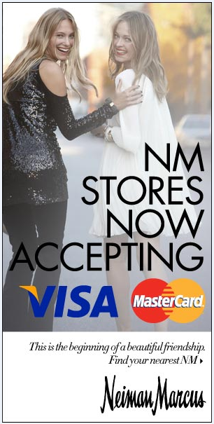
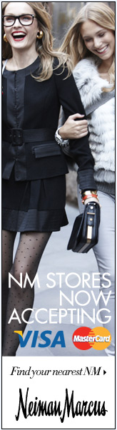
Neiman Marcus Now Accepting Visa / MasterCard
Here are a few of the variations we ran during the campaign.
Note: all banners had the functionality to ‘find your nearest NM’ based on your geographic location.
1

Slide 2
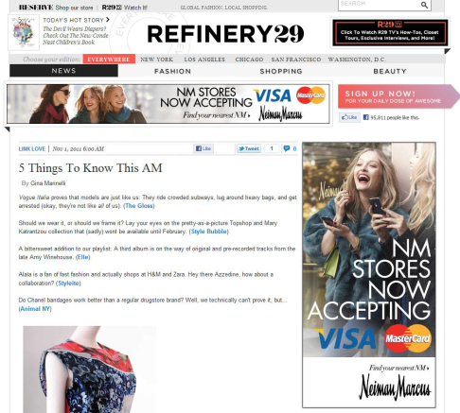
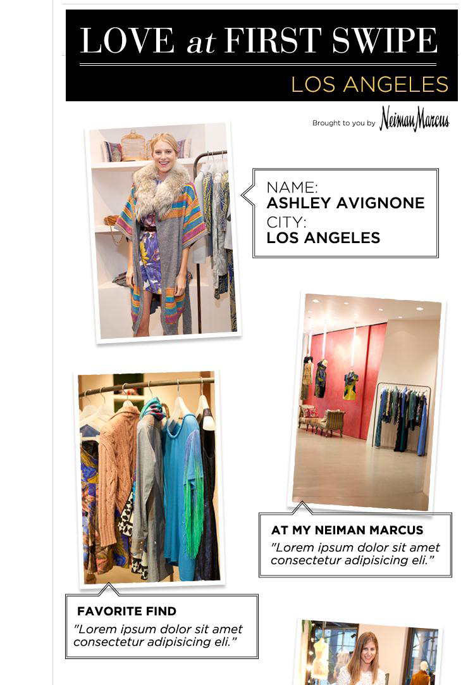
Creative Executions | Refinery 29 Blogger outreach
Refinery 29 Blogger / PR Outreach:
Note: Bloggers in store (below) + editorial content (left) giving it the feel of organic content + ads
2

Slide 3
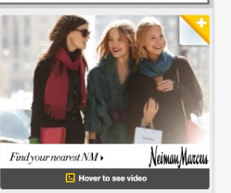
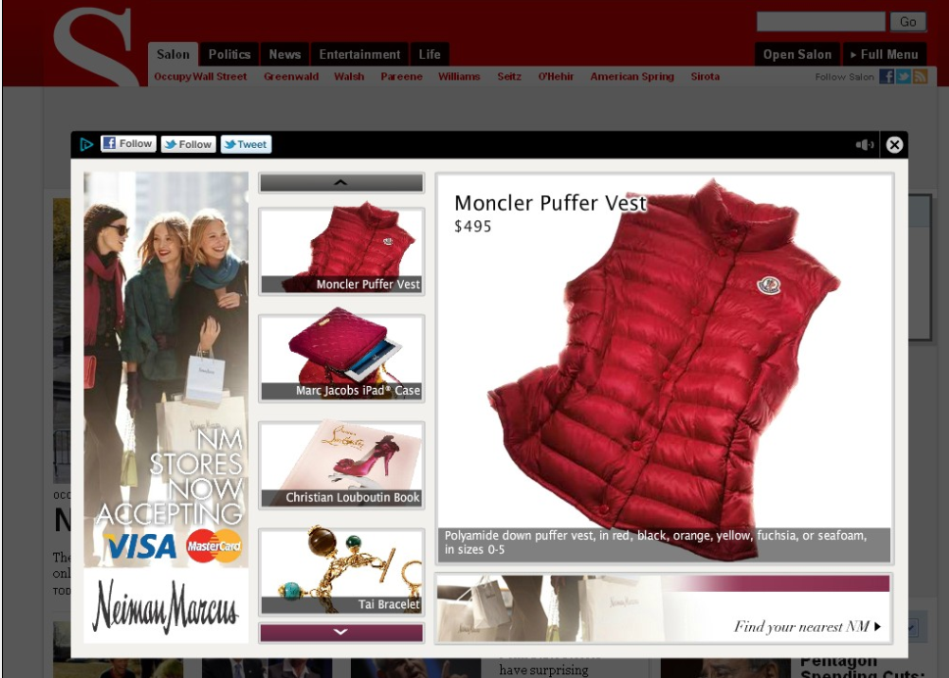
Creative Executions | Say Media
Small 300x250 unit, expands into:
SAY Media Custom Banner:
300x250 expands into a large ad unit that takes over the page. The unit offers in unit conversions as well as the ability to share, follow, or tweet, and find your closest NM. More Online + Offline integration.
3

Slide 4
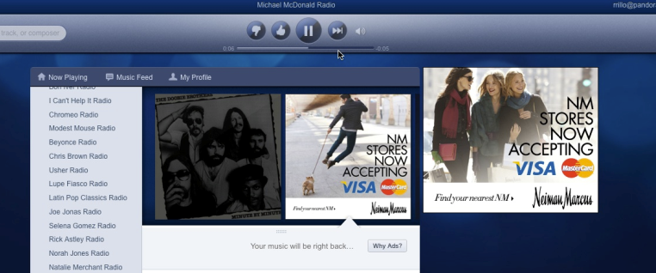
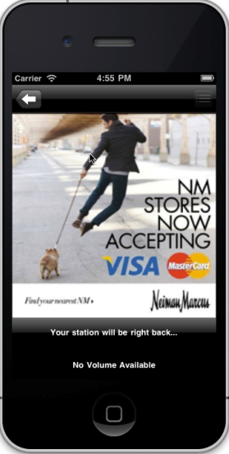
Creative Executions | Mobile Pandora
Pandora & Pandora Mobile:
In-stream audio ads through the Pandora and Pandora Mobile drove users to both eComm site as well as to their nearest location. Had the highest CTR out of any branding buy.
4

Slide 5
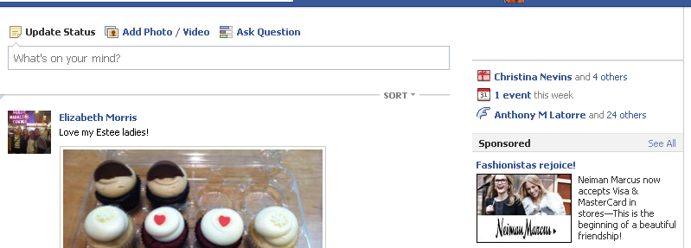
Creative Executions | Mobile Pandora
Facebook:
Demographically targeted competitors fans, current fans of NM, top designers, and Friends of Friends, with the competitor targeting as the most efficient spend, CTR, and conversion rate.
5

