Slide 1







2012: 66 COUNTRIES
Present Global Search Coverage
Norway, Sweden, Finland
Canada
UK, Netherlands
Ireland, Belgium
Austria, Azerbaijan, Bosnia, Bulgaria,
Czech Rep, Croatia, Denmark , Estonia, France,
Germany, Greece, Hungary, Ireland, Italy, Latvia,
Lithuania, Luxembourg, Macedonia, Moldova,
Poland, Romania, Serbia, Switzerland,
Slovakia, Slovania, Turkey,
Russia
United States
Korea
Spain
Portugal
Middle East
Japan
Egypt
Mexico
India
Vietnam
Colombia, Chile,
Venezuela, Ecuador
Uruguay, Paraguay,
Peru
Thailand
South Africa
Indonesia
Australia
Argentina
New Zealand

Slide 2
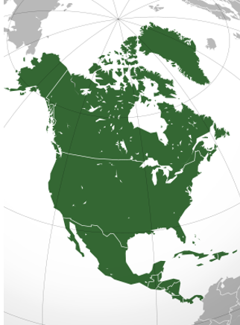









North America
External GM Slide
GM supported brands
Canada
United States
Mexico

Slide 3
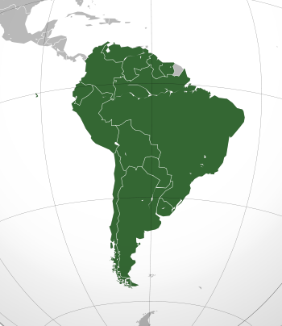

South America
External GM Slide
GM supported brands
Venezuela
Colombia
Ecuador
Peru
Paraguay,
Chili
Uruguay
Argentina

Slide 4
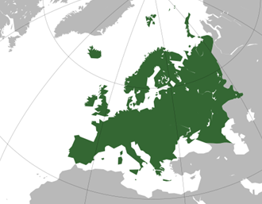
Europe
External GM Slide
GM supported brands
Norway, Sweden, Finland
UK,
Ireland
Netherland,
Belgium,
Denmark
Estonia, Latvia,
Lithuania,
Poland
Germany
Austria, Azerbaijan, Bosnia, Bulgaria,
Czech Rep, Croatia, Hungary,
Luxembourg, Macedonia, Moldova,
Romania, Serbia, Switzerland,
Slovakia, Slovania, Turkey
France
Spain
Portugal
Italy
Greece

Slide 5
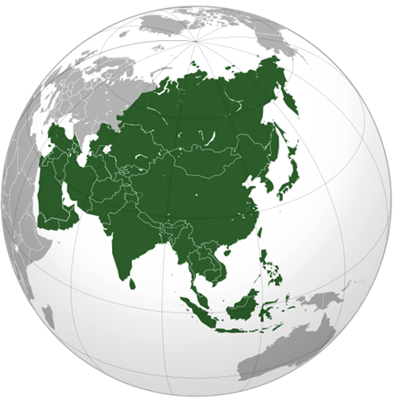
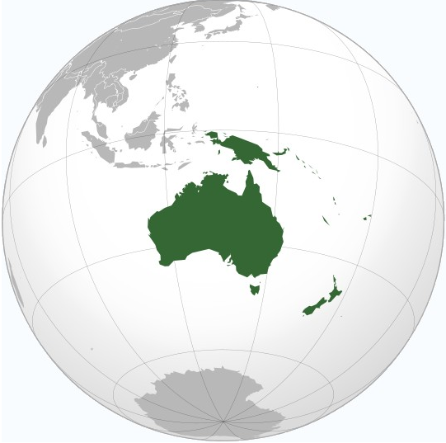
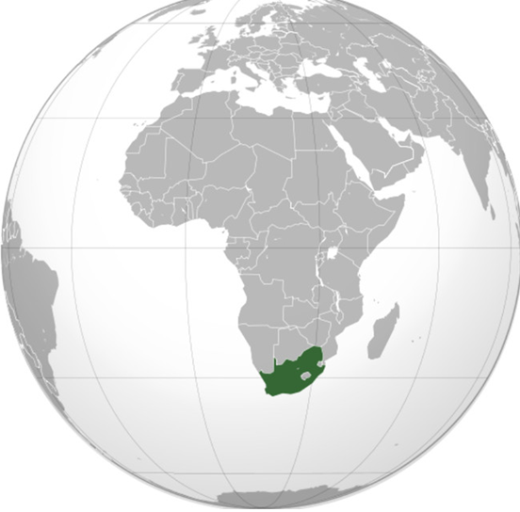
GMIO
External GM Slide
GM supported brands
Egypt
Russia
Middle East
Korea
Japan
Australia
Thailand
India
Vietnam
South Africa
New Zealand
Indonesia

