Slide 1

Grundfos Book

Slide 2
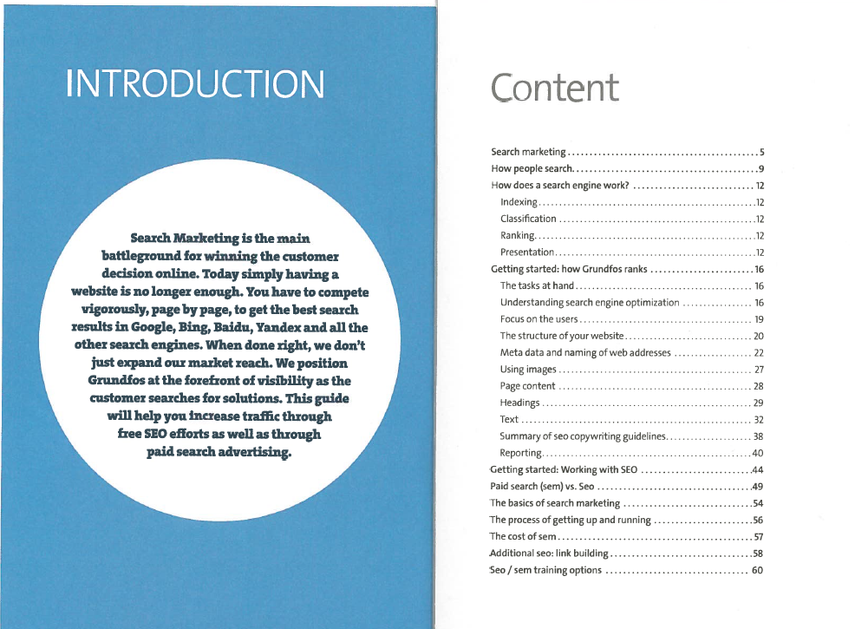
Table of contents

