Slide 1

Capstone Project Airbnb Bookings Analysis By: Naghma Firdous

Slide 2
Let us go through steps involved in analyzing Airbnb NYC Data
1. Defining problem statement
2. Data Summary
3. Data Cleaning
4. Feature Selection
5. Performing EDA and Data Visualisation
6. Geospatial Analysis
7. Statistical Analysis
8. Univariate Analysis (Textual mining)

Slide 3
Data Pipeline
Defining problem statement– In this part, we try read working model of the business and understand the underlying problem in the given dataset which needs to be tackled.
Data Summary – In this part, we take a look at data types, total number of records and null values.
Data Cleaning – There are certain columns with lot of null values. We identify those columns and replace the null values with 0. We have also used fillna() function to replace null values in certain cases.
Feature Selection – In this part, we select the columns which are most relevant for the objectives defined at the beginning of the EDA.
EDA - In this part, we perform Data Analysis and Visualizations on the selected features to gain insights in the data and present answers to the objectives defined.

Slide 4

NYC Airbnb : Exploratory Data Analysis
Airbnb, Inc based in San Francisco, California, operates an online marketplace focused on short-term homestays and experiences.
In this project, we will analyze the data descriptively and statistically to determine how the variables are correlated to generate hypotheses useful for future decision-making.
It’s imperative to analyze the data carefully in order to obtain meaningful insights that can assist in and understanding customer and host behavior.
To work on data, we will be using different tools like classifications of variables, histograms, textual mining, and measures of central tendency.
Image reference - Airbnb Goes Public, Rental Kingdom Worth $3.4 Billion | LATF USA NEWS

Slide 5
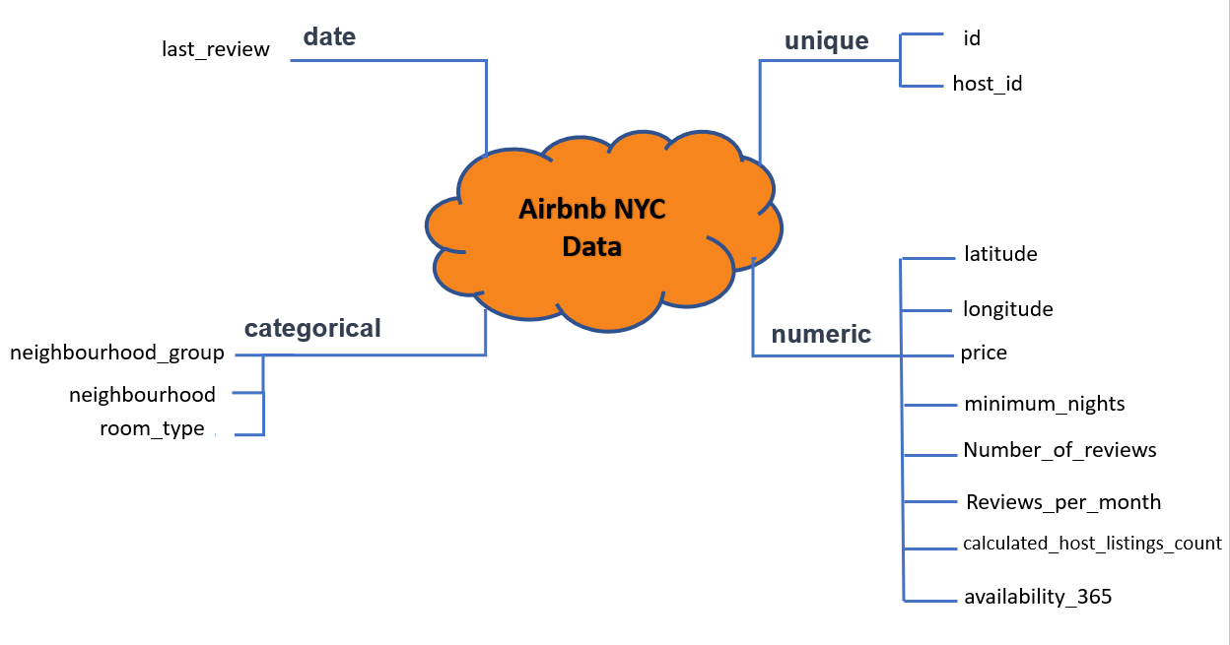
Data Summary

Slide 6
Data Summary
id - It’s a numeric column. This column contains a unique identifier for each rows. There are no missing values in id column.
name – It’s a string which identifies the name of the listing on Airbnb. It has 47906 unique values. 16 values are missing from name column.
host_id – It’s a numerical column which contains unique identifier for each host_name. It has 37457 unique values. host_id column has no missing values.
host_name – It is a string which identifies name of the host. There are 11453 unique values in this column. We have 21 missing values in host_name.
neighbourhood_group – This column has categorical values. It has 5 unique values, namely, Brooklyn, Manhattan, Queens, Staten Island and Bronx. We do not have any null values in this column.

Slide 7
Data Summary
neighbourhood – This is again a categorical column which contains neighbourhoods belonging to above 5 neighbourhood groups. There are 221 unique neighbourhoods in this column.
latitude – This is numerical column which has latitude information of hosts. It has no missing values. We can use this information along with longitude information to plot the listings on graph/map.
longitude - This too, is a numerical column which has longitude information of hosts. It has no missing values.
room_type – This is again a categorical column. It has three types of listings – entire apartment, private room and shared room. This column has no null values.
price – This is a numerical column. It has information for price of all the listings in the given dataset. There are no missing values in this column. It is one of the most significant columns for EDA.

Slide 8
Data Summary
minimum_nights – This is a numerical column which tells about minimum number of nights stay at a particular listing. There are no missing values in this column as well.
number_of_reviews – This is an important numerical column in dataset. It tells us about how many visitors reviewed the listing. We can use this information to find out traffic at a particular host and reasons behind it. There are no null values in this column.
last_review – This column contains the date of the latest review for that listing. The value is in string format. For performing EDA, we can convert it into date format. There are 10052 missing values in this column. We can replace these values using fillna() function.
reviews_per_month - This is a numerical column which gives number of reviews for a particular listing. This column has 10052 null values. We replace these values by 0 in the data cleaning stage. This is one of the important columns in EDA, as we can measure popularity of a listing using this information.

Slide 9
Data Summary
calculated_host_listings_count – This is a numerical column. It shows number of listings on Airbnb by a particular host. There are no missing values in this column. We can use this column to find out maximum number of listings from a single host in given data.
availability_365 – This is one more numerical column which has information about what is availability of a particular listing throughout the year. There are no missing values in this column.

Slide 10
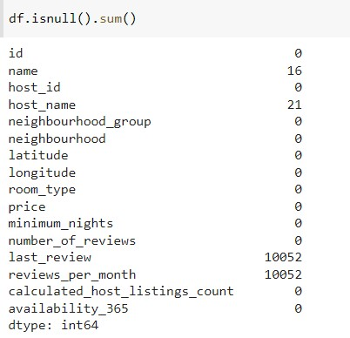
Data Cleaning
We can see that this dataset has around 48895 observations in it with 16 columns and it is a mix of categorical and numeric values.
We can also see from the above, there are some missing NaN values that will require cleaning and handling.
Cleaning the data for further predictive analysis
Remove NaN values from the data
Replace all the missing values with 0
Dropping columns that are not required and are insignificant for our analysis

Slide 11
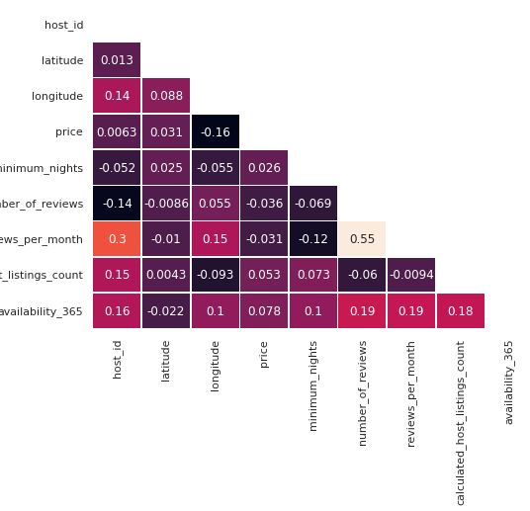
Correlation between different variables
Using the color variation, we can depict the correlation between the variables on both axes. On either side of the axis, darker colors indicate a negative correlation between both variables.
It is visible that ‘number_of_reviews’ and ‘reviews_per_month’ are positively correlated as one can expect a higher rate of reviews per month if there is more number of reviews.
There is a negative correlation between ‘price’ and ‘longitude’ since the higher prices are usually found in busier places.

Slide 12
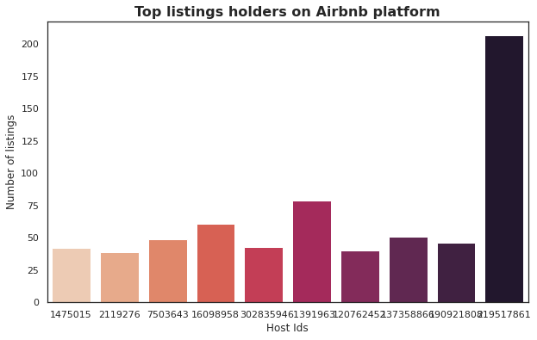
Graphical visualization about different hosts and areas
We can see our top 10 hosts have a good deal of listings on the Airbnb platform.
The first host has more than 200 properties listed on the platform.

Slide 13
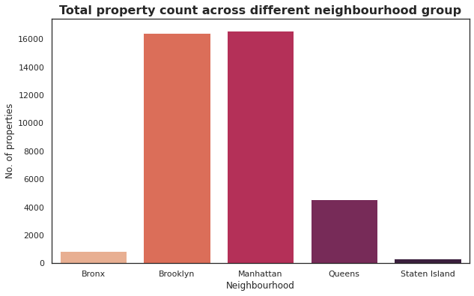
Mapping neighbourhood group
Based on the bar graph above, we can say that Manhattan and Brooklyn are the most popular neighborhood, followed by Queens. Clearly, Manhattan is among the world’s top commercial, financial, and cultural centers, which is why there are so many listings here.
Staten Island and the Bronx, not very famous, have the lowest number of listings.

Slide 14
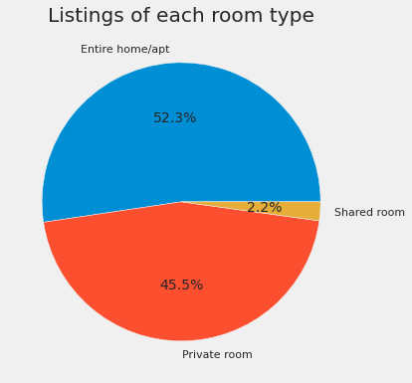
Percentage of room distribution
There is a very clear percentage division of the three different room types across the region, with ‘Entire home/apt’ accounting for 52.3% of listings, and shared rooms representing just 2.2%.

Slide 15
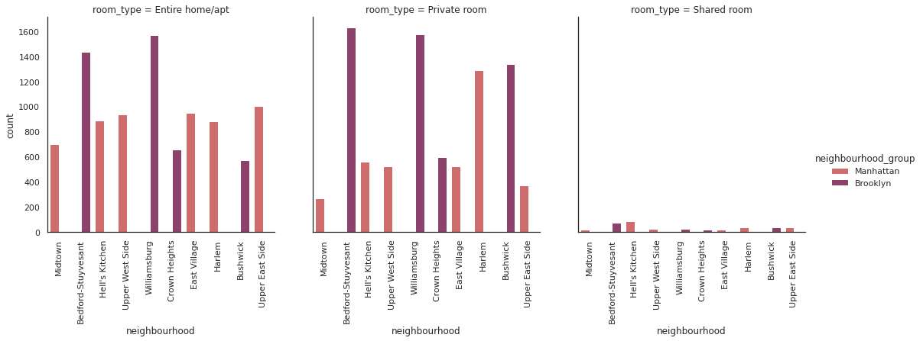
Top 10 neighbourhoods with maximum listings
One thing to note is that we only have two boroughs listed among the top ten: Manhattan and Brooklyn. For Brooklyn borough, Williamsburg and Bedford-Stuyvesant are more popular.
It is surprising to see that ‘Shared rooms’ barely make the top 10 neighbourhoods.

Slide 16
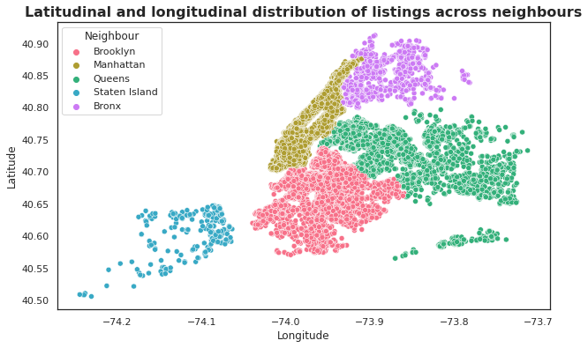
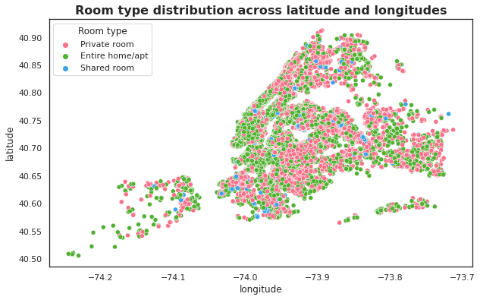
Geospatial visualization
Let's look at listing distribution across latitude and longitude with different room types.
In terms of the distribution of room types, we can see there is a good mix of different types available across the region. When compared with shared rooms, there is dominancy in private rooms and entire homes categories.

Slide 17
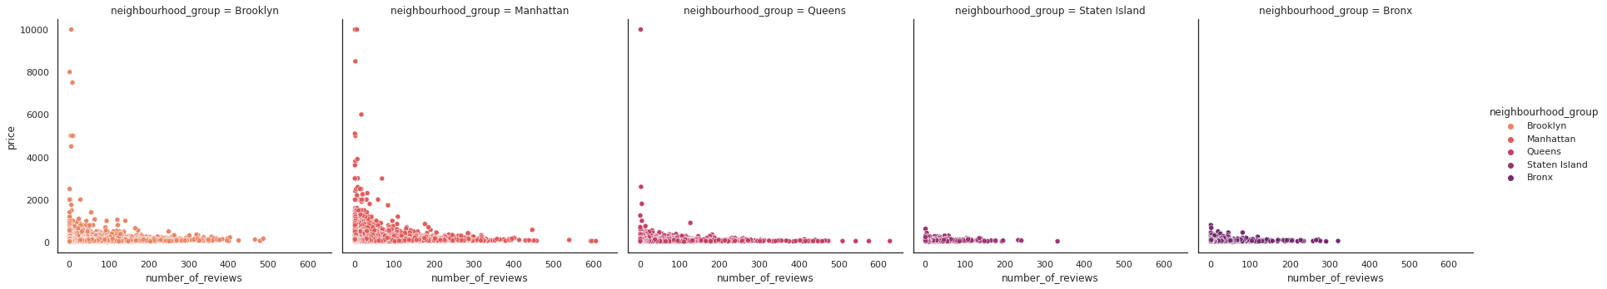
Analyzing the number of reviews and room availability with respect to price
We can see a negative relationship between price and the number of reviews. There are more reviews for properties with lower prices since they are booked more frequently

Slide 18
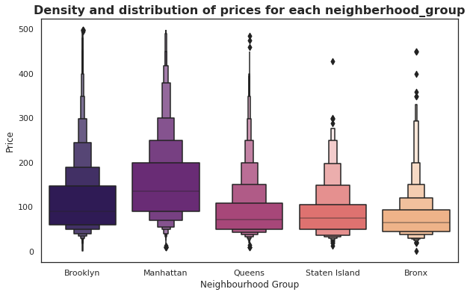
Statistical Analysis
Density and distribution of prices for each neighbourhood using central tendency
With an average price of 150 dollars, Manhattan has the highest price range and is the most expensive, followed by Brooklyn with an average of 90 dollars. It is very obvious that Manhattan is one of the most expensive places in the world.
Bronx has the cheapest listings of all with an average of 65 dollars.
The data contains some outliers because of which there is a variation between mean and median values.

Slide 19
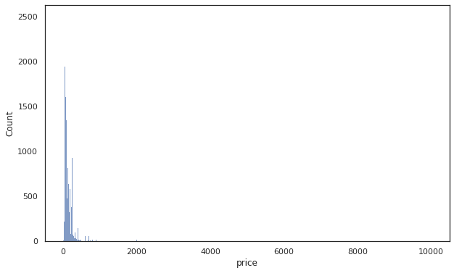
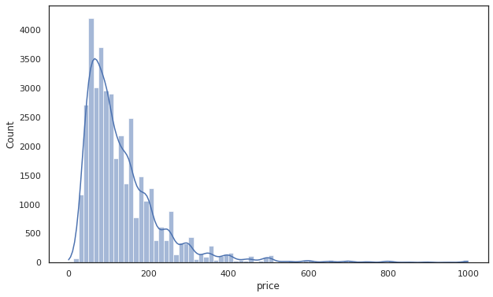
Frequency of listings with respect to the price using Histogram
By using the histogram, we can now see how prices are distributed. We have a large number of values concentrated below 200 dollars.

Slide 20
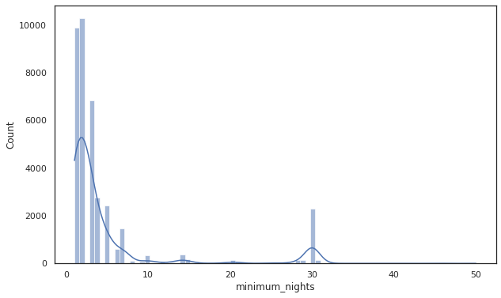
Frequency of listings with respect to the minimum number of nights using Histogram
In this case, most of the listings have listed out their minimum night record below 10. One unusual thing to note here is the peak in the listing frequency for the minimum night of 30. It is possible that some owners have listed their properties on a monthly rental basis, which may explain this.

Slide 21
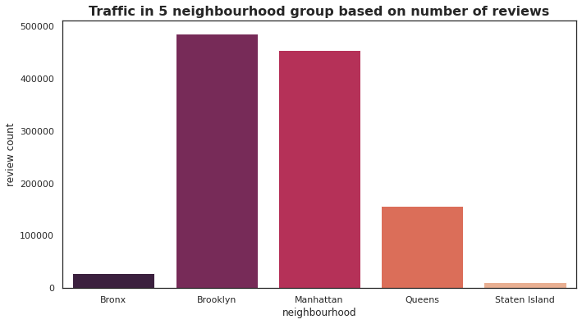
Traffic in different areas based on number of reviews
The traffic in Manhattan is somewhat lower compared to Brooklyn, which has the highest number of reviews on average.

Slide 22
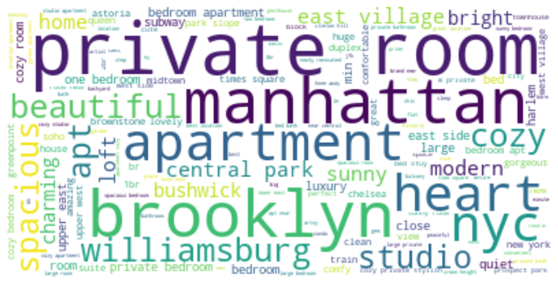
Textual Data Mining using WordCloud to find out the host’s mindset (Univariate Analysis)
Hosts are using simple and location-oriented keywords.
In this case, location is the key indicator, since the words “Manhattan” and “Brooklyn” are prominently displayed.
Adjectives such as “beautiful”, “quiet”, “cozy”, and “gorgeous” bedrooms/apartments, which indicates that visitor comfort is a top priority.
Several mentions of “private rooms” indicate the popularity of this room type in the city.

Slide 23
Top 10 key points to take away
Our top ten hosts have a substantial number of listings, with the top host having over 200.
The listings spread across five NYC boroughs, with Manhattan having the largest proportion, followed by Brooklyn and Staten Island having the least.
The percentage distribution of three unique room types was as follows: Entire home/apt — 52.3%, Private room — 45.5%, Shared room — 2.2%.
Williamsburg and Bedford-Stuyvesant were found to be more popular neighbourhoods in the Brooklyn borough.
A statistical analysis shows that Manhattan has the most expensive price range with an average of 150 dollars followed by Brooklyn with an average of 90 dollars.
Bronx provides the cheapest accommodation among all.
The majority of the listings have a minimum night record below 10 but there is a considerate frequency of listings for the minimum night of 30.

Slide 24
Top 10 key points to take away
Brooklyn has more traffic than Manhattan which might be due to differences in the price distribution.
It is evident that hosts are using simple and location-oriented keywords to differentiate their listings.
Several mentions of “private rooms” indicate the popularity of this room type in the city.

Slide 25
Thank You So Much Mentors
for all your guidance and help !

