Slide 1


Question Bank

Slide 2


Team Member:
Ahmed Nagi Mohamed
Ahmed Mostafa Saad
Ahmed Osama Ebrahim
Mohamed Ali Mostafa
Mohamed Abotaleb Mohamed
Supervisors: Dr.Eng. Samy El-Mokdem Prof.Dr. Bahi Mortagy Eng. Abler Showqi

Slide 3

Introduction
A design of suitable automated system for generating question papers and managing related data may prove vital in an Educational Institute. In this paper, we have proposed an integrated automated system that stores questions related to a particular course and prints a question paper based on its syllabus and curriculum
This enables an educational institute to generate question ensuring security and non-repetitiveness of question papers and is a boon for organizations with limited staff and resources. Our system aims to provide fast operations, data storage and high security for all its tasks.

Slide 4
Introduction
Thus, with the help of this app that present the solution in form of Automatic Question Paper Generator System (QGS) which enables instructors to submit questions in manual or automatic way from spreadsheet, then use it to generate various types of exams e.g. quizzes – final – midterm, that are consistent with Intendent Learning Outcomes (ILOs) standards.
And Enables students to view previous exams samples. The design process performs the scrutiny and composes the examination paper using an efficient algorithm with a high rate of success. From the entered input, the examination paper will be generated automatically.
the final paper may be stored as ‘Word Document’ files. The system shows characteristics like simple operation, a great interface, good usability, immense security, and high stability along with reliability.

Slide 5
ILOS (stands for Intended , Learning , Outcomes )
1-Knowledge and understanding:
will measure basic concepts and knowledge of the subject.
Questions like (define, mention, describe, list).
2-Intellectual skills:
will measure Ability to define and analyze different design problems.
Questions like (Explain, Express, Establish).

Slide 6
ILOS
3-Professional and practical skills:
will measure ability to integrate knowledge and understanding of mathematics, science to solve problems.
4-General and transferable skills:
Practical and non-practical skills that will be earned through course.

Slide 7

Project Model
Exams Manage and Generation.
Quizzes.
Assignments.
Report to explain what exists in(Exam-Quizzes-Assignments)
Midterm

Slide 8
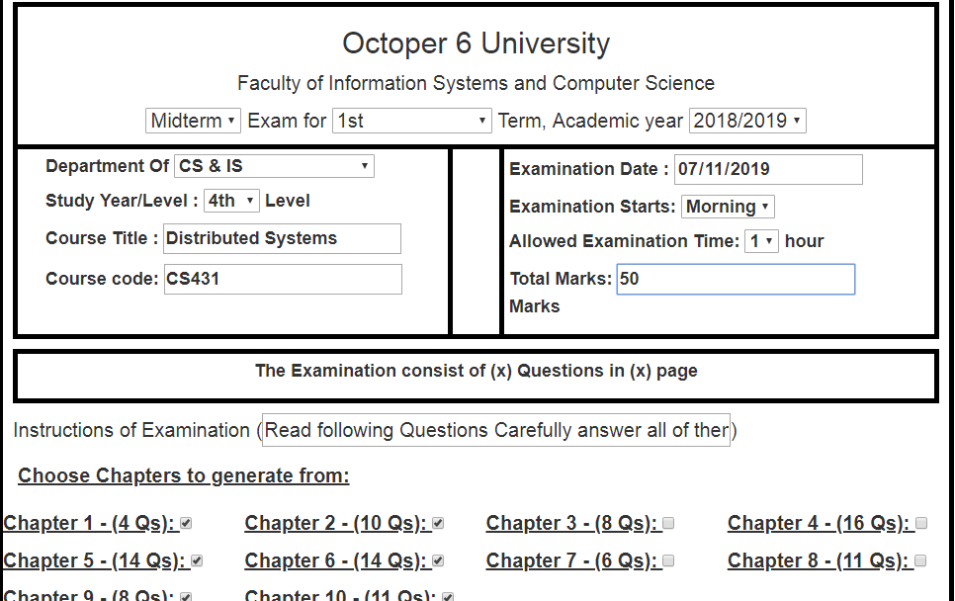
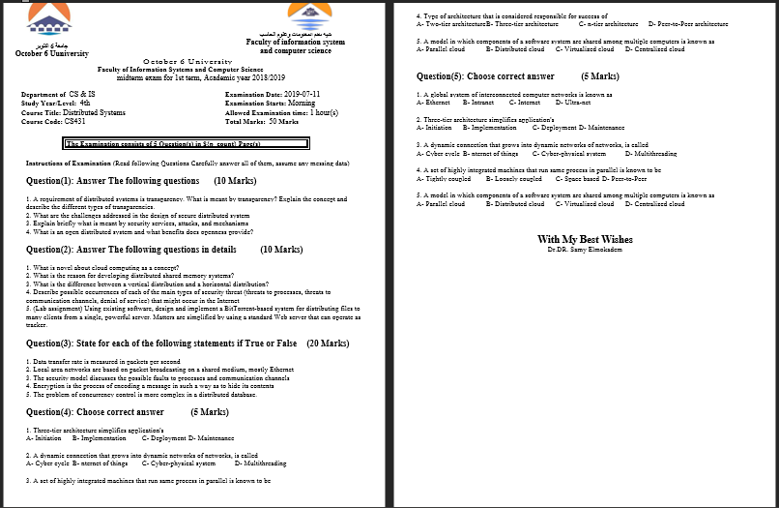
Random Exams Manage and Generation.

Slide 9
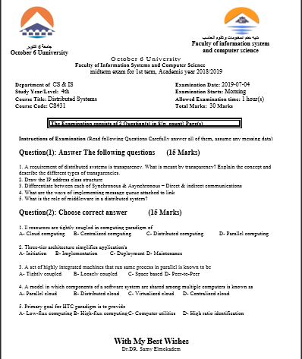
Random Midterm

Slide 10
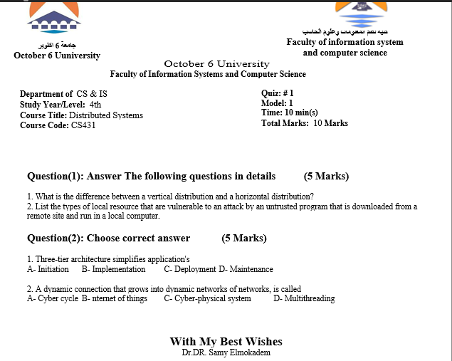
Random Quizzes

Slide 11

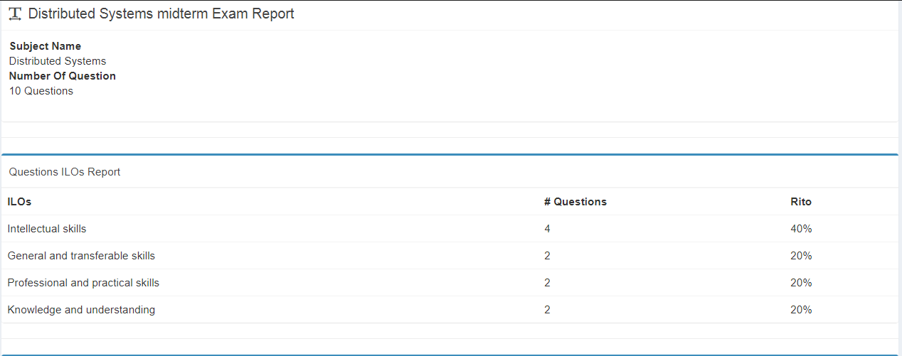
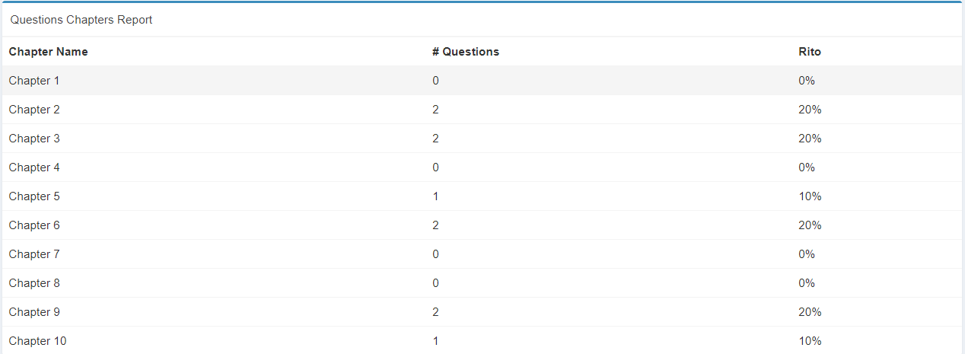
Random Report

Slide 12
Module 1: Exams Generation and management
Priority: First.
This module is the main component of the project that will involve:
- The Algorithm and the implementation of generating the exams according ILOs Standards and grantee redundancy.
- Manage and secure the exams.

Slide 13
Module 2: Quiz
Priority: Last.
This module is the additional component of the project and will involve:
Generate Random Quizzes.
Mark the quizzes online.
Enable students to take previous exams and quizzes.

Slide 14

The Algorithm of generating the exams
Submit and organize the questions according to the 4 ILOs standards into 4 banks and 4 question categories (match – true or false – choose – writing).
Every question will have (title – possible answer – ILOs standard – course – chapter –difficulty - type).
Instructor will choose preferences of the exam in 2 modes:

Slide 15
Algorithm Auto Mode
Auto mode:
Number of questions.
Max and min number of sub-questions per Question.
Number of each type of question category.
difficulty parentages (40% easy – 30% moderate – 30% hard)

Slide 16

Used Technologies
Front-end
HTML
JS
CSS

Slide 17
HTML
Hypertext Markup Language
HTML is the standard markup language for creating Web pages. HTML stands for Hyper Text Markup Language. HTML describes the structure of Web pages using markup. HTML elements are the building blocks of HTML pages. HTML elements are represented by tags.

Slide 18
CSS
Cascading Style Sheets
CSS stands for Cascading Style Sheets. CSS describes how HTML elements are to be displayed on screen, paper, or in other media. CSS saves a lot of work. It can control the layout of multiple web pages all at once.

Slide 19
jQuery
jQuery is a lightweight, "write less, do more", JavaScript library.
The purpose of jQuery is to make it much easier to use JavaScript on your website. ... jQuery also simplifies a lot of the complicated things from JavaScript, like AJAX calls and DOM manipulation.

Slide 20
Used Technologies
Back-end
PHP: Laravel
Server: Apache
Database: MySQL.

Slide 21
PHP
Hypertext Preprocessor
is a server-side scripting language designed for Web development, and also used as a general-purpose programming language….
PHP originally stood for Personal Home Page, but it now stands for the recursive..

Slide 22
Apache
Apache is the most widely used web server software.
Developed and maintained by Apache Software Foundation, Apache is an open source software available for free. It runs on 67% of all web servers in the world. ... However, Word Press can run on other web server software as well.

Slide 23
MySQL
My Structured Query Language
MySQL is a database management system.
A database is a structured collection of data. It may be anything from a simple shopping list to a picture gallery

Slide 24
Main Features Summary
Manage and generate Exams.
Manage and mark quizzes.
Save and reuse questions.
Act like a bank for previous exams.
Support multiple ways of submitting questions
[ Excel Sheet - CSV files - Plain Text listed questions ]

Slide 25
Recommendations
Online Quiz
Model Answer
Add Marks to Exam Reports
Print Model Answer with the Exam

Slide 26
Reference
www.5damat-web.com
www.W3schools.com
www.Wikipedia.com
www.zero-web.com

Slide 27


Any Question..?
Thank you..

