Slide 1
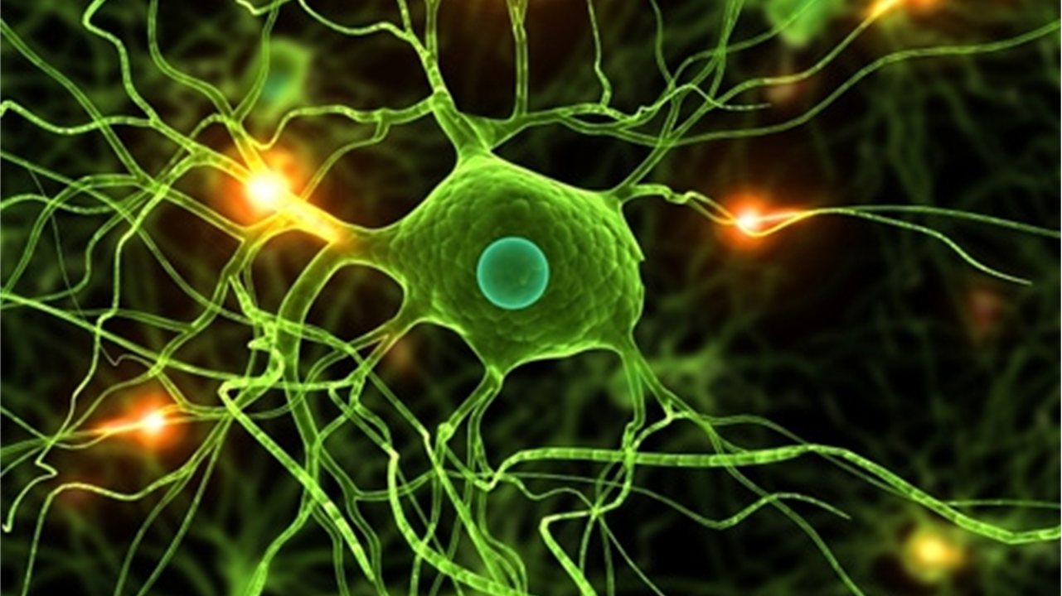

Group 16
Nagib Shah (nsha9343)
Ling Qi (liqi6811)
Young Choi (ycho8487)
Xinan Ma (xima3772)
Protein
post-translational modifications

Slide 2




Overview
Analysis
Evaluation
Validation and Results

Slide 3
Overview

Slide 4
Analysis

Slide 5
Evaluation

Slide 6
Validation and Results

