Slide 1



Group 16
Adaptive Sampling for positive-unlabelled learning
Group members:
Nagib Shah (nsha9343)
Ling Qi (liqi6811)
Young Choi (ycho8487)
Xinan Ma (xima3772)
Stat 5003 – predict Akt and mTOR
STAT 5003 Survey Data Analyss
STAT5003
Group16

Slide 2
Objective
Our objective is to predict unlabelled data, based on partially labelled Akt and mTOR data.

Slide 3
Description of data
The given main phosphoproteomics dataset has 12062 rows and 16 columns. Rows are phosphorylation sites and columns are specific characteristics of each phosphorylation site including: Identifier, Seq Window, 15s, 30s, 1m, 2m, 5m, 10m, 20m, 60m, Avg Fold, AUC, Ins 1, Ins 2, LY, MK
22 known Akt substrates were given with there identifiers.
26 known mTOR substrates were given with there identifiers.
STAT5003
Group16

Slide 4
Data Preparation
Data analysize :
Xxxxx
STAT5003
Group16

Slide 5
Feature extraction
Seq window transformation :
Fitting score extraction
STAT5003
Group16

Slide 6
Feature selection
STAT5003
Group16

Slide 7
Model Evaluation
Model evaluation results showing GBM and SVM Polynomial are the best models
STAT5003
Group16

Slide 8
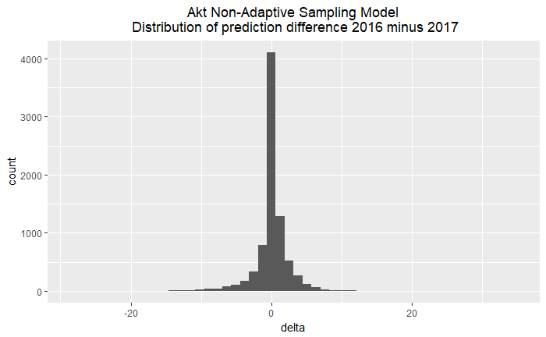
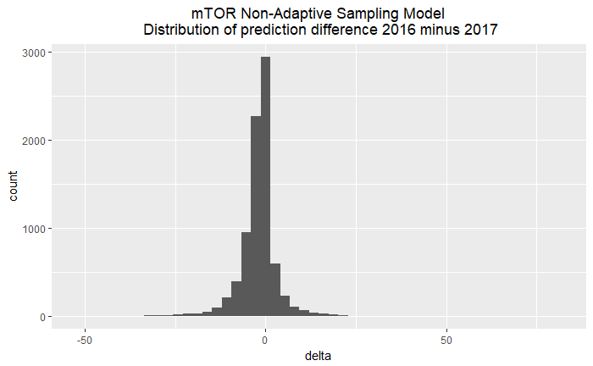
Positive Unlabelled Learning
Problems we need to solve are:
Unbalanced data
Semi-supervised learning
Adaptive sampling
Phase I result:
12k + unlabeld data
Randomly select 22
22 known Akt
- We built model.
- Predicted full data set.
- Saved the results.
- Iterated the sample process 1000 times.
- Average the probability value
STAT5003
Group16

Slide 9
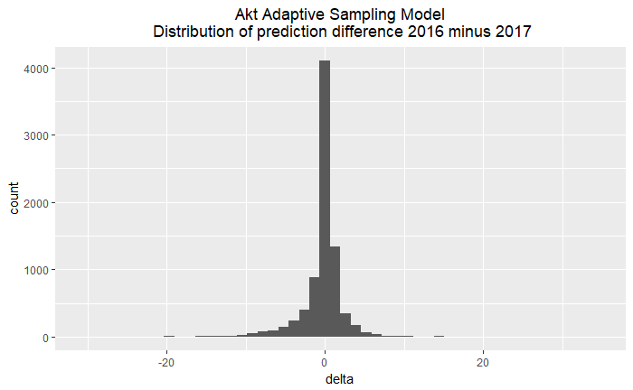

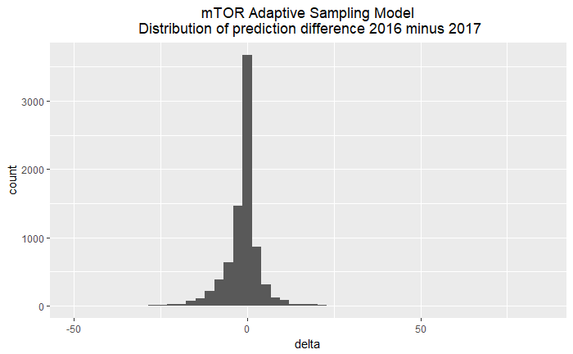
Positive Unlabelled Learning
Phase II result:
Akt probability value
50%
Negative subset
22 known Akt
Randomly select 22
We picked 22 from negative subset generated from Phase I
Build model
Predict full data set
Saved the result
Iterate the sample process 1000 times.
Average the probability value.
mTOR negative subset threshold set up at 80%
STAT5003
Group16

Slide 10
Benchmarking and Evaluation
This flow chart illustrates the process we undertook to benchmark 2016 versus 2017
prediction results
STAT5003
Group16

Slide 11
Benchmarking and Evaluation
This flow chart illustrates the process we use simulation data set for performance
STAT5003
Group16

Slide 12
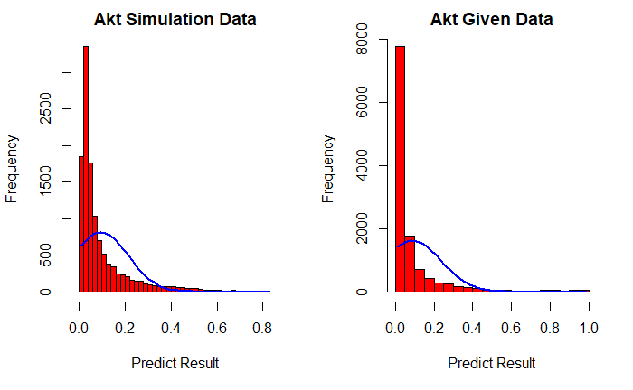
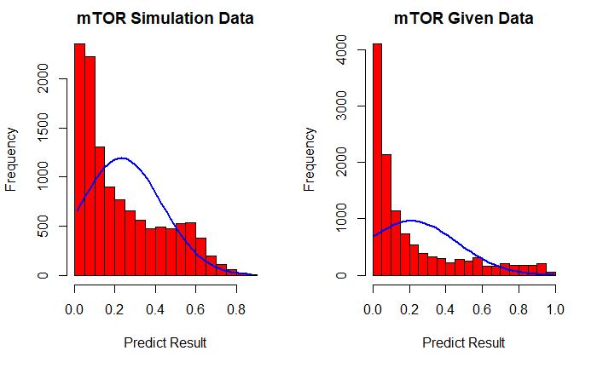
Benchmarking and Evaluation
Our simulation result is following the same probability distribution as the actual data
STAT5003
Group16

Slide 13
Conclusion
Our Phase 1 prediction achieved a good result, especially for the Akt model.
The 2017 vs 2016 distribution histogram shows that the majority of deltas are
within -5% to 5%. The spread is around -15% to 12%.
However, mTOR prediction result is showing a spread from -35% to 25%
From the phase 1 result, we set up a negative threshold to create a negative sub-set and
use that sub-set as negative pool for random selection. Combined with positive data
do the prediction model again, iterative 1000 time and average the probability value
as a result of adaptive sampling approach.
The adaptive sampling approach improved mTOR prediction result. Now we can see
That the majority of deltas are between -5% to 5%. The spread of deltas and the total
count of larger deltas was smaller than the Phase I result.
STAT5003
Group16

Slide 14
Group 16
Group members’ contribution
Nagib Shah | Data Preparation / Feature Extraction / Feature Selection / Motif / Presentation
Ling Qi | Data Preparation / Model Evaluation / Model Build / Prediction Result / Delta Analysis / Presentation
Young Choi
Xinan Ma | Sourcing references
STAT5003
Group16

Slide 15

THANK YOU
Group 16
Nagib Shah (nsha9343)
Ling Qi (liqi6811)
Young Choi (ycho8487)
Xinan Ma (xima3772)

