Slide 1

PROJECT A
PROJECT TITLE:TELEMEDICINE FOR SPECIALIZED CONSULTATIONS
PRESENTER:IVY LIJAGULU NAGIDE
REGNO:SCII/00643/2020
DATE:31/1/2024

Slide 2
INTRODUCTION
Geographic barriers, congestion in major hospitals, and the need for specialized medical care often hinder timely and convenient access to healthcare services.
Recognizing these challenges, we propose the development of a state-of-the-art telemedicine platform that is designed to address these matters and provide a solution that enhances patient care, empowers healthcare professionals, and advances the field of healthcare technology
The significance of this project is weighed by the huge impact it is going to have on the healthcare industry at large.

Slide 3
BACKGROUND STUDY
Telehealth, in particular, is a critical tool that can come in handy in bridging the geographical and logistical gaps that have impaired healthcare access since time immemorial.
The complexity of many medical conditions and the demand for expertise across diverse fields make it necessary to come up with more advanced and comprehensive solutions.
Language and Cultural Diversity increases the need for multilingual support and real-time translation services within a telemedicine platform since language and cultural differences can create barriers to effective medical care

Slide 4
PROBLEM STATEMENT
Many people especially those living in remote and rural areas fail to have access to specialized medical care due to issues such as poor road networks and long distances to the nearest healthcare facilities. This results in delays in diagnosis, treatment, and ongoing care.
The traditional system for scheduling appointments, getting second opinions, and obtaining medical records contains a lot of time-consuming processes that lead to patient frustration.
In addition, language and cultural diversities affect further the access of specialized medical care. Language barriers can impair effective communication, diagnosis, and treatment.

Slide 5
OBJECTIVES
Major objectives
To design, develop, test and implement a comprehensive telemedicine platform for specialised consultations.
Specific objectives
To implement secure data storage and medical management systems to ensure security of medical data.
To design and implement a multilingual support system and real time language translation to curb language barrier.
To design and implement telerehabilitation services for video consultations.
To create educational medical resources to equip patients with knowledge on medical conditions.
To design and implement a payment and subscription system for patients and healthcare professionals.

Slide 6
SCOPE
The project will be developed as a web-based platform accessible countrywide and potentially worldwide. The platform will include core features up to and including;
Virtual waiting rooms
Multilingual support and real-time language translation
Telerehabilitation services that include video consultations.
Secure medical records. Secure data storage, encryption and access controls will be implemented to ensure data privacy within the platform.
Educational resources. A library of educational resources will be provided to equip patients with information about certain conditions their causes, treatment and preventive measures.
Payment and subscription models will be incorporated to facilitate payment.

Slide 7
JUSTIFICATION
This platform aims at improving access to specialized medical care especially for individuals who are in remote and rural areas.
The platform aims to improve effective communication by offering multilingual support and real-time language translation.
The platform incorporates telerehabilitation services for patients undergoing post-injury and post-surgical rehabilitation.
The project has commercial potential because it can be monetized through subscriptions and partnerships with healthcare providers as well as pharmaceutical companies. ,

Slide 8
COST/REQUIREMENTS
COMPONENTS | UNITS | COSTS
Computer | 1 | 60,000
Internet | N/A | 3,500 monthly
Hard disk | N/A | 20000
Legal consultation | N/A | 10,000
Miscellaneous costs | N/A | 5,000
TOTAL |  | 98,500

Slide 9
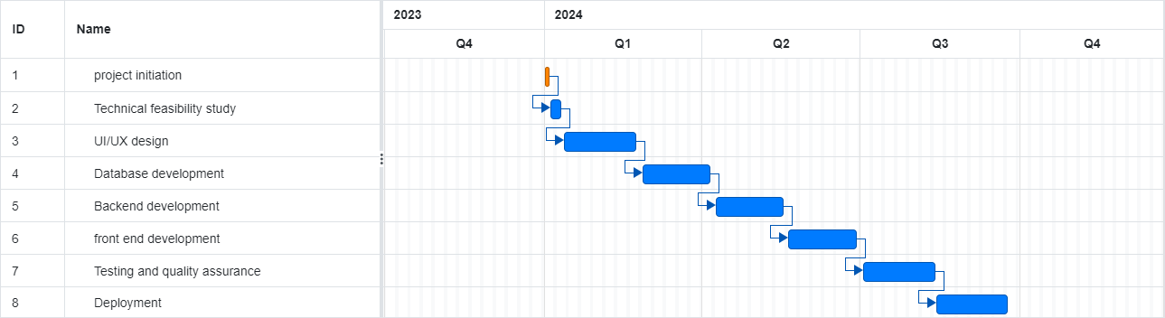
PROJECT SCHEDULE

Slide 10
LITERATURE REVIEW
WEDOCTOR
CAREPATRON
AMWELL
Widely used in Boston
Widely used in China to provide telehealth services.
Has 27 internet hospitals and has linked its appointment making system to 7800 hospitals across China.
Each doctor is registered and filed and each prescription is reviewed by a pharmacist.
Patient portal that allows patients to have access to their medical records.
Integrated with a mobile friendly app accessible through all devices.
Allows patients to set healthcare appointments and reduces no-shows by sending reminders.
Connects patients with clinicians through secure video

Slide 11
LITERATURE REVIEW cont.
TELADOC
Is a multinational telehealth company situated in the United States.
HEALTH TAP
Is a medical group and technologfy company delivering telehealth virtual healthcare via the web and health apps.
Primary Services include telehealth, medical opinions AI and analytics, telehealth devices and licensable platfrom services.
It is the oldest telehealth platform in the united states.
In early Jnauary 2023, Teladoc launched a newapp that offered all services and programs for its members in one place.
Their customers include health consumers in the U.S health systems, insuarance companies and self insured employers.
It offers the option to immediately connect to, schedule an appointment for a consultation via video conference, phonecall or text cat via web or mobile application.

Slide 12
LITERATURE REVIEW
Gaps in the existing systems
Do not prioritize patient education on these medical conditions
Lack telerehabilitation services for patients undergoing post-surgical and post injury rehabilitation.
Platforms may not be used by non- natives who do not understand the native languages

Slide 13
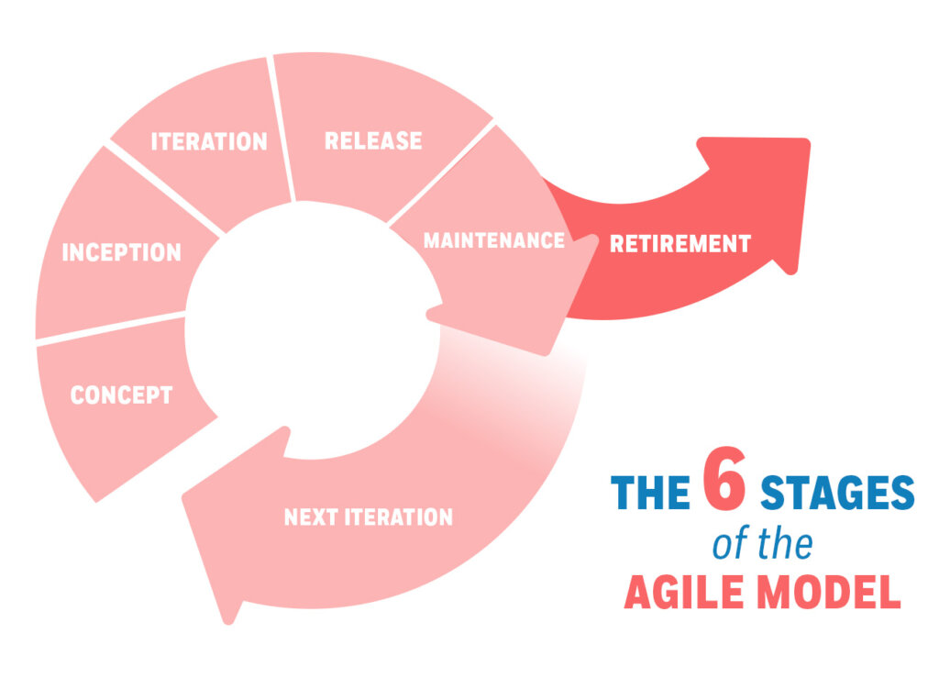
METHODOLOGY/DEVELOPMENT TOOLS

Slide 14
METHODOLOGY/DEVELOPMENT TOOLS
Concept- This involves the definition of the project scope and priorities in collaboration with medical experts and stakeholders to define the overall vision and objectives of the telehealth system.
Inception- this involves building the agile team according to project requirements. Here, the team is created and each member is assigned specific roles. Build the Agile team according to project requirements
Iteration-This is the phase in which the system is developed. It involves the creation of code for the telehealth system while factoring in customer and user feedback.
Release-In this phase the code created for the telehealth system is tested and troubleshooting any issues that may arise in the use of the telehealth system
Maintenance- This stage involves providing ongoing tech support to ensure the telehealth system remains serviceable.
Retirement- This is the end of the product lifespan. This involves deployment of the final release of the telehealth system.

Slide 15
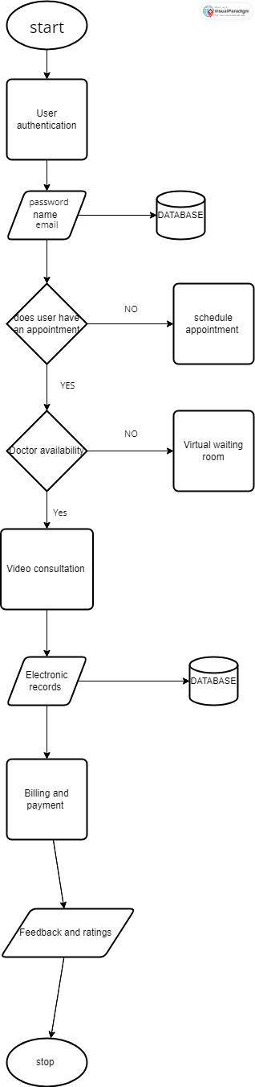
SYSTEM ANALYSIS AND REQUIREMENTS MODELING
Flowchart

Slide 16
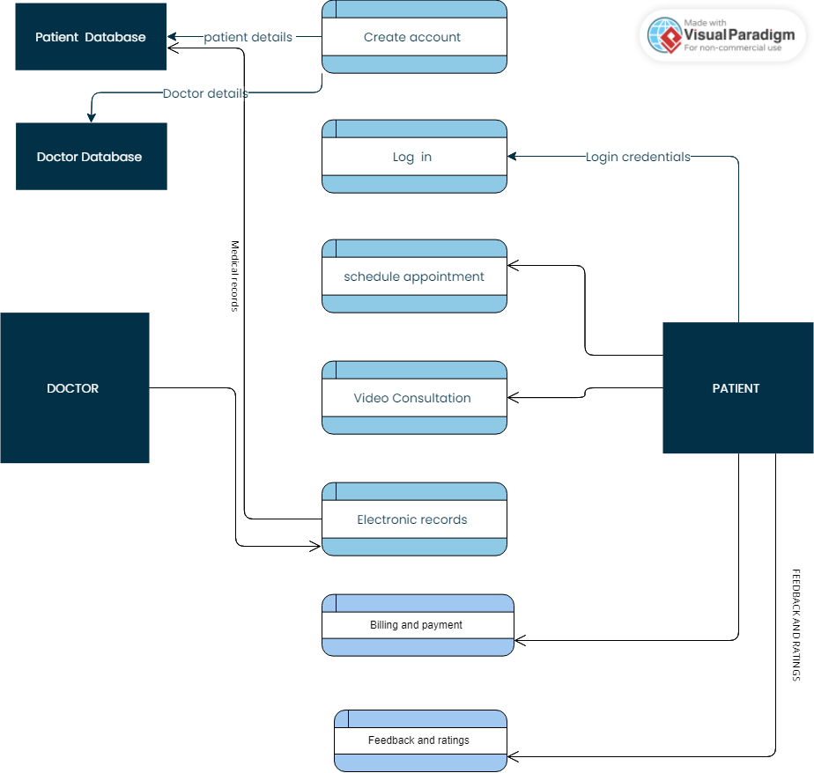
SYSTEM ANALYSIS AND REQUIREMENTS MODELING cont.’
Dataflow diagram

Slide 17
REFERENCES

