Slide 1


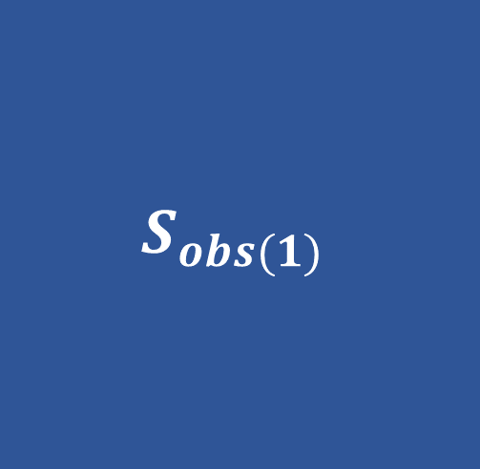
$$S_{obs(1)}$$
$$S_{1}$$
$$Q_{0(1)}$$

Slide 2






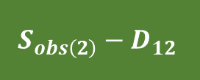




Community 1
Community 2
$$D_{12}$$
$$Q_{+0}$$
$$S_{12}$$
$$Q_{0+}$$
$$Q_{00}$$
$$S_{obs\left(1\right)}−D_{12}$$
$$S_{1}−S_{12}$$
$$Q_{0(1)}−Q_{+0}−Q_{00}$$
$$S_{obs\left(2\right)}−D_{12}$$
$$S_{2}−S_{12}$$
$$Q_{0(2)}−Q_{0+}−Q_{00}$$

