Slide 1
Book Recommender System with Graph Neural Networks
Naglis, Linka, Bartolomeo, Jules
Text Mining– Recommender Systems Project
Amsterdam University College
May 31st
Text Mining
‹#›
Notes:
‹#›

Slide 2
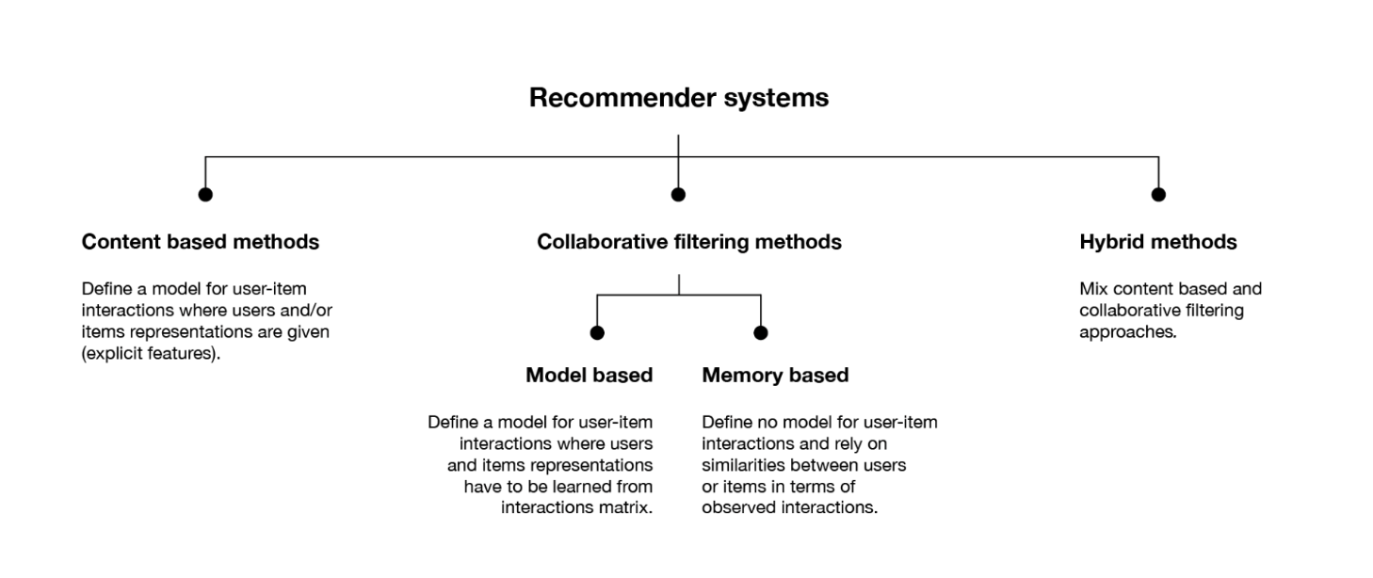
Book Recommender Systems
Predicting the relationship between users and items
Implicitly or Explicitly depicting preferences
High relevance of RecSys in social media
Graph taken from the Text Mining lecture on Recommender Systems
Text Mining
May 31st
‹#›
Notes:
‹#›

Slide 3
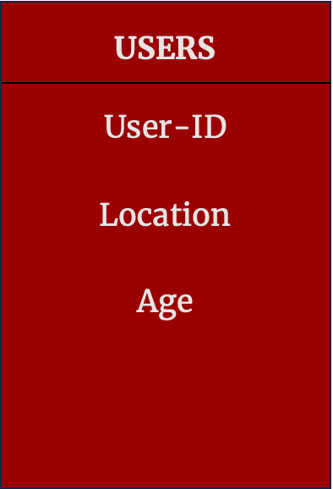
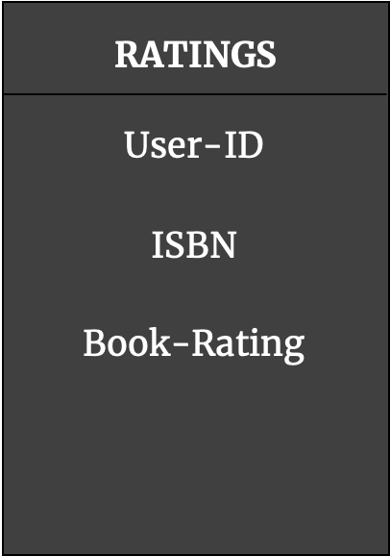
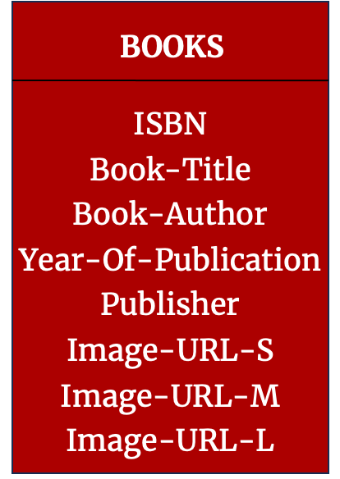
Data
Text Mining
May 31st
‹#›
Notes:
Pre-Processing of the data
books_and_ratings = ratings.merge(books, on='ISBN')
print(f"Books and Ratings shape after merge: {books_and_ratings.shape}")
Predicting the Book from the ratings
content base:
merge all the different data sets
user based collaborative filtering:
merge we only merge books and ratings and books

Slide 4
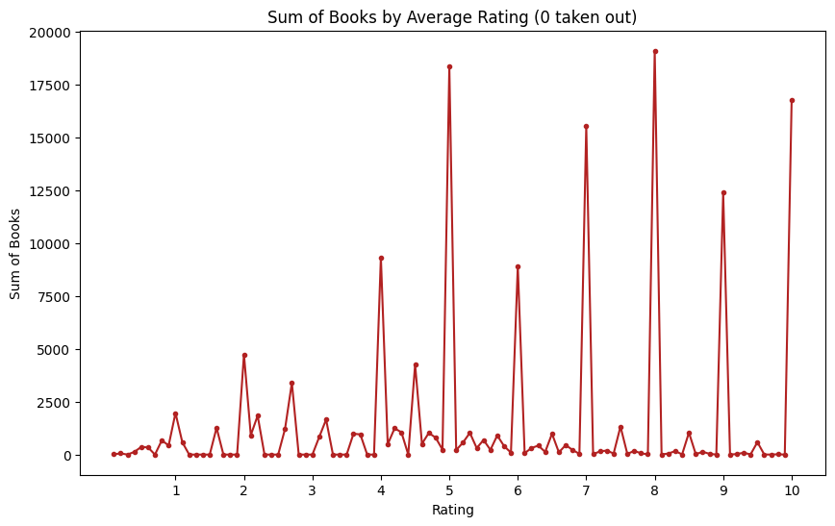
Data example:
Text Mining
May 31st
‹#›

Slide 5
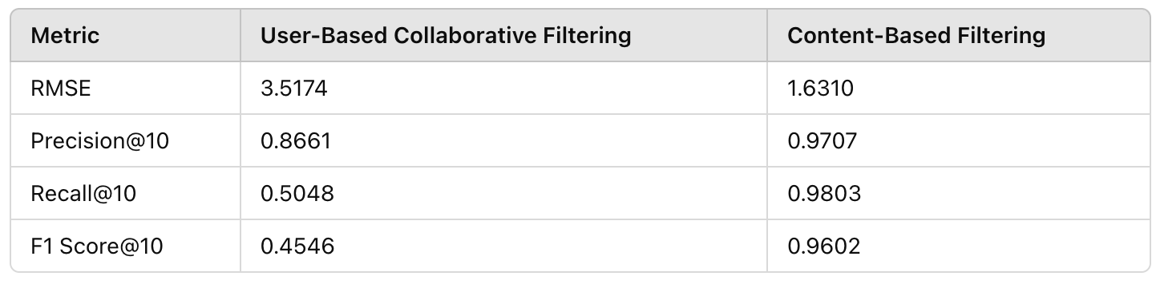
CBF vs CF
Singular Value Decomposition (model based) - Decomposes user-item interaction matrix into latent factors
k -NN (memory based) - Directly measures the similarity between users and items for recommendation
User-Based Collaboration: recommends a book for a given user matching its preferences with other similar users
Content-based: recommends books which the user considered positively before
Text Mining
May 31st
‹#›
Notes:
SVD: decomposes user-item interaction matrix into latent factors - better for scalability
k - NN: Directly measures the similarity between users and items for recommendation
Why CBF is better performing than CF: Books have more diverse information: 5 columns of info while users 2 valuable (location and age)
Precision: Out of all the positive predictions we made, how many were true?”
Recall: Out of all the data points that should be predicted as true, how many did we correctly predict as true?”

Slide 6
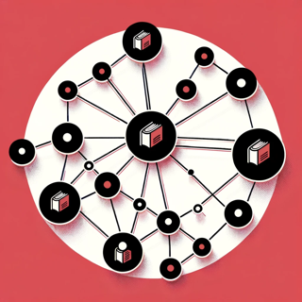
Why a GNN?
Natural fit for data
Enhanced personalization:
context understanding
Robust to sparse data:
handle better presence of few or missing information
Dynamic adaptation:
easily handles new data points
Scalable and efficient:
idea of locality
Text Mining
May 31st
‹#›

Slide 7
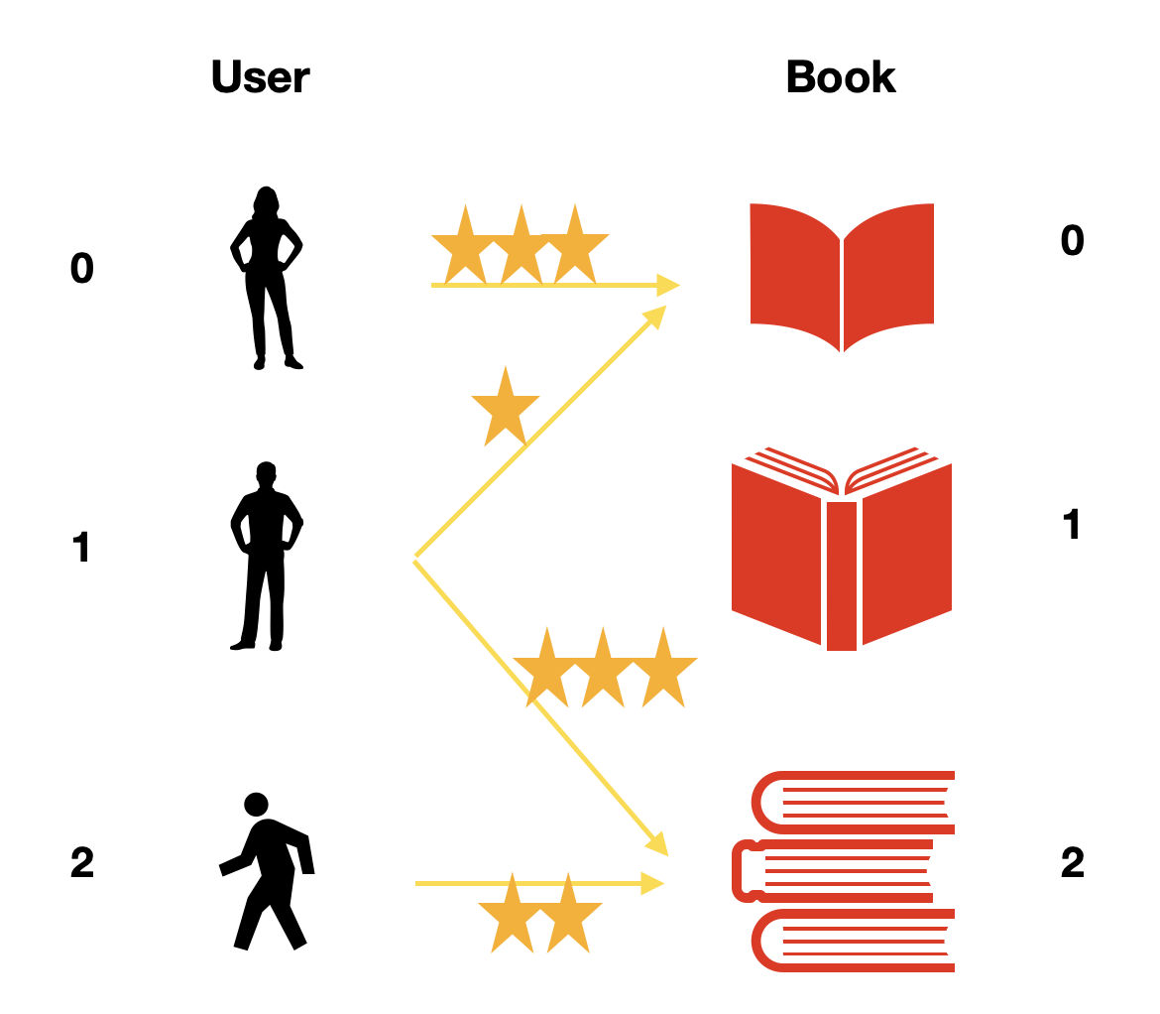
Constructing the GNN
Graph construction
Embedding data into a
heterogeneous graph
Two node types: user and
book
Edges: ratings
Metadata of users:
Location
Age
Build GNN architecture
Hyperparameter optimization
Test final model and compare with baseline methods
Text Mining
May 31st
‹#›

Slide 8
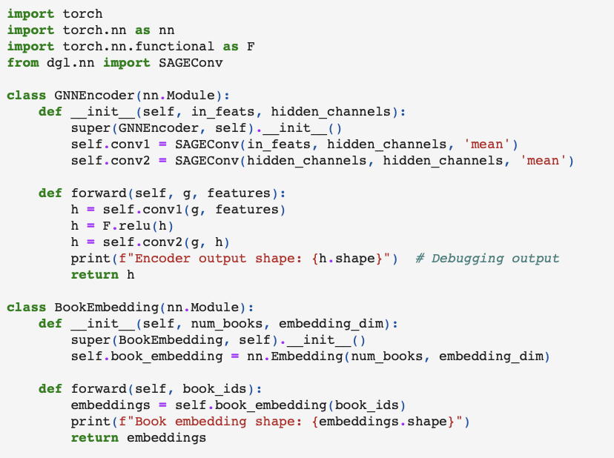
Defines GNN Encoder using SAGEConv
Generates a layer which retrieves book embeddings
Taken and adapted from: https://github.com/josephlewisjgl/GNNRecommender/blob/main/PyTorch_Boostrapped_GNN_Recommendationsipynb.ipynb

Slide 9
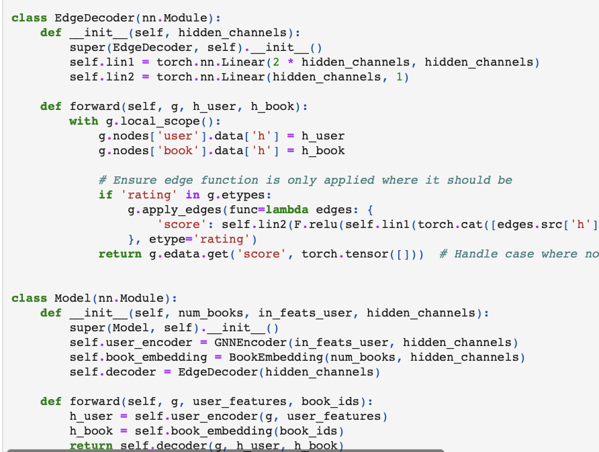
Decodes ratings between users and books
Combines the encoder, book embedding, edge decoder.
Outputs a list of predicted ratings for a user
Taken and adapted from: https://github.com/josephlewisjgl/GNNRecommender/blob/main/PyTorch_Boostrapped_GNN_Recommendationsipynb.ipynb

Slide 10
References
BOOK RECOMMENDER. (n.d.). Kaggle.com. Retrieved May 31, 2024, from https://www.kaggle.com/code/hilalmleykeyuksel/book-recommender#CONTENT-BASED-COLLABORATIVE-FILTERING
AUC_TM_2024/slides/AUC_9_Recommender_Systems.pdf at main · bloemj/AUC_TM_2024. (n.d.). GitHub. Retrieved May 31, 2024, from https://github.com/bloemj/AUC_TM_2024/blob/main/slides/AUC_9_Recommender_Systems.pdf
Collaborative Filtering Books Recommendation. (n.d.). Kaggle.com. Retrieved May 31, 2024, from https://www.kaggle.com/code/alnourabdalrahman9/collaborative-filtering-books-recommendation
Emami. “History of Graph Neural Networks (GNN).” Medium, 12 Mar. 2023, medium.com/@saluem/graph-neural-networks-gnn-93b32567a6d9.
GNNRecommender/PyTorch_Boostrapped_GNN_Recommendationsipynb.ipynb at main · josephlewisjgl/GNNRecommender. (n.d.). GitHub. Retrieved May 31, 2024, from https://github.com/josephlewisjgl/GNNRecommender/blob/main/PyTorch_Boostrapped_GNN_Recommendationsipynb.ipynb
Jérémi DeBlois-Beaucage. “Recommendation with Graph Neural Networks | Decathlon Digital.” Medium, Decathlon Digital, 31 Mar. 2021, medium.com/decathlondigital/building-a-recommender-system-using-graph-neural-networks-2ee5fc4e706d.
Text Mining
May 31st
‹#›

