Slide 1
SOLID
Robert C. Martin

Slide 2
Motivation
5 Design-Prinzipien ( Gang of 5 five )
Besserer Code
Struktur
Wartbar
Erweiterbar

Slide 3
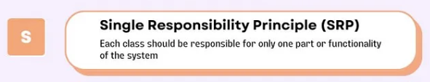
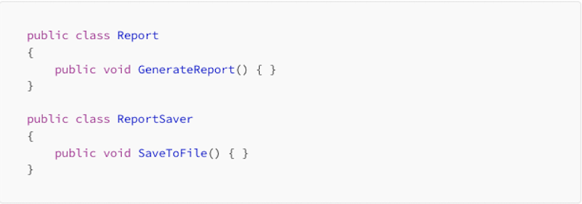
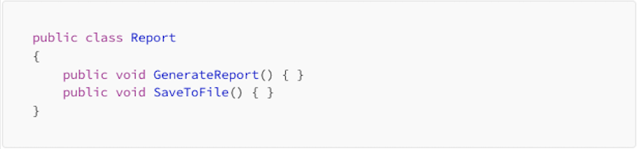



Slide 4
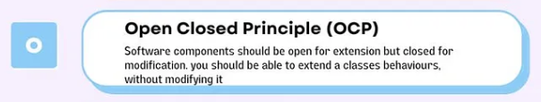
Key Idea: Once a class is written, it should be closed for modifications but open for extensions

Slide 5
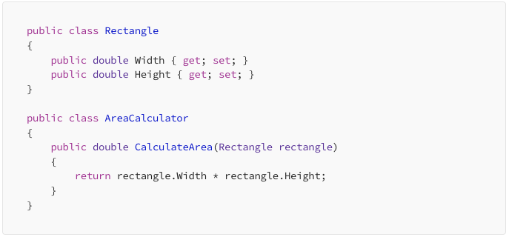

Slide 6
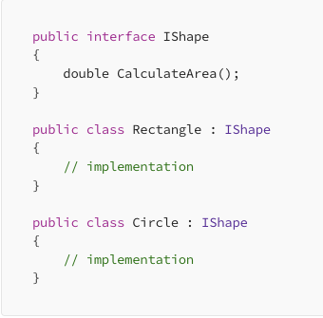
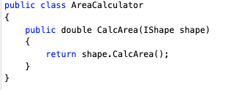

Slide 7
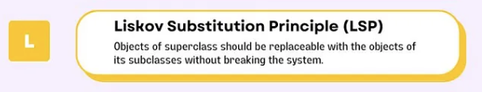
Key Idea: You should be able to use any subclass where you use its parent class.

Slide 8
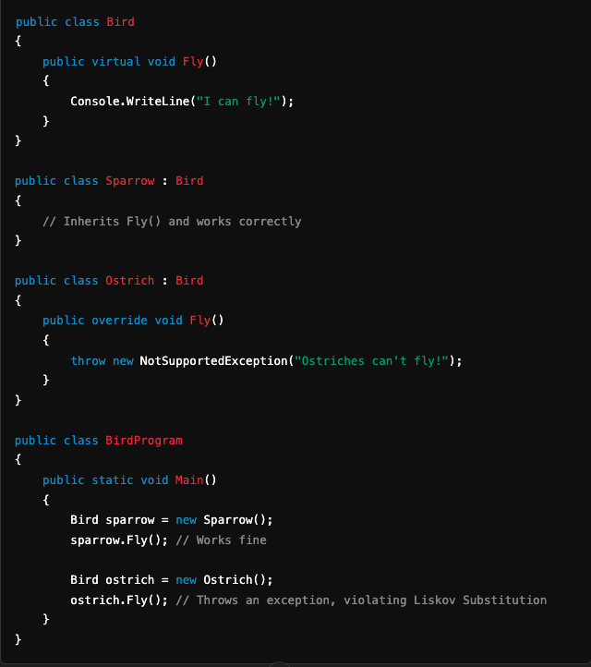

Slide 9
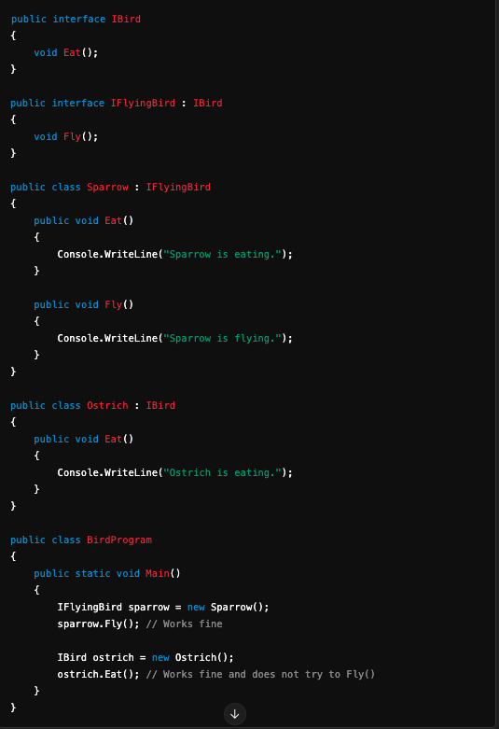

Slide 10
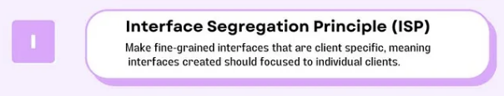
Key Idea: A class should not be forced to implement interfaces it doesn’t use..

Slide 11
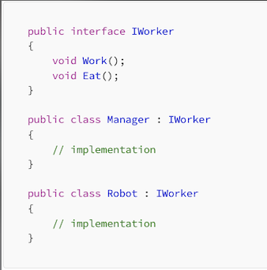
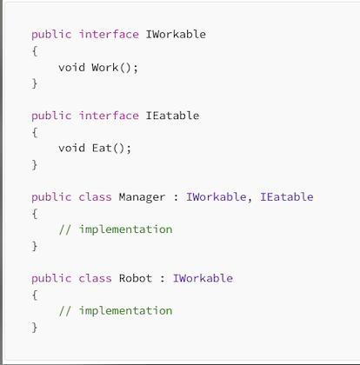

Slide 12
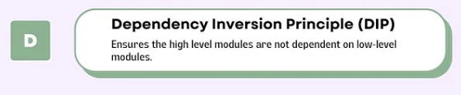
Key Idea: High-level modules should not depend on low-level modules; both should depend on abstractions

Slide 13
