Slide 1

Datacus Multi-Dimensional Data Explorer
October 26th, 2010

Slide 2
Team Members
Ryan Daubert
Buck Heroux
Adam Jackson
Ian Smith
Matt Smith
Adam Jackson
Datacus

Slide 3

Major Points Of This Presentation
Adam Jackson
Datacus

Slide 4
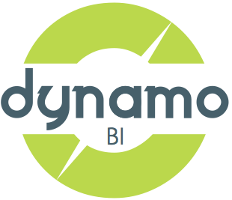
Dynamo Business Intelligence Corporation
Adam Jackson
Datacus
Notes:
Dynamo is a start-up company between 8 members based in Seattle, Washington with employees also located in San Francisco and India
Goal is to make collecting and reporting on data easy and fun for customers
Core product and specialty is an open source BI database

Slide 5
What is Business Intelligence?
The Tools & Techniques used to Analyze Business Data
Analytics, Data Mining, Dashboards, Reporting, Charting & Graphing, Predictive Analysis
Used by majority of Fortune 500 Companies across all Industries
Adam Jackson
Datacus
Notes:
Dynamo is a start-up company between 8 members based in Seattle, Washington with employees also located in San Francisco and India
Goal is to make collecting and reporting on data easy and fun for customers
Core product and specialty is an open source BI database

Slide 6

Problem
SELECT { [Measures].[Sales Amount], [Measures].[Tax Amount] } ON 0, { [Date].[Fiscal].[Fiscal Year].&[2002], [Date].[Fiscal].[Fiscal Year].&[2003] } ON 1 FROM [Adventure Works] WHERE ( [Sales Territory].[Southwest] )
Adam Jackson
Datacus
Notes:
Businesses have massive amounts of data with no simple solution for exploring their data or building charts and graphs from their data.
Existing products require knowledge of programming or databases and are unusable by business users
The mouse interface for exploring data is unintuitive and a new paradigm needs to be developed

Slide 7

Solution
Datacus
Matt Smith
Datacus
Notes:
Datacus software package
Simple Business Intelligence tool that allows business users to quickly explore data and build charts and graphs
Requires no knowledge of programming or of database structures
Does so through the use of touchscreens

Slide 8
Solution Overview
Matt Smith
Datacus
Notes:
We will be discussing the uses for such a technology
The requirements for such a technology to exist
A high level conceptual overview of how the technologies interact with the new system
The actual UI and architecture of our solution

Slide 9
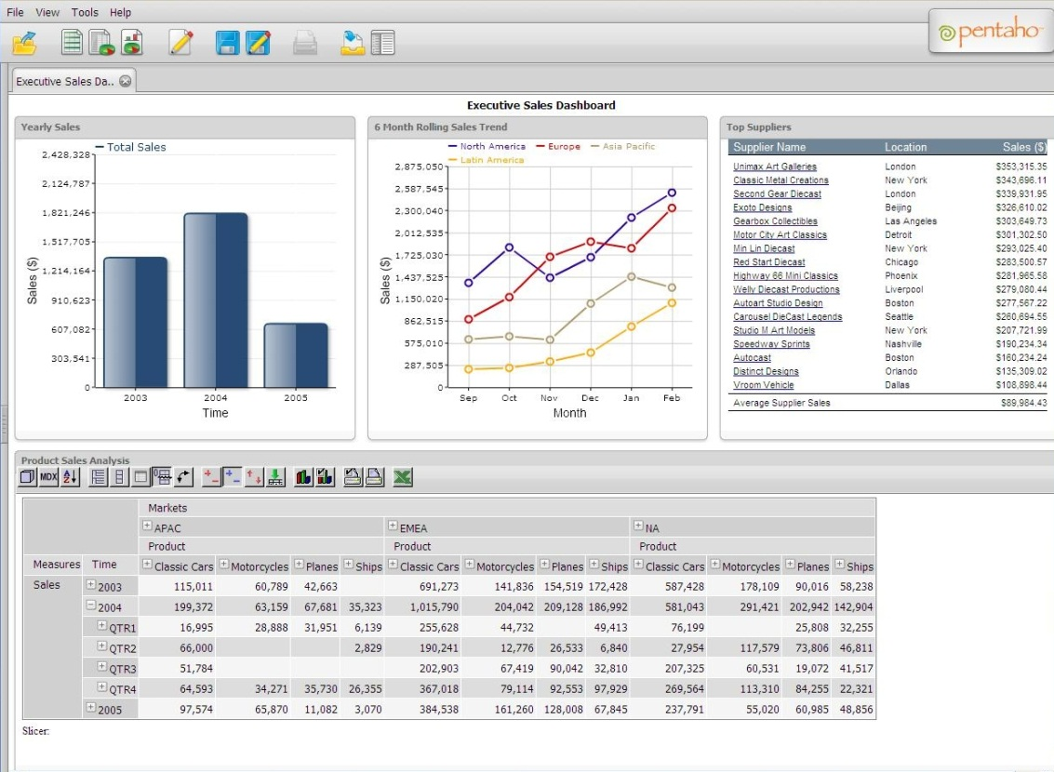

Uses of Datacus
Matt Smith
Datacus
Notes:
Intended for use by any business with large amounts of data that need help making sense out of it
Intuitive/Standardized touchscreen gestures give less technical users the power to build charts and graphs

Slide 10
More Uses
Great solution for companies fed up with their current BI systems
Anyone who needs help making sense out of large amounts of data
Matt Smith
Datacus
Notes:
No database master needed to collect data and make queries
Graphical interaction allows users to easily make decisions of what data to query

Slide 11
Requirements Overview
Ryan Daubert
Datacus

Slide 12
Environment Requirements
Ryan Daubert
Datacus
Notes:
Windows 7 – good touch environment, target market uses it
Flash – cross platform, rich graphic libraries
Hardware – Picked these hw env to reflect application framework

Slide 13
Functional Requirements
Ryan Daubert
Datacus
Notes:
States – current data and graph pref (datacus user environment)

Slide 14

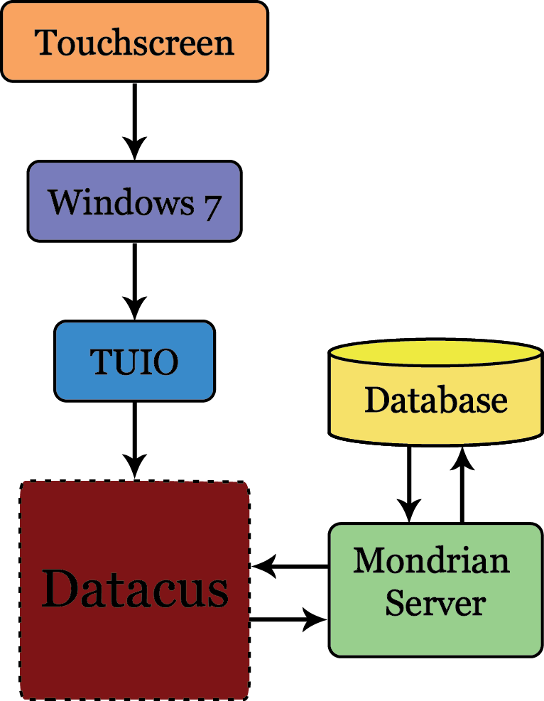
Conceptional Overview Diagram
Ryan Daubert
Datacus

Slide 15
User Interface Requirements
Ryan Daubert
Datacus
Notes:
Picker – dynamic database categories selector
Sets – saved states

Slide 16
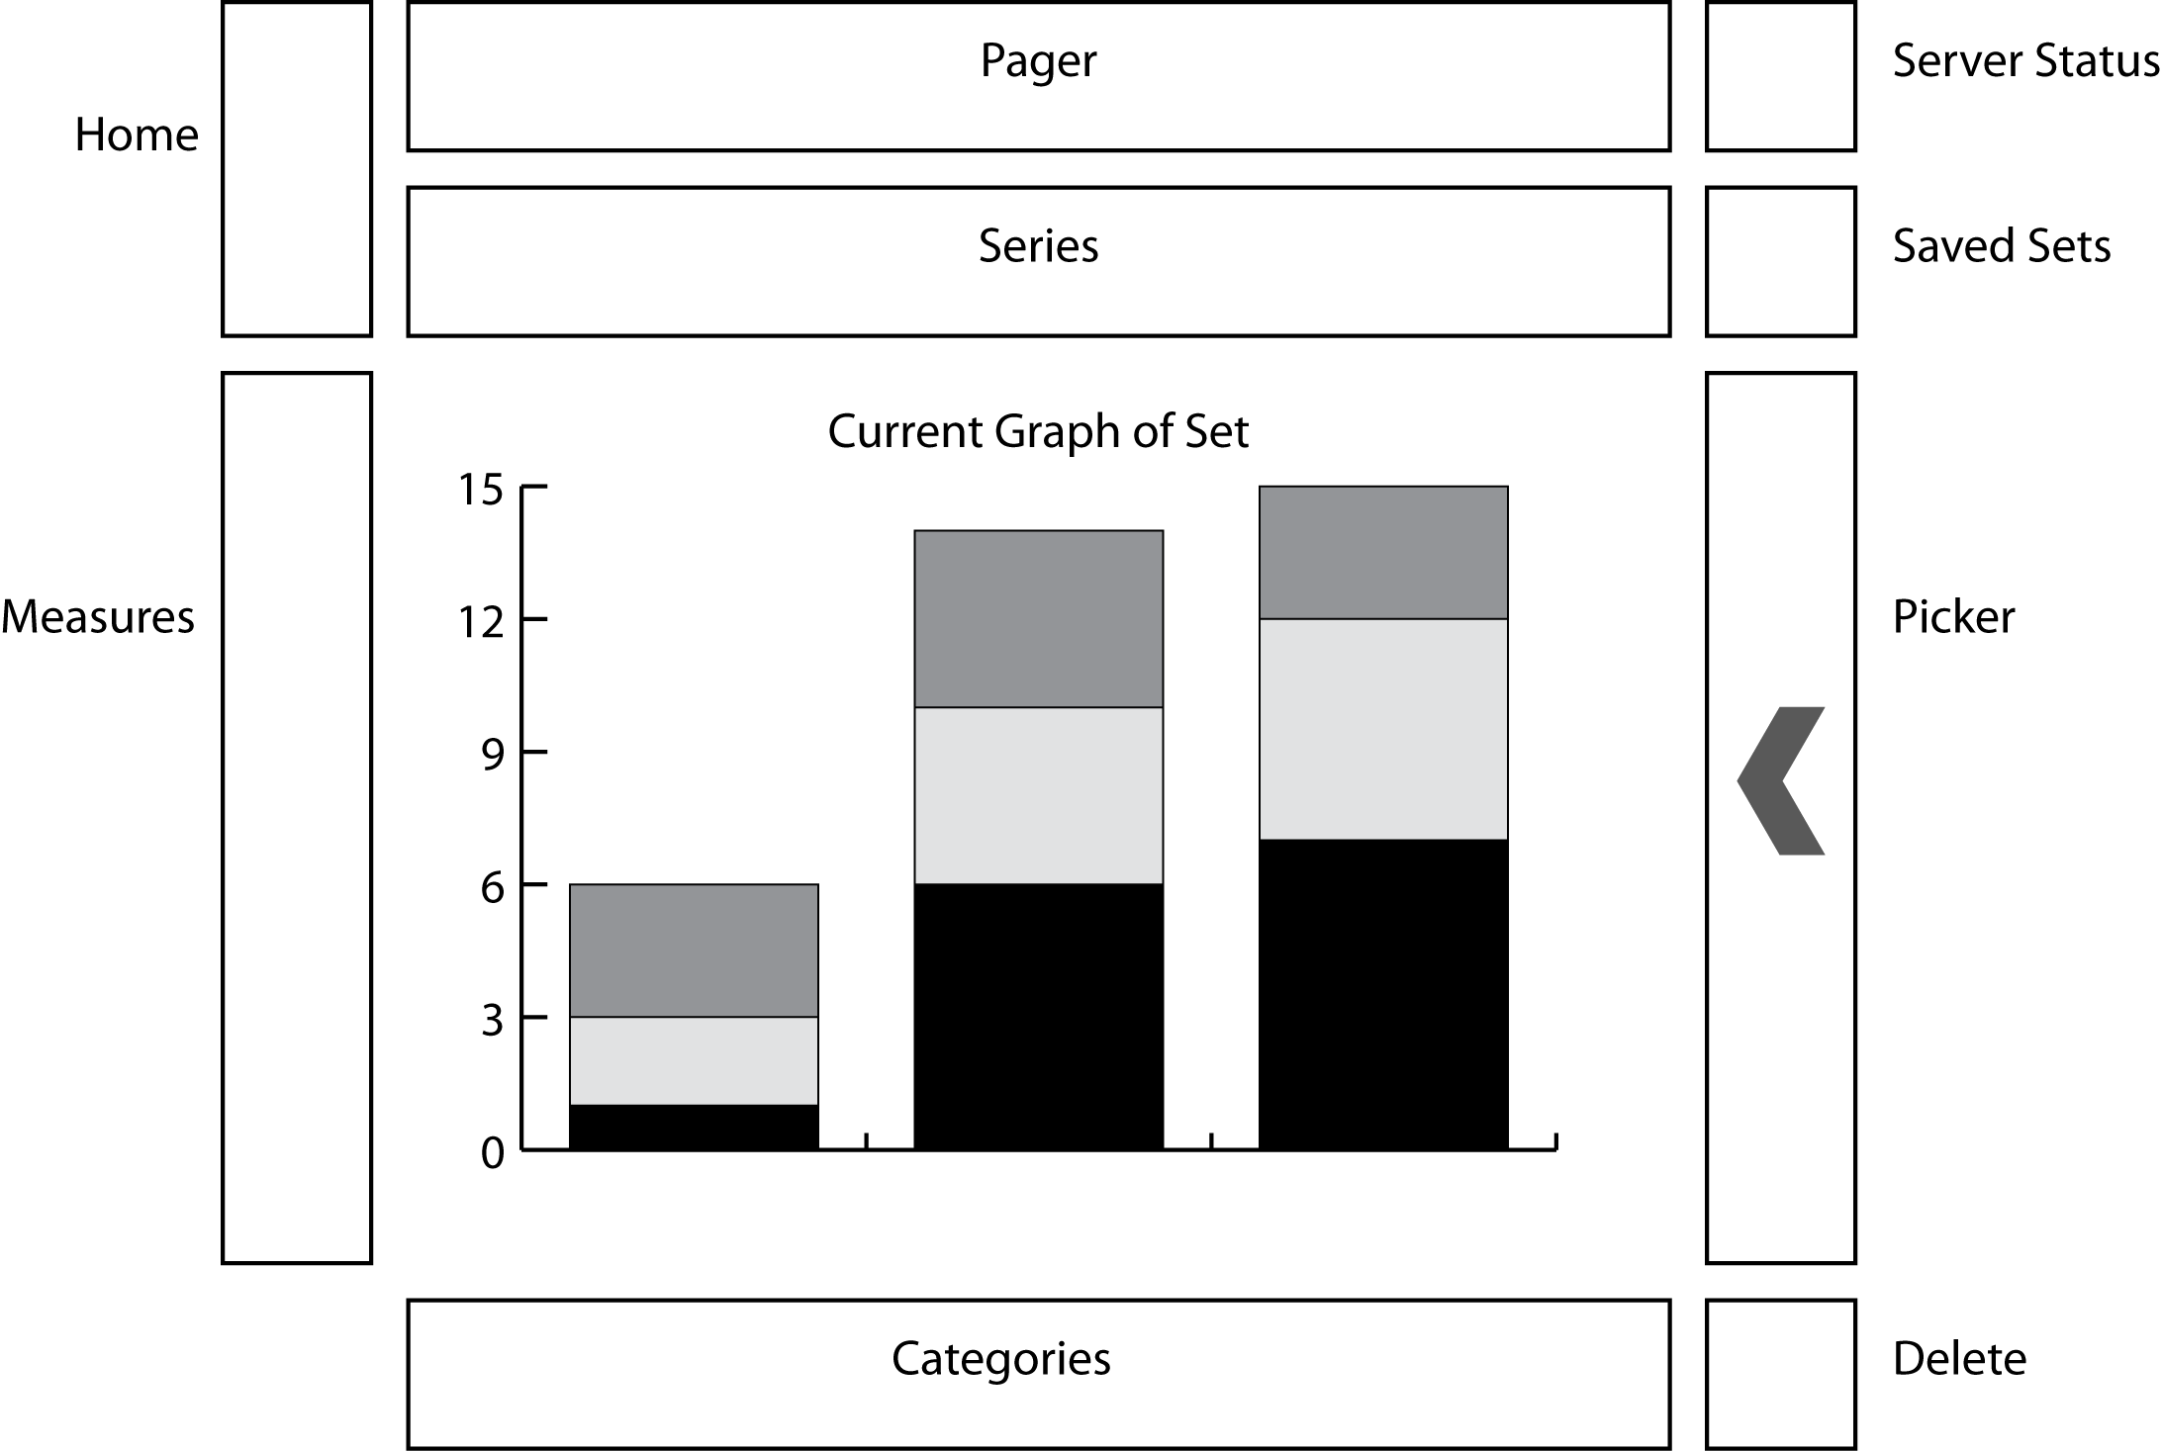
GUI
Matt Smith
Datacus
Notes:
Graphing area
Sets
Server status
Trash
Panels
Picker – simulate pulling out

Slide 17
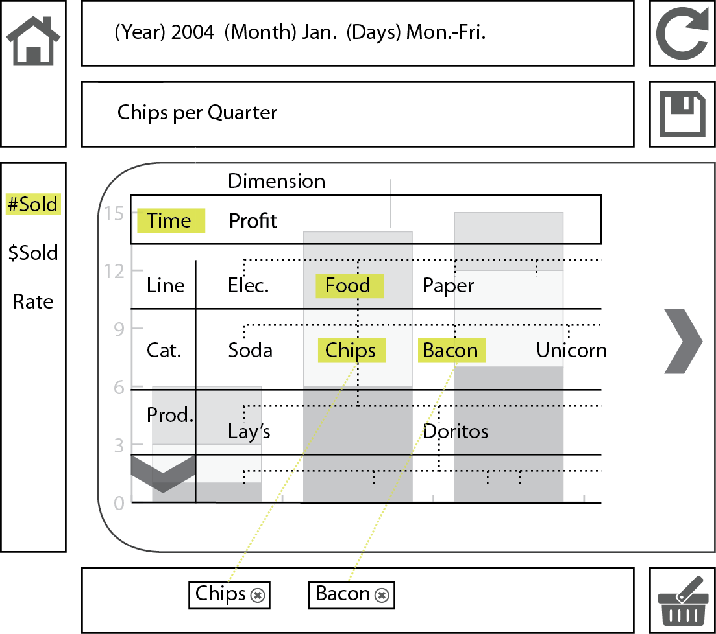
GUI
Matt Smith
Datacus
Notes:
Talk about time/profit = series
Chips/bacon categories
Must be on same line
Measures are controlled by user’s request not the user
Pager = time control
Simulate saving this set of info

Slide 18
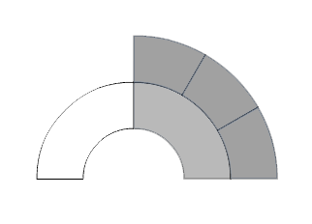
Dynamic Touch Menus
Matt Smith
Notes:
Depending on the options hierarchy the menu will change accordingly to provide user with all available customization options
Hand off to Buck and Ian for design of the Datacus system: issues, implementation, and architecture

Slide 19
Design: Issues
Buck Heroux
Datacus

Slide 20
Design: Implementation
DB Communication
Mondrian
BlazeDS
Touch
Visualization
TUIO
Flash Charts
Degrafa
Architecture
Model
View
Controller
Buck Heroux
Datacus
Notes:
TUIO
Mondrian
BlazeDS
Visualizations
Model-View-Controller
States

Slide 21
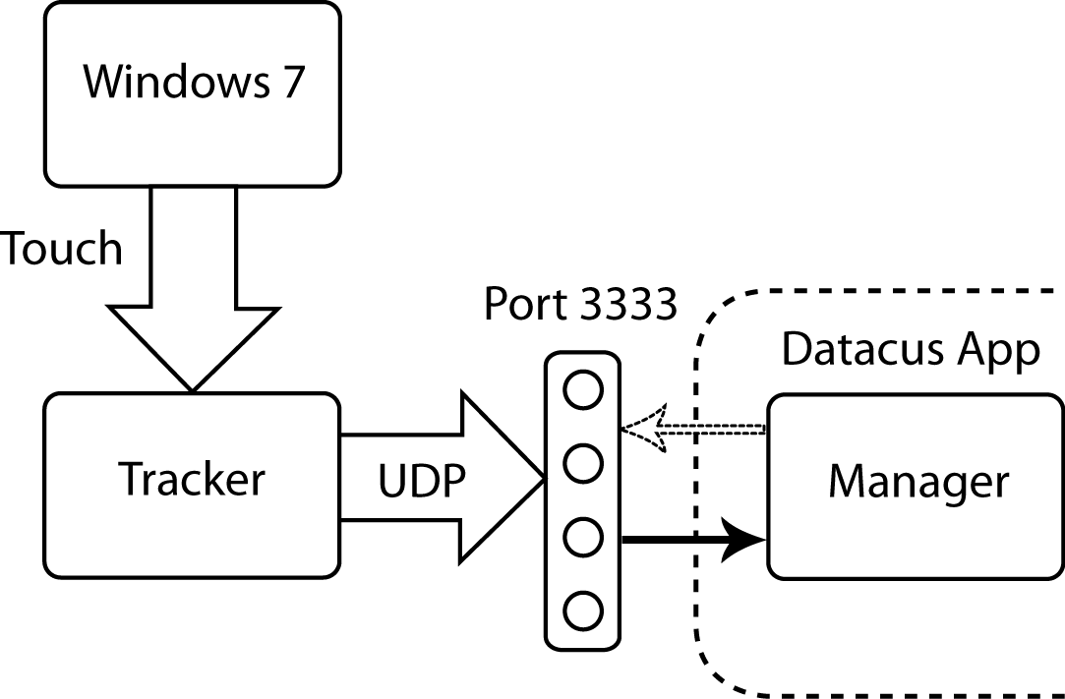
TUIO
Table-top User Interfaces Objects
Buck Heroux
Datacus
Notes:
Listens to port 3333 and translates the events to manageable items
Publishes Windows 7 touch events to port 3333 via UDP

Slide 22
OLAP/Mondrian
OnLine Analytical Processing
Time
Products
Cities
Buck Heroux
Datacus

Slide 23
BlazeDS
Allows Flash applications to remotely communicate with external Java applications.
Flash
Java
RPC
Buck Heroux
Datacus
Notes:
BlazeDS is a set of data services that allow the Datacus app to access data from the Mondrian server.
BlazeDS allows the ActionScript portion of Datacus to invoke methods in the Java portion of the application, which will then return dynamic ActionScript objects.
The methods invoked in the Java portion of BlazeDS will interact with the Mondrian Wrapper in order to retrieve the data required by the Model Element of Datacus

Slide 24
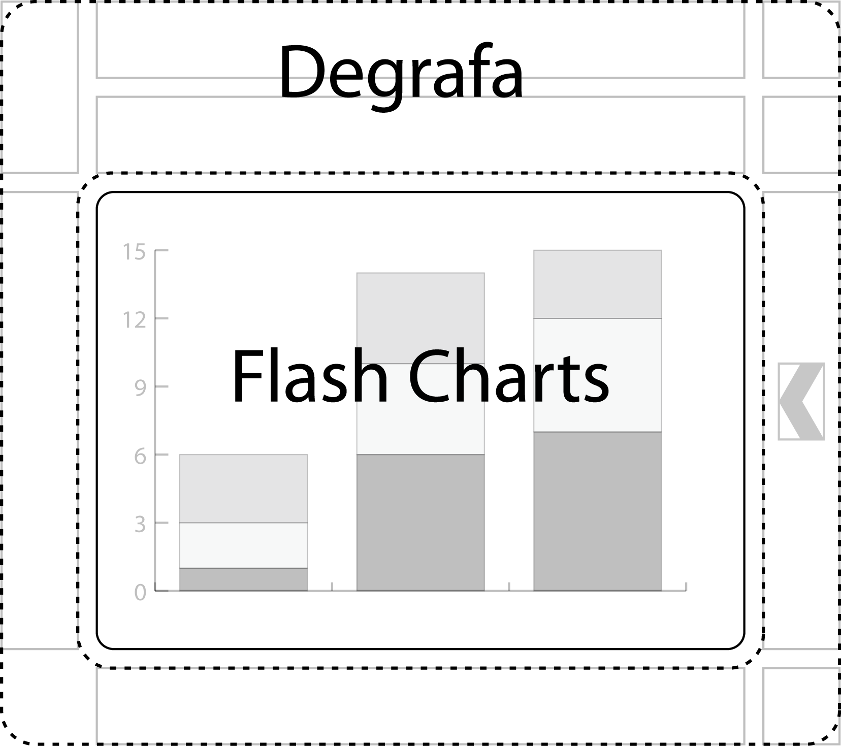
Visualization
Buck Heroux
Datacus

Slide 25
Model, View, Controller (MVC)
Controller
View
Model
Ian Smith
Datacus

Slide 26
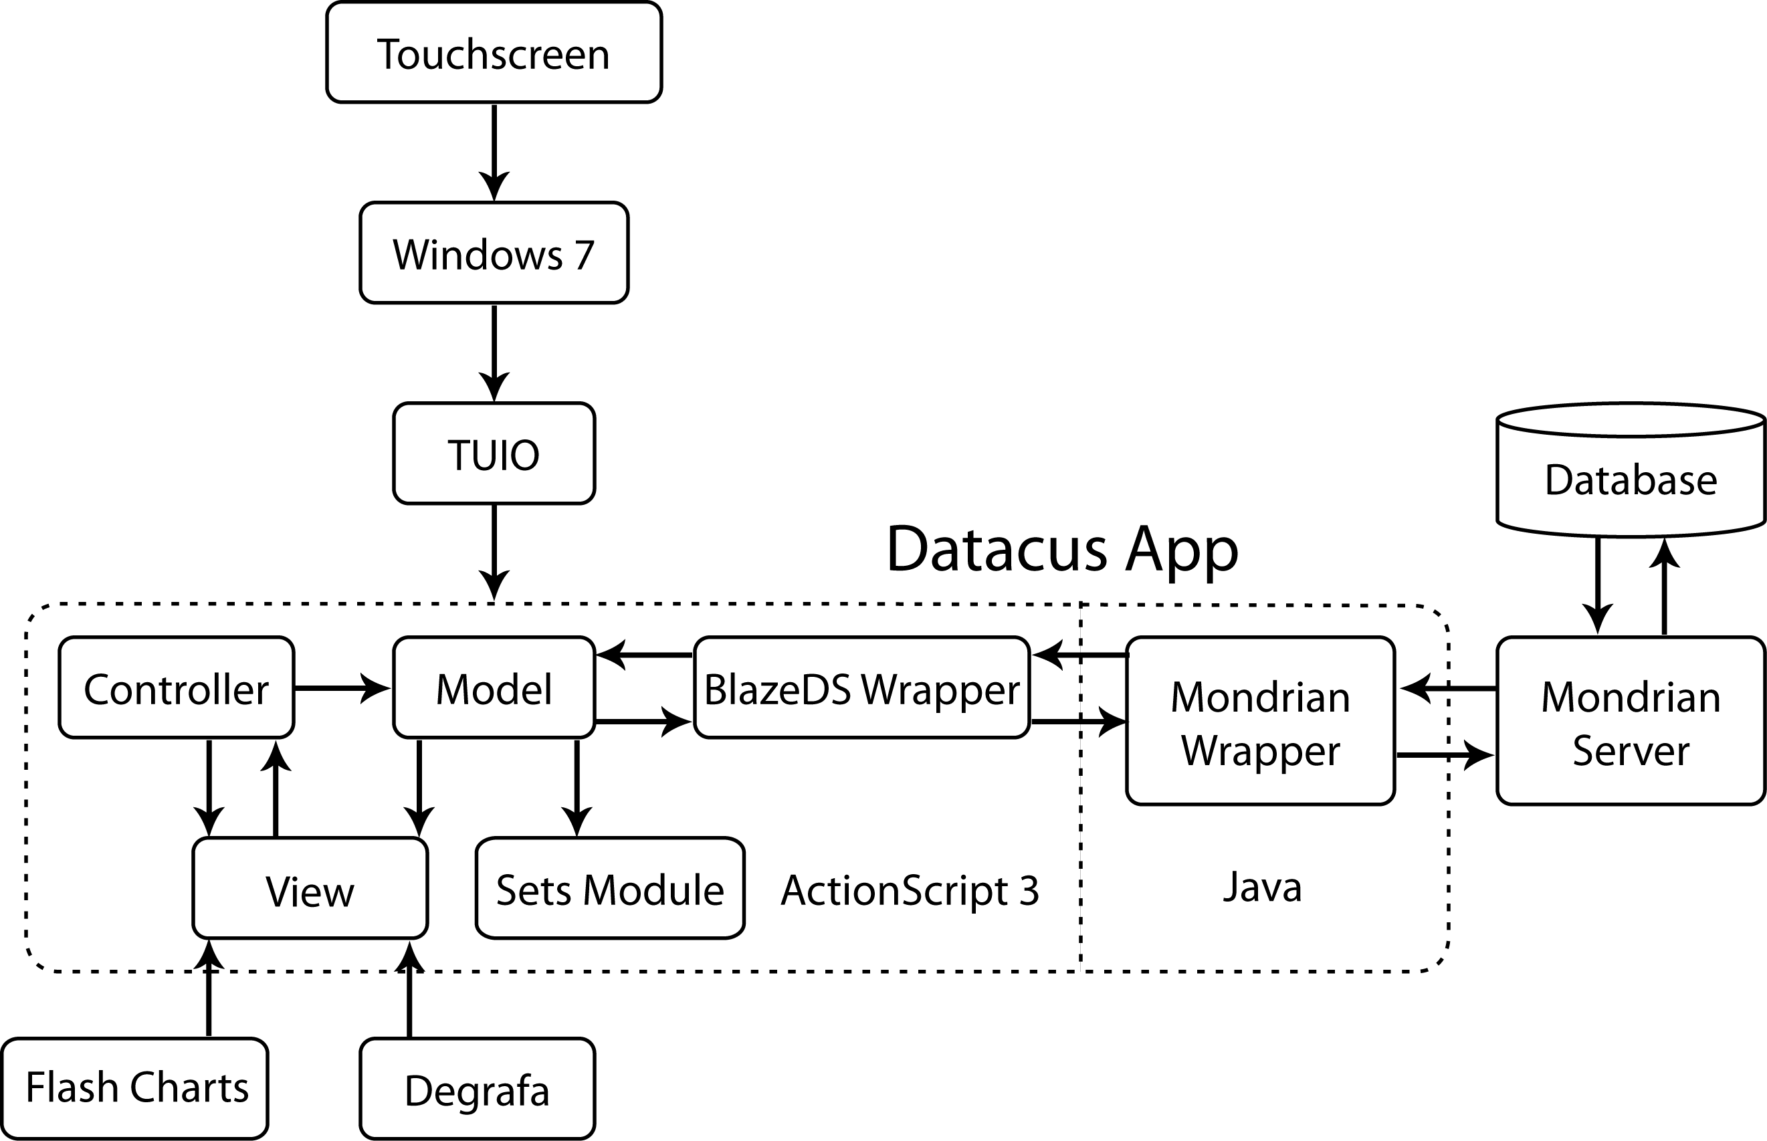
Datacus Architecture Diagram
Ian Smith
Datacus
Notes:
(will get into specifics of mvc stuff later…) TUIO input that is handled by controller, which tells model to update. Model will get new data or labels by issuing a query to BlazeDS wrapper. We use BlazeDS in order to connect our actionscript and Java components. BlazeDS wrapper issues an RPC to mondrian wrapper, which will generate a query to the mondrian server. Server will return data/dimension labels, which will be represented as Java objects within the Mondrian wrapper. BlazeDS then takes Java objects and then translates them into AS dynamic objects, then sends them to the model. Model will update the current internal state and also give new data to the view component, which will then generate a new graph.

Slide 27
Model
The Data Manager
Active Data
Active State
All Categories/Labels
Ian Smith
Datacus
Notes:
Everything that is stored from mondrian server saved as dynamic objects and can save them to the state module. The model keeps track of all available categories and labels (eg “Food – Chips – Doritos”) so that the user can quickly modify the graph. The model also holds all active data and gives it to the View for graphing whenever the data being graphed changes.

Slide 28
View
The Visualization
UI
Graph
Graphing Libraries
Ian Smith
Datacus
Notes:
The view is the corpus of everything that the user sees on the screen. It is divided mainly into two categories: the UI and the graph (as Buck covered earlier). The UI will show all active labels etc and the user will be able to manipulate them. The view will update whenever the user interacts with it; how it updates is determined by both the model and the controller. If the model gets new data, then the graph will update. If the user adds a category, then both the graph and the UI will change.

Slide 29
Controller
The Event Handler
Interaction Handling
Model Control
View Control
Ian Smith
Datacus
Notes:
Handles all of the user interaction. If the user drags off a label/category, the controller will notify the model to update, which will in turn update the view. If the user inputs a gesture to change the type of graph, then the controller will tell the view to update.

Slide 30
States
Ian Smith
Datacus
Notes:
A state consists of the current Series, Categories, and Graph preferences
State Module: talks to the Model Element and gets the current state
Saved States: allows the user to explicitly save a current state and restore it at a later time

Slide 31
External Save File (.xsf)
Save File
Database Name
Saved Sets, Preferences, Trash
Ian Smith
Datacus
Notes:
State Cache: the current state of the model will be saved to an External Save File when an item is deleted to the Trash. This allows the user to undo changes they made to the Model element.
External Save File (.xsf): Representation of the local work done within Datacus.
Plain text file in JSON format
This file is written to when a new database is connected, when the user creates a Saved State, or when the user deletes something to the Trash.

Slide 32
Summary
Datacus project for Dynamo BI Solutions
Multitouch BI System
Utilize Multiple Existing Open Source Systems
Adam Jackson
Datacus

Slide 33
Demo
Degrafa Pie Menu
Dynamic Flex Charts
Bump Top
Adam Jackson
Datacus

