Slide 1
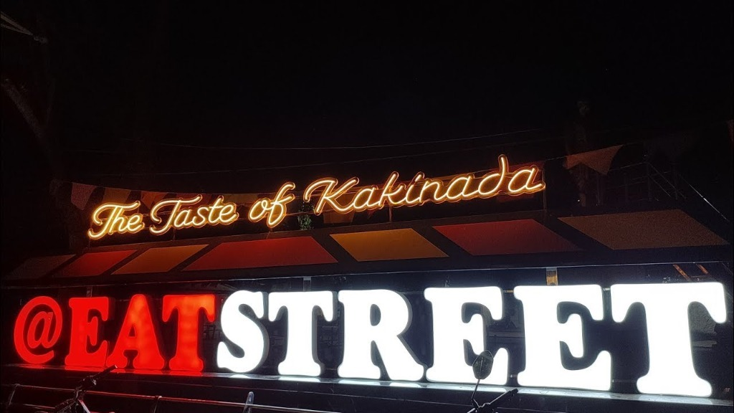
🍴 EAT STREET KAKINADA
AI-Powered Smart Food Court & Multi-Vendor Marketplace
A modern unified digital platform connecting food lovers with Kakinada's premier street food stalls, featuring Home Delivery, Takeaway, Smart Dine-In Table Booking, and a Tri-Lingual AI Food Concierge.
🔥 Multi-Vendor Commerce • 🤖 Llama-3 Multilingual AI • 🛡️ Live SMTP Security
Eat Street Kakinada • AI-Powered Multi-Vendor Marketplace • Confidential & Proprietary

Slide 2
01. INTRODUCTION & PROBLEM CONTEXT
Executive Summary & Problem Statement
The Street Food Dilemma ⚠️
The Eat Street Solution 🚀
• Long Queues & Peak Hour Rush: Customers face 30-45 minute waiting times at busy street stalls with manual paper-token disorder.
• No Multi-Stall Unified Cart: Ordering from 3 different stalls requires standing in 3 separate queues and paying 3 times.
• Lack of Table Booking System: Dine-in visitors struggle to find seating during evening peak hours without reservations.
• Language & Discoverability Barriers: Tourists and locals struggle to discover specialty dishes, dietary tags (Veg/Halal), and stall specials.
✔ Unified Multi-Vendor Digital Marketplace: Single cart checkout across all 10 Kakinada street food vendors with automated commission splitting.
✔ Tri-Mode Fulfillment Flexibility: Seamless choice between GPS-tracked Home Delivery, Express Takeaway counter pickup, or QR Dine-in Table booking.
✔ Multilingual AI Food Assistant (Llama-3): Instant menu recommendations in Telugu (తెలుగు), Hindi (हिंदी), and English with live inventory verification.
✔ Enterprise-Grade Security & OTP: Bcrypt hashing, brute-force security lockouts, and live Gmail SMTP email verification.
Eat Street Kakinada • AI-Powered Multi-Vendor Marketplace • Confidential & Proprietary

Slide 3
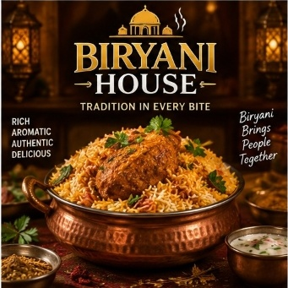

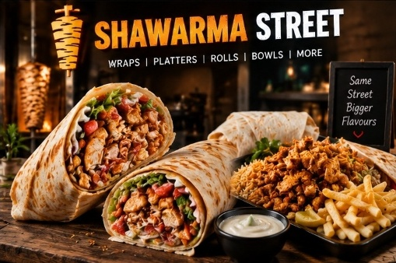
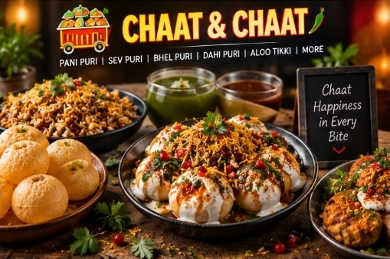


02. VENDOR ECOSYSTEM & PLATFORM ARCHITECTURE
Multi-Vendor Marketplace Ecosystem
Biryani House (ES001)
Dum Biryani, Mutton Biryani, Chicken 65
⚡ Live Orders Sync
Bullet BBQ (ES002)
Smoked Wings, BBQ Platters, Malai Tikka
⚡ Live Orders Sync
Shawarma Street (ES003)
Chicken Shawarma, Paneer Rolls, Platters
⚡ Live Orders Sync
Chaat Chat (ES004)
Pani Puri, Sev Puri, Bhel, Chole Bhature
⚡ Live Orders Sync
Momos & More (ES005)
Steamed & Fried Momos, Tandoori Momos
⚡ Live Orders Sync
Waffle World (ES006)
Belgian Waffles, Oreo Shakes, Ice Creams
⚡ Live Orders Sync
📊 Key Marketplace Metrics: 10 Verified Kakinada Food Stalls | 70+ Curated Menu Items | 15% Platform Commission | Automated Splitting
Eat Street Kakinada • AI-Powered Multi-Vendor Marketplace • Confidential & Proprietary

Slide 4
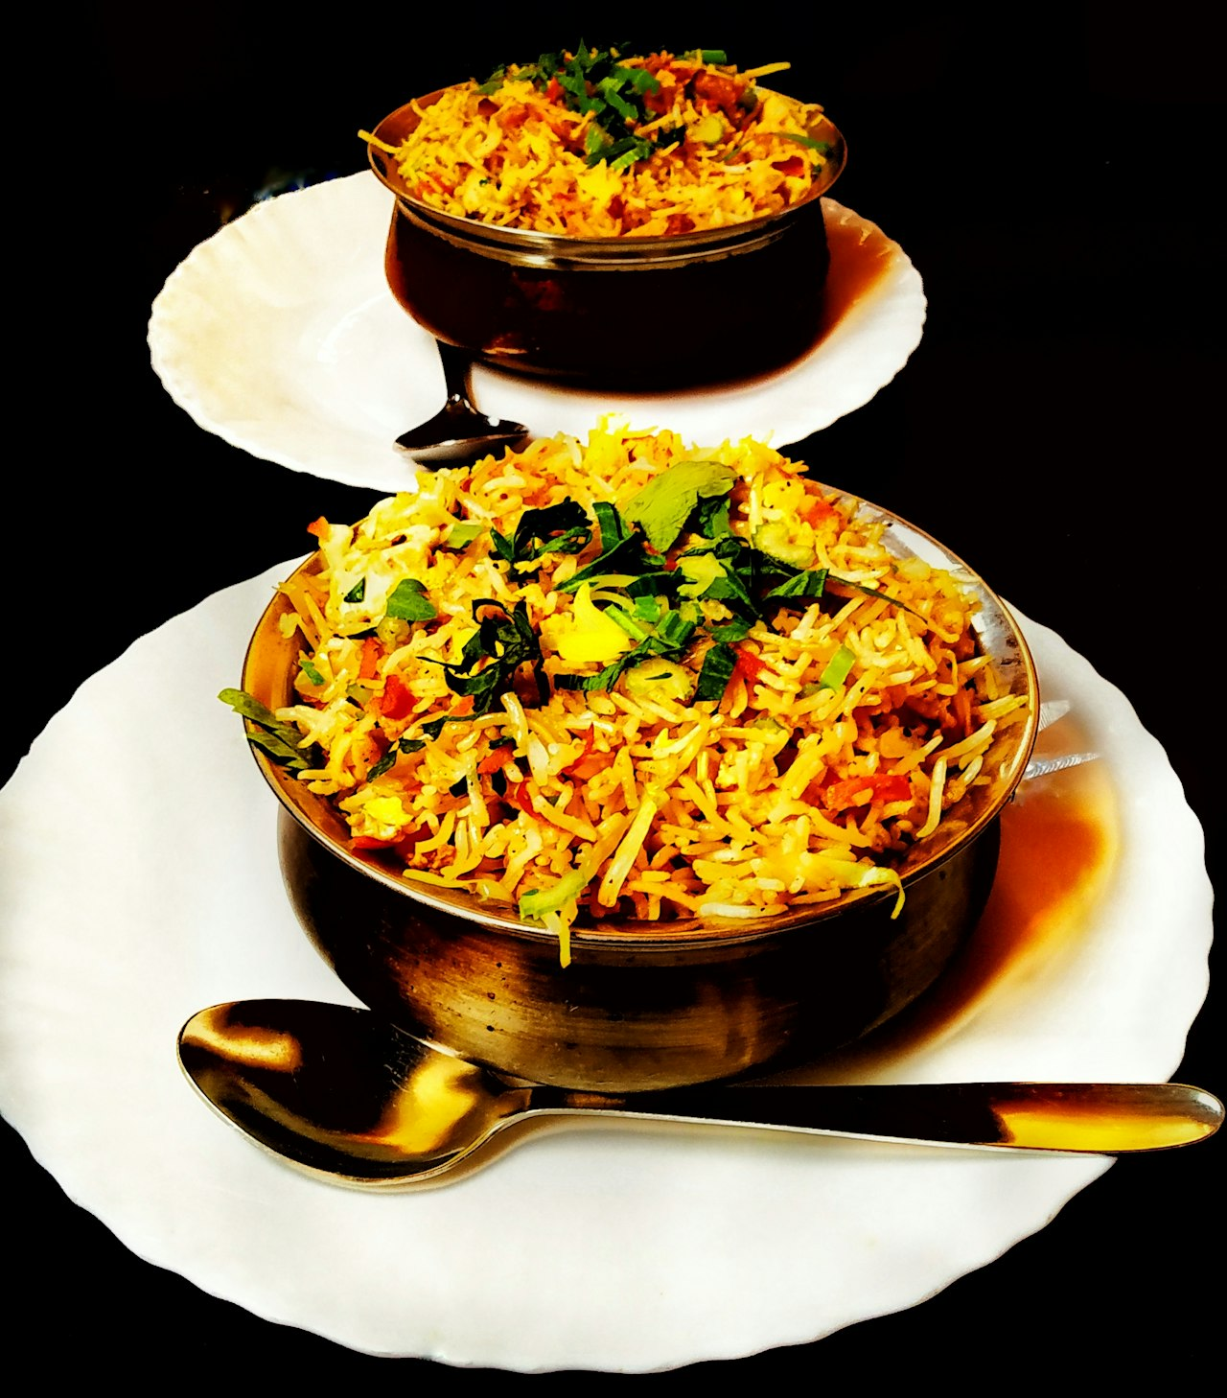
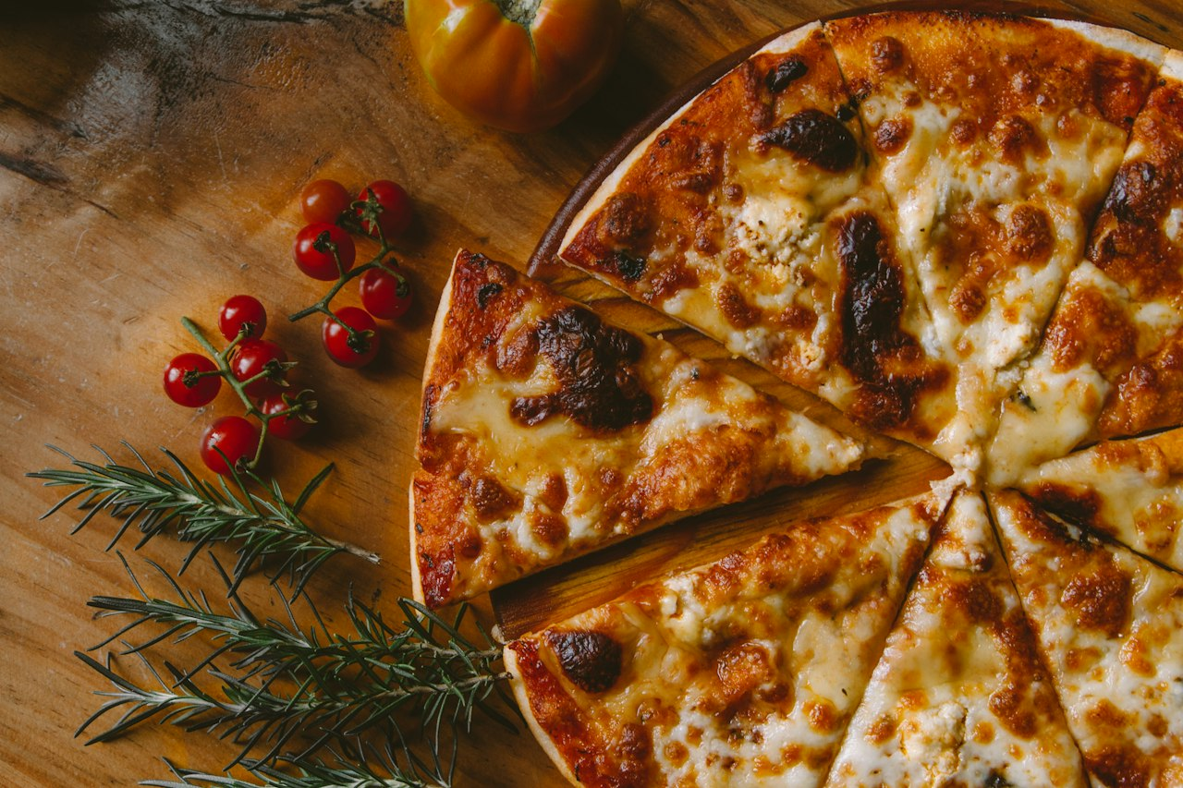
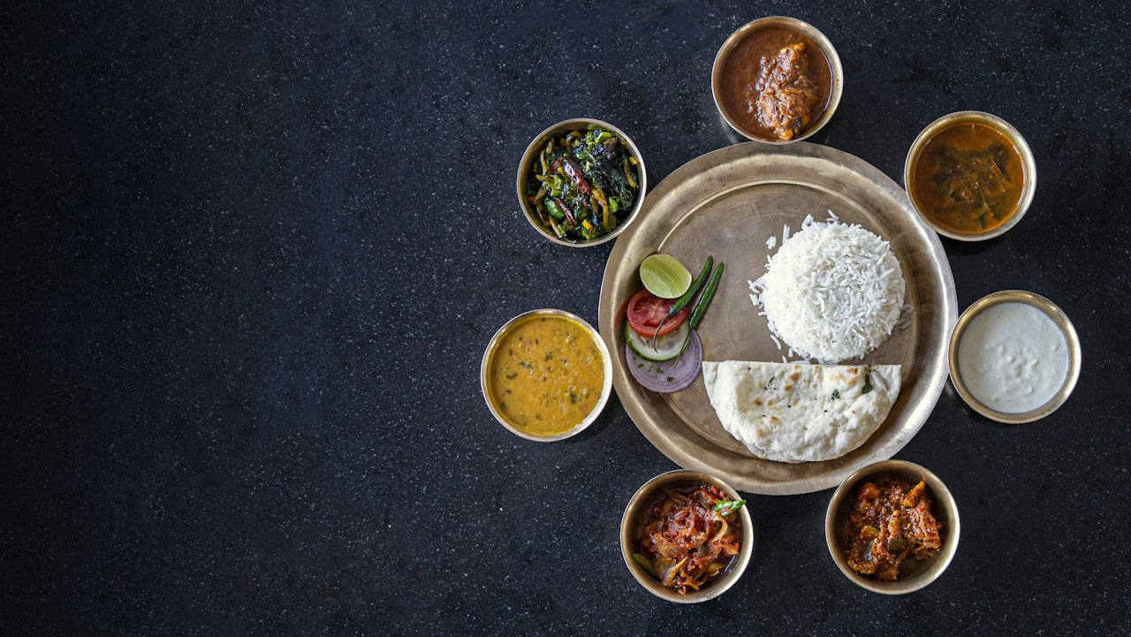
03. FULFILLMENT & DINE-IN INNOVATION
Tri-Mode Ordering Experience
1. Home Delivery 🛵
2. Express Takeaway 🛍️
3. Smart Dine-In & Table Booking 🍽️
GPS mapped delivery with automated distance calculation, driver dispatching, live order status tracker, and contact-free delivery options.
Pre-order food before reaching Eat Street. Real-time preparation timers, digital token generation, and zero-wait counter pickups.
Interactive table selection (indoor / outdoor / family cabana), instant QR table booking, pre-ordering items, and bill settlement before arrival.
Eat Street Kakinada • AI-Powered Multi-Vendor Marketplace • Confidential & Proprietary

Slide 5
04. ARTIFICIAL INTELLIGENCE & LLM ENGINE
Multilingual AI Food Concierge
Llama-3 Powered Neural Assistant 🤖
Live Chatbot Conversations 💬
✨ Tri-Lingual Natural Language Processing: Seamlessly communicates in Telugu (తెలుగు), Hindi (हिंदी), and English with automatic language detection.
✨ Live Inventory & Availability Validation: Queries live shop inventory so it never recommends out-of-stock dishes or closed stalls.
✨ Smart Dietary & Taste Filter Engine: Understands queries like 'Spicy non-veg starters under ₹200' or 'Kids sweet dessert without nuts'.
✨ Dual Hybrid Inference Architecture: Primary: Local Meta Llama-3 via Ollama; Fallback: Rule-based fast semantic intent matcher for zero-latency response.
[Telugu Prompt 🇮🇳]
User: 'Kakinada lo best chicken biryani ekkada dhorukuthundhi?'
AI: 'Biryani House (Stall 1) lo Chicken Dum Biryani (₹220) & Boneless Biryani chala popular and available ga unnay!'
[Hindi Prompt 🇮🇳]
User: 'Mujhe kuch spicy chicken starter recommend karo'
AI: 'Bullet BBQ se Peri Peri Wings (₹180) aur Chicken 65 try kijiye, dono fresh aur available hain!'
[English Prompt 🌐]
User: 'I want a dessert under 150 rupees'
AI: 'Waffle World offers Belgian Chocolate Waffle for ₹140 and Oreo Shakes for ₹120!'
Eat Street Kakinada • AI-Powered Multi-Vendor Marketplace • Confidential & Proprietary

Slide 6
05. PLATFORM SECURITY & EMAIL DISPATCH
Authentication, Security & Live Gmail SMTP
Live Gmail SMTP OTP Verification
Brute-Force & Bot Mitigation
Session & Data Protection
• Real-time 6-digit cryptographic OTP generation with 10-minute expiry.
• Dispatched via Google App Passwords over TLS (smtp.gmail.com:587).
• Auto-formatted responsive HTML email template with dark brand styling.
• Dynamic .env reload mechanism with password space sanitization.
• IP & Account Lockout: 5 failed attempts trigger a 5-minute cooldown.
• Honeypot anti-bot form traps to block automated submission scripts.
• Mathematical dynamic CAPTCHA challenges during suspicious traffic.
• Timing-attack resistant Bcrypt password hashing (dummy hash verification).
• HTTP-Only, SameSite='Lax' secure session cookies.
• CSRF Token validation on all state-altering POST forms.
• SQLAlchemy ORM parameterized queries preventing SQL Injection.
• Role-based access control (RBAC): Customer, Vendor, and Super Admin.
Eat Street Kakinada • AI-Powered Multi-Vendor Marketplace • Confidential & Proprietary

Slide 7
06. VENDOR MANAGEMENT & LIVE DISPATCH
Vendor Partner Dashboard & Management
Stall Owner Operational Hub 📊
⚡ Live Kitchen Order Display (KDS)
Orders flash in real-time with acoustic alerts, items, addons, customer notes, and fulfillment mode (Takeaway / Dine-In / Delivery).
⚡ Single-Click Order Status Progression
Four-stage pipeline: 'Pending' ➔ 'Preparing' ➔ 'Ready for Pickup' ➔ 'Completed' with live customer SMS/Web updates.
⚡ Menu & Inventory CRUD Suite
Instant item price updates, description edits, food photo uploads, and 'Sold Out' toggle to prevent ordering unavailable dishes.
⚡ Financial & Settlement Reports
Daily / Weekly gross sales, commission deductions (15%), net payouts, and item popularity analytics.
Eat Street Kakinada • AI-Powered Multi-Vendor Marketplace • Confidential & Proprietary

Slide 8
07. TECHNICAL STACK & DEPENDENCIES
Technology Stack & Architecture
Backend Framework 🐍
AI & Multilingual 🤖
Frontend & UX 🎨
Communication & DevOps ⚙️
Language:
Python 3.13
Framework:
Flask 3.0+ Microframework
ORM:
Flask-SQLAlchemy (SQLite)
Auth & Session:
Flask-Login & Flask-Bcrypt
Form Protection:
Flask-WTF / CSRF Protect
LLM Engine:
Meta Llama 3 8B Parameters
Local Runtime:
Ollama Local REST Service
Supported Langs:
Telugu, Hindi, English
Fallback:
Semantic Regex Keyword Matcher
Response Time:
< 800ms Average Latency
Markup & Style:
HTML5 & CSS3 Glassmorphism
Icons:
Remix Icons 4.0 Suite
Interactivity:
Vanilla JS (Zero Framework Bloat)
Responsive:
Mobile-First Grid & Flexbox
Typography:
Playfair Display & Poppins
Email Protocol:
Python SMTPLib over TLS 587
Mail Server:
smtp.gmail.com (App Password)
Config Loader:
python-dotenv (override=True)
Unit Testing:
Python unittest framework
Codebase Structure:
Modular Flask Blueprints
Eat Street Kakinada • AI-Powered Multi-Vendor Marketplace • Confidential & Proprietary

Slide 9
08. DATABASE DESIGN & ENTITY RELATIONSHIPS
Relational Database Schema & Data Models
SQLAlchemy Relational Models (SQLite)
📦 User (Customer/Vendor/Admin)
Attributes: id, name, email, phone, password_hash, role, is_active, created_at
📦 Shop (Food Court Stalls)
Attributes: id, name, owner_id, category, description, image_url, is_open, rating, commission_rate
📦 MenuItem (Dishes & Drinks)
Attributes: id, shop_id, name, description, price, category, is_veg, is_available, image_url
📦 Order (Multi-Vendor Orders)
Attributes: id, user_id, order_type, total_amount, commission_fee, status, delivery_address, created_at
📦 OrderItem (Order Line Items)
Attributes: id, order_id, menu_item_id, shop_id, quantity, price, special_instructions
📦 TableReservation (Dine-In)
Attributes: id, user_id, shop_id, table_number, reservation_time, guest_count, status, pre_order_id
📦 Review (Ratings & Feedback)
Attributes: id, user_id, shop_id, rating (1-5), comment, created_at
Eat Street Kakinada • AI-Powered Multi-Vendor Marketplace • Confidential & Proprietary

Slide 10
09. VERIFICATION, METRICS & TESTING
Testing & Quality Assurance
Automated Test Suite (100% Passed) 🧪
Performance & Robustness Highlights ⚡
✅ Authentication & Session Security: Verified user registration, Bcrypt verification, security challenge CAPTCHAs, and session expiration.
✅ Multi-Vendor Cart Operations: Tested multi-item addition from different stalls, quantity modification, and dynamic total calculation.
✅ Live Gmail SMTP OTP Pipeline: Validated SMTP connection over TLS 587, password formatting, email delivery, and OTP verification.
✅ Order Workflow & Commission Splits: Tested order placement for Takeaway, Dine-In, Delivery with commission deductions.
🚀 Sub-Second Page Load Times: Optimized static asset bundling, compressed food images, and zero heavy frontend dependencies.
🚀 Zero-Downtime Environment Reload: Dynamic .env reloading enables live credential updates without server restarts.
🚀 Secure Error & Edge Case Handling: Protected against empty carts, expired OTPs, timing attacks, and unauthenticated routes.
🚀 Mobile & Desktop Cross-Browser Responsive: Flawless rendering on Chrome, Safari, Edge, Firefox, Android, and iOS viewports.
Eat Street Kakinada • AI-Powered Multi-Vendor Marketplace • Confidential & Proprietary

Slide 11
10. FUTURE ENHANCEMENTS & ROADMAP
Future Roadmap & Scalability
Phase 1: UPI Gateway 💳
Phase 2: WhatsApp Bot 📲
Phase 3: Live GPS Tracking 📍
Phase 4: Telugu Voice AI 🎙️
Direct Razorpay / PhonePe QR automated settlements & instant vendor bank payouts.
Allow customers to browse menus, chat with AI, and order directly via WhatsApp Business API.
WebSocket-powered live map tracking for delivery riders from Eat Street to customer doors.
Voice-to-text AI ordering enabling customers to speak orders in natural colloquial Telugu.
Eat Street Kakinada • AI-Powered Multi-Vendor Marketplace • Confidential & Proprietary

Slide 12
11. PROJECT CONCLUSION & WRAP-UP
Conclusion & Summary
Transforming Kakinada Food Culture 🍴
🌟 Empowering Local Vendors: Brings traditional Kakinada street food stalls onto a modern digital marketplace with zero high-commission aggregator lock-in.
🌟 Delighting Foodies: Gives consumers a single unified cart, express queue-skip takeaway, and smart table booking with AI recommendations.
🌟 Robust Engineering: Built on secure Flask blueprints, Bcrypt password hashing, live Gmail SMTP OTP dispatch, and local Llama-3 AI intelligence.
🌟 Scalable Foundation: Ready for deployment on cloud servers (AWS/GCP/DigitalOcean) with SQLite to PostgreSQL migration path.
THANK YOU! 🙏
Eat Street Kakinada • The Taste of Kakinada
Questions & Answers
Eat Street Kakinada • AI-Powered Multi-Vendor Marketplace • Confidential & Proprietary

