Slide 1
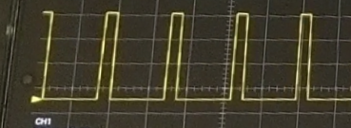
Logic voltage = 3.3v
Duty cycle = 1ms/20ms=0.05=5%
Period=20ms
Frequency=1/20ms=50Hz
On time=1ms

