Slide 1


Slide 2
Team members
Artem Nahornyi – team lead
Nick Vakulov
Maria Korolenko – designer
Olga Neyezhsal
Rabih Aoun

Slide 3
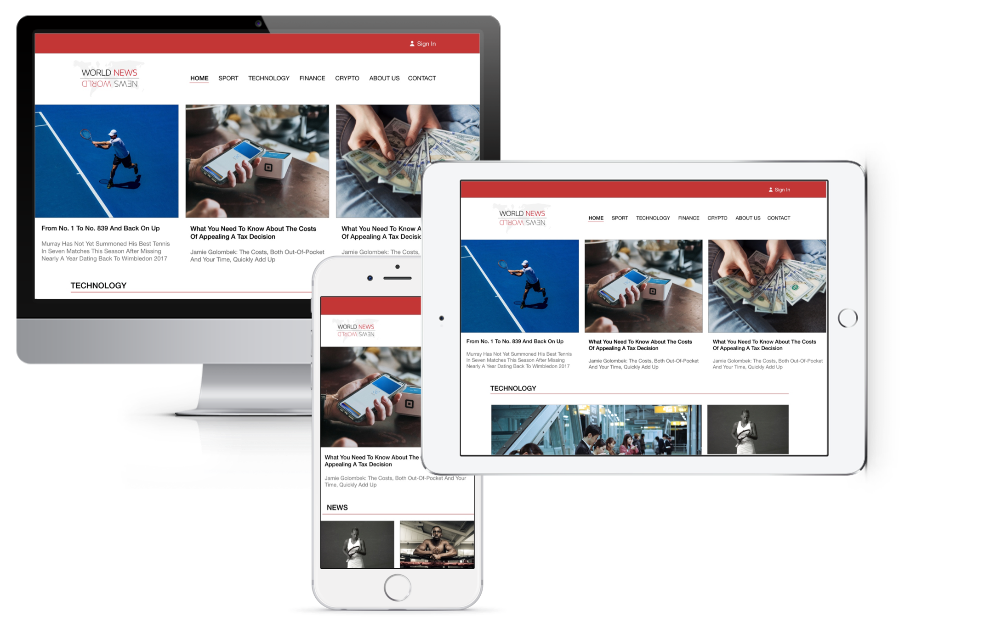
What we did
Artem Nahornyi – home page, crypto news page.
Nick Vakulov – sport news page, admin dashboard.
Maria Korolenko – technology page, about us page.
Olga Neyezhsal – contact us page, economics page.
Rabih Aoun – login/registration, header/footer.

