Slide 1

Major Project
IOT Controlled Car
Under the Guidance of:
Assist. Prof Mr. Nishant Munjal
Nagendra Chaudhary Kuchanapalli Akhil Sachin Hembrom
140166 140161 140180
Notes:
1

Slide 2
Internet of things -
The Internet of things (IoT) is the network of physical devices, vehicles, home appliances, and other items embedded with electronics, software, sensors, actuators, and network connectivity which enable these objects to connect and exchange data.
IOT Controlled Car -
It is a application of Internet of Things in which controlling of the car is done automatically by using various Internet based control techniques. In this project we are controlling car using Web Page Dashboard and Google Assistant.
To implement this we need:-
1.A Internet Connected MCU connected to Appliances.
2.A Server
3.A Internet Access Device to interact with with Server and a Recent Android Device .

Slide 3
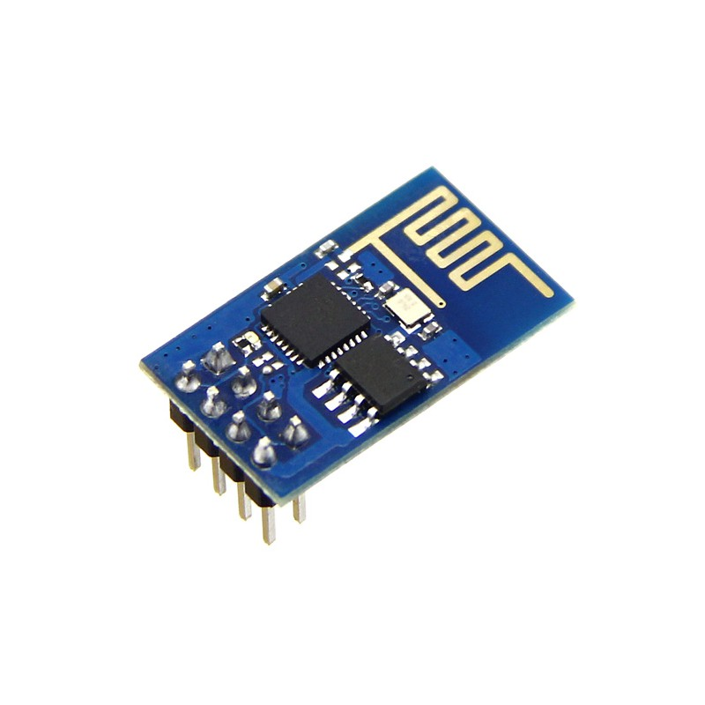
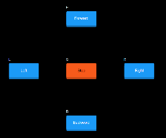

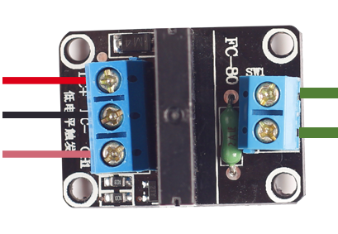

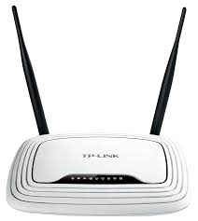
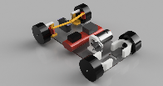
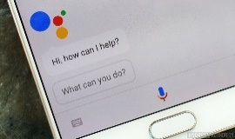
Complete Layout
Dashboard
MQTT Server
internet
Motor Controller
router
ESP8266
Wifi connection
Google assistant

Slide 4
Resources Used
Hardware
1. ESP8266 12E Chip (A WiFi MCU)
2. L298N Dual H Bridged Motor Controller
3. Mini Bread Board
4. 9V DC Battery
5. Jumper Wires
6. 3.5V Battery
7. A Toy Car Chassis with 2 motors
8. Four LEDs
Software
1 .Arduino IDE (To Code MCU)
2. Google Assistant
3. MQTT protocol based Server (io.adafruit.com)
4. A Facebook Page (IOT)
Network
Wifi Connection

Slide 5
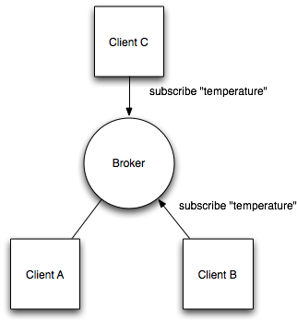
MQTT Protocol
Introduction
MQTT (Message Queue Telemetry Transport) is a publish /subscribe messaging protocol designed for lightweight M2M communications. It was originally developed by IBM and is now an open standard .It is an application layer protocol.

Slide 6
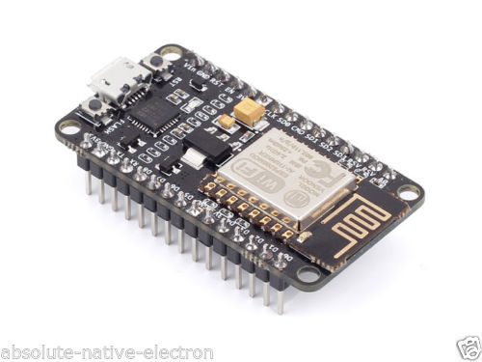
ESP8266 12E ( A WiFi Module)

Slide 7
Specification of MCU
Architecture 32-bit
RAM 128 KiB
ROM 4MB
ProcessingSpeed 80 MHz(Default) but can run on 160MHz
Wifi/Hotspot Yes/Yes
Micro usb Yes
Antina size 2mm

Slide 8
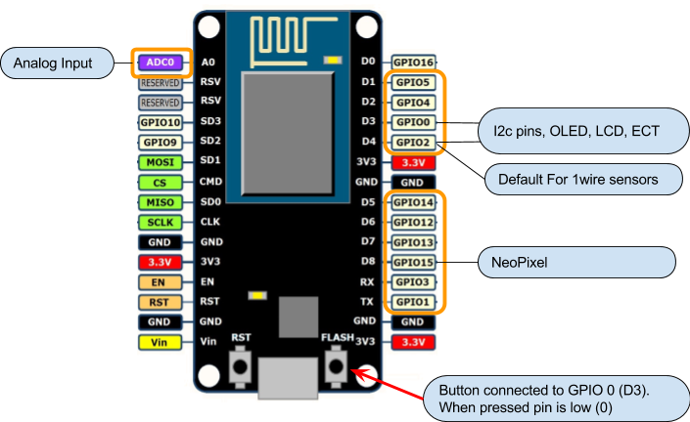
PIN Diagram

Slide 9
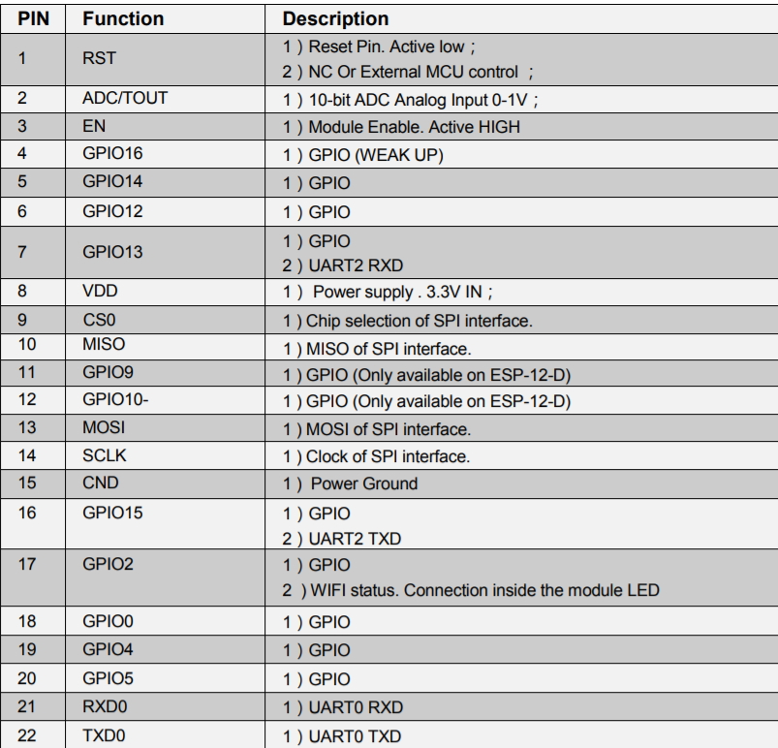
PIN Description

Slide 10
Arduino IDE
Introduction
Arduino is an open-source platform used for building electronics projects consists of both a physical programmable circuit board (often referred to as a microcontroller) and a piece of software, or IDE (Integrated Development Environment) that runs on your computer, used to write and upload computer code to the physical board.

Slide 11
Function Signature | Description
void setup() | The setup() function is called when a sketch starts. Use it to initialize variables, pin modes, start using libraries, etc.
void delay(ms) | To delay process in ms.
unsigned int micros() | To Return time from start of mcu in ms.
Serial.begin(speed) | To set speed of serial input output in baud.
void pinMode(pin, mode) | To set pin for either input or output.
Void loop() | After creating a setup() function, which initializes and sets the initial values, the loop() function does precisely what its name suggests, and loops consecutively, allowing your program to change and respond. Use it to actively control the Arduino board.
WiFi.begin(ssid, pass); | To connect with wifi.
server.begin() | Tells the server to begin listening for incoming connections.
client.connected() | Whether or not the client is connected
client.read() | Read the next byte received from the server the client is connected to (after the last call to read()).
client.stop() | Disconnect from the server.

Slide 12
Structure of Basic Program
void setup() {
// put your setup code here, to run once:
}
void loop() {
// put your main code here, to run repeatedly:
}

Slide 13
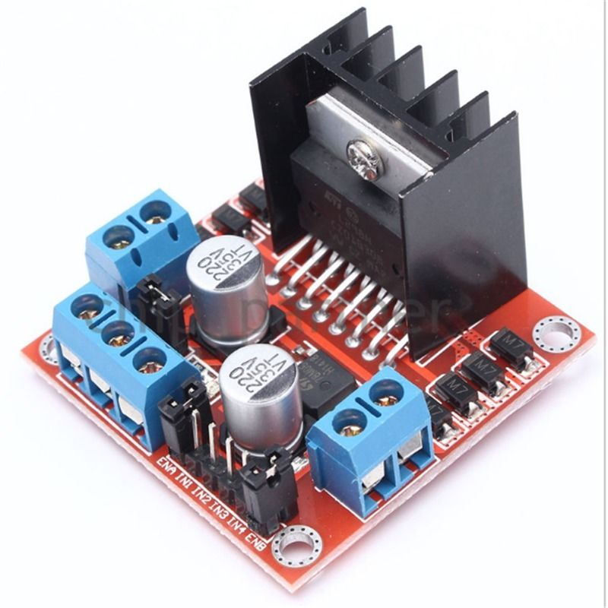
L298N Dual H Bridged Motor Controller

Slide 14
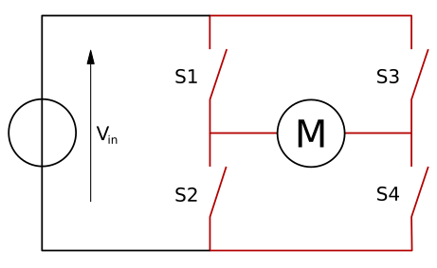
Internal Diagram Of Motor Controller

Slide 15
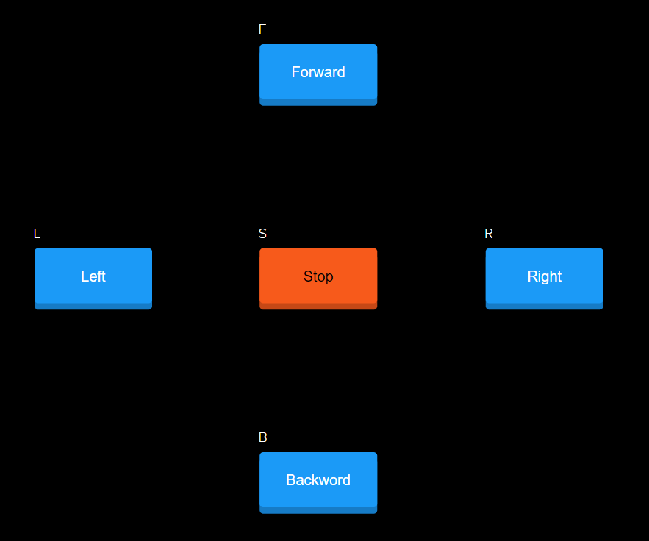
Adafruit Dashboard

Slide 16
Data Interpretation Recevied From Server
if (subscription == &f) {
Serial.println((char *)f.lastread);
uint16_t num1 = atoi((char *)f.lastread);
if ( num1 == 1) {
digitalWrite(D0,HIGH);
digitalWrite(D1,LOW);
digitalWrite(D2,HIGH);
digitalWrite(D3,LOW);
}
}

Slide 17
Data Interpretation Recevied From Server
if (subscription == &r) {
Serial.println((char *)r.lastread);
uint16_t num1 = atoi((char *)r.lastread);
if ( num1 == 1) {
digitalWrite(D0,LOW);
digitalWrite(D1,LOW);
digitalWrite(D2,HIGH);
digitalWrite(D3,LOW);
delay(6000);
digitalWrite(D0,HIGH);
digitalWrite(D1,LOW);
digitalWrite(D2,HIGH);
digitalWrite(D3,LOW);
}
}

Slide 18
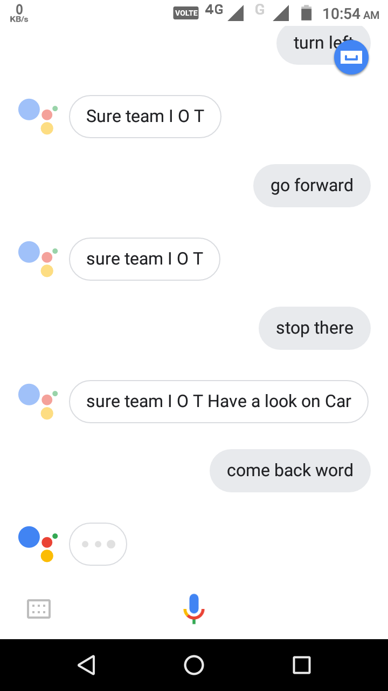
Google Assistant

Slide 19
Thank You !!

