Slide 1
Facebook Utilisation – Exploratory Data Analysis
- Nagraj Deshmukh

Slide 2
Problem Statement
Two entrepreneurs who had founded a job hunt platform (Jovia) in 2014, want to now foray into the social media space.
With an experience of running the company profitably for last 3 years, and a substantial amount of funding they are set to launch a new social media platform within one year.
But to make a mark in the industry, they need some data insights into the social media platform’s success drivers.

Slide 3
Scenario
The Jovia team wants to understand the target audience for the social media platforms.
They also want to understand the usage pattern of the mobile application versus the web application.
They also want to gather some marketing insights from this and improve their visibility.
The result will help the company to utilize these patterns in the decision making and prioritization of tasks.

Slide 4
Let’s Go
Lets dive into the data, and identify some patterns

Slide 5
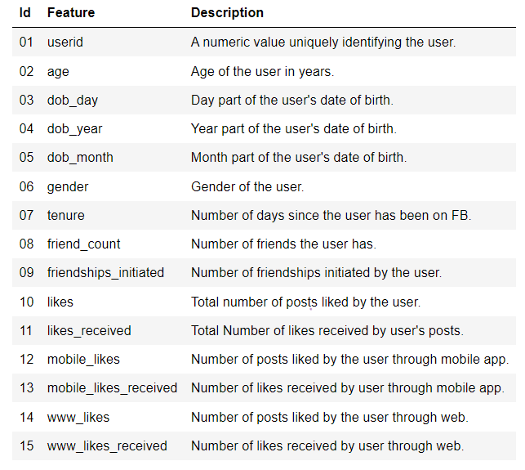
We had a dataset with 15 columns.
After generating a pre-profiling report, we did some transformations to the data for :
Handling missing data,
Handling duplicated data,
Handling redundant data,
Handling inconsistent data,
Handling outliers,
Handling typos
After cleaning the data, we started the exploratory data analysis.

Slide 6
The Target Age Group

Slide 7
1.
What is the age distribution of the users of Facebook
Age is just a number !

Slide 8
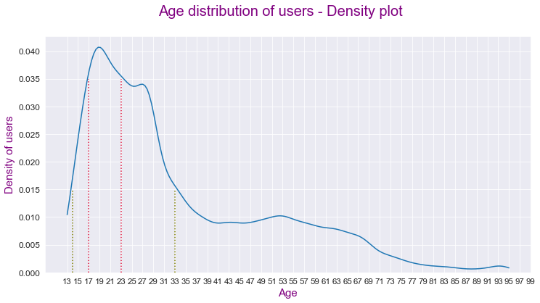

Slide 9
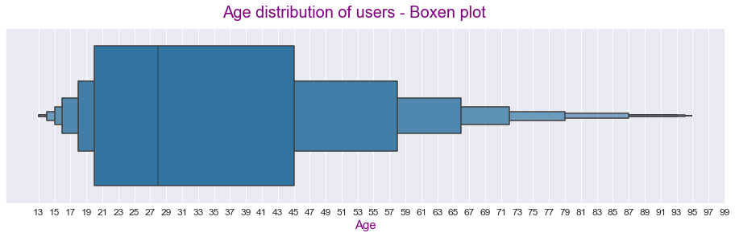

Slide 10
2.
Which age-group is the driver of growth.
Creating new accounts continuously ?

Slide 11
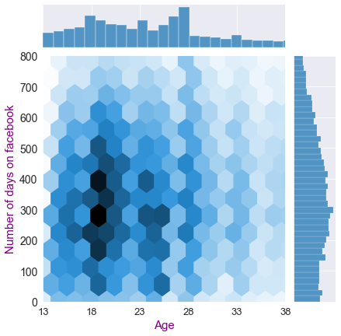
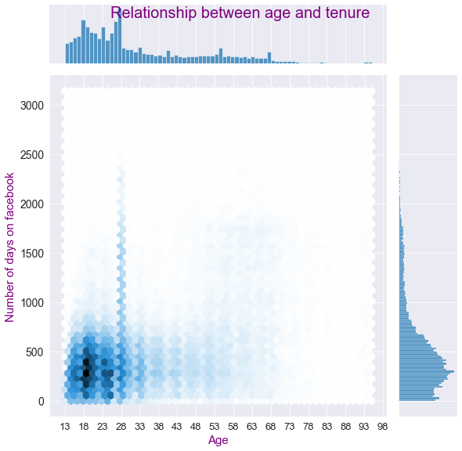

Slide 12
3.
Which age-group gets more traction on Facebook
Likes. Friends. Likes.

Slide 13
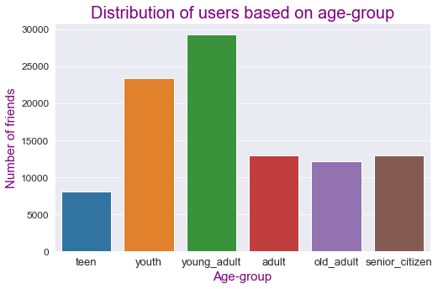
13-17
17-23
23-33
33-45
45-58
58+

Slide 14
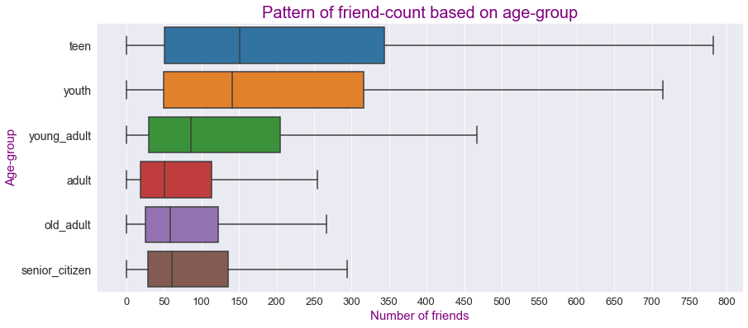

Slide 15
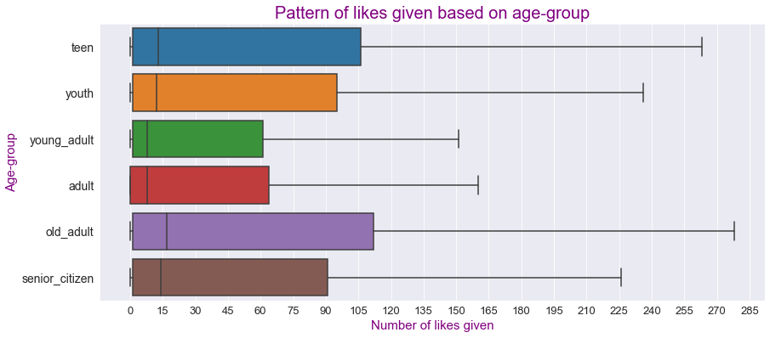

Slide 16
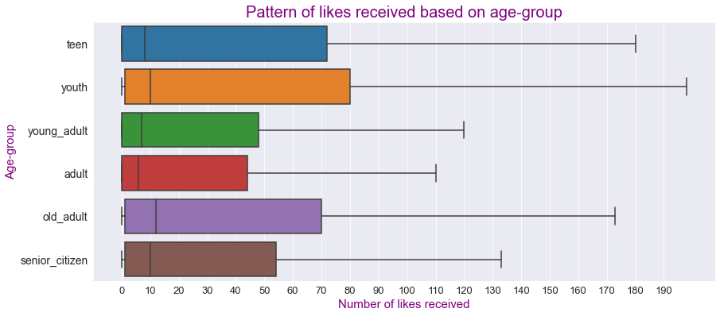

Slide 17
The Role of Gender
👧
👦

Slide 18
1.
What is the gender distribution of Facebook users

Slide 19
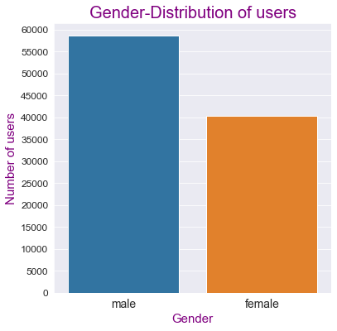

Slide 20
2.
What role does gender play in getting traction on Facebook
Likes. Friends. Likes.

Slide 21
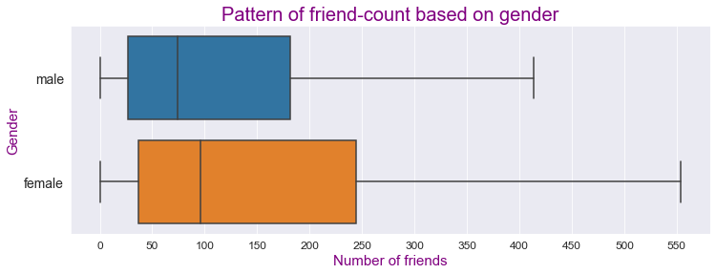

Slide 22
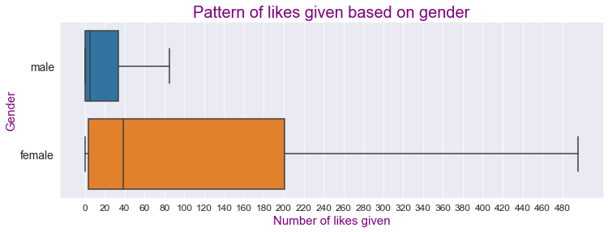
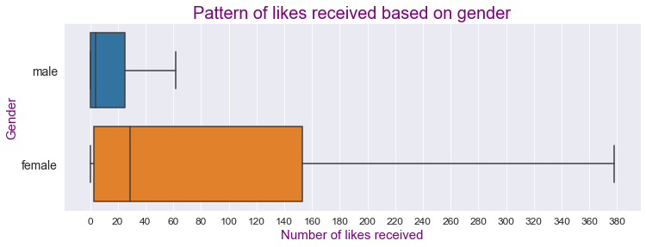

Slide 23
High Like Worth Individuals

Slide 24
1.
What are the trends of HLIs getting traction on Facebook
Celebrity culture.

Slide 25
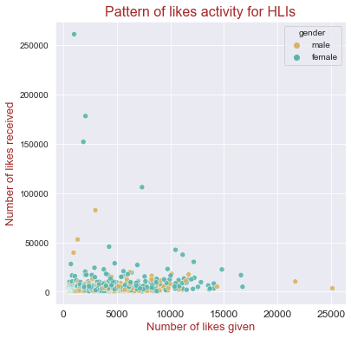

Slide 26
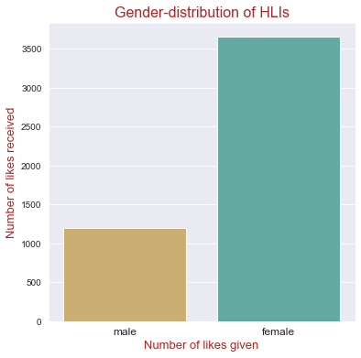

Slide 27
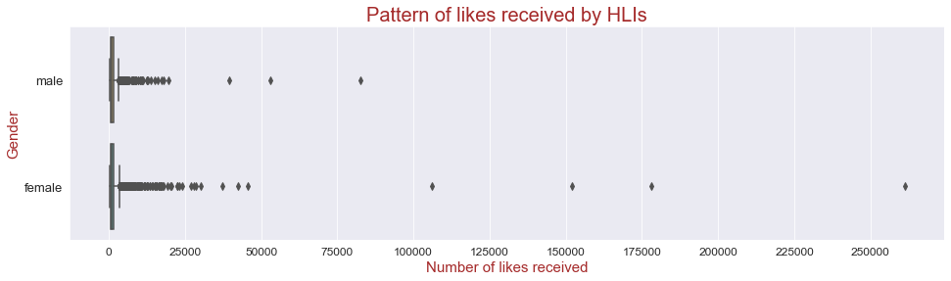
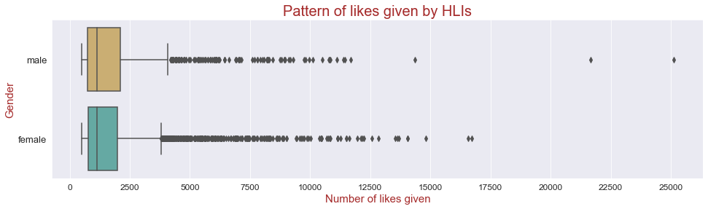

Slide 28
Mode of Access

Slide 29
1.
Which is more popular – mobile application Vs web application
Make an app. Accelerate growth.

Slide 30
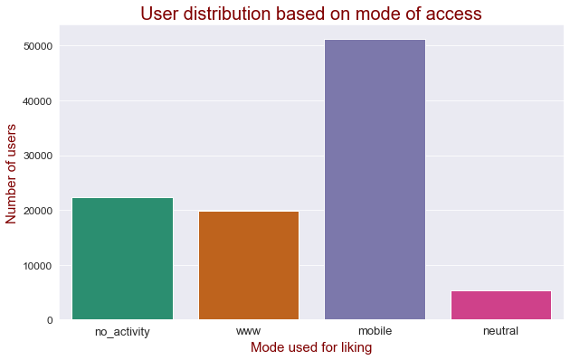

Slide 31
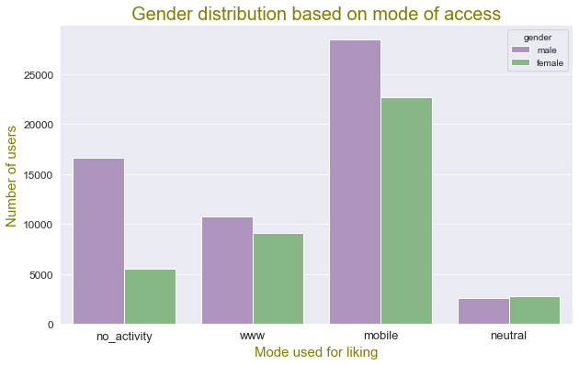

Slide 32
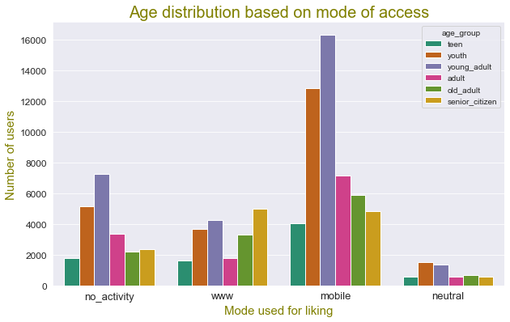

Slide 33

Summary and conclusions

Slide 34

Trends based on Age
Density
People in just 15 years age gap (13-28) form half the total users of Facebook.
Core
The age-group 17-23 is the most important part of the Facebook users.
Accelerate
Age-group 17-21 contributes significantly to creating new accounts.
Network
The teens(13-17), followed by the youth(17-23) are good at networking.
Stats
Median likes given are around 15 and median likes received are around 10 for all the age groups.
Activity
From the age 19 onwards, activity is inversely proportional to age. As age increases, activity decreases.

Slide 35
Trends based on Gender
Interaction
Female users give and receive significantly higher number of likes as compared to males. At least 25% (last quarter) of the female users have more likes given as well as received, than all of the males.
Distribution
There are 50% more male users on Facebook. For every 2 female users, there are approximately 3 male users on Facebook.
Friends
Female users have higher number of friends on an average as compared to the male users.
Growth
The female users contribute to more traction on the platform

Slide 36
HLI Trends
Distribution
The percentage of female HLIs is more, for every male HLI, there are three female HLIs on Facebook.
Density
There are 4851 HLIs which is close to 5% of total number of users.
Growth
HLIs contribute to more traction as compared to normal users. Even in HLIs, the females help in getting more traction.
Interaction
The number of likes given as well as received by HLIs of both genders are similar.

Slide 37
Trends based on mode of access
Core
Youth, young adults and adults are overwhelmingly preferring the mobile application.
Transition
Teens and old adults using mobile application are twice in number than those using web application.
In-Sync
For both the genders the trends are similar, and the mobile application is most used.
Dormant
There are significant number of people, who have not used the platform at all.

Slide 38
Actionable Insights
We will finally look at some actionable insights on which Jovia team can work.
1
3
5
2
4
6

Slide 39
Youngsters at the fore.
13-28 years
Should be the target age group which will contribute most to the use and popularity of platform.
13-17 years
People of this age group are good at networking, and contribute to fast downloads of the platform. Early focus should be on the needs of this group. And later focus should be on the 17-23 age-group which is the growth user-base.

Slide 40

Female engagement and empowerment.
Making the platform more appealing to female users will work as a differentitaing factor from facebook, and at the same time lead to more traction.
Finding out the issues faced by female users on a platform like facebook, and solving those would be a catalyst.

Slide 41


Celebrities and influencers
Getting 5-10% High-Like-Worth-Individuals like actors and sportspeople or influencers, with more focus on Women will also help to sustain the growth of the application.

Slide 42
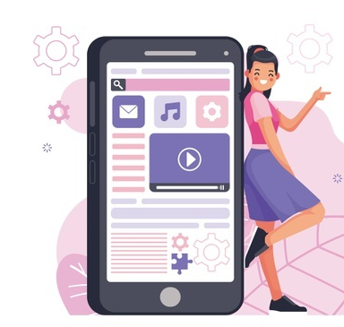
Focus on mobile application.
The mobile application should be built first, and more focus should be kept on improving the UI/UX of mobile application, as more active participation happens through mobile.

Slide 43
Thanks!

