Slide 1

Setup:DI:COMPILE
2.4 UPDATES
VSBRIDGE INDEXER

Slide 2
Supporting files?
Proxies
Interceptors
Factories
Interfaces
metadata

Slide 3
1st process
Proxies generated very first
checkEnviornment() > to check key “module” exists in config.php
2 files
Magento\Framework\Config\ConfigOptionsListConstants
Magento\Framework\App\DeploymentConfig

Slide 4
2nd process
Check available config for “module”, “library”, “setup paths”, “generated folder”
Clean cache > frontend cache > “default”
Take all compile file/module list from all 4 paths
Also, take excluded_path_lists

Slide 5
Before starts
Before starts, clean up file system > cache, metadata
Add all operations (7) into task manager
Start displaying symphony class with progress bar start displaying here
Task_manager will take care of process from here

Slide 6
7 compile steps
Proxy generators
Repository generators
Data attributes generators
Application code generators
Interceptors
Area config generators
Interception cache
(application action list generators)

Slide 7
1. Proxy generators
Scan all di.xml files (primary, global, frontend, adminhtml, crontab, webapi_rest, webapi_soap)
Magento\Setup\Module\Di\App\Task\Operation\ProxyGenerator
Around > 400-480 di.xml
Check of entities with regex, *Proxy
If found, check for class definition with class_exists php function
(Search for config/preference, argument, item, config/virtual Type)

Slide 8
2. Repository generators
Scan all di.xml files
Scan for all “preference” tags, and check for “for” and “type” words “For” >> Check for all “RepositoryInterface”
If found, check for class definition with class_exists php function Replace and find >> 3 types class Interface_Persistor, Interface_Factory, SearchResult_Interface_Factory

Slide 9
3. Data attributes
Scan all custom_attributes.xml
Scan file with “ extension_attributes” >> takes “for” value
2 types of files >> replace “Interface” >> Extension_Interface, Extension

Slide 10
4. Application code
Tokenized method to find all classes
Get real path of each module and start building class files >> recursively
It also gets all declared classes inside classes using token method
token_get_all
Ex: Magento\AsynchronousOperations\Api\Data\BulkSummaryExtensionInterface, But does not exists, this class will be created here.

Slide 11
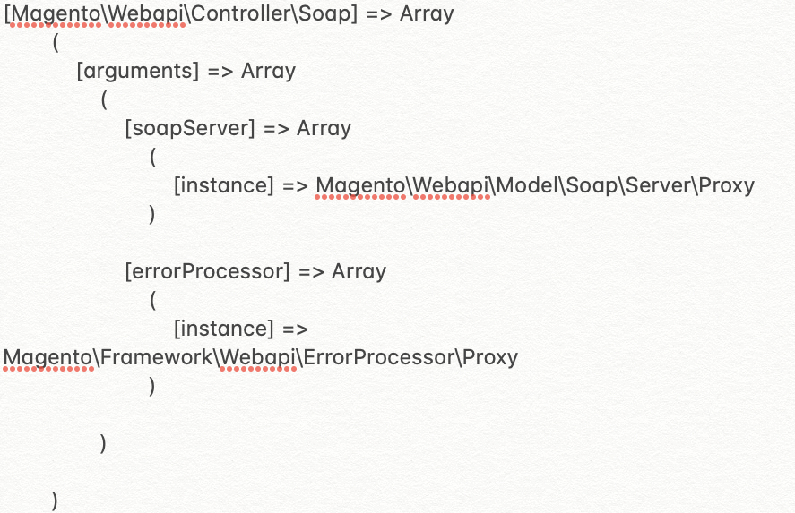
5. interceptors
A plugin, or interceptor, is a class that modifies the behavior of public class functions by intercepting a function call and running code before, after, or around that function call
Takes all modules in an array as intercepted_paths
Takes file list for all modules
Takes all types/virtual types from di.xml

Slide 12
6. AREA CONFIG GENERATE
Get preferences and virtual types/preferences for area specific di files
Modify input types using modification class
This config stored in metadata folder as array >> area specific

Slide 13
7. INTERCEPTOR CACHE
Interceptor, proxy, factory classes converted into huge array (with appx 15000 files array)
Created an array and stored as “interception” cache key

Slide 14
8. APPLIcATION ACTION LIST
Actions list

Slide 15
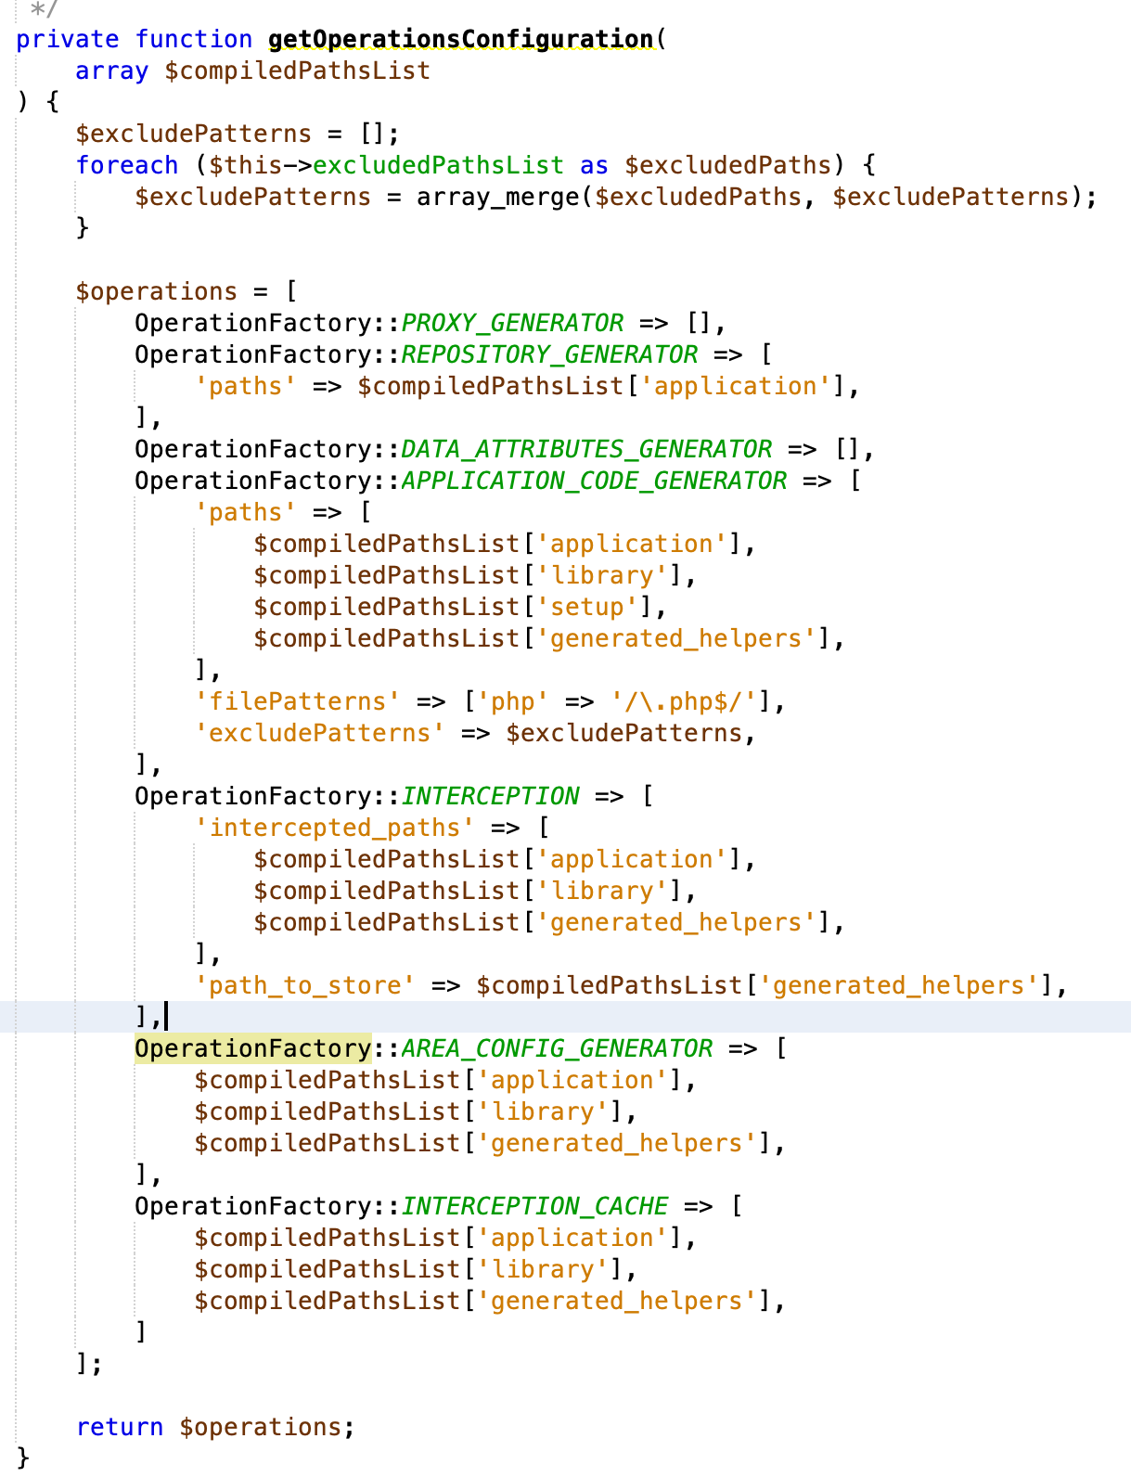
ARRAY LIST

Slide 16
2.4 highlights
Php 7.4, deprecated 7.1, 7.2
Phpunit 9.x
Elasticsearch 7.x
Mysql 8
Mariadb 10.4
Remove mysql search engine > force to use elasticsearch
Laminas project (managed by linux foundation, namespace change), no zend
Core modules removed

Slide 17
VSBRIDGE
php bin/magento indexer:reindex vsbridge_taxrule_indexer
php bin/magento indexer:reindex vsbridge_attribute_indexer
php bin/magento indexer:reindex vsbridge_product_indexer
php bin/magento indexer:reindex vsbridge_category_indexer
php bin/magento indexer:reindex vsbridge_cms_block_indexer
php bin/magento indexer:reindex vsbridge_cms_page_indexer
php bin/magento indexer:reindex vsbridge_review_indexer

Slide 18
Thank you

